Slide 1
Visualization & Exploratory Data Analysis
Matplotlib
Pyplot
Object Oriented interfaces
Seaborn
EDA with seaborn and Pandas

Slide 2
Introducing Matplotlib
Matplotlib is a plotting library that produces publication quality figures in a variety of formats and interactive environments.
Documentation:
https://matplotlib.org/stable/

Slide 3
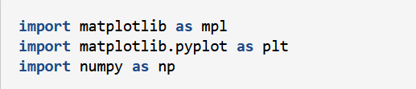
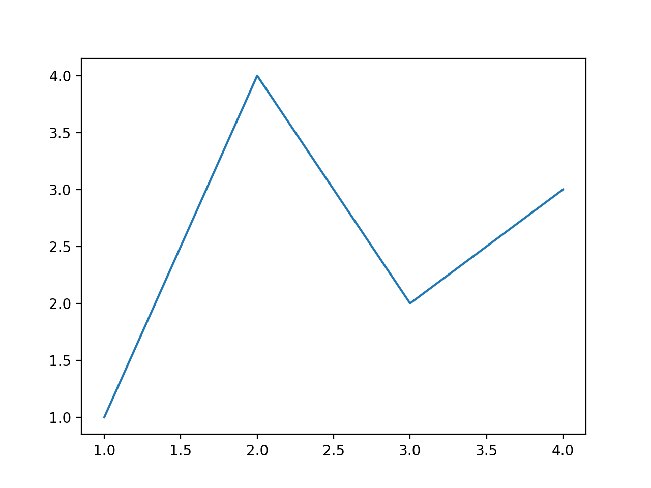

A Simple Example

Slide 4
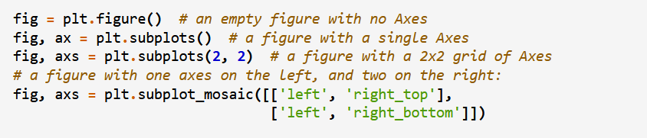
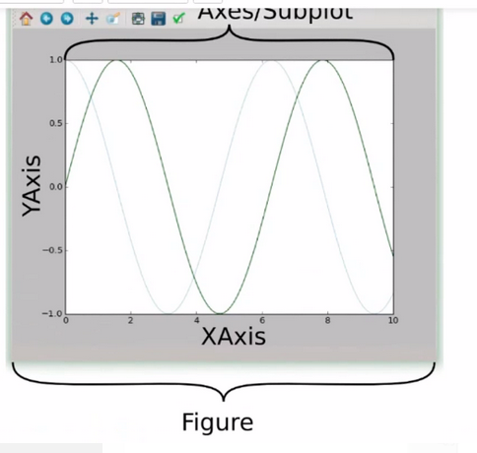
Parts of Figure
Figure
Axes
Axis
Artist

Slide 5
Introduction to pyplot
Pyplot is basically a collection of command style functions that make matplotlib work similar to MATLAB.
It have a collection of functions and each function makes some changes to a figure, and this figure is considered to be the current figure.
e.g., creates a figure, creates a plotting area in a figure, plots some lines in a plotting area, decorates the plot with labels,

Slide 6
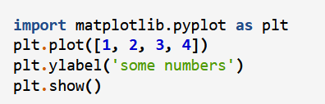
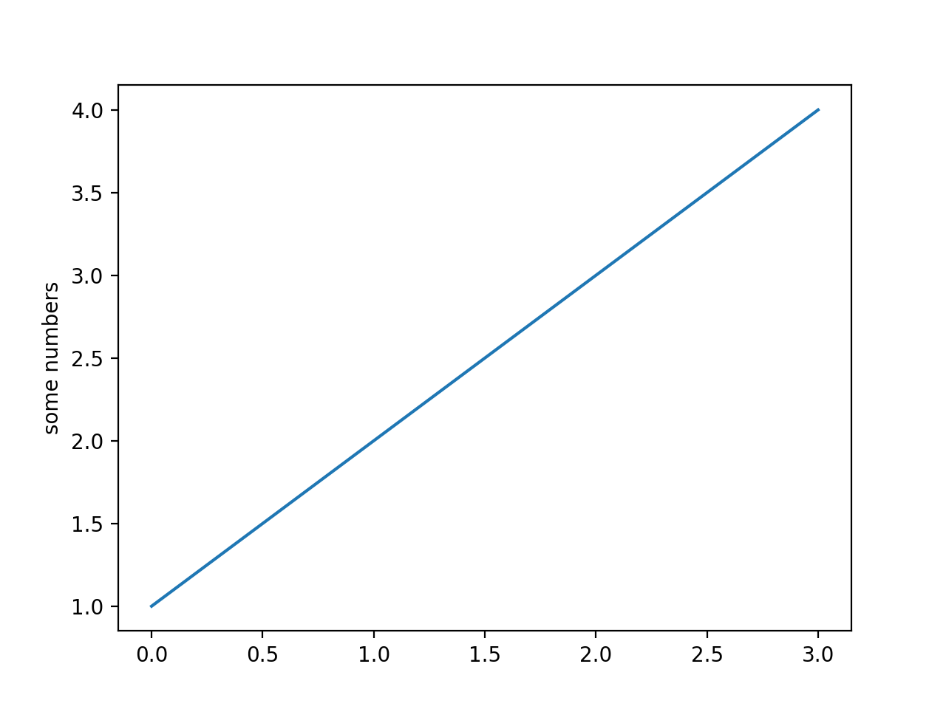
Plotting a Graph

Slide 7
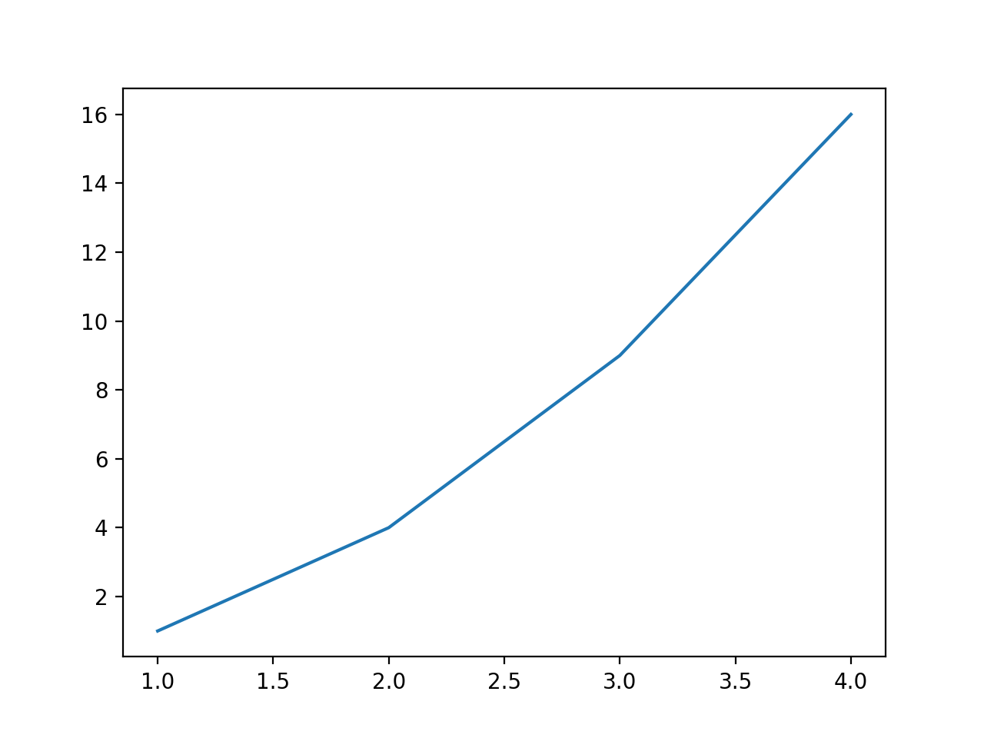
Plotting a Graph with Multiple Arguments

Slide 8
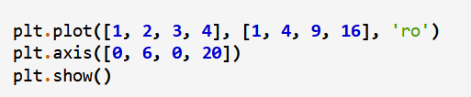
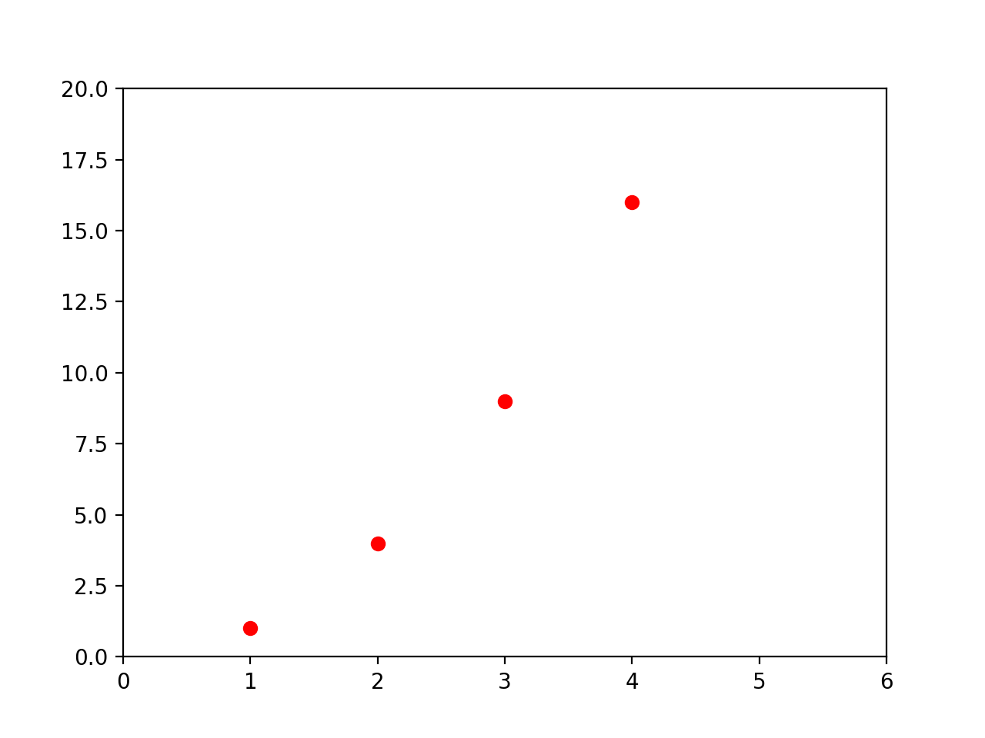
Plotting a Graph with Multiple Arguments

