Slide 1
Python Data Types
Variables
Data Types
Numbers
String
Tupples
Sets
Dictionaries
Files

Slide 2
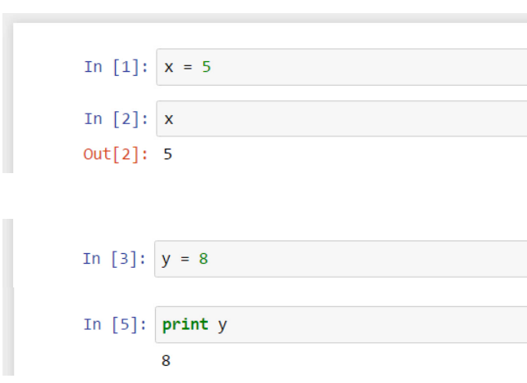
What is Variables?
Represent your data input

Slide 3
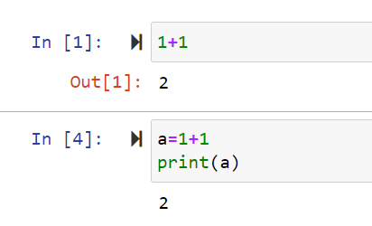
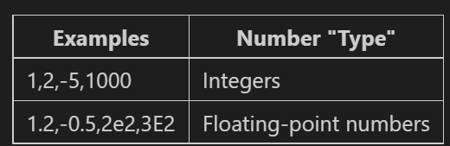
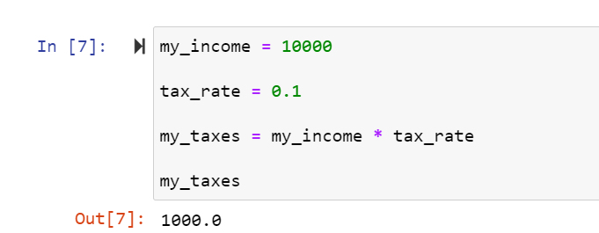
Numbers
Two types of Number Data types

Slide 4
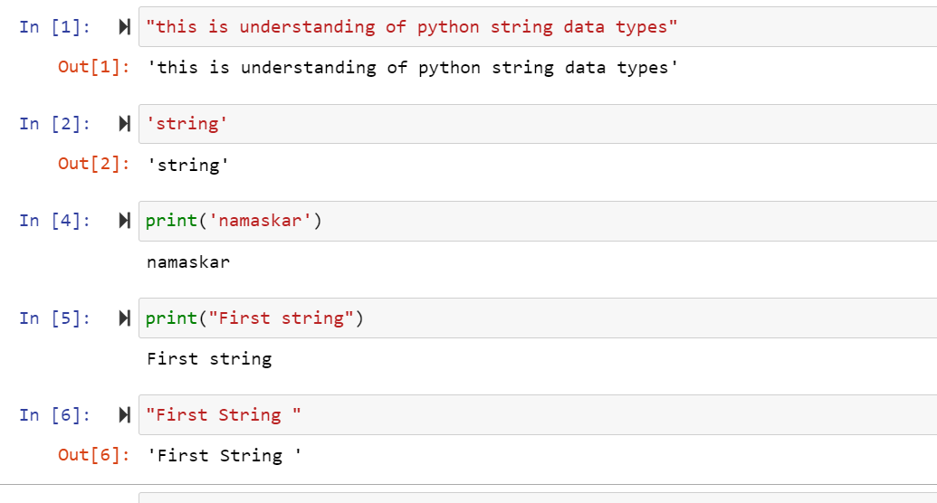
Strings
are used in Python to record text information, such as names

Slide 5
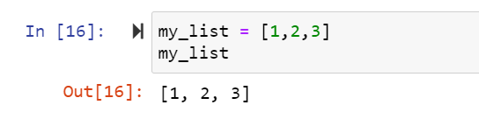
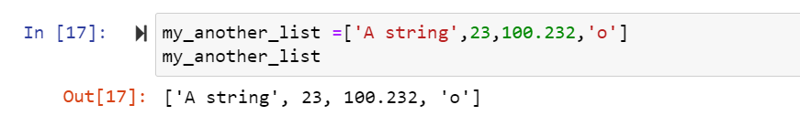
List

Slide 6
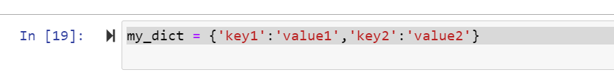
Dictionaries
Mappings : Key and Value

Slide 7


Tupples
tuples are very similar to lists, however, unlike lists they are immutable.
use tuples to present things that shouldn't be changed, such as days of the week, or dates on a calendar.

Slide 8

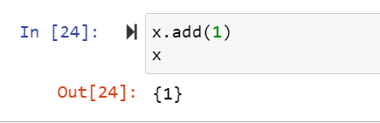
Sets
Unordered collection of unique elements.
We construct it by using set() function

Slide 9

Files
Can open files in python,read & write data

