Slide 1
Pandas Library
What is Pandas
Capabilities of Pandas
Importance in Data Analytics
Series
Dataframes

Slide 2
What is Pandas
Pandas is a library for Python that provides fast, flexible, and expressive data structures designed to work with relational or tabular data, such as an SQL table, or an Excel spreadsheet.
It is a fundamental, high-level building block for doing practical, real-world data analysis with Python.
#The importing convention import pandas as pd

Slide 3
When to use Pandas
Tabular Data with hetergenously types columns, like SQL table or Spreadsheets
Ordered or unorderd time series data
Data in rows or columns, similar to matrix
Observational or other types of statistical datasets

Slide 4
Types of Data Structures in Pandas
Series - One Dimensional data structure
DataFrame – Two-dimensional data structure
Finance
statistics
Social science
Engineering and Business
Many more……

Slide 5
Capabilities of Pandas
Easy handling of missing data in floating as well as non-floating data
Easy insertion and deletion of data in Dataframes & higher dimensional objects.
Automatic Data Alignment
Group by functionality for powerful and flexible aggregation and transformation of Data
Conversion of other differently indexed python and NumPy Datastructures into Dataframe Objects
Intelligent label-based slicing, fancy indexing & Subsetting of large datasets.
Intuitive merging and joining of datasets.
Hiearchical labelling of axes
Robust IO tools for loading from flat files, excel files, database & saving/loading data from the ultra-fast HDF5 format.
Timeseries functionality, frequency conversion, moving window statistics, linear regression, date shifting, logging & so on………..

Slide 6
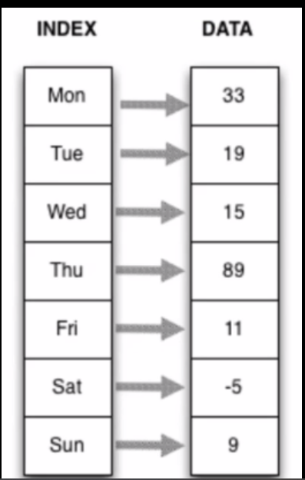
Series
One Dimensional Labelled Array
Any type – integers, strings, floating-points
numbers, python objects etc.
Homogeneous Data
Always has index that gives data structure

Slide 7
Ways to create Series
Creation from a list
Creation from a dictionary
Creation from a NumPy array
Creation from an external data source, such as a file

Slide 8
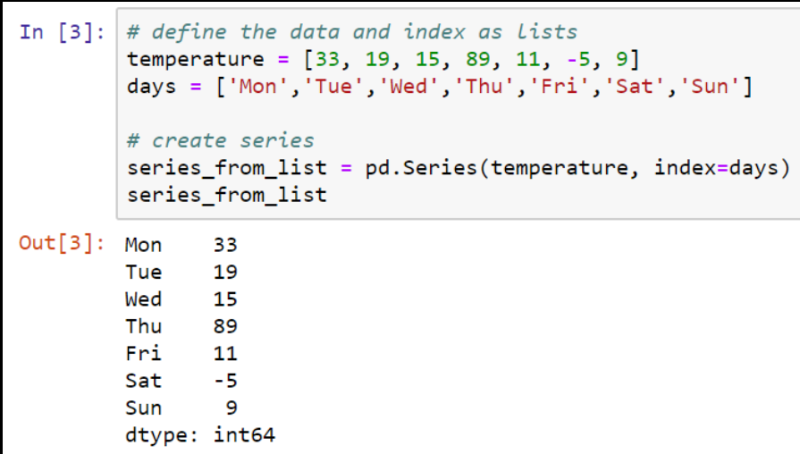
Series: Creation from a list

Slide 9
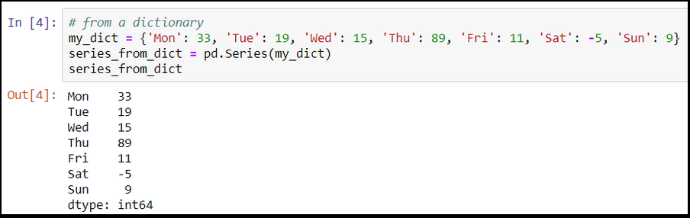
Series: Creation from a Dictionary

Slide 10
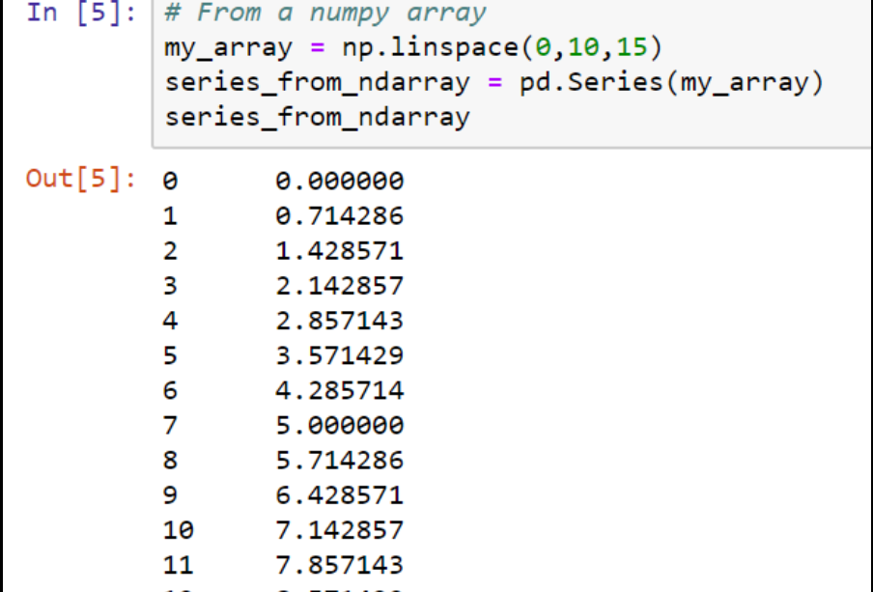
Series: Creation from a NumPy Array

Slide 11
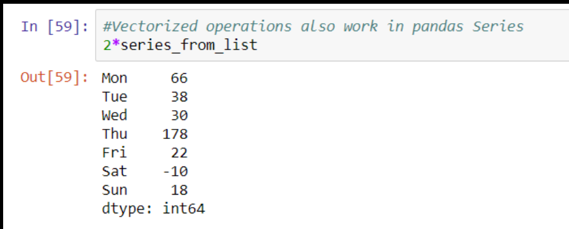
Vectorized Operation on Series

Slide 12
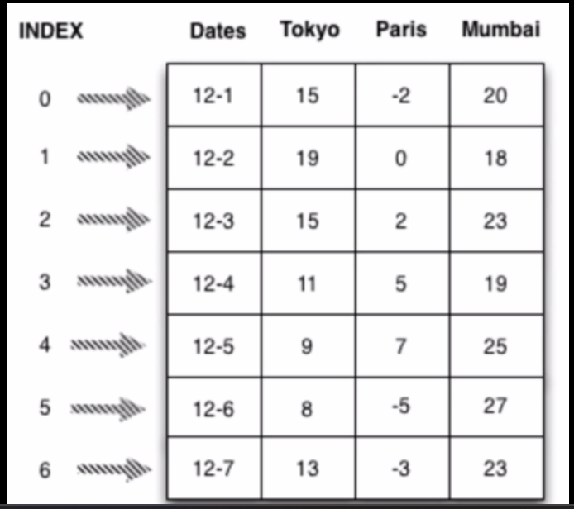
DataFrames
Two-dimensional labelled data structure with columns of potentially different types.
Similar to excel spreadsheet

