Slide 1
Unit I Chapter 1: Introduction and Overview of SAC

Slide 2
What IS SAP Analytics Cloud?
SAP Analytics Cloud is SAP’s flag-ship product in the overall Analytics portfolio and the move to a single analytics product based in the cloud.
Business Intelligence
Analytics Product
Planning
Predictive
Application Building

Slide 3
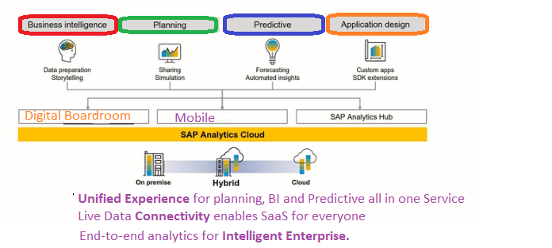
SAP Analytics Product Overview

Slide 4
Today’s Business for SAP Analytics Cloud
The pace of Change ➔ Data-driven organizations, Digital transformation ➔ Data and Intelligence at centre.
Data Growth
Intelligent Enterprises – Building new capabilities, skills and evolving the culture.
New Data Types Larger Volume New Locations
Experience Data Operational Data
Analytics Big Data IoT AIML Blockchain

Slide 5
Today’s Business for SAP Analytics Cloud
Data Intelligence: -
Data
Information
Insight
Action
Value

Slide 6
Today’s Business for SAP Analytics Cloud
Decision Making Evolution
Linear
Historical
Static
Top Down & Costly.
Dynamic
Self Service
Fast Iterations
Distributed
Augmented
AI – Driven
Instantaneous adjustments
Continuous ➔ Plan, Discover, Analyze, Predict , Act & Plan

Slide 7
WHO is doing what now?
Data Engineers ➔ Tracking Data
Data Analyst and Scientists ➔ Analyse the data
Decision Makers ➔ Receives the analysis data and take decision
Employees ➔Receives the decision and act accordingly.
No tools provide all the above features at same time.

Slide 8
The Intelligent Framework
Intelligent Suite
Digital Platform
Intelligence Technologies

Slide 9
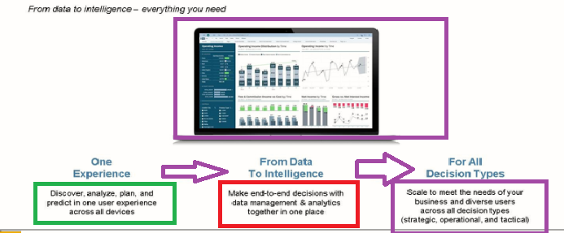
SAP Analytics Cloud
Automating the discovery of insights and giving us the opportunity to SAP Leverage data Science.
Complete:

Slide 10
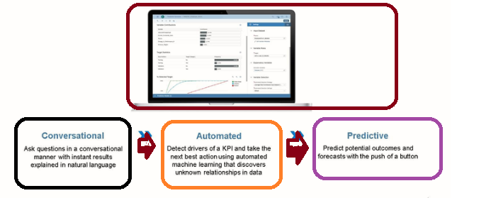
SAP Analytics Cloud
Confident:

Slide 11
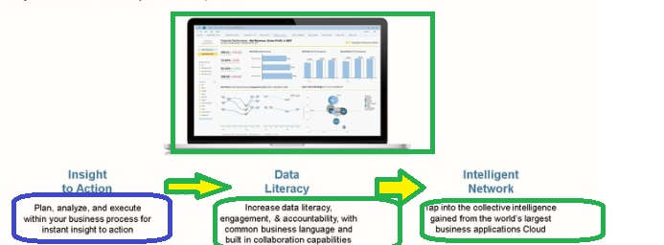
SAP Analytics Cloud
Contextual:

Slide 12
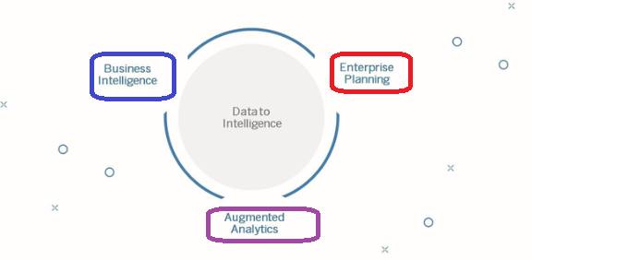
SAP Analytics CLOUD

Slide 13
Thank you!!
Questions ??? ?

