Slide 1
Unit I Chapter 4: Preparation, Sharing & Collaboration

Slide 2
Cloud Concepts overview
Data : Acquiring the data using connections to different data providers.
Visualizations: Visualize & Explore : Story board
Share: Collaborate

Slide 3
Data Acquisition
SAP HANA
SAP BW
SAP BPC
SAP ERP
SAP BO Universe
SQL – IBM Puerdata, MS SQL Server 2008 -14, MySQL 5, Oracle 11 Open Edge 11
Odata Service
Excel - .xls; .csv
Cloud : Successfactors, FieldGlass, Concur, Google Drive etc.

Slide 4
Data Acquisition
Live Connection
SAP HANA
SAP BW
SAP BPC
SAP S/4 HANA
SAP ERP
SAP BO Universe
SQL – IBM Puerdata, MS SQL Server 2008 -14, MySQL 5, Oracle 11 Open Edge 11
Odata Service
Excel - .xls; .csv
Cloud : Successfactors, FieldGlass, Concur, Google Drive etc.

Slide 5
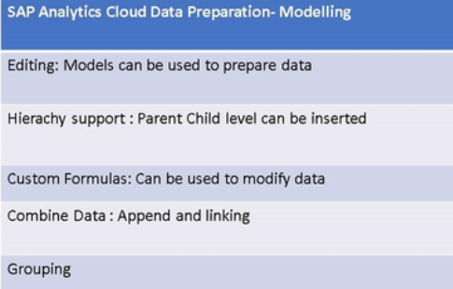
Data Preparation

Slide 6
Collaboration
Having Discussions
Posting Comments ➔ Feedback
Assigning a task
Sharing Stories:
Internally
Externally

Slide 7
Thank you!!
Questions ??? ?

