Slide 1
Unit I Chapter 5: SAP AnaYTICS Cloud Clients

Slide 2
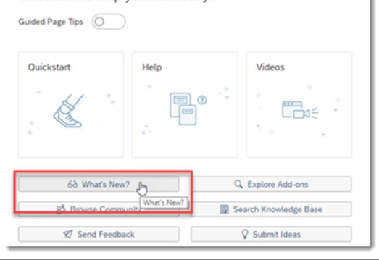
Getting your License or Trial Version
Trial Version: Only email address needed.

Slide 3
Data :- Collect data from various points.
Model : - Gain insights from the Data using SAP Analytics Cloud. “Modeler” an advanced modelling tool can be used to create complex models
Stories: Explore and visualize the data for reporting, planning and analysis.

Slide 4
Thank you!!
Questions ??? ?

