Slide 1
Unit 2 : Chapter 2 Data Preparation : Basic Modelling

Slide 2
Data Modelling
Data Model or Data Modelling is base of all SAC activities.
Describes the ways data will be analysed.
Provides structure and different functions like calculation or security.
SAP’s Machine Learning technology helps automatically clean your data by alerting of possible errors and categorizing measures and dimensions.
Modelling tools helps to enhance the data for geo analysis and multi-level hierarchies to gain deeper insights.

Slide 3
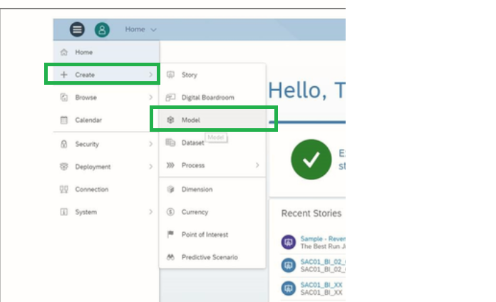
Data Preparation

Slide 4
SAP Analytics Cloud’s BI
Offers two main components:
Models ➔ Data Wrangling/Cleaning dataset, defining measures and dimensions, establishing hierarchies, setting units, currencies and adding formulas.
Analytics Model
Planning Model
Stories
Uses Models in order to visualize the prepared data coming from a model.

Slide 5
Basic ModeLling
Data Integration strategy :
Start with empty Model
Upload an Excel or .csv file
Live Connection or Data Import
Cloud Data
Common Uses for Modeler:
Blending
Data Wrangling
Setting Units and Currencies
Creating Hierarchies
Adding formulas

Slide 6
Thank you!!
Questions ??? ?

