Slide 1
Unit 2 : Chapter 3 Performing Basic Data Modelling

Slide 2
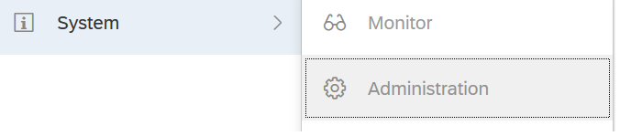
Process
Setup ➔ One time IT Driven workflow
Connection ➔ End-User Driven Operation, either Acquire Data or Connect Remotely.
Preparation ➔ Operations on Acquired Data, Cleansing dirty data, compiles datasets
Modelling Data ➔ Power users to create common semantic layer for all users. Enables Security and Planning capability.

Slide 3
Where to start to Get Data into SAC
From Home Screen | From the Modeler | From Stories
A story is automatically created when we do one of the following: Drag & Drop a Microsoft Excel File. Connect to Data | Connect to all supported sources Declare Connections before modelling Refresh, by importing data from a file | Import a Microsoft Excel or CSV file Import an existing file Connect to Google drive.

Slide 4
Model in SAC
Semantic Layer: Business representation of corporate data that helps end users access data easily using common business terms.
Model is SAC’s Semantic Layer:
Dimensions & Measures
Security defined
Dimensions are shared
Series of Business rules

Slide 5
SAC Model Types
Planning Type Model: preconfigured with dimensions for time and categories. They offer support for multi-currency and security features at the level of both model and dimension. Users with planning privileges can create their own versions of model data.
An Analytics Type Model :Does not support categories and does not require a time dimension.
An Analytics Model based on SAP HANA View: Simple model with a single account dimension, but with access to other dimension through SAP HANA.Security is inherited from SAP HANA.

Slide 6
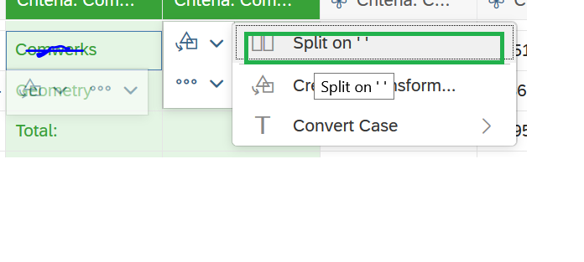
Data Wrangling
Manipulate the data to make it accurate and match your business needs.
SAC Wrangle the data which frees us to focus on higher-value work.
Following ways for Data Wrangling:
Split
Convert text to number
Duplicate Columns
Merge Columns
Edit Single Cells
Add highlights for all cells with the same value when selecting a cell.
Maintaining a history of transformations with undo/redo features.

Slide 7
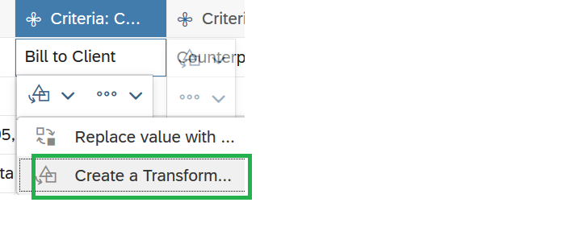
Increasing User Creativity
Let user focus on higher-valued workflows through suggestions of most obvious actions:
Infer Datatypes
Transformation suggestions based on end-user’s selection
Suggest dimension relationships.
Let users play with Data:
Show different states : Previous , future
Preview Transformations
Let user decide on the result
Data preparation function to transform the data

Slide 8
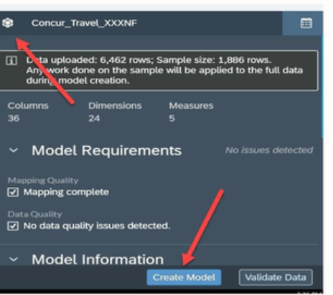
Responsive Experience with data
Work from Sample
Transform replayed on the entire dataset:
Sample serves as blueprint.

Slide 9
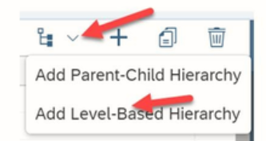
Hierarchies in Models
Hierarchies : structure the data, and when displayed in stories in a table, the nodes of the hierarchy can be expanded or collapsed.
Types:
Level-Based Hierarchies : Organized into levels .Example: Country, State, City
Parent-Chid Hierarchies : organized based on Parent-Child relationships.

Slide 10
Thank you!!
Questions ??? ?

