Slide 1
Unit 3 Business Intelligence: Chapter 1 :Basic Story Design

Slide 2
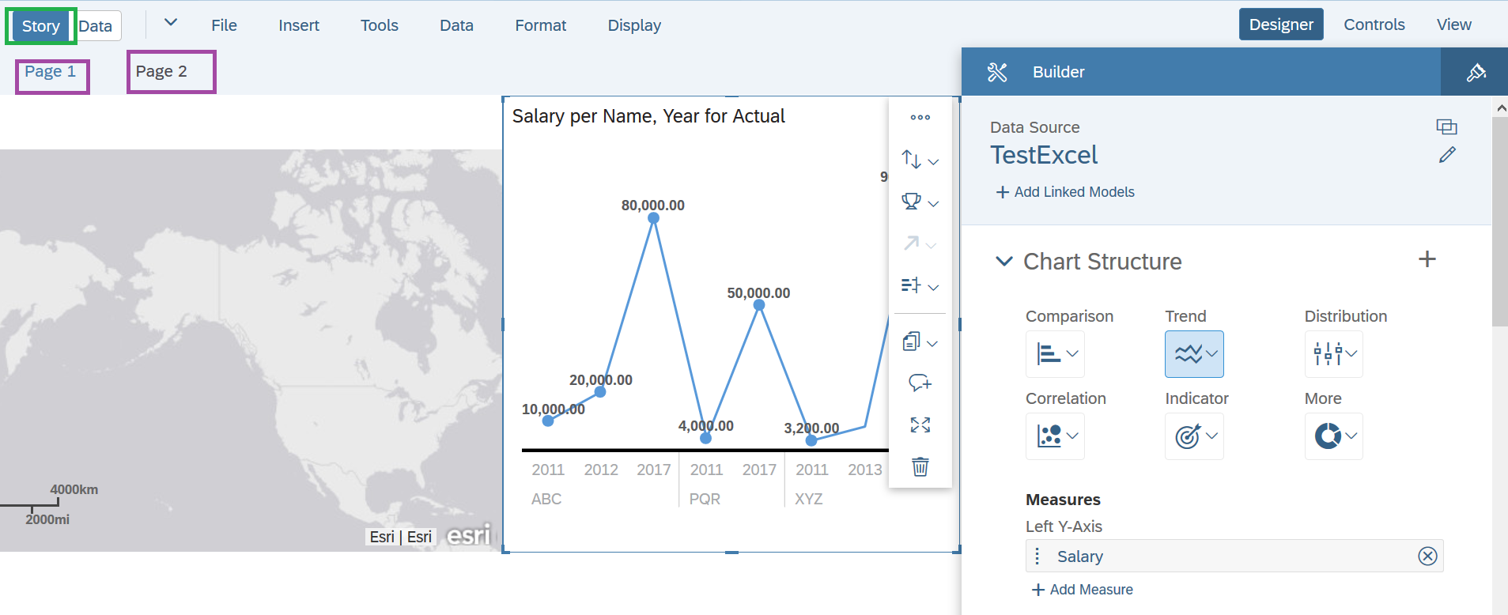
Story Design
Story ➔ presentation-style document that uses charts, visualizations, text, images and pictograms to describe data.

Slide 3
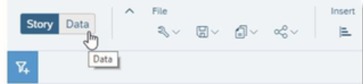
Story?
Two Main views:
Data ➔ Explore Data in real time with dynamic visualizations chaning on-the-fly.
Story ➔ can design beautiful, interactive dashboards for users.
Measures, Dimensions and Models?
Measures ➔ represent quantities that provide meaning the data.Example: Sales Revenue, Salary.
Dimensions ➔ Provides perspective on the data.example: Product Category, first name, last name etc.
Model ➔ Using Dimensions and measures we can model the data.

Slide 4
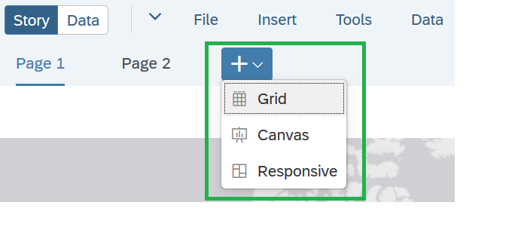
Responsive Pages
Canvas Page ➔ Pixel perfect report for presentations
Responsive Page ➔Flexible dashboards that can be presented on any device or screen size.
Grid Page ➔ A traditional spreadsheet give full view of data.

Slide 5
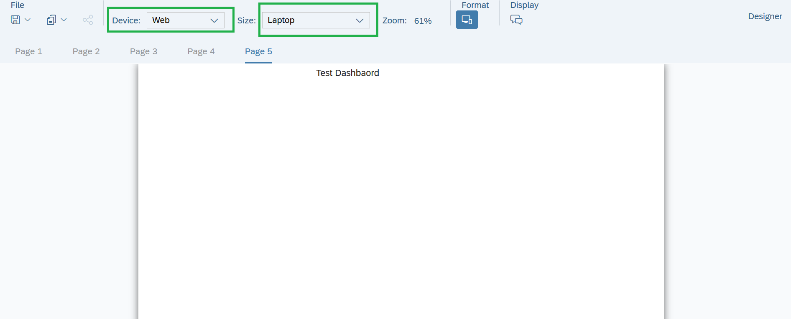
Responsive Page

Slide 6
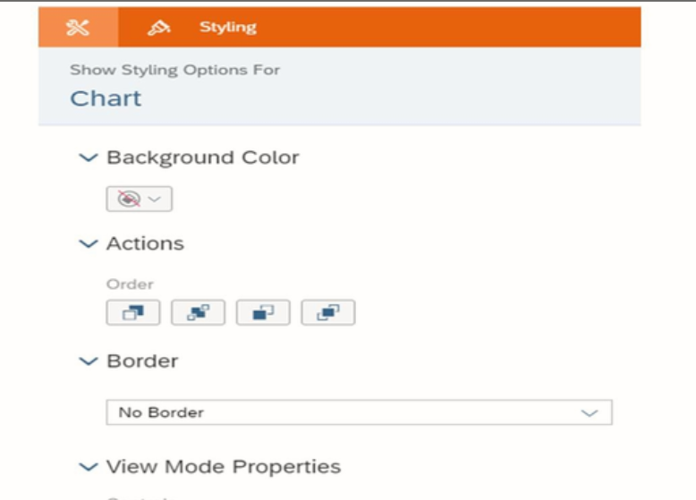
Styling a Page

Slide 7
Components to Add on Story Page
Charts:
Comparison
Trend
Correlation
Distribution
Indicator
Tables
Map (Geo Map)
Story Filter, Page Filter, Widget Filter
Prompts
Thresholds
Linked Dimension

Slide 8
Explore Data
Faceted view of data which can be manipulated to generate charts of your story pages.
When measures and dimensions are selected in upper page, the visualizations in the lower panes updates in real time.

Slide 9
Bookmarking
Bookmarking story views: create bookmarks to save different states of a story.
Need of Bookmarking: When viewing a story, we may want to come back to the same view of the data every time or we may want to set up different states or scenarios.

Slide 10
Thank you!!
Questions ??? ?

