Slide 1
Unit 3 Business Intelligence: Chapter 2 : Storytelling: Visualization, Basic Calculation and formatting

Slide 2
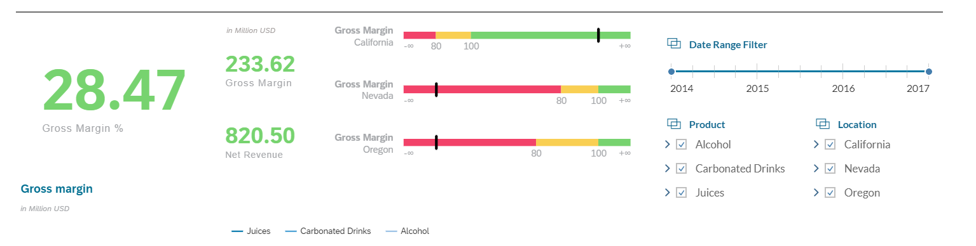
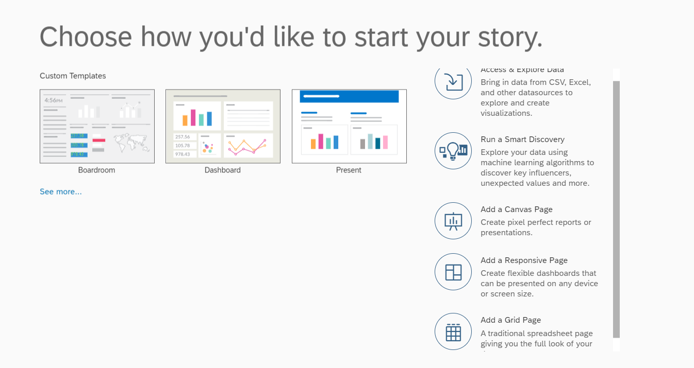
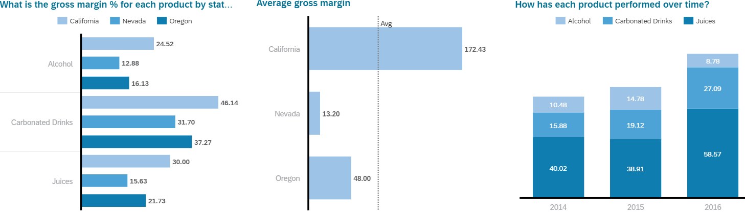
Story Telling

Slide 3
Define Story Structure
- Visualize the story within a canvas
- Use a grid
- Use a Responsive Page
- Run a smart Discovery (Data Analysis)
- Design to Choose:
New Design
Templates provided by SAP
Templates customized by your business.

Slide 4
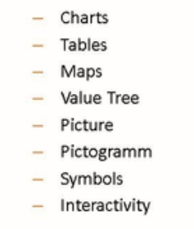
Visualizations
Right way of visualization?
Create Visualization as:
Choose a direction – Importance of visualizations
Keep it simple – ensure user-friendly
Reading Direction – follow format
Logical Graphical Grouping – topics should be located next to each other, follow logical format.

Slide 5
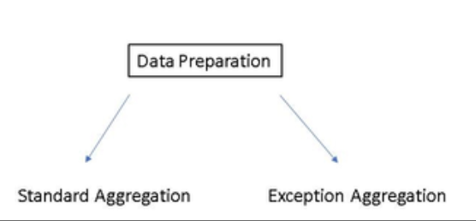
Data Preparation/Calculation/Aggregation

Slide 6
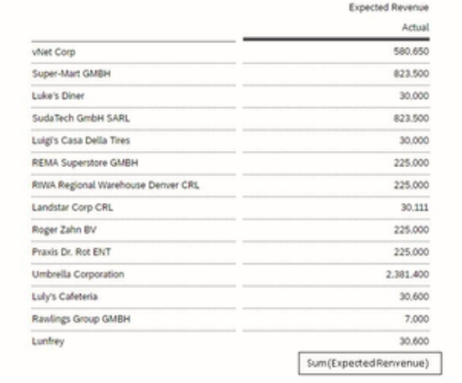
Standard Aggregation
Standard Aggregation is predefined in the data source of data Model
Standard Aggregation

Slide 7
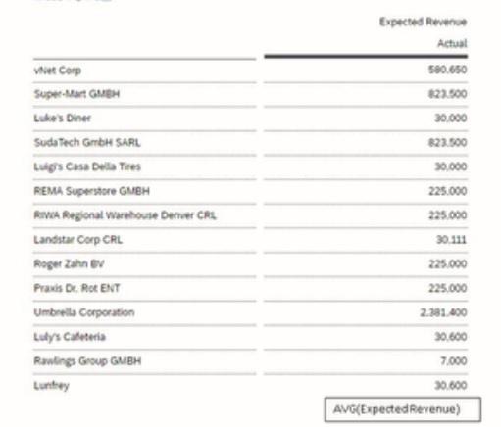
Exception Aggregation
Allows to use another calculation type, which was not part of the data source of the model connected.
Exception Aggregation can be applied from:
A Model
A Story
Exception Aggregation

Slide 8
How to Add Exception Aggregation
Exception Aggregation Types:
SUM
MIN
MAX
AVG
AVG excl.0
FIRST
LAST

Slide 9
Thank you!!
Questions ??? ?

