Slide 1
Unit 3 Business Intelligence: Chapter 3 : Data Integration with SAP BW/4 HANA and SAP Universes

Slide 2
Advantages of SAP BW/4 HANA
Leverage the investment into SAP BW and provide the users with Analytics beyond data discovery.
Directly Consume BW data without data replication.
Utilize native BW query concepts to get most out of your data.
Re-use of existing authorization concepts for data level security.
Continue established best practices : Query design, life cycle management, data level authorizations.

Slide 3
Connectivity features
Direct, Secure and Simple
Simply Connect to BW queries or generated HANA views in your on-premise SAP BW systems
No additional modelling is required
No Data replication into SAP Analytics cloud
Data remains behind your corporate firewall when running queries and displaying results
No Authorization replication needed: SAP BW authorizations are fully respected.
End-to-end Integration
Ability to access SAP BW and SAP HANA features that cannot be accessed through standard Query interfaces( SQL, MDX).
Use of Unique best-in-class query interface to SAP BW and SAP HANA engines
Query Interface is continuously enhanced alongside SAP BW & HANA engine enhancements.

Slide 4
Summary: Integration with BW
Chart to Chart filtering – Create filters or drill through hierarchical data in one chart.
BW Variable prompt enhancements
BW Variant and Personalization consumption BW structures
BW Structures
New Table Calculations
Integration with BW query techniques
Parallel execution of BW queries.

Slide 5
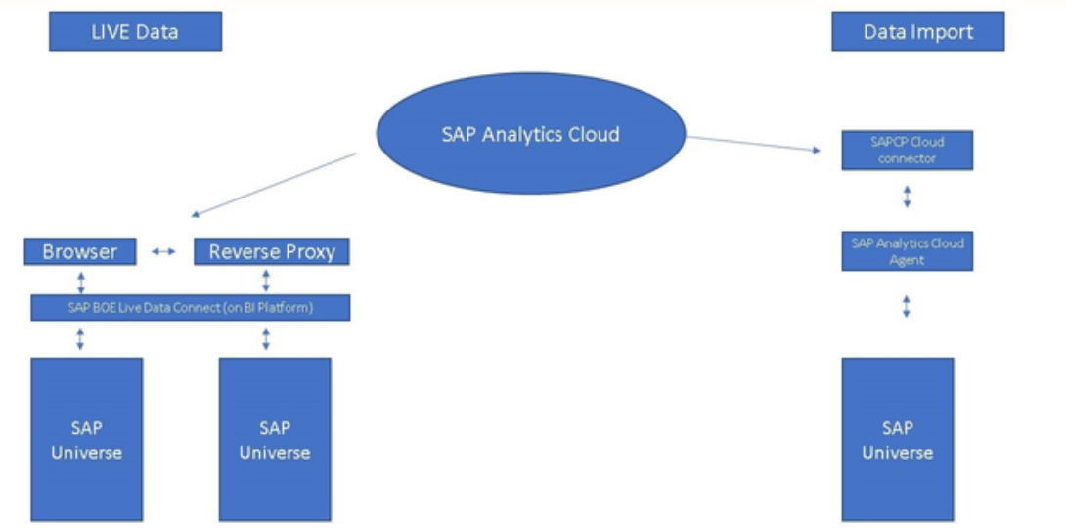
Integrating with SAP universe
Live Connection – No Data will be stored on the cloud called as On Demand connection.
Replicative Data Import connection - data will be stored in the cloud and updated within intervals.

Slide 6
Requirement
Live Connection:
Live universe Connector setup and configured
BOE properties should have following content:
“boe.temporaryDocumentFolder holds the name of the folder that is created inside each users favourites folder when they consume live data connection.
Data Import:
SAP Cloud Connector
SAP Analytics Cloud Agent

Slide 7
Thank you!!
Questions ??? ?

