Slide 1
Unit 3 Business Intelligence: Chapter 4 : Analytic Applications

Slide 2
What is Analytic Application
Analytic Applications: An analytic application is a document that can contain visualizations such as tables, charts, and filters to allow navigation and analysis of data.
can personalize the visualizations and interaction behaviors of the UI elements according to user requirements.
Analytic applications are created and consumed in SAP Analytics Cloud.

Slide 3
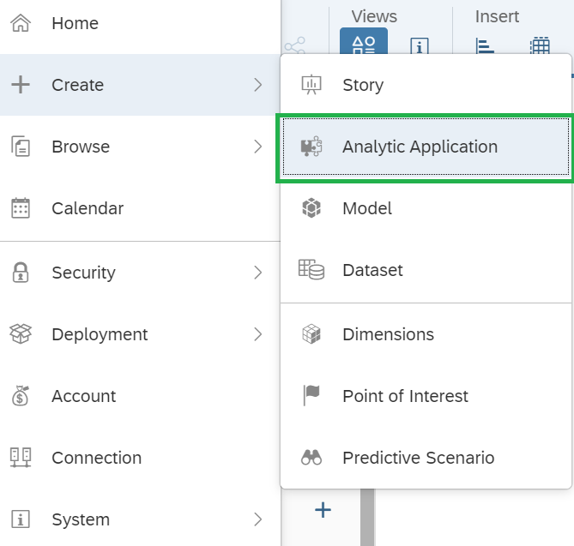
How to Create Analytic Application

Slide 4
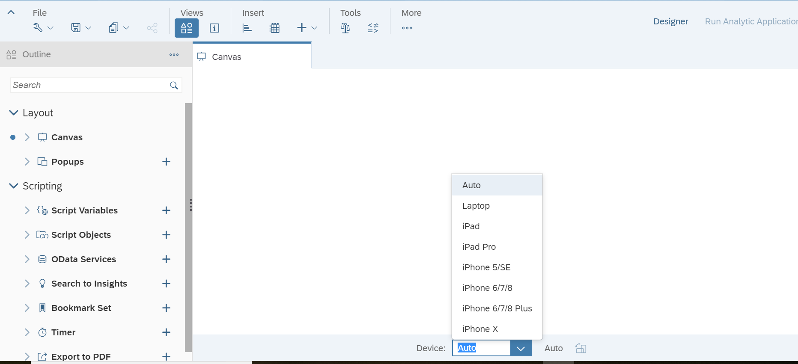

Slide 5
Thank you!!
Questions ??? ?

