Slide 1
Unit 4 Introduction to SAP Analytics Cloud Planning: Chapter 1 :Planning with SAC

Slide 2
What is PLANNING
Planning is all about setting strategic goals for a business and then determining how to meet those goals by creating annual budgets, tracking progress in forecasts, and simulating scenarios to find new opportunities.

Slide 3
Planning
Act ➔
Analyse, Predict and report all.
Plan and analyse directly within the enterprise solution for instant Insight to action.
Visualize performance metrics.
Continuously Collaborate ➔
Discuss plans
Interact on screen
Crowdsource plans
Become an Intelligent Enterprise ➔
Discover top influencers
Augment Manual Insights
Ask Questions to get answer.

Slide 4
Planning, Budgeting & Forecasting
Planning: Provides overall Process for stating direction and financial Objectives (What is Possible)
Strategic plans- set overall goas and objectives
Long-range plans - Financial targets over 3-10 year horizon
Annual plans – first years of long range plan
Budgeting: Provides execution path for the plan. ( What is Expected)
Sales/Gross Margin budgets
Capital Expenditure Budgets
Headcount budgets
Operating Expense Budgets
Forecasting: Uses actual performance data to project remainder of the current year performance.
Rolling Forecast – Reset expectations for some predefined future

Slide 5
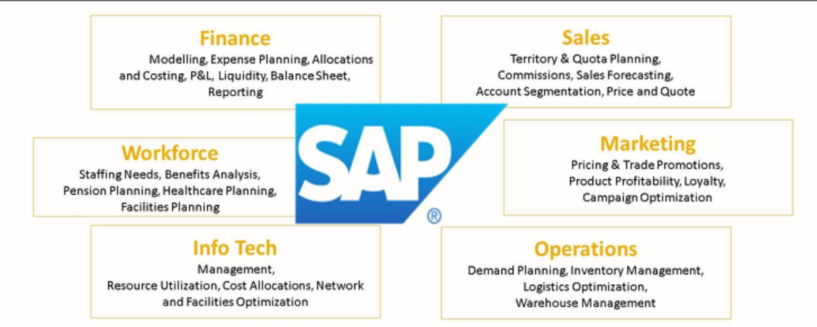
Where SAP can help for Enterprise

Slide 6
Thank you!!
Questions ??? ?

