Slide 1
Unit 5 Augmented Analytics IN SAC: Chapter 1 : Introduction to SAP Analytics Cloud Predictive

Slide 2
Augmented Analytics
SACs machine learning technology augments(increases) the analytics process.
Helps:
Go from Insight to Action within fraction of time
Avoid agenda-driven and biased decision making by revealing what drives the business.
Search to Insight :- Quick way to find answers
Smart Insight :- Instant explanations - Understand top contributors of specific data points without having to manually pivot, slice and dice.
Smart Discovery :- Easily reveal Insights – Identify Key Influencers and relationships in the data to discover how business factors influence performance.

Slide 3
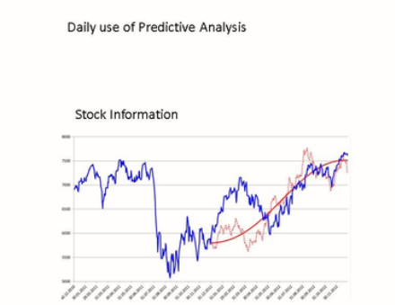
Predictive forecasting:
Predictive forecasting: Early warning system.
Uses multiple mathematical techniques such as data mining
Statistics, Machine learning and artificial Intelligence.

Slide 4
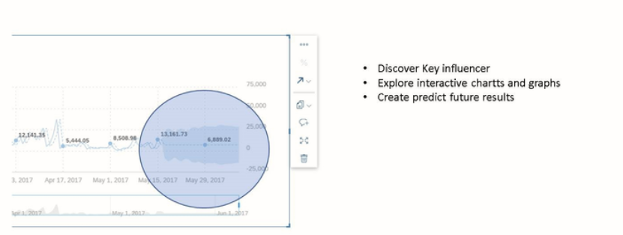
Predictive Analysis in Story

Slide 5
Predictive Model
If Predictive calculation should be used again, it could make sense to develop a Predictive Model.
What Predictive model do:
Create different calculation type to get the right data about your usual data model.
Can be used as data source for a new story.
Additional functionality to create your own predictive modulation.

Slide 6
Predictive Model Consumption
Data Scientist: Create content with embedded predictive models using SAP BusinessObjects Predictive analytics and deploy them to SAP BusinessObjects Cloud.
Business Users: Interact with predictive content and complex simulations using filters and parameters. Retrain the predictive model in real-time – allowing data generation with support for generating scores, probabilities & estimates.

Slide 7
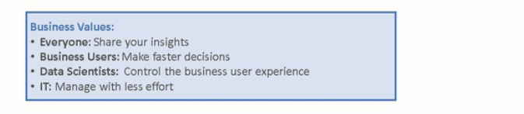
Zero Code deployment
Seamlessly deploy predictive models from SAP BusinessObjects Predictive Analytics to SAP BusinessObjects Cloud without coding.

Slide 8
Thank you!!
Questions ??? ?

