Slide 1
Unit 5 Augmented Analytics IN SAC: Chapter 2 : Exploring with Smart Assist

Slide 2
What is Smart Assist?
Gartner’s Definition of Smart Data Discovery
is a next-generation data discovery capability that provides business users or citizen data scientists with insights from
advanced analytics. Business Intelligence and Analytics leaders should plan for adoption as capabilities mature.

Slide 3
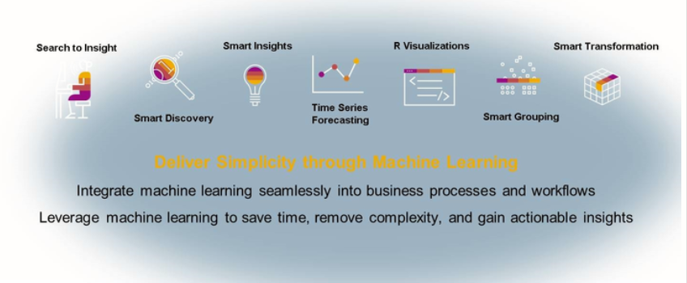
What is Smart Assist?

Slide 4
Smart Assist
Includes
Smart Discovery
Smart Insights
Smart Grouping
Smart Transformation.

Slide 5
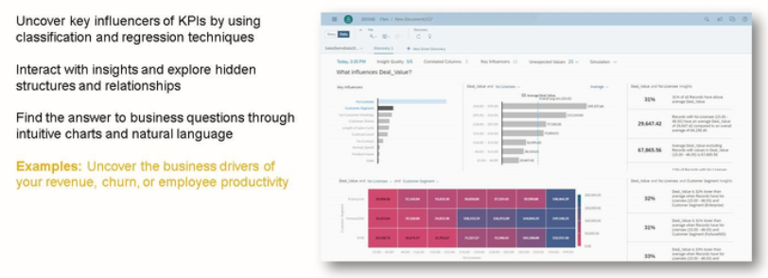
Smart Discovery
Core KPIs, how we understand the our main business drivers behind the core KPIs.

Slide 6
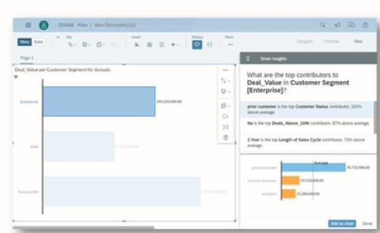
SMART insights
Develops clear understanding of intricate aspects of the business data.
Example: Want to know more about revenue
in Enterprise Segment? Smart Insight panel
will give an explanation.

Slide 7
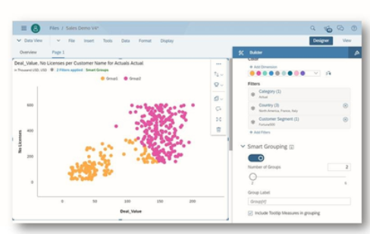
Smart grouping
Automatically creates segments on different types of data in the organization.
Example: Automatically identifies customer groups in the data.

Slide 8
Thank you!!
Questions ??? ?

