Slide 1
Unit 5 Augmented Analytics IN SAC: Chapter 2 : Simplifying Predictive with Smart Predict

Slide 2
SAP Analytics Cloud Smart Predict
Augmented Analytics
Rely on machine learning technology to produce intuitive results.
Smart Predict
Business problem focus captures users intention
Transparent, understandable and trustworthy results.
Smart BI and Planning
Uses predictive results everywhere in BI and planning
Offer content driven predictive options everywhere
End to end lifecycle which delivers business value
Deploy to SAP S4/HANA applications using Predictive Analysis Integrator
Scheduled train and apply to keep predictions up to date

Slide 3
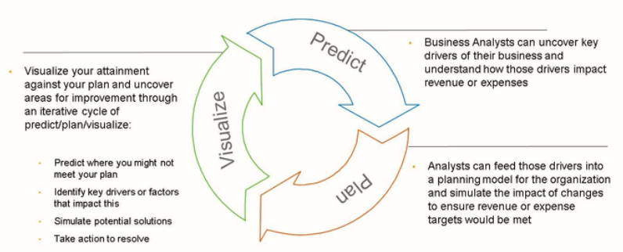
Smart Predict
Includes

Slide 4
Basic Concepts used in Smart Predict
Predictive Scenario – guides in terms of Insights we need based on Business Questions.
Predictive Model – visualizations and KPIs that helps to understand predictive results.
Variables – Describes observations stored in dataset
Dataset – collection of data presented in table.
Training – Uses SAP Machine learning algorithms to explore relationships in dataset.
Partition strategy – decomposes training dataset to “Training” and “Validation subsets”.

Slide 5
Predictive Scenario Types
Classification :- What is the likehood that a future event occurs?
Example – Who is likely to buy or buy not a new product?
Regression:- What could be the prediction of a business value, taking into account the context of its occurrence?
Example – What will be revenue generated by a product line, based on the planned transport charges and tax duties.
Time Series - What are the future values of a business value over time, at a certain granularity/place?
Example - How much ice cream will I daily sell over the next 12 months? I have my historical daily sales information, but I'd like to be able to include other factors such as vacation months, and the seasons.

Slide 6
Thank you!!
Questions ??? ?

