Slide 1
Unit 6 Users, Security and Administration: Chapter 1 : Defining Users, Teams, Roles and Security

Slide 2
Users, Teams, Roles & Security
SAP Analytics cloud uses SAP Cloud identity as the default authentication method.
Single sign-on(SSO) authentication to a custom identity provider can be configured using SAML 2.0 protocol.
SAP Analytics Cloud provides basic user management, including creating, deleting, changing and role assignment.
We can also import user data from CSV file for Active Directory if we want to synchronize users with other systems or maintain users in batch mode.

Slide 3
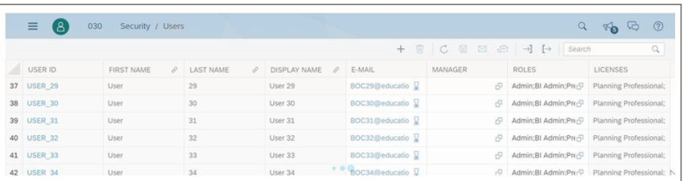
User Management – Create, Delete, Change and search
Includes

Slide 4
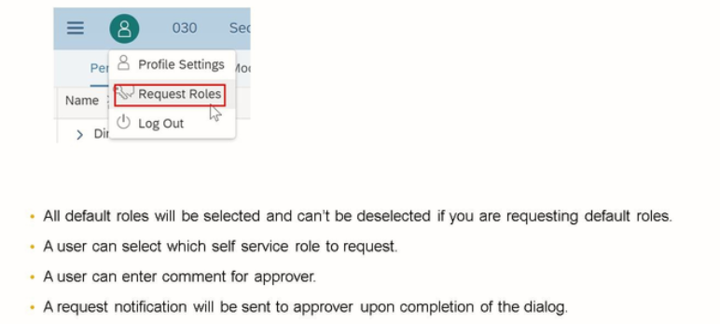
User Role Creation and Approval
Role Creation:

Slide 5
Other functions
Password creation or Reset password
Role Management
Rights
Create/Delete/Read
Execute
Maintain

Slide 6
Thank you!!
Questions ??? ?

