Slide 1
Unit 6 Users, Security and Administration: Chapter 1 : Performing Administration Tasks

Slide 2
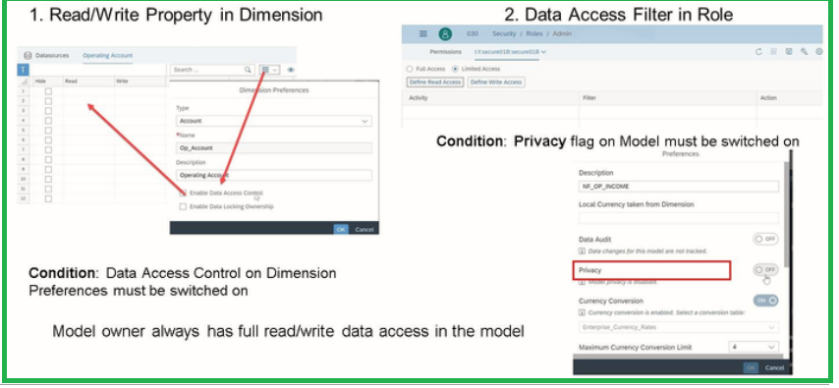
Administration Tasks
Define Data Access in a Model:
Who can see what level of
detail can easily be assigned.
Model privacy set then we
need to have the role include the
data access levels.

Slide 3
Read/Write property in Dimension
Apply to all the models that use this dimension.
One model can have more than one data-access-control-enabled dimension
Access defined on hierarchy node will be propagated to its descendants, but will be overwritten if another access if defined on a lower-level node.
Write includes read access
Write controls the publishing.
Write Access is only for planning..

Slide 4
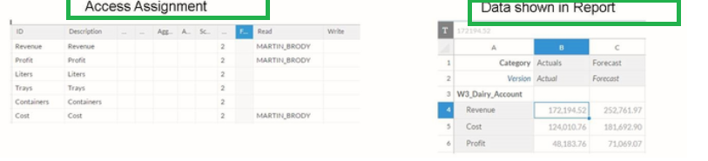
Read/Write property in Dimension

Slide 5
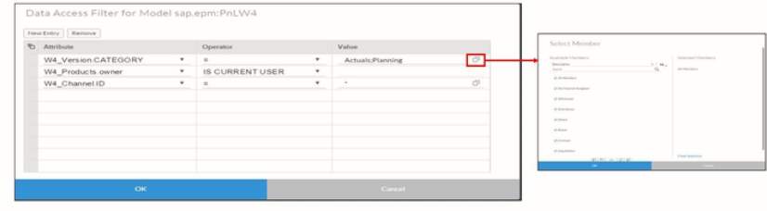
Model-Based privacy settings
Filters can be defined on any property of the dimension in the model:

Slide 6
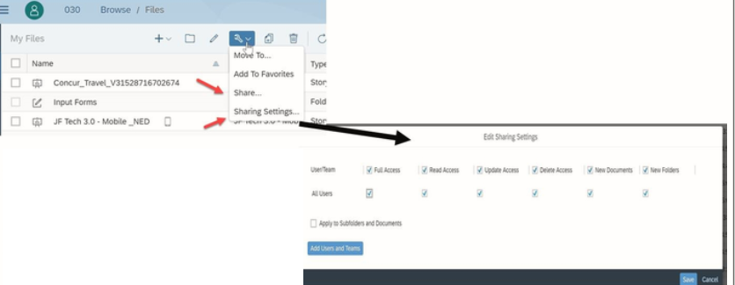
Model-Based privacy settings
File Permissions:
Full Access
Read Access
Update Access
Delete Access
New Documents
New Folders

Slide 7
Teams in SAC
A team is group of users
A User can belong to multiple teams.
If a role is assigned to a team, then all the members of the team inherit that role.
Each team has a team folder, which can only be accessed by the users in that team.

Slide 8
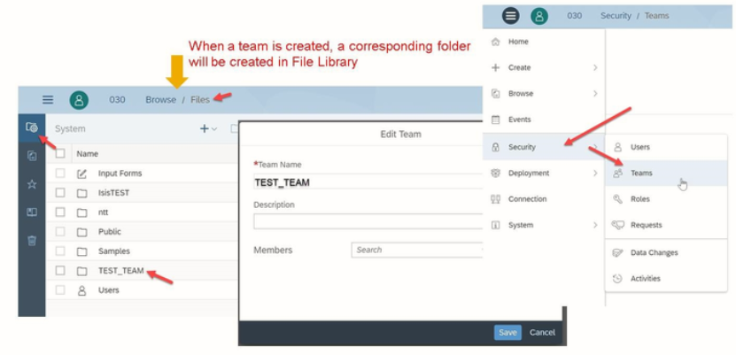
Team Creation.

Slide 9
Best practices for assigning roles to teams
Assign users to teams.
Assign roles to teams.

Slide 10
Content Deployment Guidelines
SAP Analytics Cloud supports easy export and import of content to and from a file.
If there are dependencies between content, the dependent content is automatically selected, unless it is a location dimension if you have geo-enrichment in your model.
Point-of-Interest data is not exported.
Only public content can be exported.
You cannot import old exports into newer tenants.

Slide 11
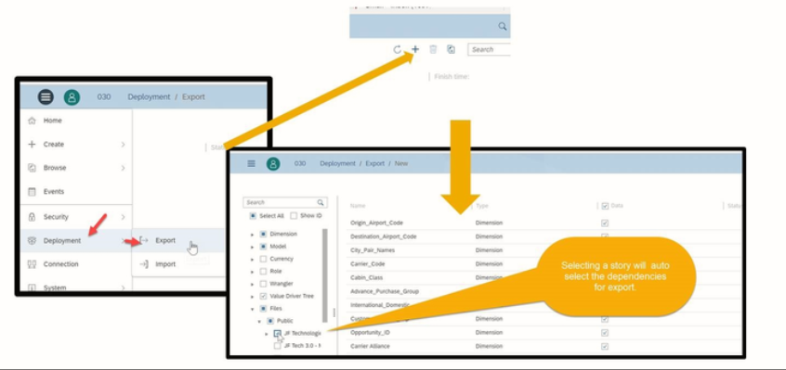
Content Deployment – Export to File

Slide 12
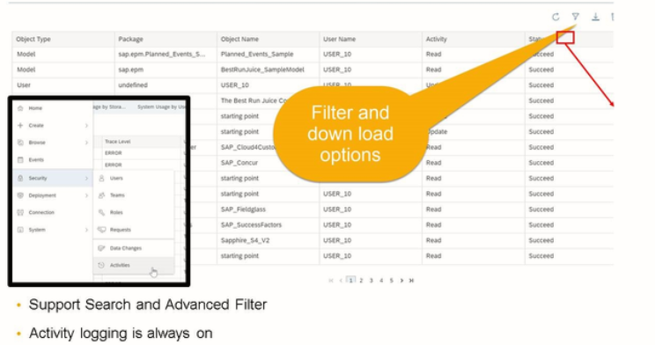
Audit Logs

Slide 13
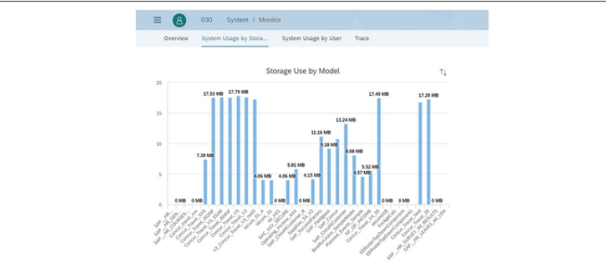
System Usage

Slide 14
Thank you!!
Questions ??? ?

