Slide 1

SMART INDIA HACKATHON 2026
RASAD (रसद)
Decide before the road shuts
Problem Statement ID – SIH26251
Problem Statement Title- Indian Army: Predictive Logistics & Forward Supply Chain
Theme- Transportation & Logistics
PS Category- Software
Team ID- 163616
Team Name- Code ZCrew

Slide 2
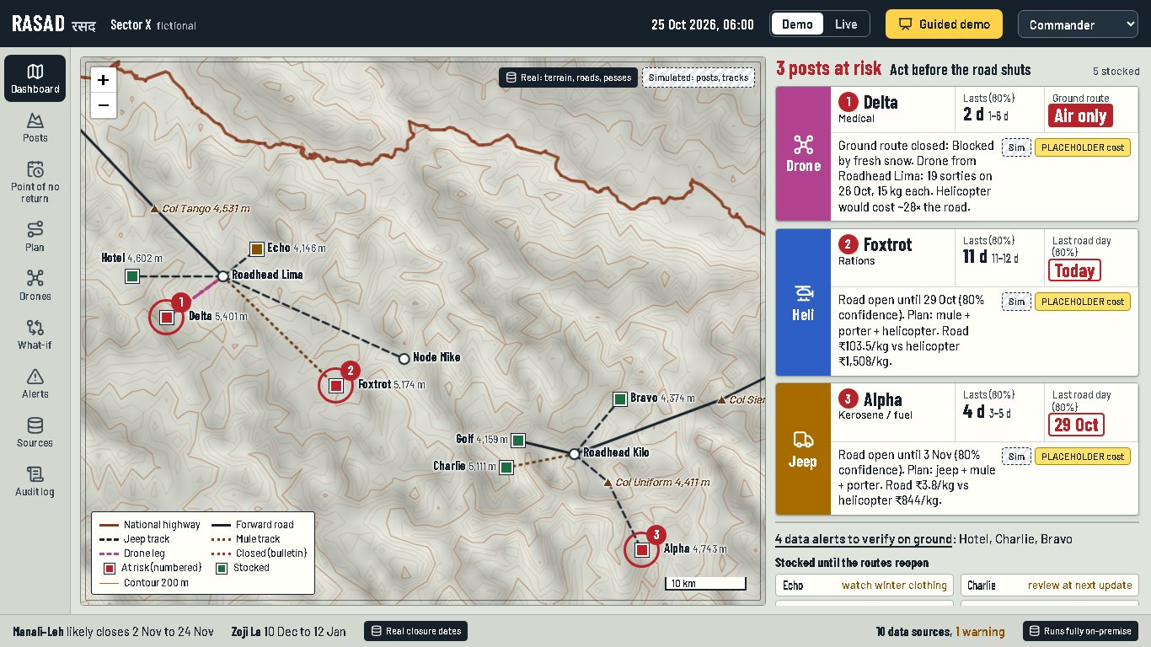
RASAD: DECIDE BEFORE THE ROAD SHUTS
Code ZCrew
ID 163616
❖ Proposed Solution (Describe your Idea/Solution/Prototype)
Detailed explanation of the proposed solution
Forecast
need
Last safe
road day
Mixed-fleet
plan
Commander
approves
How it addresses the problem
Joins 10 separate data streams into one decision picture
Innovation and uniqueness of the solution
Closure probability window
Drones as a real mode
Drone basing advisor
Offline, on-premise
Working prototype · military data simulated · terrain, highways, weather real

Slide 3
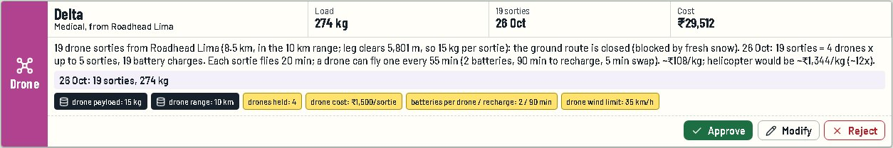
TECHNICAL APPROACH
Code ZCrew
ID 163616
Technologies to be used (e.g. programming languages, frameworks, hardware)
AI / ML
LightGBM quantile forecast (P10 / P50 / P90)
Optimisation
Google OR-Tools
CP-SAT solver
GIS
Leaflet map · Copernicus DEM · OpenStreetMap
Backend
Python · FastAPI · pandas · SQLite
Frontend
React + TypeScript web app
Hardware
One on-prem laptop or server · IoT fuel sensors
Methodology and process for implementation (Flow Charts/Images/ working prototype)
10 data streams
Real: weather since 1995, 16-day forecast, terrain (DEM), highways (OSM)
Simulated: CICG-like stock & issues, IoT fuel sensors, BRO roads, IAF airlift
Adapters
1 config file per stream
Unknown codes refused
Health checks
One database
SQLite on the unit's own machine
Engines
Forecast (LightGBM) → Point of No Return (31 real winters) → Mixed-fleet plan (CP-SAT, 7 days)
+ drone advisor · what-if · data alerts
Commander
9 screens
Approve / Modify / Reject
Audit log
Working prototype
Every plan line explains itself: route, terrain clearance, sorties and cost vs helicopter, then Approve / Modify / Reject.
Costs are PLACEHOLDER.

Slide 4
FEASIBILITY AND VIABILITY
Code ZCrew
ID 163616
Analysis of the feasibility of the idea
Limitation → Mitigation our honest gaps, and how we handle them
✓
Built and running: 9 screens, one-click start, guided demo
Limitation (potential challenges and risks) | Mitigation (strategies for overcoming these challenges)
Military data is classified, so our stock and use data are simulated | Adapters read real CICG, BRO and IAF exports through one config file each; simulated data is labelled on every screen
Forecast accuracy is measured only on simulated data, built from the same weather inputs | The model is used only where it beats a 28-day average on held-out days; real accuracy is measured once CICG data is connected
Forward-track closure dates use PLACEHOLDER scaling of the pass rule | Pass rules are fitted on real closure dates; the unit's own track records replace the placeholders
Only 4–5 real closures per pass (error ±13 / ±18 days) | Plan at 80% confidence, not the middle date; add BRO's records as they come
The demo scenario is designed, and all costs are PLACEHOLDER | The same engine was re-run with changed inputs and responded correctly; real costs go into one parameter file
Large sectors may hit the solver's 20-second limit; roles are demo-only | The screen then says "best plan found within time limit"; Army SSO/PKI supplies roles in deployment
✓
Works offline on one laptop; no data leaves it
✓
Free, open-source stack: no licence or cloud cost
✓
Plugs into existing systems: reads CICG, BRO and IAF exports without changing them
✓
Stress-tested: troops ×1.5 → posts at risk 3 → 6; pass closes 10 days early → helicopter sorties 30 → 49

Slide 5
IMPACT AND BENEFITS
Code ZCrew
ID 163616
Potential impact on the target audience
Benefits of the solution (social, economic, environmental, etc.)
For commanders, logistics staff and post quartermasters
⏰
Decide before passes close
Last safe road day for every post and supply
⛑
Less risk to troops
Fewer risky helicopter sorties and porter / mule trips
29 Oct
Alpha's last safe road day, at 80% confidence, known before the pass closes
✈
Ready for 2,715 drones
Advises where to base them, by altitude band
✓
Full accountability
Every approve, modify or reject is logged
simulated · PLACEHOLDER track rules
30 → 0
⇄
Plugs into existing systems
Reads CICG and other exports; replaces nothing
⛰
Scales to other sectors
Any high-altitude sector: new data, same engine
Foxtrot's helicopter sorties this week, with 20 drones at the advised base
simulated · PLACEHOLDER costs

Slide 6
RESEARCH AND REFERENCES
Code ZCrew
ID 163616
Details / Links of the reference and research work
Problem and policy
MoD RFI: 2,715 logistic drones, 3 altitude bands (Aug 2026)
idrw.org · Outlook
Army RFP: 363 drones, 15 kg at high altitude, 10 km range
The Tribune, 17 Oct 2022
Joint Primer for Integrated Logistics, HQ IDS (Aug 2025)
PIB via GlobalSecurity
Winter stocking: ~2 lakh t for ~6 months; cost quotes
The Week, 13 Aug 2020
Mule units retained to ~2032
SP's Land Forces, Nov 2025
Q-FORCE logistics app (May 2026)
AIR News, 22 May 2026
Full list with confidence levels: docs/FACTS.md
Real closure dates
Zoji La closures and reopenings, 2020–25
Greater Kashmir · The Tribune · ThePrint · AIR News
Manali–Leh closures and openings, 2021–26
AIR News 2025 · AIR News 2024 · himalayan-routes
Open data used (real, cached offline)
Weather since 1995 and 16-day forecast
Open-Meteo ERA5 (CC BY 4.0)
Terrain heights and national highways
Copernicus DEM GLO-90 · OpenStreetMap (ODbL)
Logistics drone specs: Sabal 20
The Defense Post, Dec 2024
All data is free and public; no account or key needed
What we verified
✓
Real data: 31 winters of weather, terrain, highways and closure dates
✓
Prior work: 3 public prototypes for this problem studied; none plans drones or gives a closure probability
✓
Self-check: outputs change correctly when inputs change. Military data simulated; costs PLACEHOLDER

