Slide 1
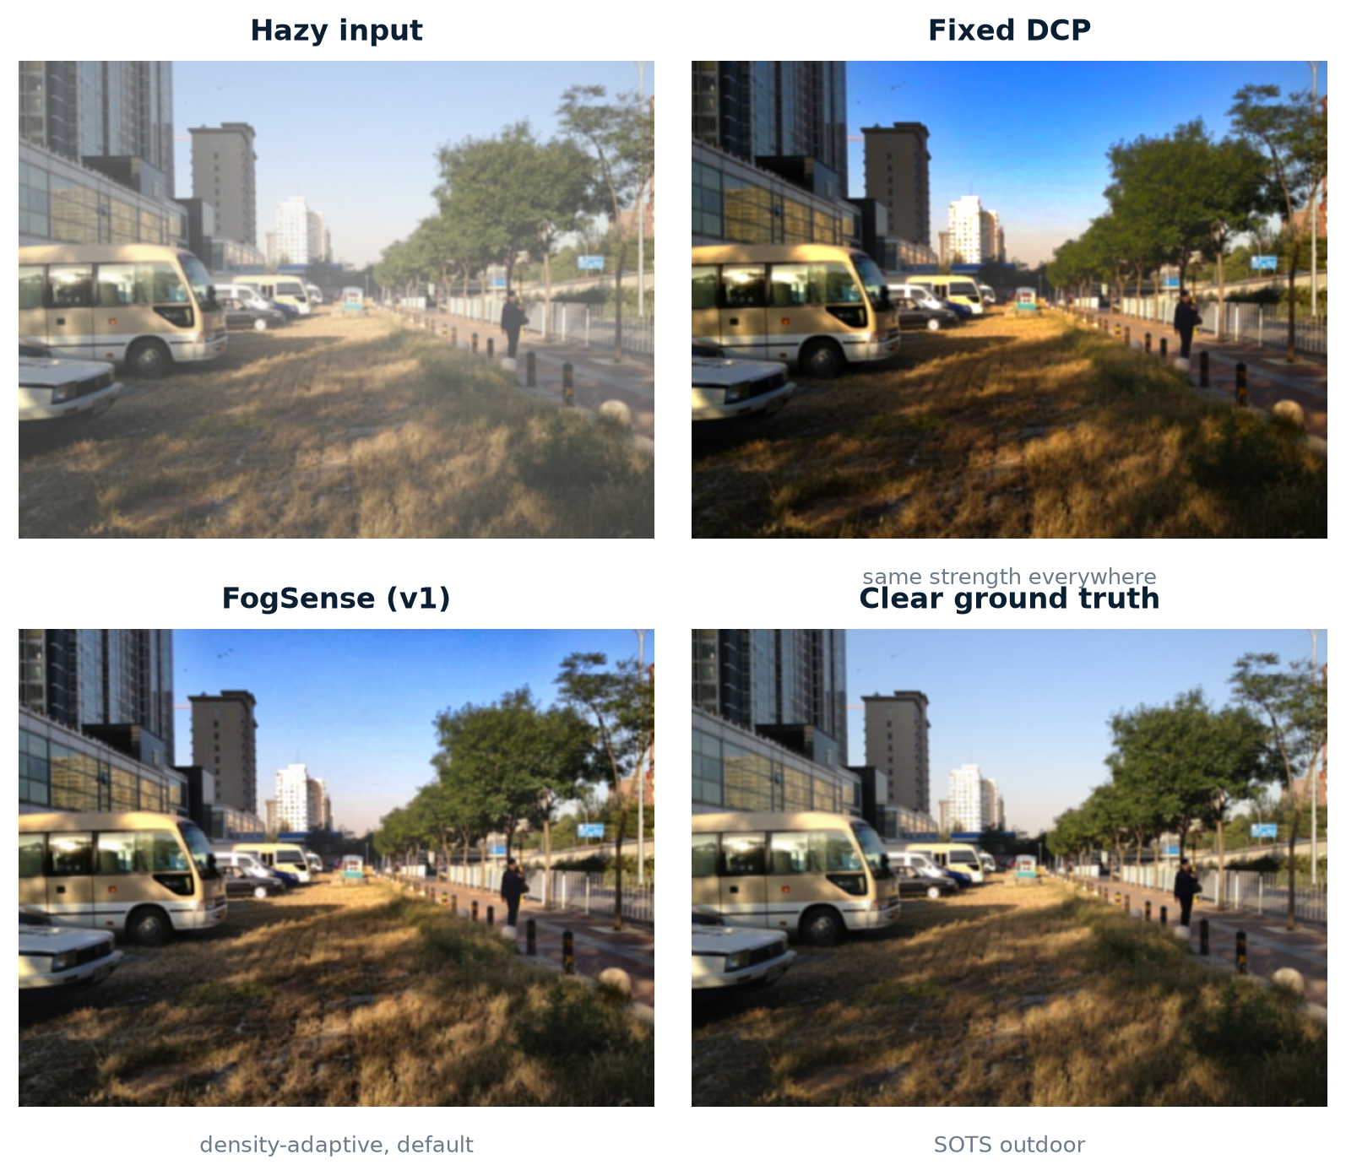
FogSense
An Intelligent Multi-Algorithm Framework for Adaptive Haze Removal
IPA Course Project · Image Processing & Analysis
Classical image processing only · no deep dehazing networks
v1 default · v2 opt-in
October 2026 · github.com/AtulTejaswi/adaptive-fog-density-dehazing
Notes:
Welcome. FogSense is a classical, density-aware, multi-algorithm dehazing framework. The headline is not a black box: every decision is explainable and every number is reproducible. v1 is the recommended default; v2 is an opt-in extension that we evaluate honestly.

Slide 2
Agenda
What we will cover
• 1. Problem: why fixed-strength DCP fails across haze levels
• 2. Atmospheric model and label-free fog-density estimation
• 3. FogSense architecture and adaptive strategy selection
• 4. Evaluation protocol, baselines and main SOTS results
• 5. v2 upgrade: stronger baselines and an honest negative result
• 6. Ablations, runtime, demo, failure cases and conclusions
FogSense · IPA course project
1
Notes:
Six parts, about twelve minutes. The key message: adapt the correction to estimated density, keep it classical and explainable, and report the v2 result honestly.

Slide 3
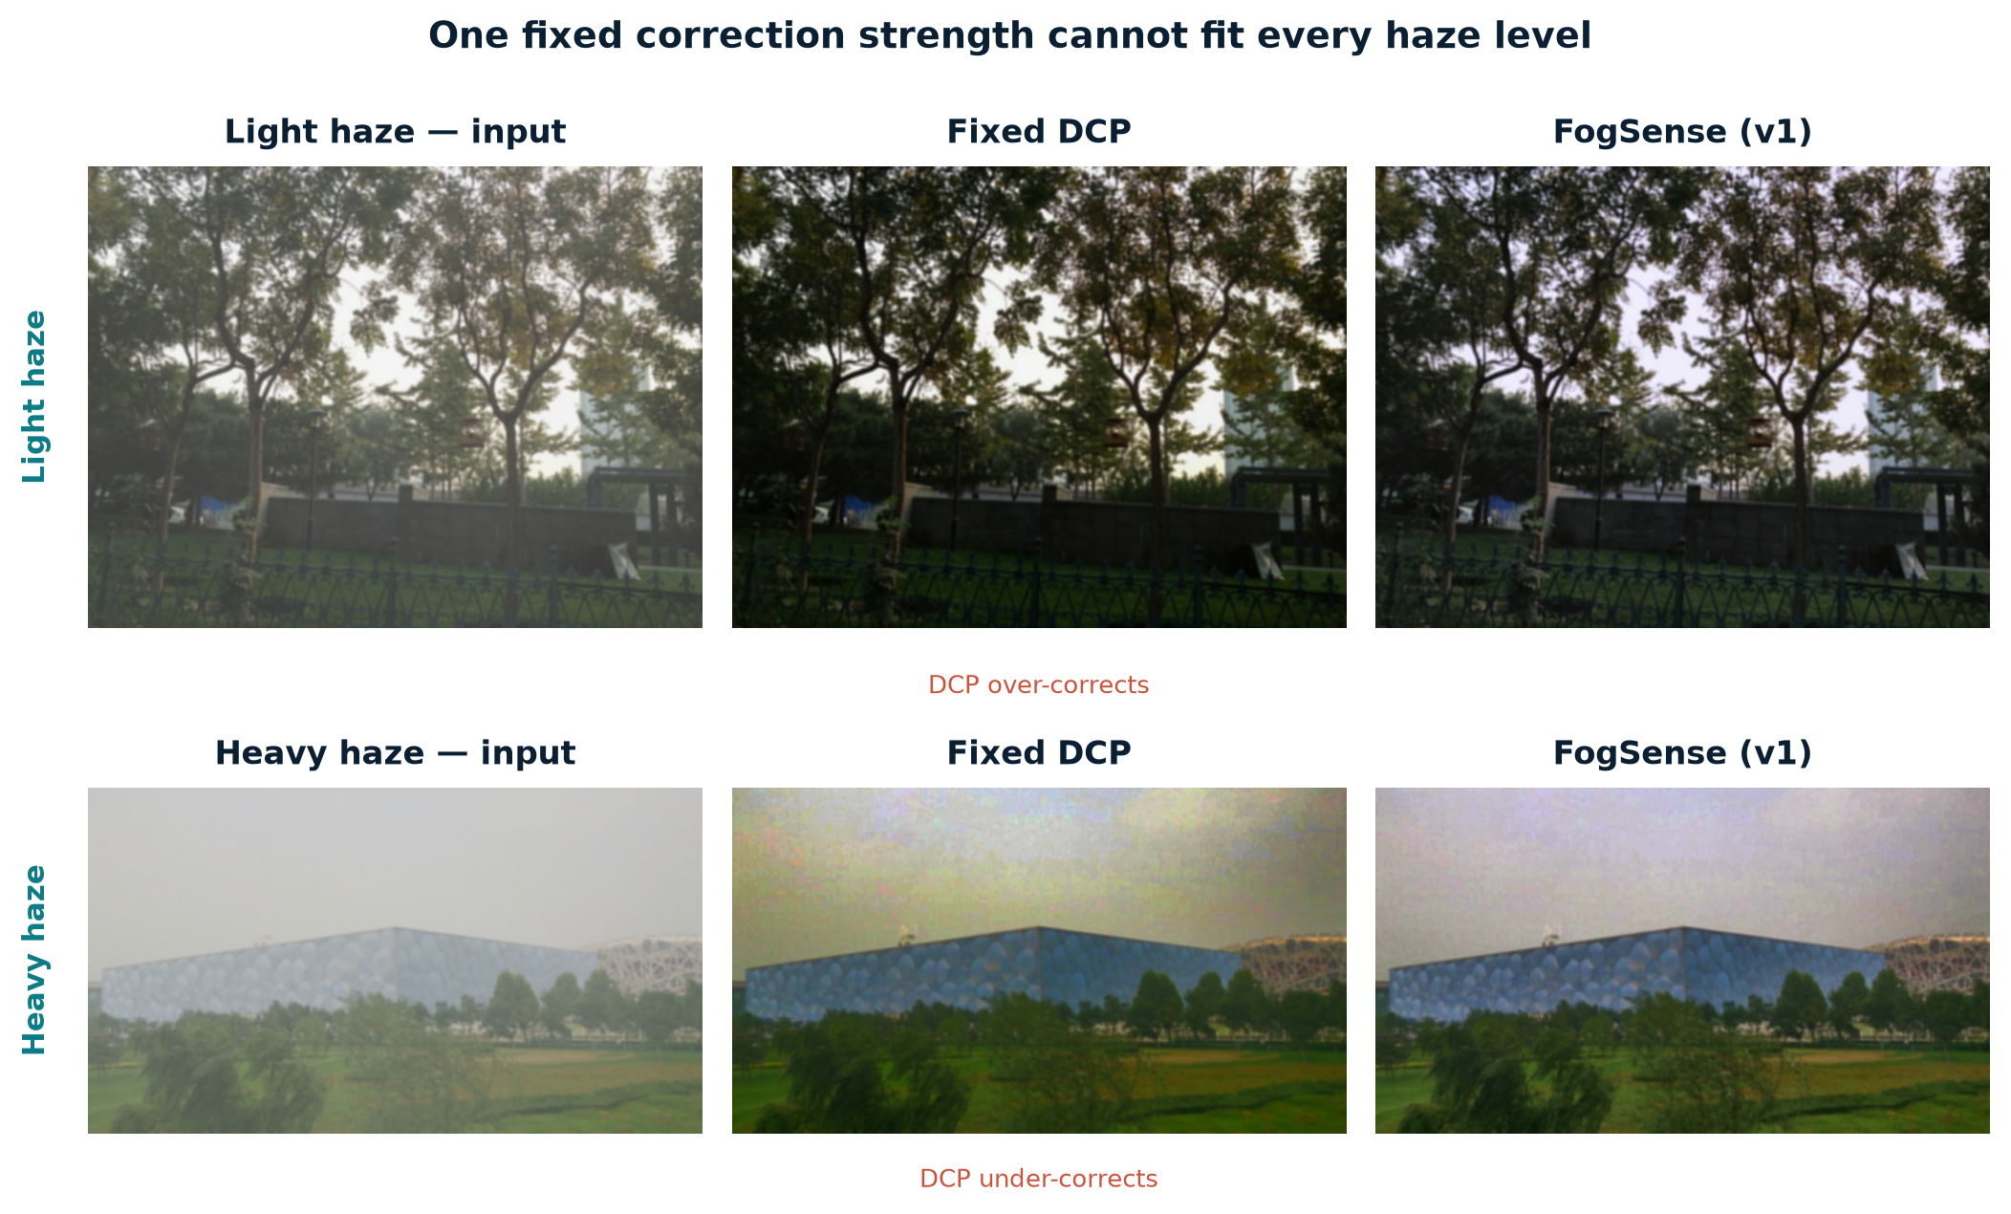
Problem: one fixed strength cannot fit every haze level
• Haze scatters and attenuates light; contrast and colour fidelity drop.
• Dark Channel Prior with one ω and t₀ over-corrects light haze and under-corrects dense haze.
• The correction strength and enhancement should depend on the image, not on a global constant.
• Goal: estimate fog density first, then adapt DCP and enhancement to that density.
FogSense · IPA course project
2
Notes:
Show the two rows: light haze becomes too dark with fixed DCP, heavy haze stays hazy. FogSense adapts ω, t₀ and the enhancement chain per class.

Slide 4
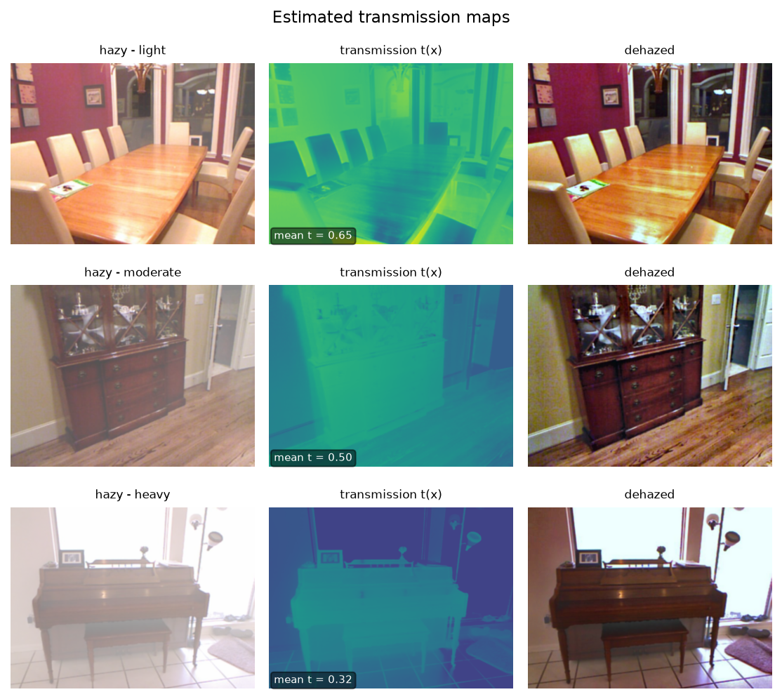
Atmospheric model and transmission
I(x) = J(x) t(x) + A (1 − t(x)), t(x) = exp(−β d(x))
• J: clear scene radiance; A: atmospheric light; t: transmission; βd: optical depth.
• DCP estimates A from the brightest 0.1% of dark-channel pixels and t from the dark channel.
• Guided filter refines the noisy transmission map while preserving edges.
• Radiance recovery: J = (I − A) / max(t, t₀) + A.
• Baseline uses fixed ω = 0.95, t₀ = 0.10 for every image.
FogSense · IPA course project
3
Notes:
Explain the model in one minute. The guided filter is the difference between a usable transmission map and a noisy one; we implement the box-filter version locally.

Slide 5
FogSense architecture
Input
Preprocess
Density
score
Selector
DCP +
guided filter
Enhance
• Preprocessing: RGB float32, long side 640 px, light bilateral denoise. Shared by all methods.
• Density score → three-bin selector (light / moderate / heavy) → class-specific ω, t₀, filter, CLAHE, Retinex.
• Baseline branch: fixed DCP for the paired comparison.
• Stronger baselines (v2): CAP (Zhu 2015) and a BCCR-style boundary-constraint variant.
• v2 opt-in branch: v2 airlight, sky/white-object handling, local density maps.
FogSense · IPA course project
4
Notes:
This is the 'multi-algorithm' part: the same density-aware interface can dispatch the adaptive pipeline and the fixed DCP, CAP and BCCR-style baselines. v2 is strictly opt-in.

Slide 6
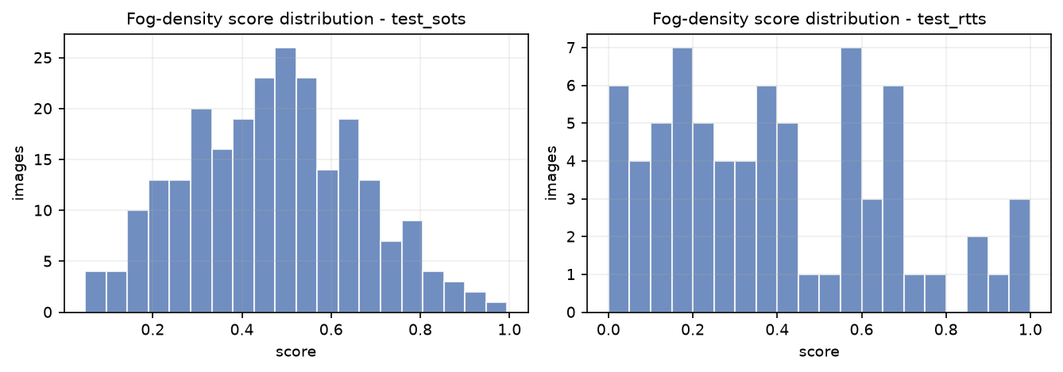
Fog-density estimation (label-free)
• Dark-channel mean (15×15 patch): higher → hazier. Weight 0.45.
• Shannon entropy of grayscale: lower → hazier. Weight 0.30.
• Global contrast (RMS + Michelson): lower → hazier. Weight 0.25.
• Each feature is percentile-normalised (p2–p98) using calib statistics only.
• score = 0.45·ndc + 0.30·(1−nentropy) + 0.25·(1−ncontrast).
• Thresholds are the calib tertiles: t₁ = 0.3937, t₂ = 0.5885.
No per-image beta label is needed on SOTS; the score is validated on the synthetic beta sweep.
FogSense · IPA course project
5
Notes:
Stress that this is label-free and fitted only on calib. Entropy carries most of the signal; contrast is close to neutral but kept for complementarity on real low-contrast images.

Slide 7
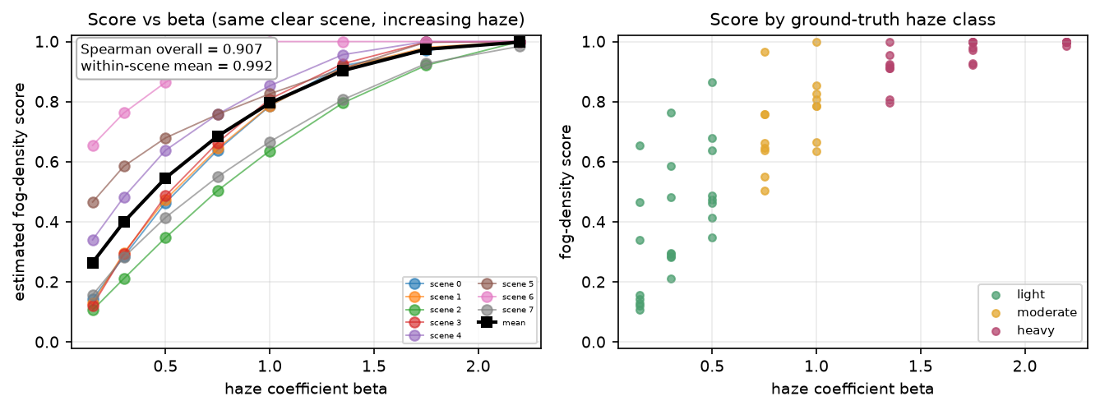
Density validation
• Overall Spearman ρ(score, β) = 0.907.
• Within-scene mean ρ = 0.992 (minimum 0.939 across 8 scenes).
• Local density is the best single signal on the sweep: 0.948 vs 0.907 global.
• On RTTS the ordering flips: global density tracks FADE better (0.933 vs 0.817).
• Calib-fitted ridge weights reach 0.969 vs FADE but are reported as an experiment only.
FogSense · IPA course project
6
Notes:
The score is monotone in beta for every scene. The RTTS result is why the shipped estimator stays global while the ridge version is documented but not shipped.

Slide 8
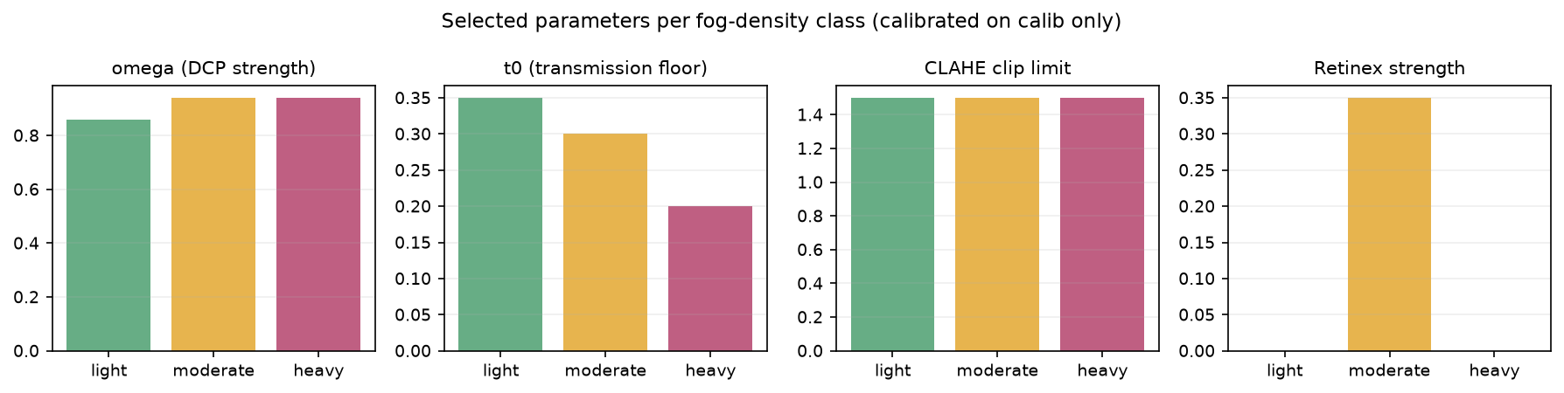
Adaptive strategy selection
class | ω | t₀ | CLAHE clip | Retinex
light | 0.86 | 0.35 | 1.5 | off
moderate | 0.94 | 0.30 | 1.5 | 0.35
heavy | 0.94 | 0.20 | 1.5 | off
Parameters fitted on calib with a constrained two-stage search; correction strength increases with density.
• Continuous interpolation: 18.80 dB / 0.8574 SSIM (over-enhances some images).
• Depth-3 classifier: 18.40 dB / 0.8780 SSIM.
• Three-bin rule retained: simplest, interpretable, best SSIM (0.8896).
FogSense · IPA course project
7
Notes:
The selector comparison is an ablation, not a claim that three bins are magically optimal. They win on SSIM and remain interpretable, which matters for a course project.

Slide 9
DCP dehazing and guided filtering
• Dark channel on 15×15 patches estimates haze thickness.
• Atmospheric light from the brightest 0.1% of dark-channel pixels.
• Transmission: t = 1 − ω · dark(I/A), refined by the guided filter.
• Radiance recovery with a t₀ floor to limit noise amplification.
• Guided filter is edge-preserving; we use the local box-filter version.
• Ablation: removing the guided filter costs about 0.85 dB PSNR.
FogSense · IPA course project
8
Notes:
The transmission figure shows why refinement matters: raw DCP transmission is noisy and blocky; the guided filter recovers edges and avoids halos.

Slide 10
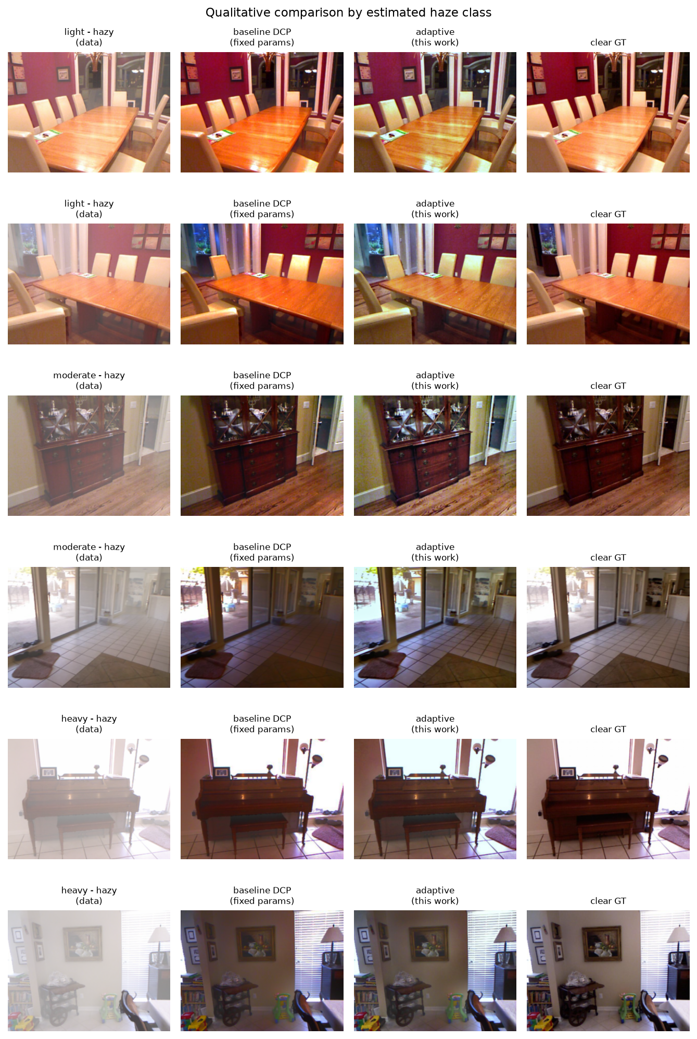
Enhancement stack
• Retinex: multi-scale illumination correction on luminance (moderate class only).
• CLAHE: adaptive histogram equalisation on L in LAB, blended at strength 0.4.
• Gray-world: per-channel gains remove residual colour cast.
• Each step is individually switchable for ablation.
• Light/heavy disable Retinex; heavy keeps CLAHE for detail.
FogSense · IPA course project
9
Notes:
Enhancement is where the SSIM gain comes from. CLAHE alone reaches 18.18 dB / 0.8850; adding Retinex raises PSNR to 19.30 but lowers SSIM to 0.8840.

Slide 11
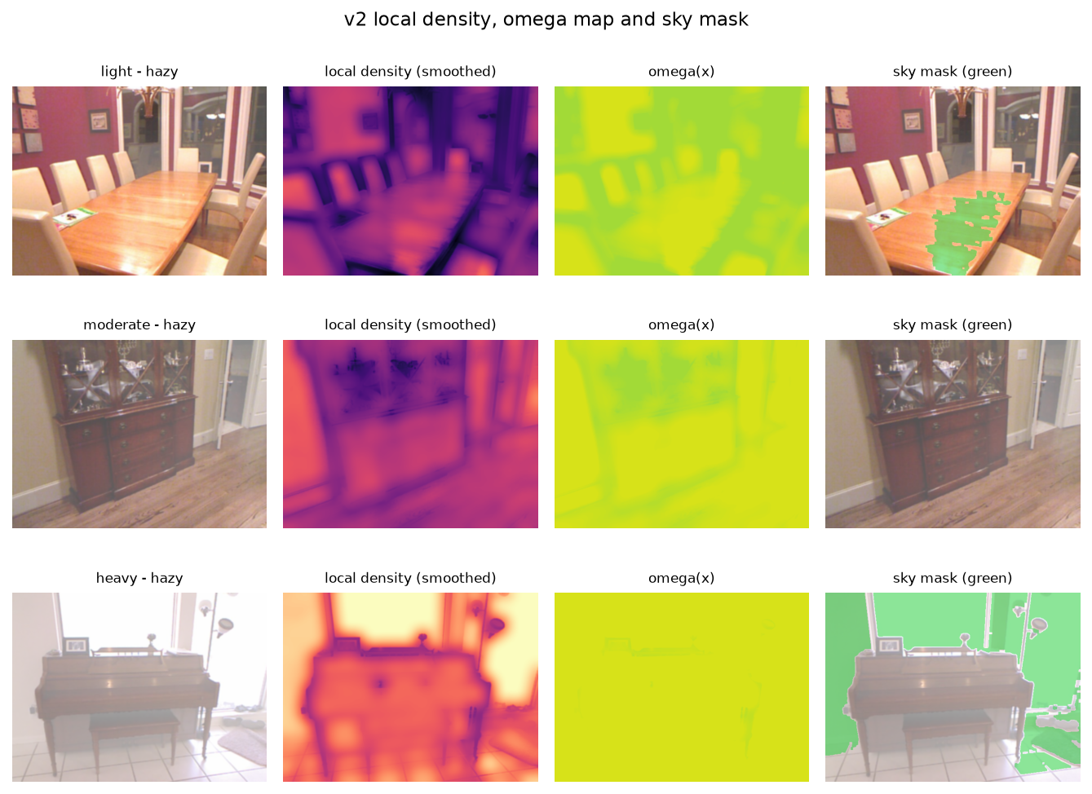
v2 opt-in upgrades
• Airlight v2: brightest 0.5% of dark channel, reject small components and high-gradient pixels; fallback to v1.
• Sky / white-object mask: bright + smooth + connected; floors transmission at 0.25 and blends 25% toward input.
• Local density map: local dark channel, rank entropy and contrast; guided-filter smoothed.
• Per-pixel ω(x), t₀(x) interpolated from class centroids; enhancement blended by local density.
• Quad-tree airlight search rejected on calib (−0.88 dB), so it is not used.
The green mask shows the conservative sky/white-object region; it can false-positive on bright indoor areas.
FogSense · IPA course project
10
Notes:
v2 is deliberately conservative: airlight changes PSNR by only +0.11 dB on calib. The sky stage is the only step that improves both PSNR and SSIM; the local maps are the risky part.

Slide 12
Evaluation protocol and baselines
• Data: calib 299 pairs, SOTS test 243 pairs, RTTS 72 images, density validation 64, selector set 180.
• Split by unique clear scene; preprocessing identical for every method.
• Frozen tags: v0.1-frozen-params, v1.0, v2.0-frozen-params, v2.0. No test-set tuning.
• Baselines: fixed DCP, CAP (Zhu 2015), BCCR-style (Meng 2013, simplified).
• Metrics: PSNR/SSIM, CIEDE2000, NIQE-style and FADE-style (proxies), entropy, contrast, edge, runtime.
• All v2 knobs fitted on calib only; v1 tables remain unchanged.
FogSense · IPA course project
11
Notes:
Emphasise the freeze discipline: parameters are written before the test run and the repository is tagged. NIQE/FADE are locally fitted or fixed-weight proxies, not official models.

Slide 13
Main results: SOTS test (243 pairs)
method | PSNR (dB) | SSIM | CIEDE2000 | ms/image
DCP | 15.71 | 0.8263 | 12.64 | 59
CAP | 18.09 | 0.7833 | 9.84 | 38
BCCR-style | 16.02 | 0.8309 | 12.36 | 83
FogSense v1 | 18.78 | 0.8896 | 9.50 | 192
FogSense v2 | 18.45 | 0.8873 | 9.38 | 562
• FogSense v1: +3.07 dB PSNR and +0.0633 SSIM over fixed DCP.
• Win rate v1 vs DCP: PSNR 96.3%, SSIM 90.1%; gains in every haze class.
• CAP is a much stronger PSNR baseline than DCP (18.09 vs 15.71) but lower SSIM.
• BCCR-style is the most 'natural' (best NIQE) but under-enhances detail.
• v1 also leads on real RTTS entropy gain (0.4165) and edge preservation (1.6733).
FogSense · IPA course project
12
Notes:
Read the table slowly. v1 is best on PSNR and SSIM; v2 slightly better on colour (CIEDE). CAP narrows the PSNR advantage but not the structural/colour advantage.

Slide 14
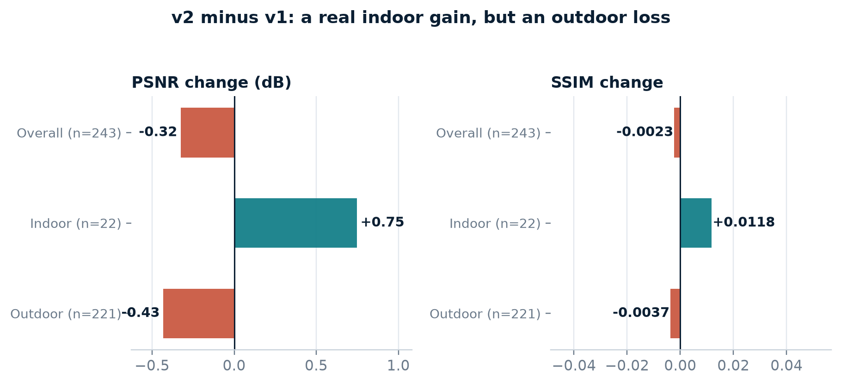
Honest v2 result: better indoors, worse on average
• v2 vs v1: PSNR −0.32 dB (p = 0.0002), SSIM −0.0023 (p = 0.44).
• Indoor (n = 22): +0.75 dB PSNR, +0.0118 SSIM.
• Outdoor (n = 221): −0.43 dB PSNR, −0.0037 SSIM.
• Sky stage alone: +0.64 dB / +0.0037 SSIM over v1.
• Local maps cost −0.87 dB; enhancement blend recovers SSIM only.
• Brightness diagnostic: after mean/std matching, v2 is +0.37 dB vs v1.
• Conclusion: v1 remains the default; v2 stays opt-in.
FogSense · IPA course project
13
Notes:
This is the honest result and a strength of the project. The sky stage is genuinely useful; the local omega/t0 maps are not, as configured. We keep the frozen config rather than tuning on the test set.

Slide 15
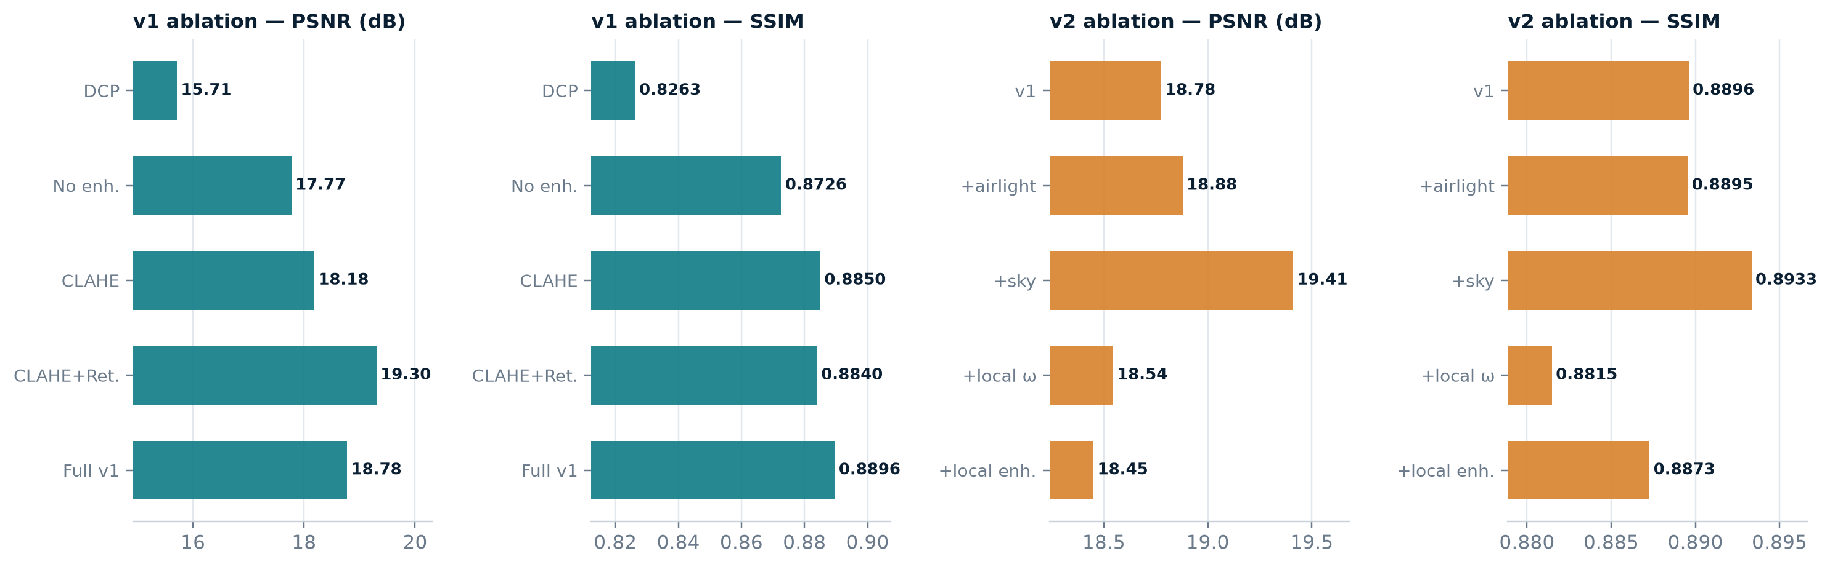
Ablations: what actually helps
• Enhancement drives SSIM: no enhancement 0.8726 → full pipeline 0.8896.
• Retinex raises PSNR to 19.30 dB but lowers SSIM to 0.8840; gray-world gives best SSIM and lowest colour cast.
• Three-bin selector beats continuous (0.8574 SSIM) and the depth-3 classifier (0.8780).
• Density: dark-channel only 18.48 / 0.8831; adding entropy reaches 18.84 / 0.8901.
• v2: only the sky step improves both metrics; local maps lose PSNR.
FogSense · IPA course project
14
Notes:
Use the ablation figure to justify the final design choices. The small SSIM difference between entropy-only and full density is within noise, so we do not over-claim it.

Slide 16
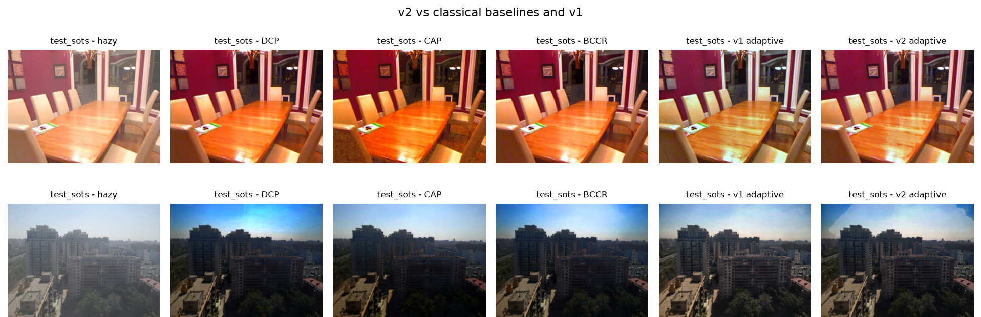
Qualitative results
• v1 recovers contrast and detail across haze levels; v2 helps indoor bright regions.
• CAP is strong on PSNR but has lower SSIM; BCCR-style is most natural but under-enhances.
• v2 can over- or under-correct outdoors, matching the quantitative outdoor loss.
FogSense · IPA course project
15
Notes:
Point at the sky regions: v2's conservative mask helps some images and hurts others. The full four-row figure is in the report.

Slide 17
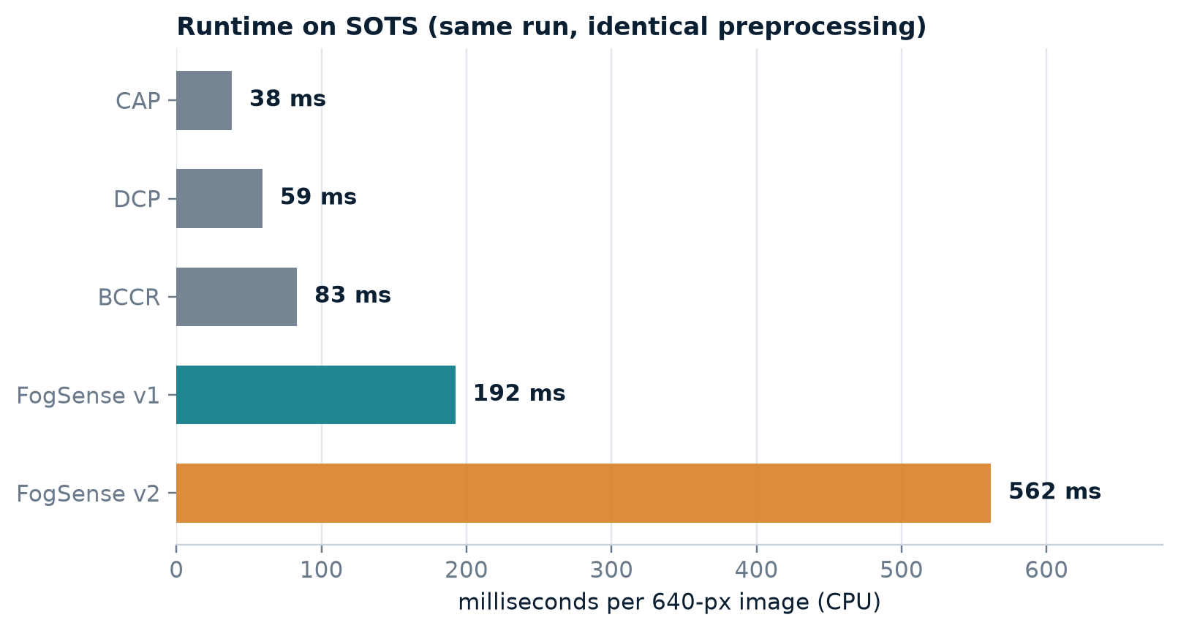
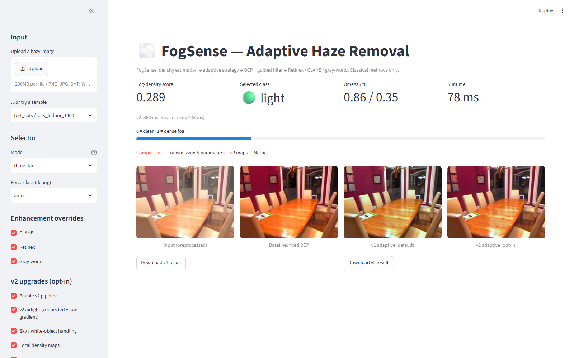
Runtime and live demo
python -m streamlit run app/app.py
• Fixed DCP 59 ms; FogSense v1 192 ms; FogSense v2 562 ms (~2.9× v1).
• Local density map is the main extra cost; airlight/sky are cheap.
• Live demo: Streamlit app with density map, transmission map and v2 toggles.
FogSense · IPA course project
16
Notes:
The screenshot is from the real app. Mention that the live timings vary with CPU load; the benchmark numbers are from the committed evaluation run.

Slide 18
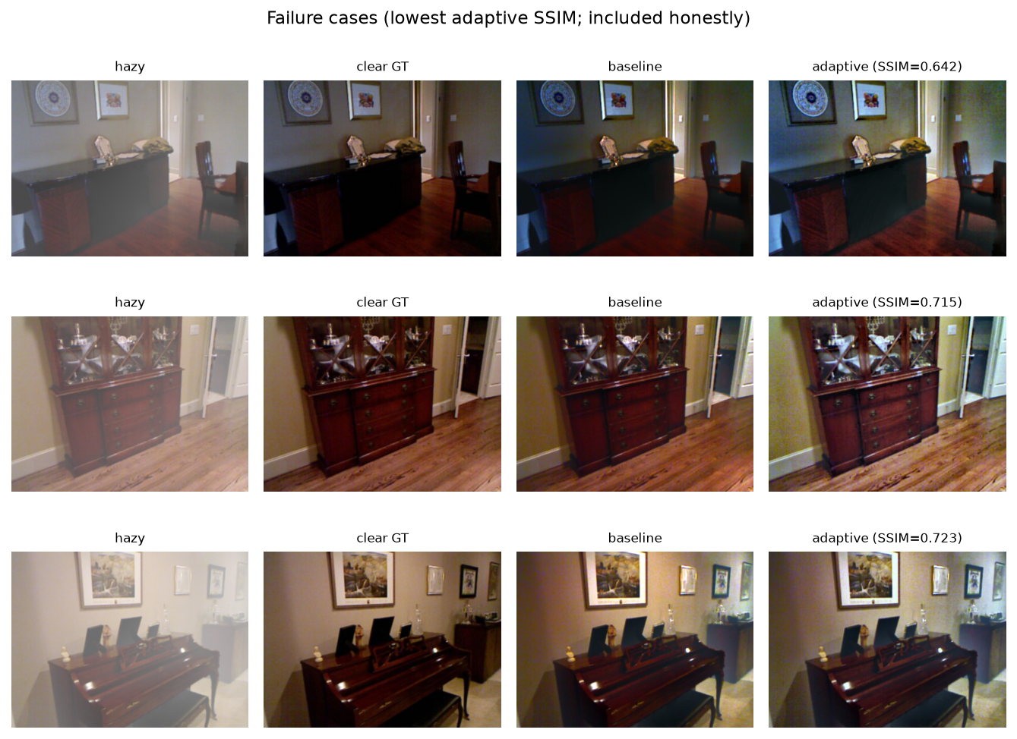
Failure cases and limitations
• Sky and white objects violate the dark-channel assumption → darkening or colour shift.
• Night haze has weak colour statistics; the density score is less reliable.
• Noise amplification in dense haze: the t₀ floor trades detail for noise.
• CLAHE/Retinex can over-sharpen texture and amplify artefacts.
• v2: indoor gain from only 22 pairs; outdoor loss dominates the average.
• NIQE-style and FADE-style are proxies, not official learned models.
• v2 is ~2.9× slower than v1 and ~9× slower than fixed DCP on CPU.
FogSense · IPA course project
17
Notes:
Be explicit about limitations; this is what makes the evaluation credible. The sky-mask false positives are visible in the v2 density-map figure.

Slide 19
Conclusions
• FogSense is a classical, density-aware, multi-algorithm framework with an explainable decision chain.
• v1 reaches 18.78 dB / 0.8896 SSIM vs fixed DCP 15.71 dB / 0.8263 SSIM on 243 SOTS pairs.
• Gains in every haze class; 96.3% PSNR and 90.1% SSIM win rates.
• CAP is a strong baseline; the adaptive advantage is structural and colour, not only PSNR.
• v2 is reported honestly: better indoors and on CIEDE2000, but an aggregate PSNR loss; v1 stays default.
• Future work: better airlight/sky handling, adaptive t₀, faster local features, real-world validation.
FogSense · IPA course project
18
Notes:
Close on the honest v2 result: we learned that the sky stage is the valuable part and the local maps need rethinking. That is a real, defensible conclusion.

Slide 20
Questions?
Thank you
• Repository: github.com/AtulTejaswi/adaptive-fog-density-dehazing
• Demo: python -m streamlit run app/app.py
• Report: report/report.md · Slides: report/FogSense_slides.pptx
• All numbers are generated from files under results/ and are reproducible.
FogSense · IPA course project
19
Notes:
Invite questions on the density estimator, the v2 negative result, or the baseline fairness audit.

Slide 21
Appendix A: metric definitions
Backup slide
• PSNR / SSIM: full-reference against the clear SOTS ground truth.
• CIEDE2000: mean colour difference in Lab (lower is better).
• NIQE-style: MSCN statistics vs a Gaussian fitted on 299 calib clear images (lower is better).
• FADE-style: Choi et al. feature set with fixed documented weights (lower = clearer).
• No-reference: entropy gain, RMS contrast improvement, Sobel edge-preservation ratio, colour cast.
• NIQE/FADE are proxies: relative trends only, not absolute scores.
FogSense · IPA course project
20
Notes:
Use if asked about metrics. Be clear that NIQE/FADE are locally fitted or fixed-weight proxies.

Slide 22
Appendix B: reproducibility
Backup slide
• v1 pipeline: .\run_all.ps1 (or the individual scripts in the README).
• v2 pipeline: .\run_all_v2.ps1 --no-download (about 35–45 minutes).
• Tests: python -m pytest (83 tests, including byte-identical v2-off compatibility).
• Tags: v0.1-frozen-params, v1.0, v2.0-frozen-params, v2.0.
• With every v2 flag off, output is byte-identical to v1.0.
FogSense · IPA course project
21
Notes:
Use if asked about reproducibility or the freeze discipline.

