Slide 1

International Trade using EGM Neural Networks and Random Forests
Base paper:
Neural Network Analysis of International Trade
Author:
Isaac Wohl Jim Kennedy

Slide 2
Group Members
Prakhar Pradhan 190618 (CE)(Group Leader)
Aditya Gupta 190060 (CE)
Kaushal Chaudhary 190422 (ECO)
Raj Aryan 190673 (CE)
Chirag Sharma 190248 (CE)
Atul Umak 190202 (CE)
Sumit Singh Sheoran 190875 (CE)
Saral Verma 190767 (CE)
Sandeep Gautam 190754 (ECO)
Anurag Yadav 190170 (CE)

Slide 3
Introduction

Slide 4
The Gravity Model is the workhorse of International Trade Literature. It all started with Tinbergen(1962),relating Trade flows with Economic sizes and Geographical Distance between two Trading partners. It is the key tool to find Trade-Related effects and since then there are many versions of Gravity model From Traditional Gravity Theory to Extended Gravity Theory. Recently Gravity Model is not only constrained to Trade in goods but also applied in Trade in Services (Kimura 2006). Now a Days Structural Gravity Models(i.e Theoretically Grounded) are being explored. In this Paper in forthcoming sections we will analyse both intuitive as well as extended gravity model as intuitive model does not account for multilateral resistance terms. We will apply Anderson and Wincoop(2003) “Gravity with Gravitas” model which is Theoretically-Grounded Gravity model. The feature of this is it incorporates both , inward multilateral and outward multilateral resistance terms. To estimate this we move on to Fixed Effects Estimation accounting the multilateral resistance terms. Further to deal with “Heteroskedasticity” and zero trade flow values, we will apply Poisson Pseudo-Maximum Likelihood Estimator because Fixed Effect and Intuitive Model uses OLS which drops zero Trade values and may lead to inappropriate results. Moving on we will also apply negative binomial model to deal with overdispersion. Moreover we will apply extension of PPML which is GPML developed by Anderson(2015).

Slide 5
Moving on, we will deploy Machine Learning Regression Algorithms to analyse the Trade data. we will use Neural Networks and Random Forest Regression. This study uses Random Forest and Neural Networks to analyse the panel data. We will compare the models predictive powers by famous evaluation metric R2 square. As gravity model evaluation are based on hypothesis testing therefore we will use Cross Validation for training the model. There is tendency for the model to get over-fit, which we will deal with regularisation and hyper-tuning. As there are various techniques like Ridge regression, Decision Trees etc. moreover for increasing prediction accuracy there are various tools available like Bagging, Random Forest, Boosting and Extra-trees regression. We will go with Random Forest one and Neural Network analysis. It is expected that random forest will work better than neural network analysis and at par with the PPML as it will provide more information to understand the bilateral trade flow as it understands the complex analysis within the data which may ultimately help the Trade Policy Makers of the country. In the upcoming sections we will analyse the trade panel data from 1948-2019 by various econometric models and Machine Learning Algorithms and compare their predictive powers.

Slide 6
Literature Review

Slide 7
Tinbergen(1962) gave the Gravity Model followed by Leamer and Levinsohn(1995)’s statement that gravity model gave many robust findings in empirical economics.
Anderson and Wincoop(2003) gave “gravity with gravitas “ model which is demand function which incorporates both outward and inward multilateral resistance terms. It was developed as intuitive model does not account for these terms.Trade cost in intuitive model is function of distance only but in Structural Gravity model we define Trade cost as function of distance , common border, colony , common language and many agreements like EU, WTO and RTA.
This can be achieved by two ways, one is fixed effect estimation and other is approximation technique developed by Baier and Bergstrand(2009).
Silva and Tenreyro(2006) developed a way to deal with Zero Trade Flow values and Heteroskedasticity as it runs like non linear squares on the equation. Researchers believed it is better than OLS as it performs better even in dataset with large number of zeros and OLS drops all those values.
Anderson(2015 ) developed the extension of PPML which is GPML and many have started using Poisson because it outperforms the OLS.

Slide 8
Head and mayer(2014) highlighted the importance of fixed effect. By using country specific fixed effects all monadic terms including multilateral terms are captured.
Wohl and Kennedy (2018) examined that neural networks have nonlinear advantage to analyse complex relation within the dataset . They Pointed that NN are more robust and highly adaptive.
Baxter and Hersh(2017) ,and Storm,Baylis(2019) offered the study of Time Series projections by applying deep learning approach as Machine Learning Algorithms can be used in studying Trade Disruptions going on in the world like the Brexit and US-China.
Ke et al.2017 showed R-square as the Statistical Measure among both Supervised and Unsupervised Learnings. Moreover study uses LightGBM and XGboost for boosting. In our study we will proceed with Random Forest Regression.

Slide 9
Dataset Preview

Slide 10
This Study collects panel dataset from the centre d’Etudes et d'Informations Internationales (CEPII), UN-Comtrade database. It includes Trade Flow and GDP between countries which are in real terms not in nominal terms as Multilateral terms affect these. Other variables to account Trade Cost like Geographical distance , Common Language, religion , Border. Many agreement variables like RTA, GATT,EU WTO are also accounted in this study. Our study Consist of Top 18 Countries which are India, China, USA, Japan, Singapore, Belgium, Hongkong, Bangladesh, Pakistan, France, Italy, Korea, SaudiArabia, United Arab, Germany, Myanmar, United Kingdom and Switzerland. We will analyse trade data from 1948-2019 so total of 23328 rows are present in our study. These countries are chosen relevant to India as this study will help Trade Policy Makers to make better policies . Further Section involves implementation of Intuitive and Extended Gravity model followed by PPML,GPML, NLS. Finally implementation of Neural Network and Random Forest and Comparison of predictive powers of these models using R2 Square.

Slide 11
Variables | Description
Tradeflow_comrade_o | Trade flow as reported by the exporter (in thousands current US$) (source: Comtrade)
iso3 | ISO3 alphabetic code
Country | Country name
Contig | Dummy equal to 1 if countries are contiguous
Distw | Population-weighted distance between most populated cities (km)
Distwces | Population-weighted distance between most populated cities (km) using CES formulation with θ = −1
Comlang_off | 1 if countries share common official or primary language
Comlang_ethno | 1 if countries share a common language spoken by at least 9% of the population

Slide 12
Variables | Description
Comcol | 1 if countries share a common colonizer post 1945
Comrelig | Religious proximity index
Pop | Population (in thousands)
Gdpcap | GDP per capita (current thousands US$)
Comcur | 1 if pair currently shares the same currency
Gatt | 1 if country currently is a GATT member
wto | 1 if country currently is a WTO member
rta | 1 if the pair currently has a RTA (source: WTO)
Rta_coverage | Indicates whether the RTA covers goods only or goods and services (source: WTO)
Rta_type | Indicates the type of RTA (customs union for instance)

Slide 13
Model and Methodology

Slide 14
Writing gravity model in its Basic Form:
(GDP_{i})^{𝝱1} (GDP_{j})^{𝝱2}
T_{ij} = ɑ __________________________________
(D_{ij})^{𝝱3}
GDP i and j Refers to GDP(real) of Two Countries and D is the Geographical Distance between the countries. T represents Trade Volume between countries.
Intuitive Gravity Model can appear as Ordinary Least Square(OLS):
lnX_{ij,t} = θ₀ + θ₁ln(GDP_{i,t}) + θ₂ln(GDP_{j,t}) + θ₃ln(Dist_{ij}) + θ₄Contig_{ij} + θ₅Comlang_{ij}+ θ₆Col_{ij} + θ₇ln(Infra_{i}) + θ₈ln(Infra_{j})+ θ₉Obor_{ij} + θ₁₀Asean_{ij} + θ₁₁Eac_{ij} + θ₁₂Sadc_{ij} + e_{ijt}
Adding some fixed country effects:
lnX_{ij,t} = θ₀ + θ₁ln(GDP_{i,t}) + θ₂ln(GDP_{j,t}) + θ₃ln(Dist_{ij}) + θ₄Contig_{ij} + θ₅Comlang_{ij}+ θ₆Col_{ij} + θ₇ln(Infra_{i}) + θ₈ln(Infra_{j})+ θ₉Obor_{ij} + θ₁₀Asean_{ij} + θ₁₁Eac_{ij} + θ₁₂Sadc_{ij} + 𝜇_{i} + ɑ_{j} +e_{ijt}

Slide 15
Neural Network :
Y = f(w₁x₁ + w₂x₂ + b)
There are different types of Activation function in the literature defined as follows:
sigmoid(x) = 1/(1 + exp(−x))
tanh(x) = 2*sigmoid(2x) − 1
ReLU(x) = max(0, x)
Random Forest Regression
Supervised learning model which prevents Overfitting of the data. It uses multiple decision Trees which increases accuracy
f_{rf}^{B}(x) = (1/B)*(∑^{B}_{b=1}T_{b}(x))
Var((1/B)*(∑^{B}_{b=1}T_{b}(x))) = 𝜌𝜎² + 𝜎²((1 - 𝜌)/B)
Here B is the number of trees.
Tb = Random Forest Tree

Slide 16
Evaluation Metric and Results

Slide 17
To evaluate our econometric models we use Hypothesis testing. Generally Distance has negative Coefficient with great negative t-score and null hypothesis is rejected. In OLS estimation we use Robust Standard error and distance is used as the cluster. R2 Square value which is Coefficient of Determination and RMSE is Root mean square error. Generally value of R2 Square is between 0 and 1. Value of 0 predicts that model is failed and value of 1 predicts model perfectly fits Data. RMSE is square root of differences between predicted and actual values. Moreover coefficients of different variables in OLS, PPML and others model gives their effect on Trade. To check the statistical significance we use p value as our measure. In random Forest to improve the accuracy boosting parameters like learning rate , number of trees is being used. In Neural Network Analysis which is Feed Forward Algorithm we have used Rprop Algorithm to minimise loss function and other hyper tuning parameters like learning rate , number of epochs and number of hidden layers.

Slide 18
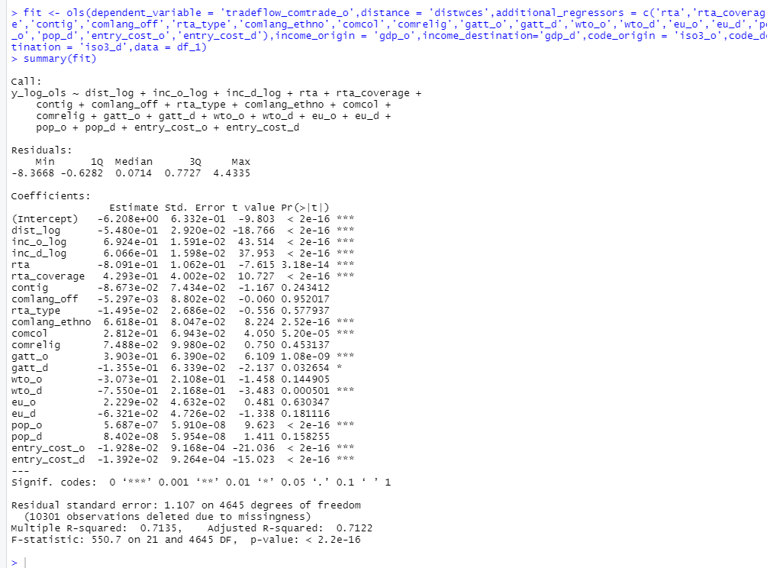
OLS Estimate of Intuitive Gravity Model
R square : 0.71
P values are significant
Null Hypothesis is rejected
Coefficients of dist , gdp_o , gdp_d etc can be used for correlation. For example 1% increase in dist would decrease trade by 0.55 percent.

Slide 19
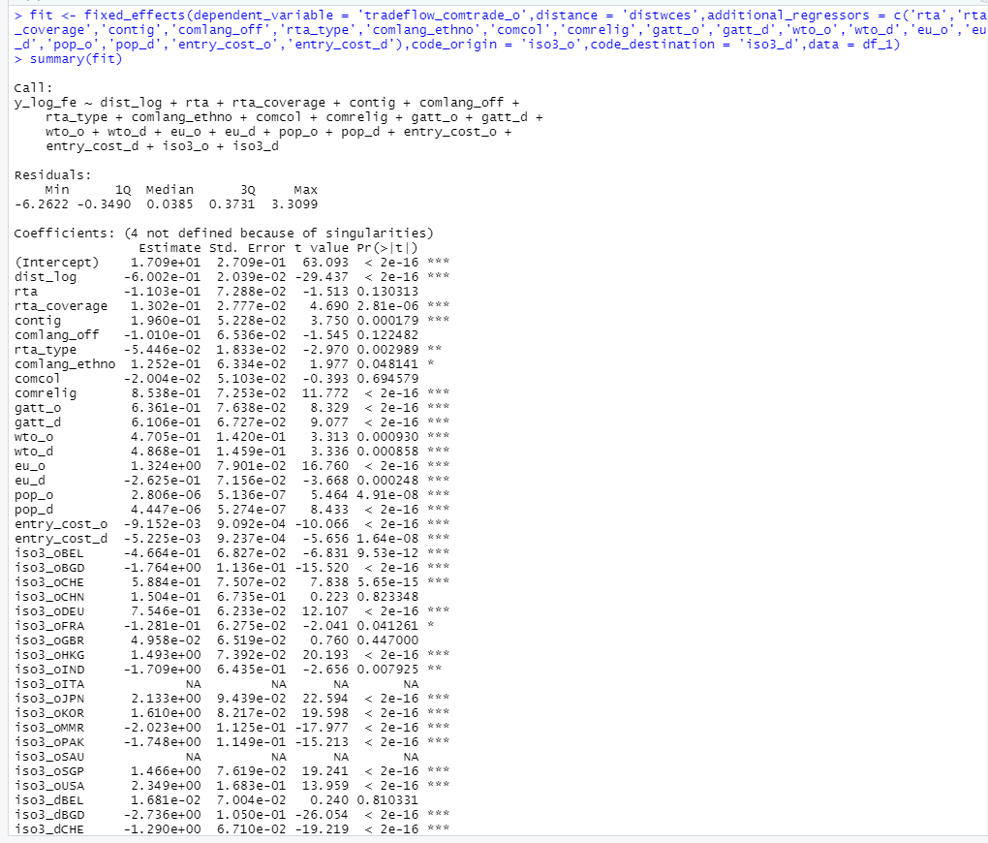
Fixed Effect Estimation incorporating Multilateral resistance terms
R2 Square : 0.86
P values are significant ,i.e Null Hypothesis Rejected.

Slide 20
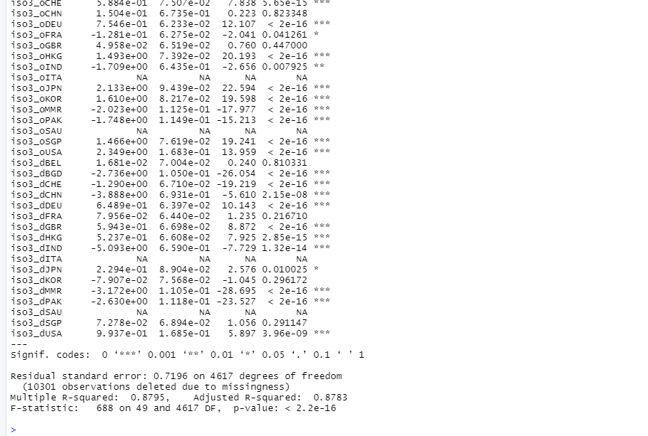
Continued Fixed Effect Estimation
Better than OLS.
Coefficients interpretation :
1% increase in following lead to % change in trade

Slide 21
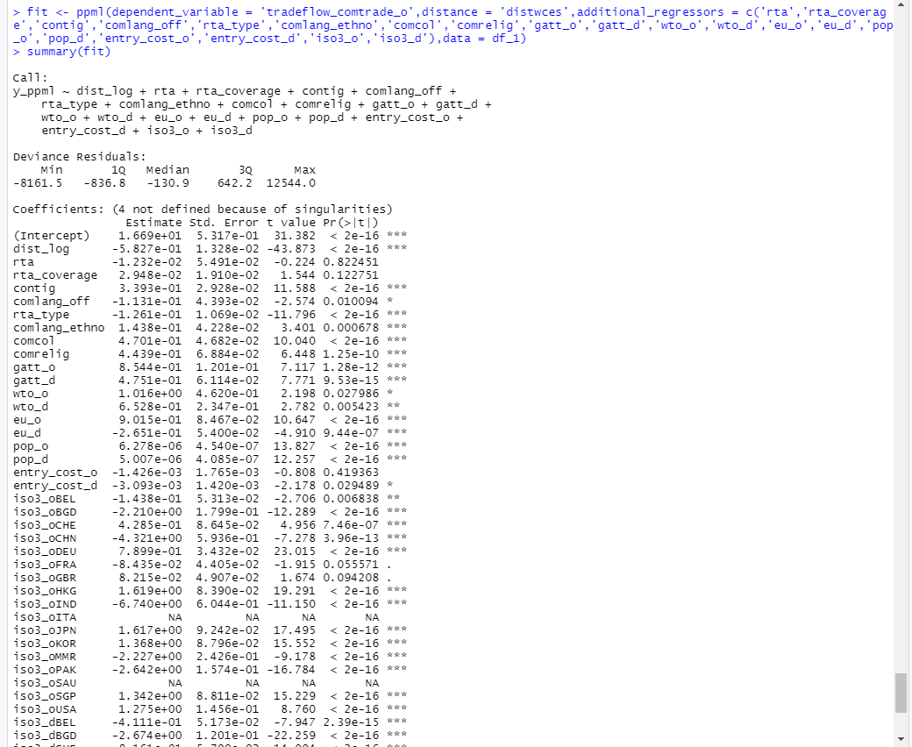
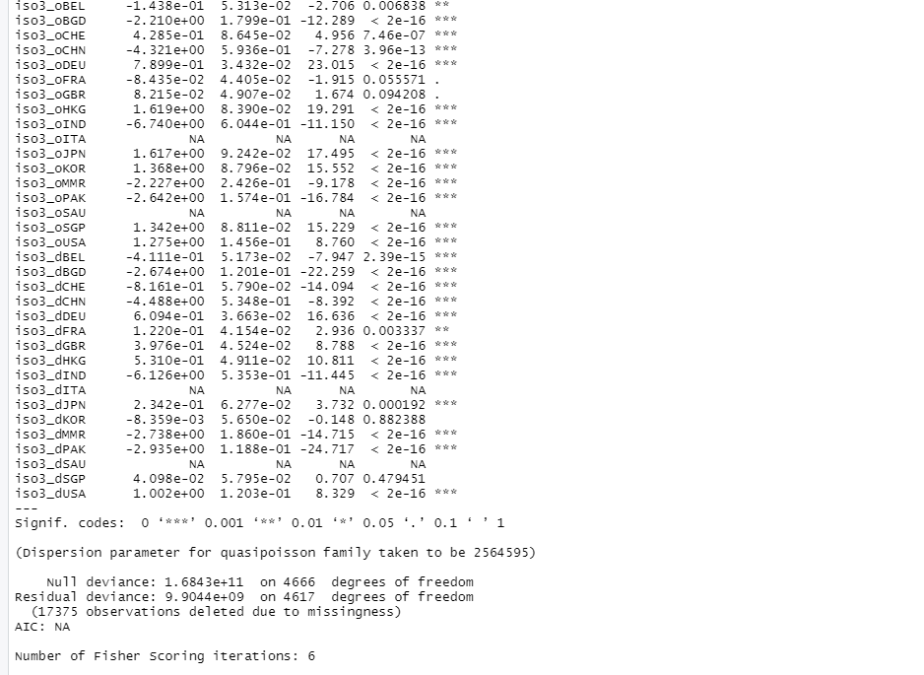
PPML estimation

Slide 22
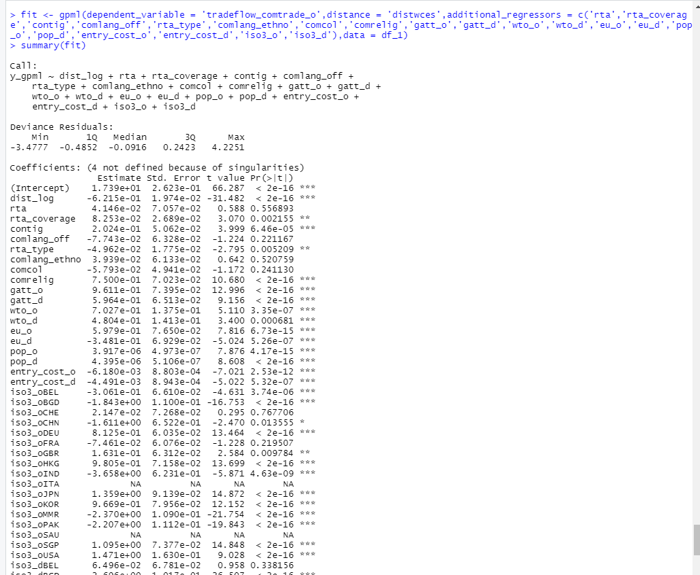
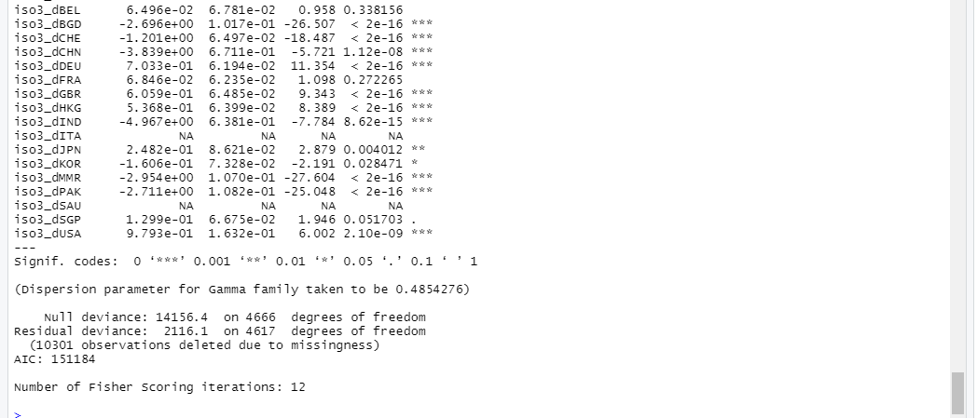
GPML Estimation

Slide 23
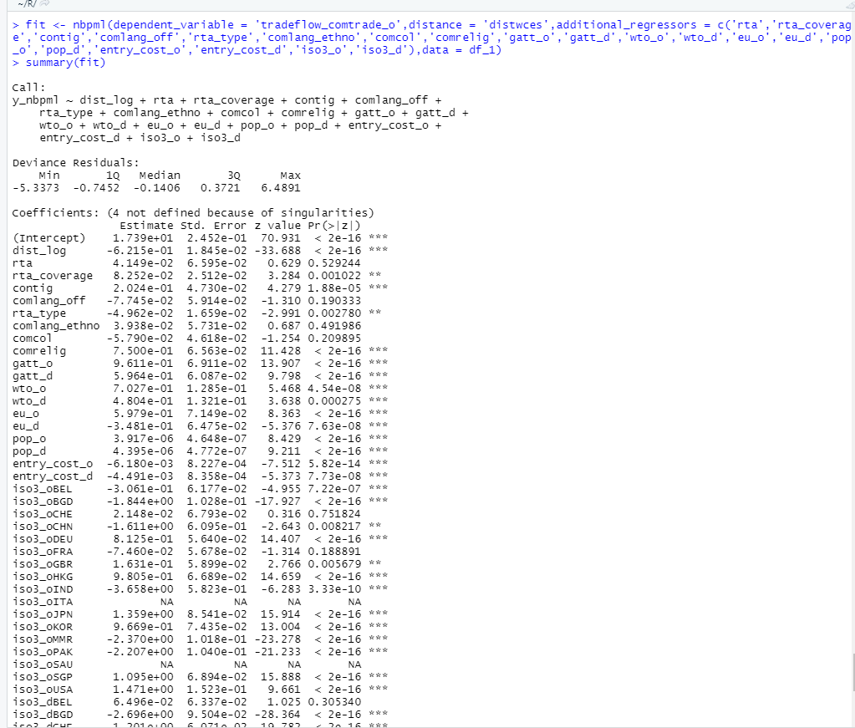
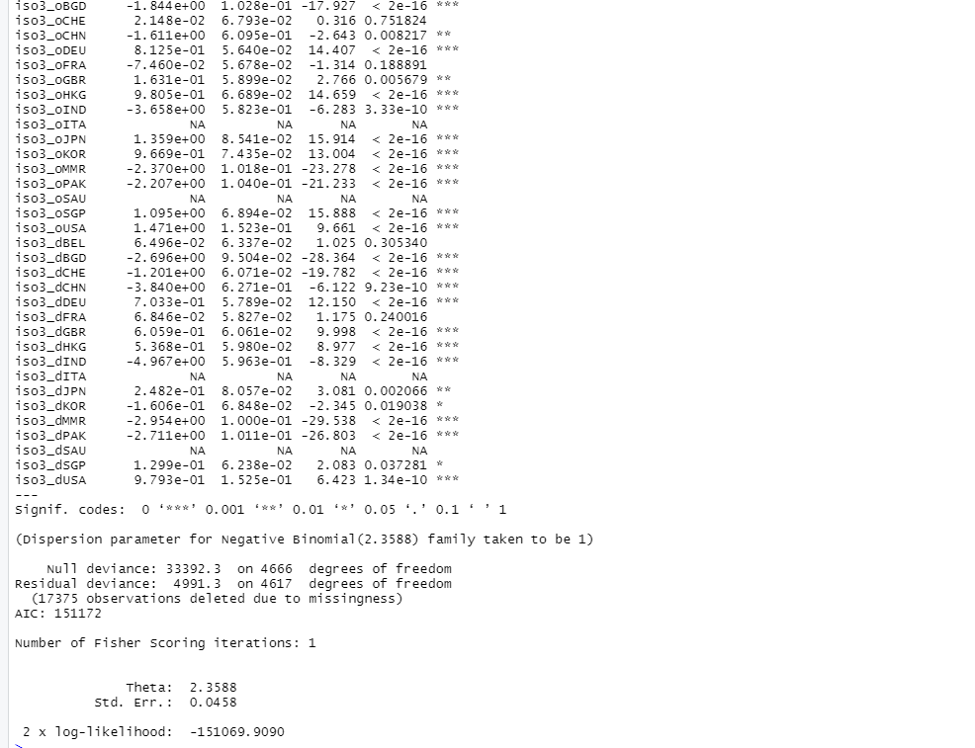
NBPML Estimation

Slide 24
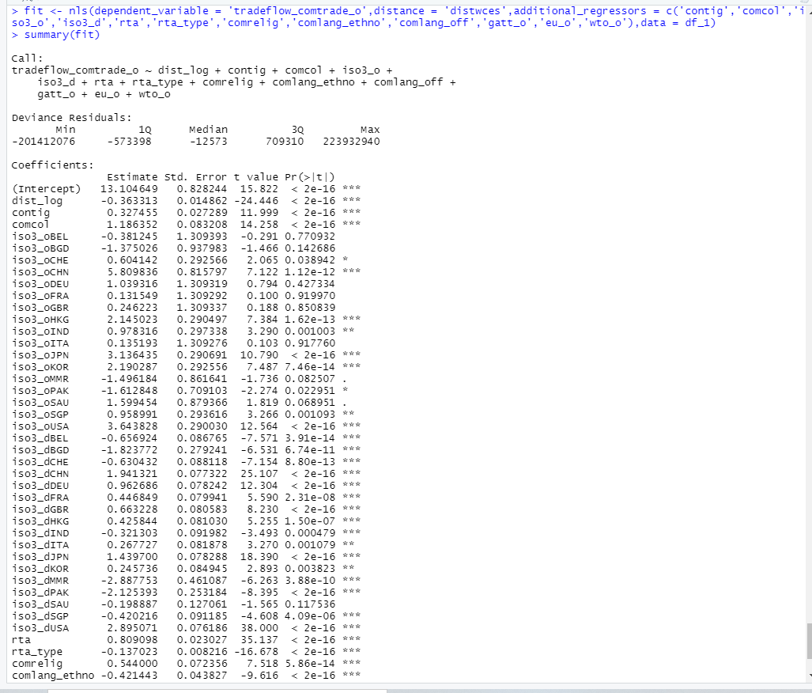
NLS estimation

Slide 25
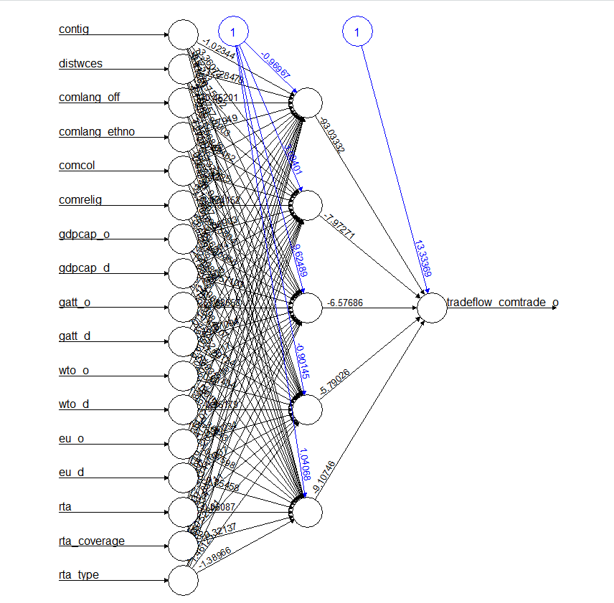
Neural Network
Hidden layer -5
Algorithm : “Rprop”
Learning rate = 0.1

Slide 26
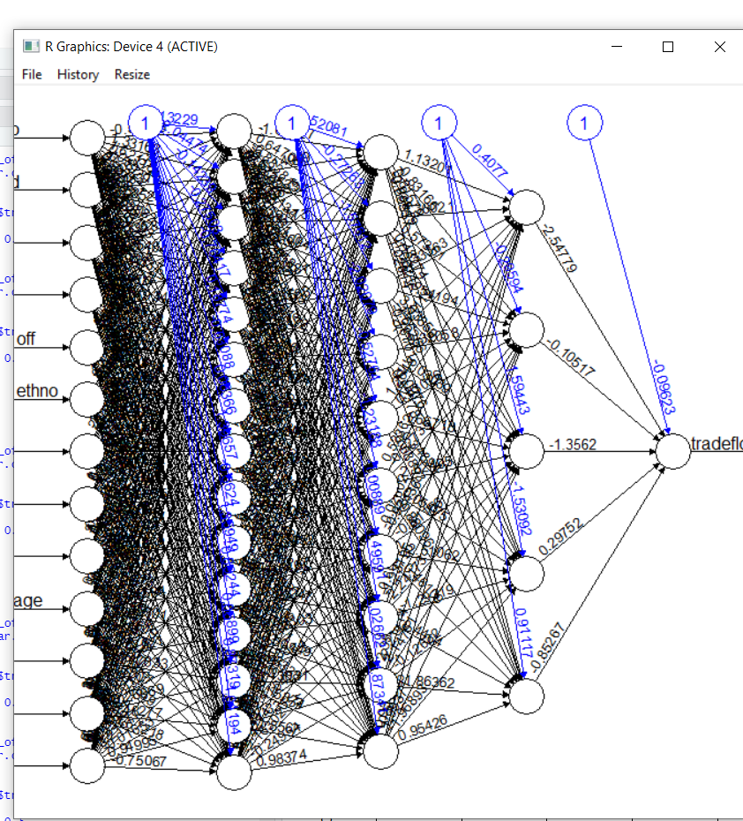
More Dense Network
Hidden Layer :- c(15,10,5)
Algorithm :- rprop+
Learning rate :- 0.01

Slide 27
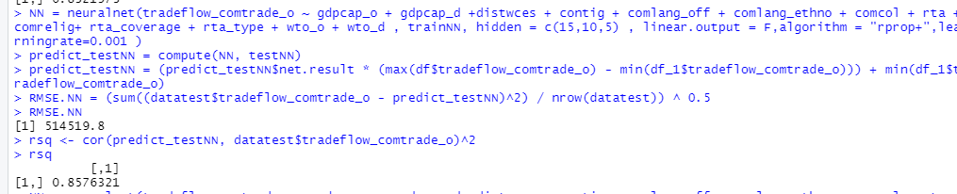
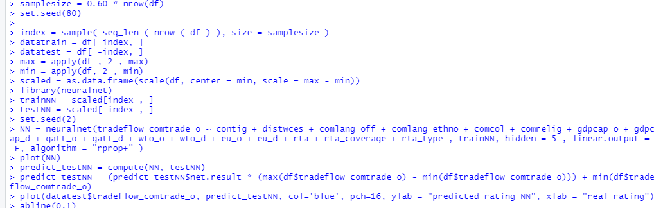
R sq value is 0.857 which clearly states that neural network is far more better than intuitive Gravity model
R code for Neural net using neural net package

Slide 28
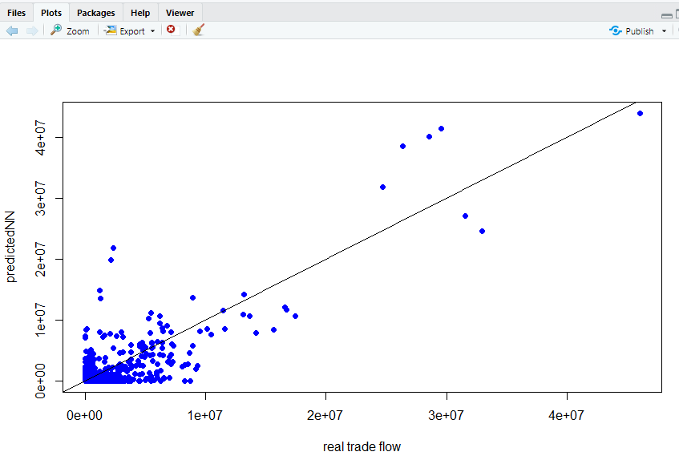
A line clearly fits the data.

Slide 29
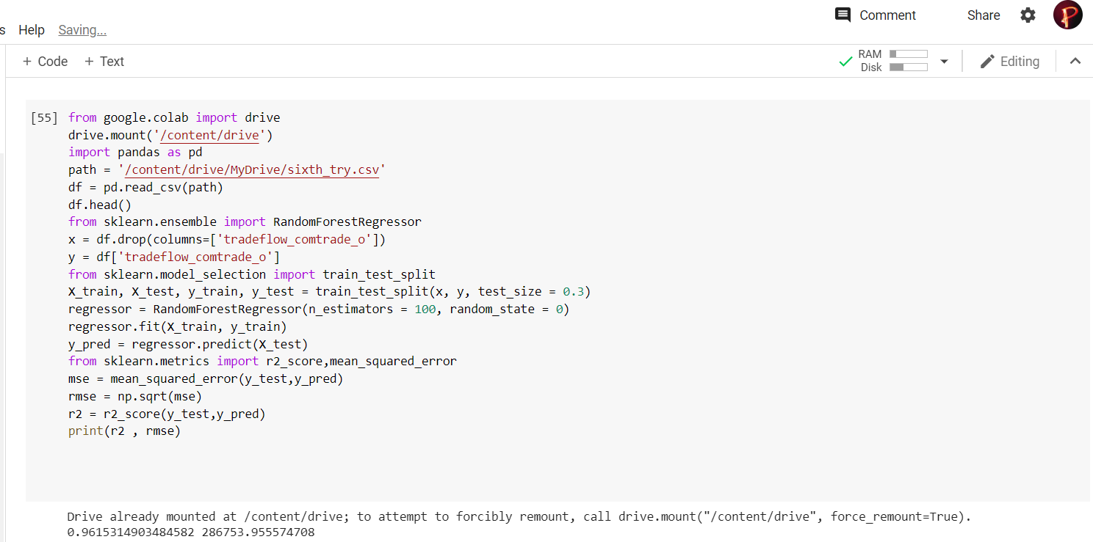
R square Value :- 0.96 . Far Better than Both Intuitive and Extended model.
Moreover better than Neural Network as well.

Slide 30
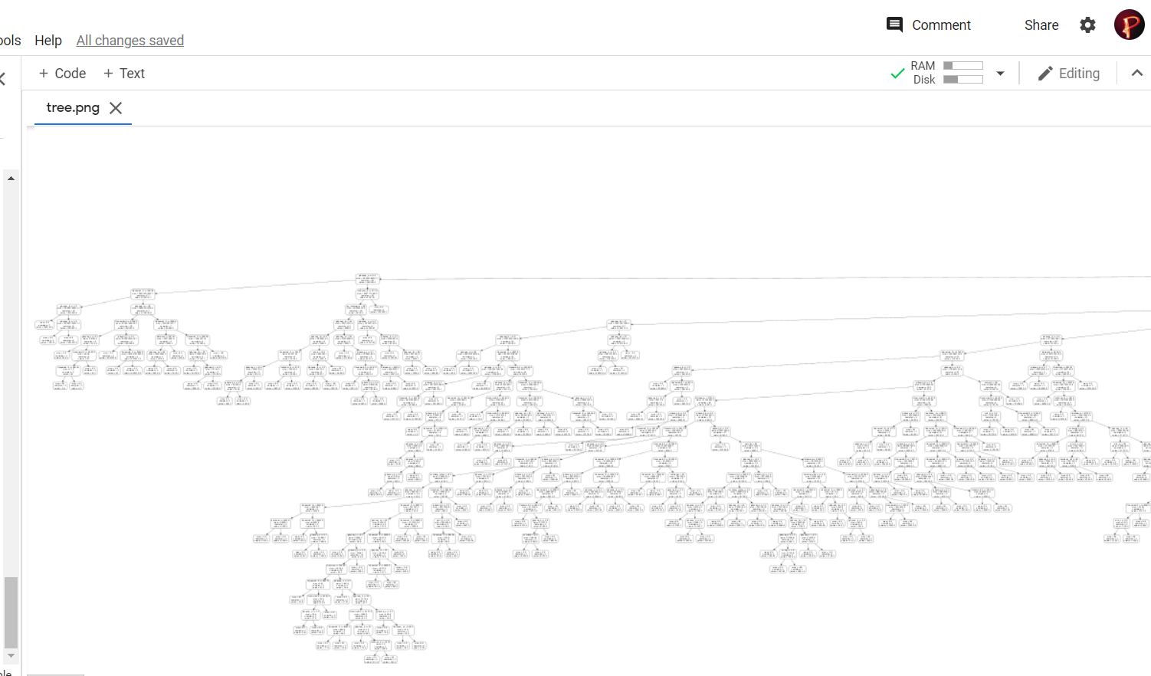
Depiction of the Tree

Slide 31
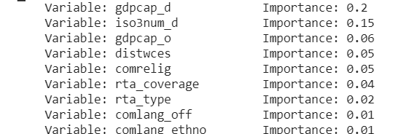
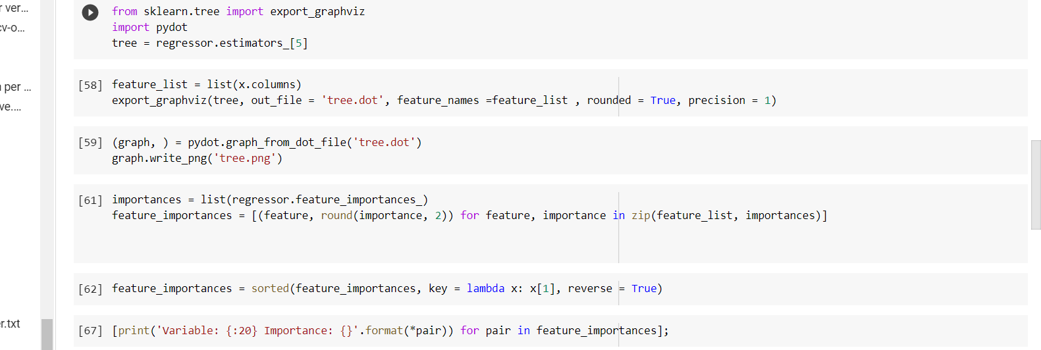
Variable Importance Table
Further Code
Of Random Forest Regression

Slide 32
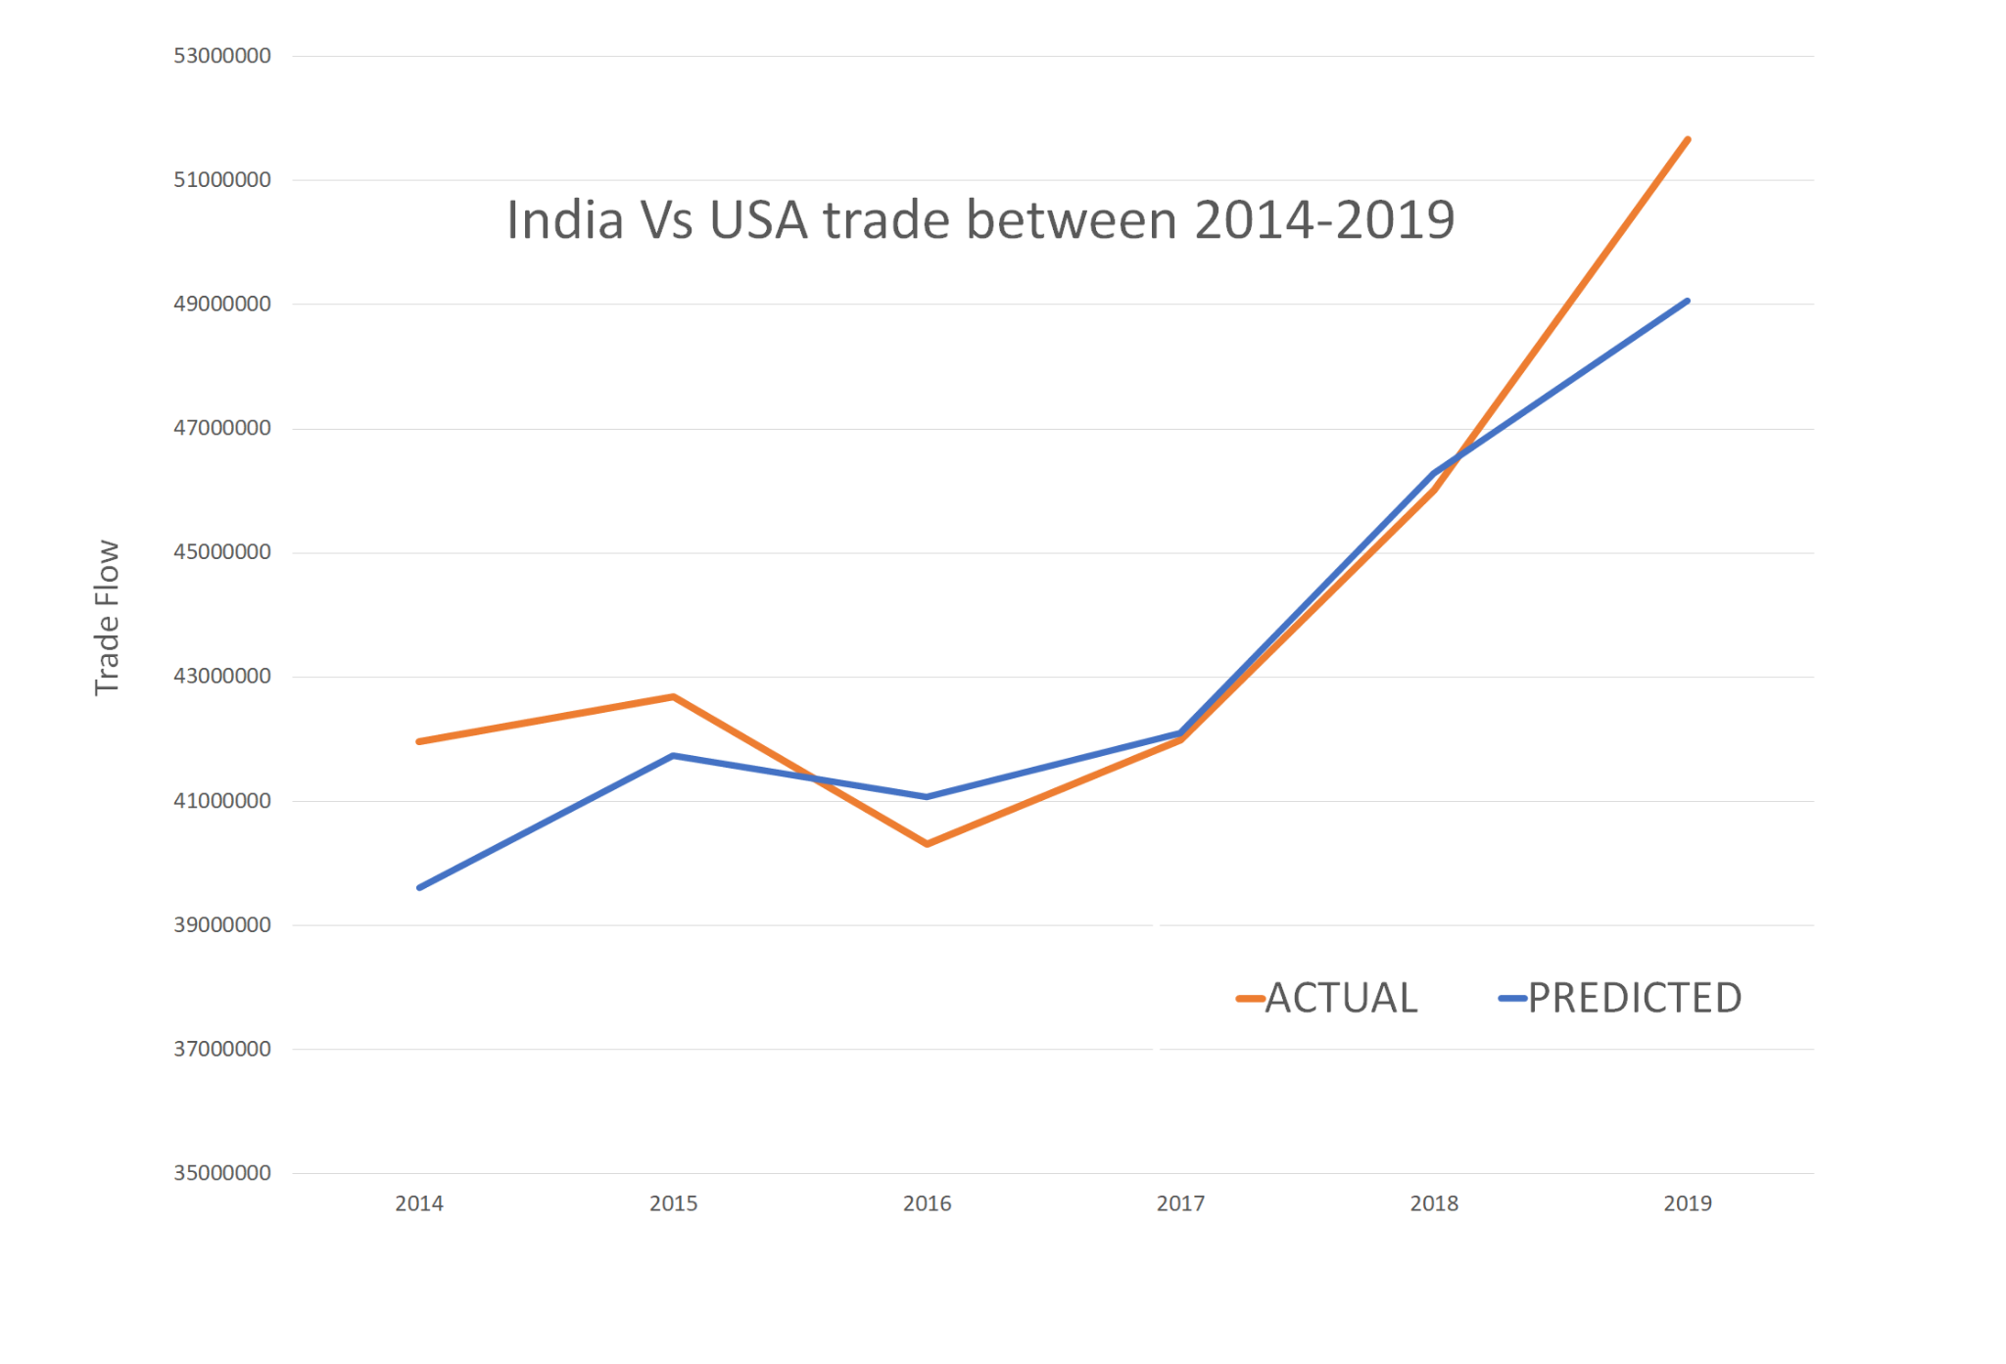

Slide 33
Conclusions

Slide 34
Neural networks have a high degree of accuracy in prediction compared to R-Square within the Gravity model.
Model’s explanatory power increased by using the Fixed effect model and it clearly underlines the importance of multilateral resistance terms.
PPML is more preferred to Other econometric methods.
Neural network RMSE is much lower than gravity ones which clearly indicates that in future we should move onto use the machine learning models for estimating international trade patterns as it helps in dealing with large datasets which have numerous interconnected variables
We saw that Intuitive Gravity Model is basic one which has R square value of 0.71. By applying fixed effect including multilateral terms we got to see R square value increased to 0.87.
We also applied new methods like PPML,NBPML,GPML and saw their results.
Finally we applied neural network and Random Forest Regression and we saw R square value to be more than intuitive Gravity Model which clearly states model is better.

Slide 35
This will be a useful aid to policymakers, analysts and firms engaged in the international trade business and provide impetus for all players in the industry to gauge the effects of this trade collaboration
This will be useful to policy makers and analysts and firms engaged of country who are involved in international trade to measure the effects of trade variables and improve their policies.
Factors like Common Border , language play a major role specifically for india in its trade and estimation of these trades using neural network model offers various ways in which country can measure its impact and possible sustainability of such partnership.
Importance of Machine learning algorithms increases as it helps in time of trade disruption for example Brexit case.
Both supervised and Unsupervised Algorithm provide useful insights and high degree of accuracy.

Slide 36
References
Base Paper: Neural Network Analysis of International Trade
Isaac Wohl and JIm Kennedy: Neural Network Analysis of International Trade
Bhattacharyya, R., Banerjee, T., 2006. Does the gravity model explain India’s direction of trade? A panel data approach. Working Paper No. 2006-09-01, Indian Institute of Management, Ahmadabad.
Anderson, J.E., 2011. The Gravity Model. Annual Review of Economics 3(1), 133-160.
Bhattacharya, S. K., 2004. Does Bangladesh benefit from preferential trade with India? a gravity analysis. Economic and Political Weekly 39 (48), 5152-5162.
Yotov, Y.V. A simple solution to the distance puzzle in international trade. Econ. Lett. 2012, 117, 794–798
Anderson, James and Eric van Wincoop. “Gravity with Gravitas: A Solution to the Border Puzzle.” American Economic Review, vol. 93, no. 1, March
Head, Keith and Thierry Mayer. “Gravity Equations: Workhorse, Toolkit, and Cookbook.” CEPII Working Paper, September 2013
Anderson, J. 1979. “A Theoretical Foundation for the Gravity Model.” American Economic Review, 69(1): 106-116

Slide 37
Datasets
https://data.imf.org/?sk=9d6028d4-f14a-464c-a2f2-59b2cd424b85&sId=1390030341854
https://data.worldbank.org/
https://commerce.gov.in/
http://www.cepii.fr/cepii/en/bdd_modele/bdd.asp
https://kof.ethz.ch/en/forecasts-and-indicators/indicators/kof-globalisation-index.html

Slide 38
Thank You

