Slide 1
Advanced Topics in Software Engineering(CSE 6324) Fall 2022

Slide 2
Team 4
Atul Upadhye
Kundana Vaka
Yamini Dhulipalla
Srikar Sai Yarlagadda
Vigneshwar Selvaraj

Slide 3

Improvements to Existing tools for Analyzing Smart Contracts

Slide 4
Agenda
Current tools / Competitors
Features
Improvements
Risks
Customers and Users
References

Slide 5
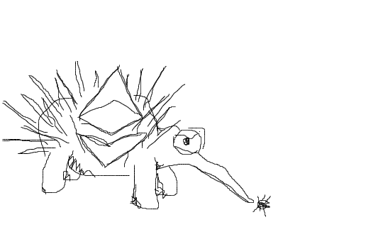

Current Tools/ Competitors
Manticore
Echidna

Slide 6
Echidna Features
Generates inputs tailored to your actual code.
Optional corpus collection, mutation and coverage guidance to find deeper bugs.
Source code integration to identify which lines are covered after the fuzzing campaign.
Automatic test case minimization for quick triage.

Slide 7
Improvements
Introduce more automation.
Improve upon code coverage.
Improving the inputs based on our program.

Slide 8
Risks
Online resources i.e. documents and community support are still limited.
Unaddressed security vulnerabilities can turn into existential threats.
Limitations of the existing tool.

Slide 9
Customers and Users
Smart contract auditors from the following domains can perform audits whenever requested.
* Finance , Gaming, Healthcare, Real estate etc;

Slide 10
References
C, C. (n.d.). GitHub - crytic/echidna: Ethereum smart contract fuzzer. GitHub. Retrieved September 12, 2022, from https://github.com/crytic/echidna
T, T. (n.d.). GitHub - trailofbits/manticore: Symbolic execution tool. GitHub. Retrieved September 12, 2022, from https://github.com/trailofbits/manticore

Slide 11
Github
https://github.com/AtulUpadhye17/CSE-6324-Team4

Slide 12


