Slide 1
Footwear Shop Inventory Management System
Atul verma

Slide 2
1 Introduction
“Footwear Shop Inventory Management System” app is a software application that helps a footwear shop owner to manage inventory and create bills (for customers). This application also gives report such as monthly profit and soled product count etc.

Slide 3
Software Requirements:
This software only works on windows pc with windows version 10 and above.
(Tested on windows 10 and 11)
For this app to work Oracle database 10g XE and Microsoft Dot Net Core 6 (long term support) must be installed in the system.

Slide 4
Hardware Requirements:
At least 15Mb of secondary storage is required. (Oracle Database and Dot Net 6 take storage separately.)
At least 15Mb of free RAM is required for. (Oracle Database and Dot Net 6 take RAM separately.)

Slide 5
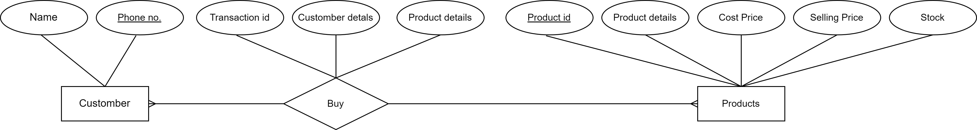
E-R Diagram

Slide 6
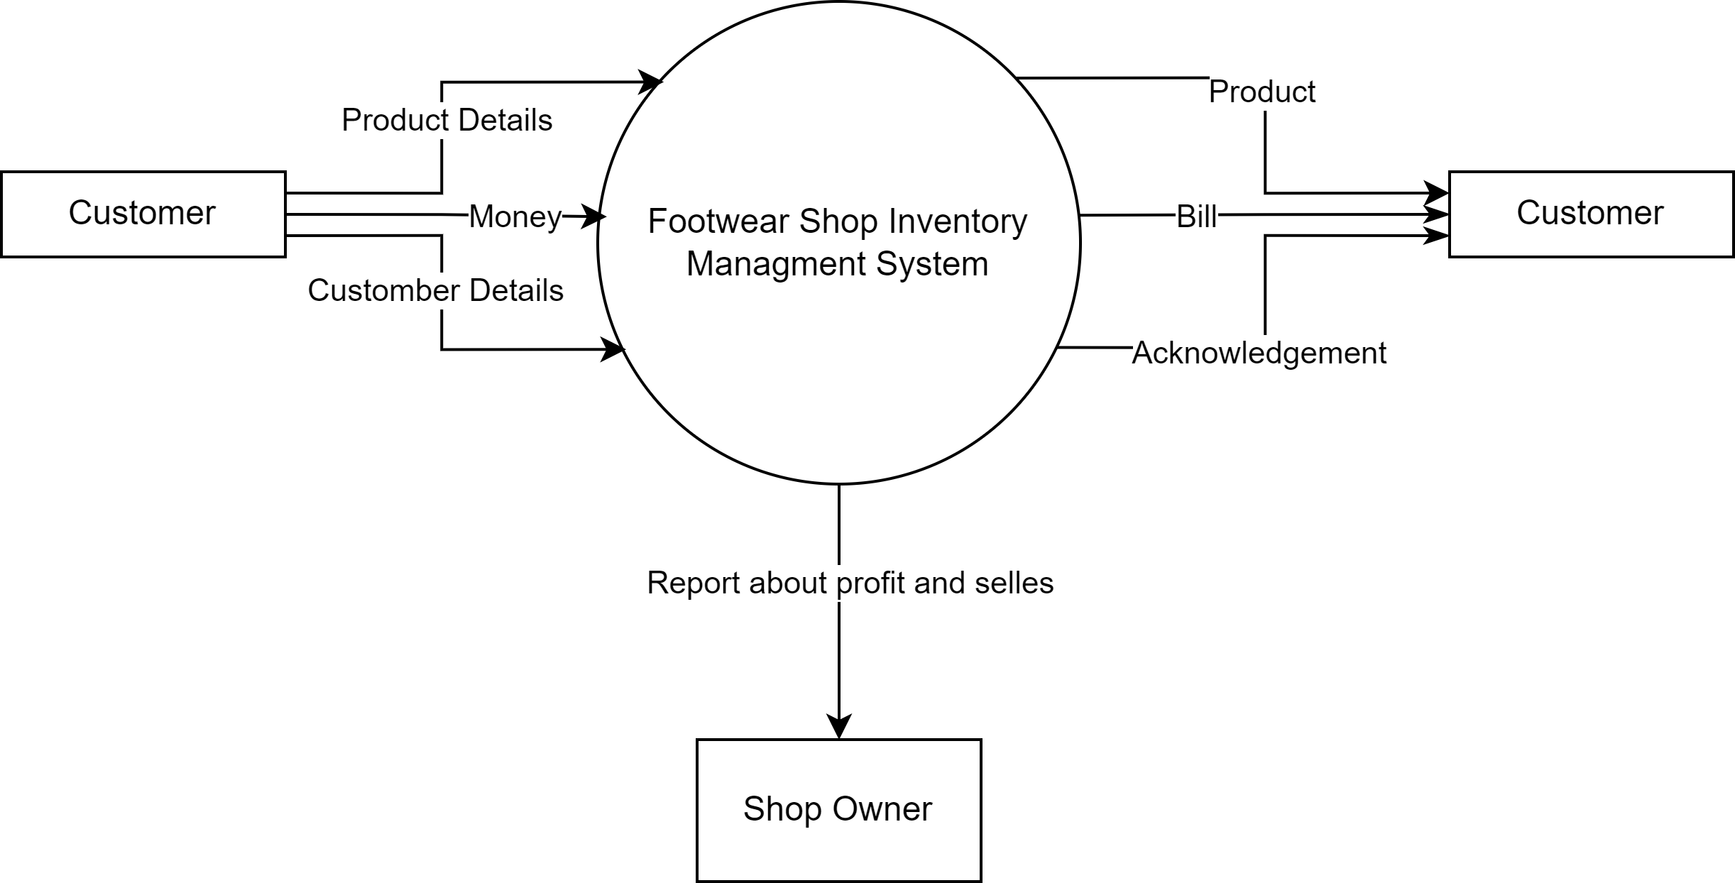
Data Flow Diagram: Level 0

Slide 7
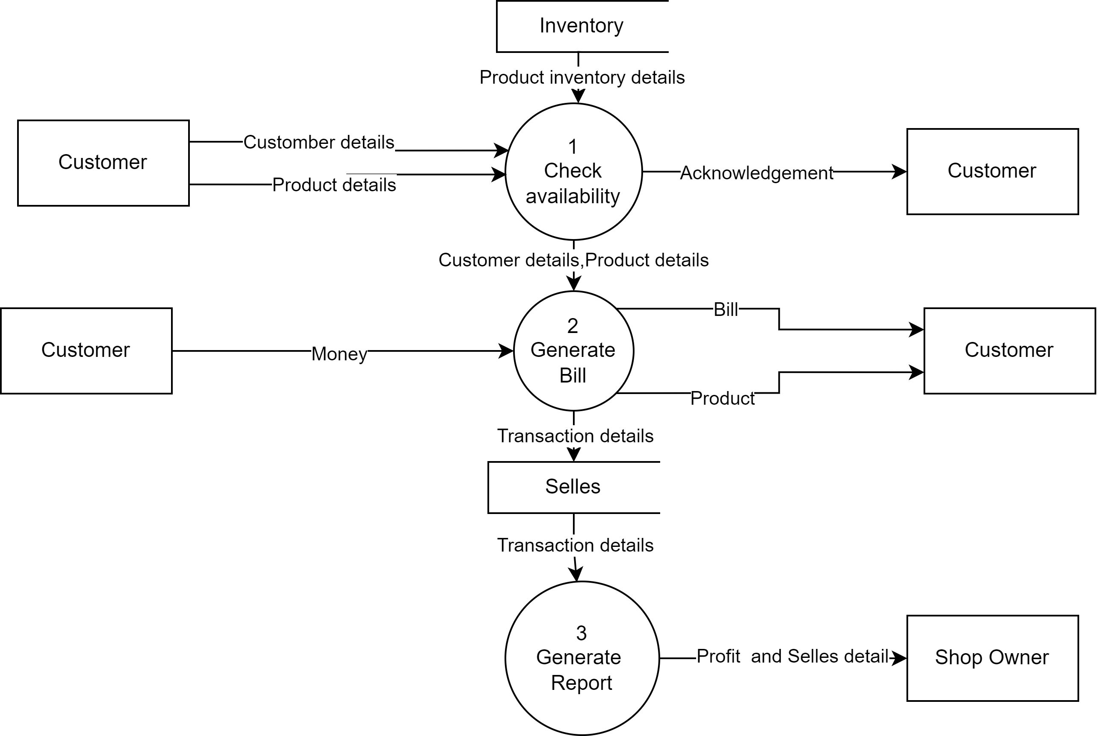
Data Flow Diagram: Level 1

Slide 8
Graphical User Interface
Images

Slide 9
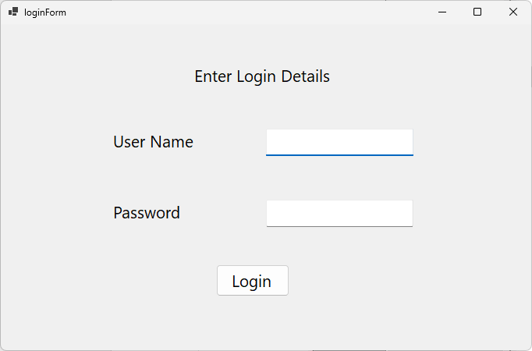

Slide 10
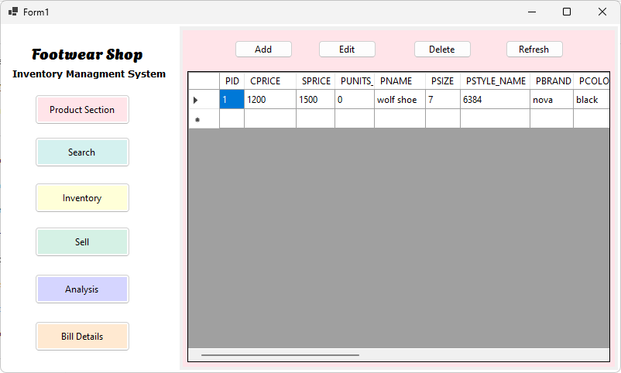

Slide 11
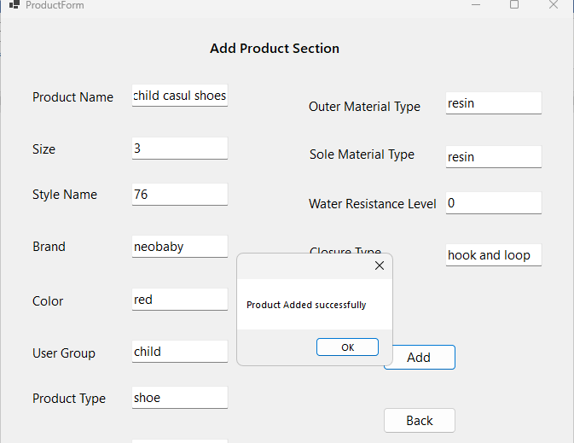

Slide 12
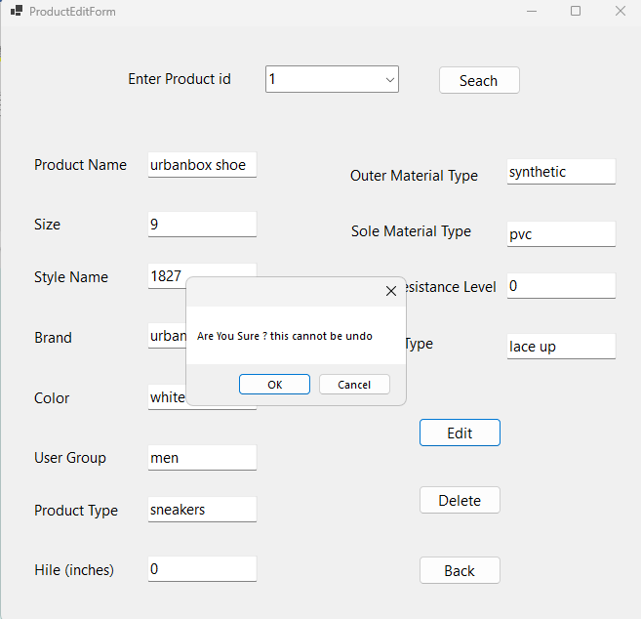

Slide 13
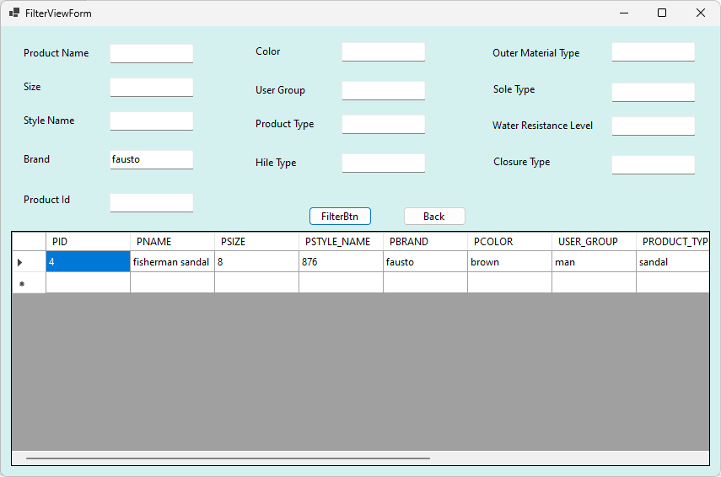

Slide 14
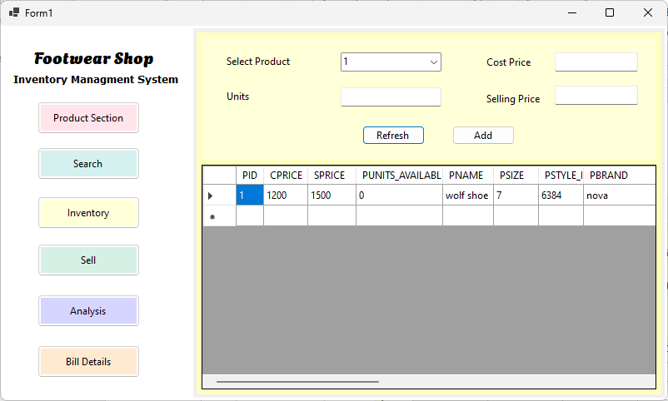

Slide 15
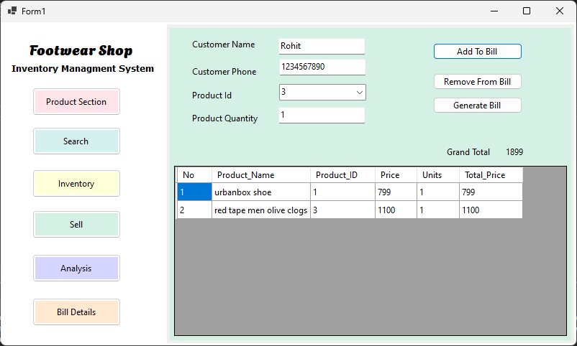

Slide 16
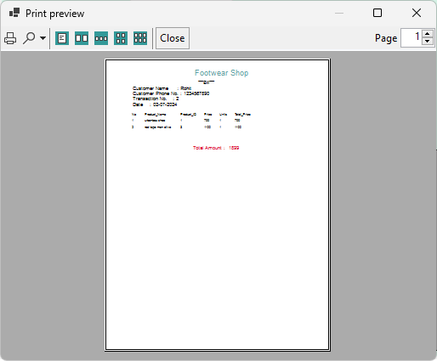

Slide 17
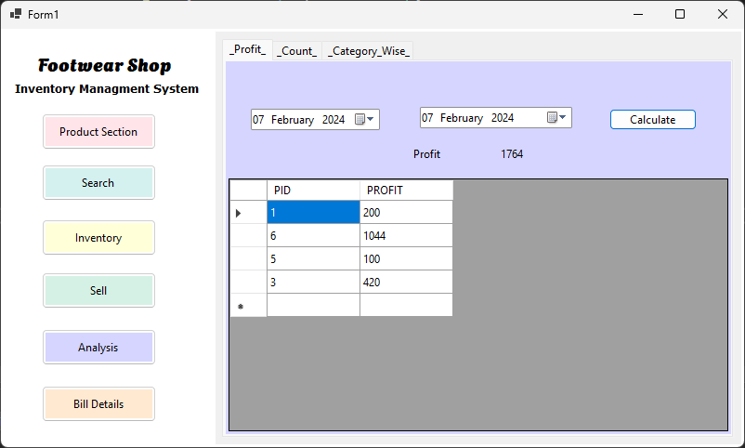

Slide 18
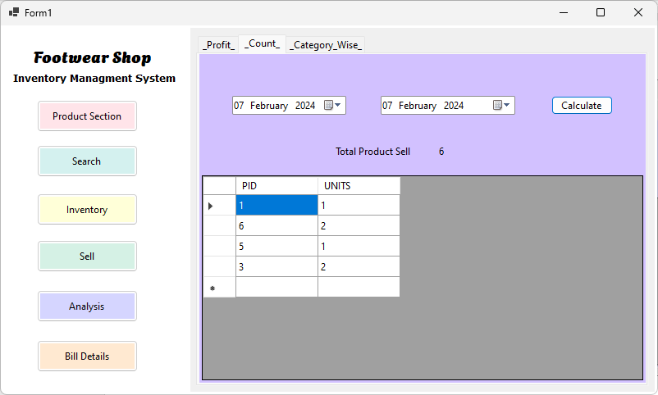

Slide 19
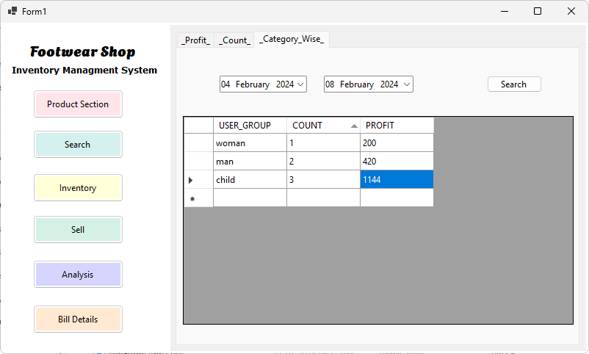

Slide 20
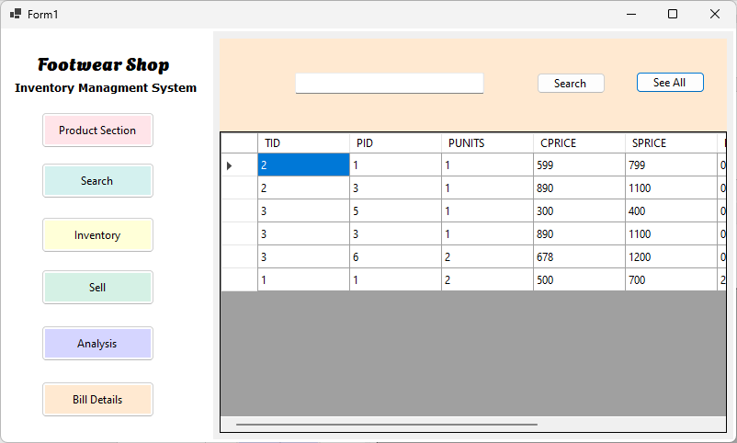

Slide 21
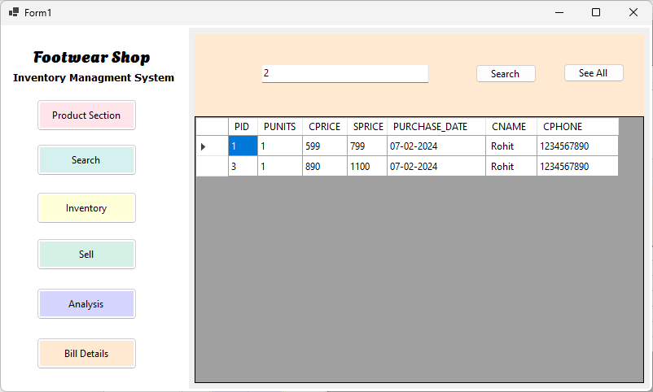

Slide 22
Thank You

