Slide 1
Healthy Eating Application System Implementation Overview
Rashna Razdan
Atulan Zaman Deep
Kevin Lee
Nadeem Ahmad

Slide 2
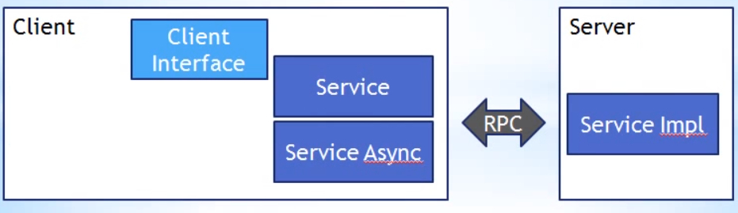
System Overview
System Scope

Slide 3
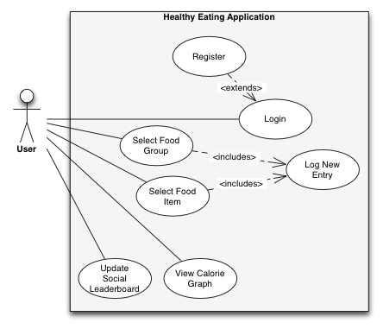
Key Use Cases

Slide 4
Underlying Technical Complexity
Remote Procedure to communicate with MySQL database
BCrypt framework
Facebook API
Google Web Toolkit Visualizations API
Google Web Tookit Framework
Notes:
Using asynchronous callback with Remote Procedure Call providers to communicate with the MySQL database
Use BCrypt framework for secure login authentication
Used Facebook API to connect to and retrieve user information from Facebook
Used Google Web Toolkit visualizations API to create interactive chart

Slide 5
Implementation Process
Process and Tools
Use Case → Class
Used GWT
Eclipse
SQL Workbench
____________________________________________________________________________
Accomplishments {see use cases}
Further Improvements
Notes:
Map use cases to classes in most cases

Slide 6
Subsystem Design
Important subsystems:
Login Management (includes session management)
Social Media Management
User Interface
Login <<component>>
Food Log <<component>>
Calorie Graph <<component>>
Leader Board <<component>>
Healthy Eating Application Database
More information about components in following slide
Notes:
Indicated how important subsystems were implemented in code using code examples

Slide 7
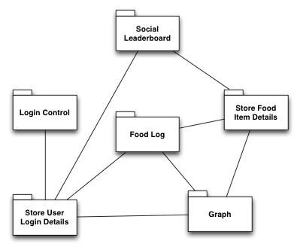
Connectors Between Components
Notes:
Explained how the important connectors between components were implemented and used using code examples

Slide 8
Control Flow Implementation
Notes:
Described how the important modules for control flow, such as modules that manage base processes, were implemented using code examples Explained how the boundary use cases, such as system initialization, termination, and failure, were implemented using code examples

