Slide 1
Healthy Eating Application System Implementation Overview
Rashna Razdan
Atulan Zaman Deep
Kevin Lee
Nadeem Ahmad

Slide 2
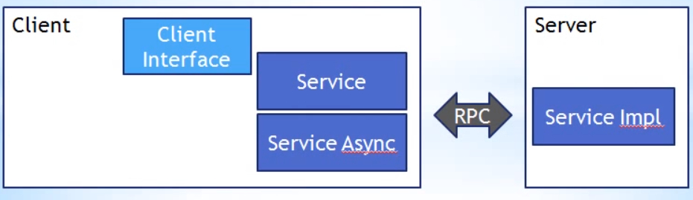
System Overview
System Scope
Notes:
Has three options within the application, limited to data items in the database although the database has more than 3000 data entries consisting of a wide variety of food groups. Additionally to use certain features of the application the user must have a facebook account already in place.
In terms of design architecture the architectural scope is client server.

Slide 3
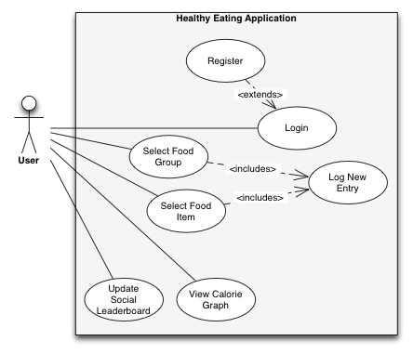
Key Use Cases

Slide 4
Underlying Technical Complexity
Remote Procedure to communicate with MySQL database
BCrypt framework
Facebook API
Google Web Toolkit Visualizations API
Google Web Tookit Framework
Notes:
Using asynchronous callback with Remote Procedure Call providers to communicate with the MySQL database
Use BCrypt framework for secure login authentication
Used Facebook API to connect to and retrieve user information from Facebook
Used Google Web Toolkit visualizations API to create interactive chart

Slide 5
Implementation Process
Process and Tools
Use Case → Class
Used GWT
Eclipse
SQL Workbench
____________________________________________________________________________
Accomplishments {see use cases}
Further Improvements
Notes:
Map use cases to classes in most cases

Slide 6
Subsystem Design
Important subsystems:
Login Management (includes session management)
Social Media Management
User Interface
Login <<component>>
Food Log <<component>>
Calorie Graph <<component>>
Leader Board <<component>>
Healthy Eating Application Database
More information about components in following slide
Notes:
Indicated how important subsystems were implemented in code using code examples

Slide 7
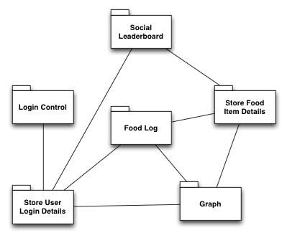
Connectors Between Components
Notes:
Explained how the important connectors between components were implemented and used using code examples

Slide 8
Control Flow Implementation
Notes:
Described how the important modules for control flow, such as modules that manage base processes, were implemented using code examples Explained how the boundary use cases, such as system initialization, termination, and failure, were implemented using code examples

Slide 9
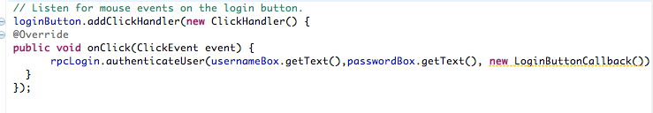
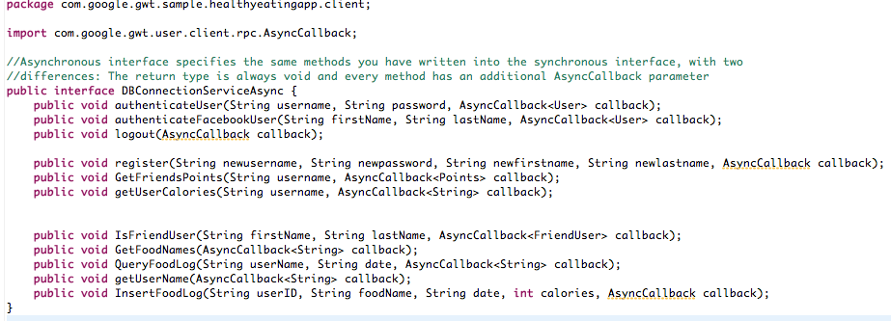
Notable Code Example (1 contd)
The code above gives an example of the RPC call mechanism used to communicate with the server. The Facade design pattern was used to communicate with the server. An interface for all methods that talked to the server was created as shown below.

Slide 10
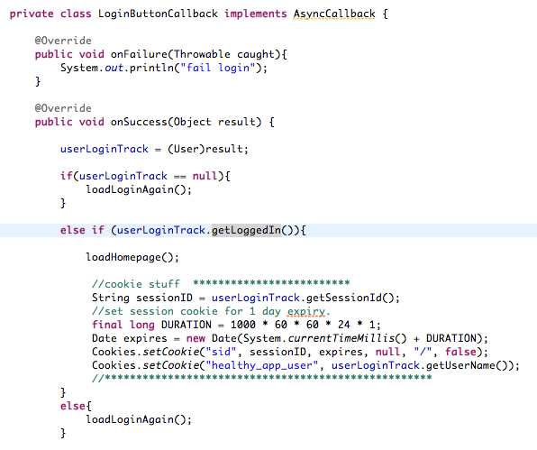
Notable Code Example (1 cont.)
Every RPC Callback had an OnFailure() and an OnSuccess() method in order to seamlessly handle any unexpected and boundary cases that might cause errors while running server side code
Notes:
Example of asynchronous RMPS callback

Slide 11
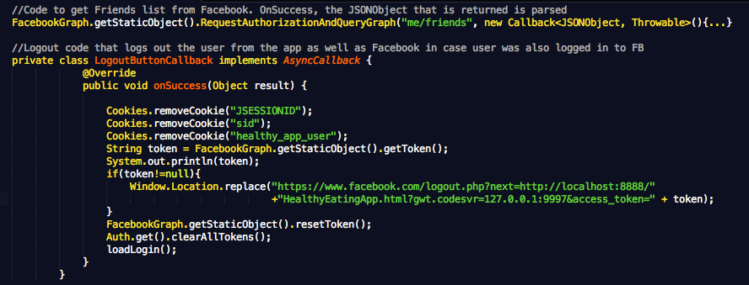
Notable Code Example (2)
The code below highlights one of the application’s ‘novel’ features: social media integration.
Code that ‘re-paints’ the graph every time a food item is inserted into Food Log. onLoadCallBack Runnable is called at every onSuccess for InsertFoodLog async method call
Code to get Friends list from Facebook. OnSuccess(), the JSONObject that is returned is parsed

Slide 12
Main Design Patterns Used
Composite (for widget creation)
Singleton (for RootLayoutPanel)
Facade (for server side method invocation)

Slide 13
Nonfunctional Requirements
Robustness
OnFailure() and OnSuccess() methods implemented for every RPC call
Error checking and prevention of duplicate registered users [see register() and authenticateUser() in DBConnectionServiceImpl.java]
Passwords stored in hashed format via Bcrypt framework
Performance
Asynchronous callbacks used in order to communicate with the server
Portability
GWT produces cross browser compatible

