Slide 1
Introduction to MHDL
Asif, Atulan, Ming, Tandra

Slide 2
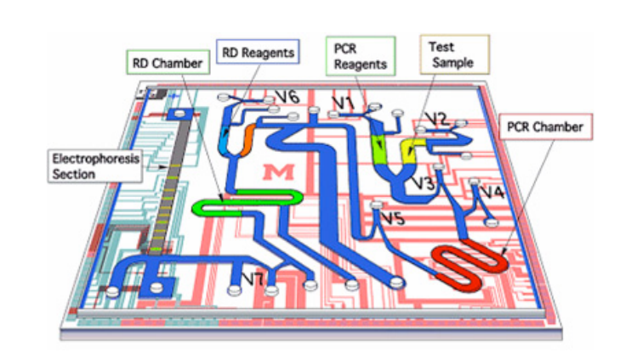
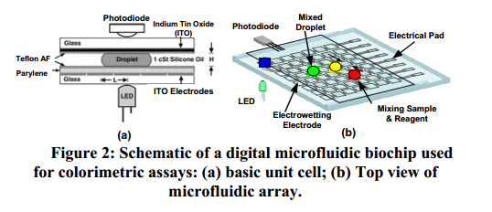
MHDL
-Hardware Description Language
-Domain-Specific Language

Slide 3
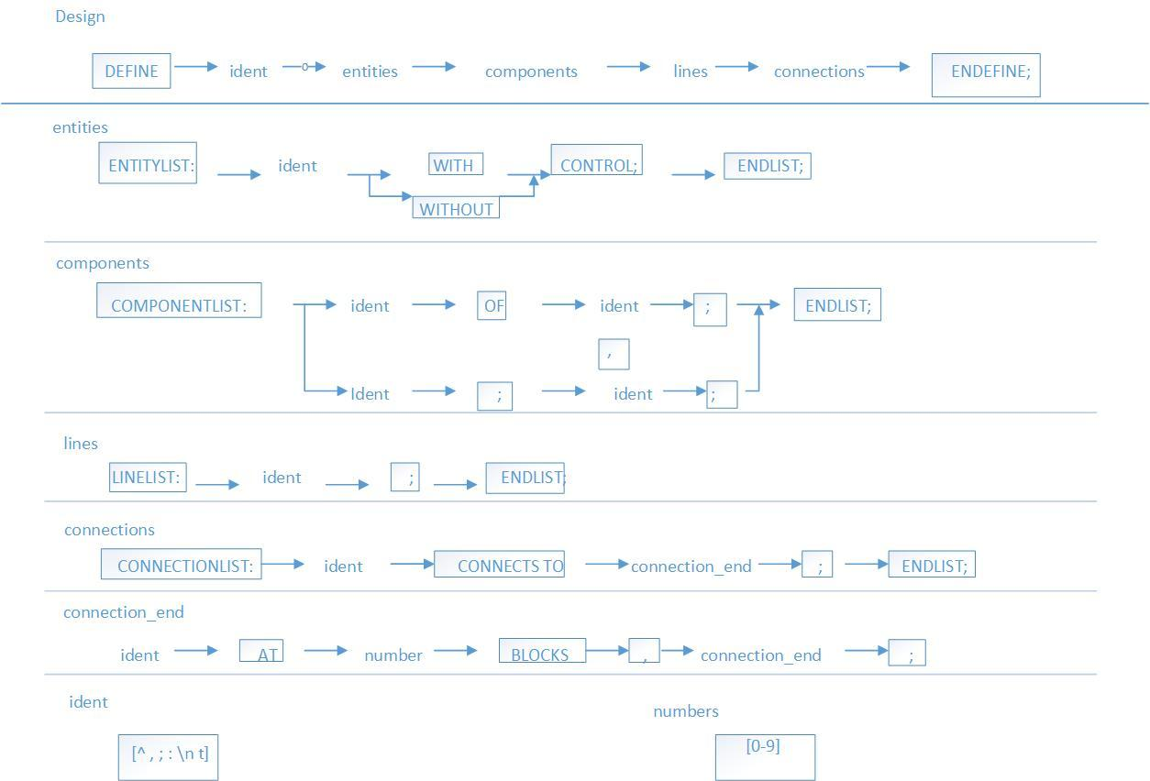
CHEAT-SHEET

Slide 4
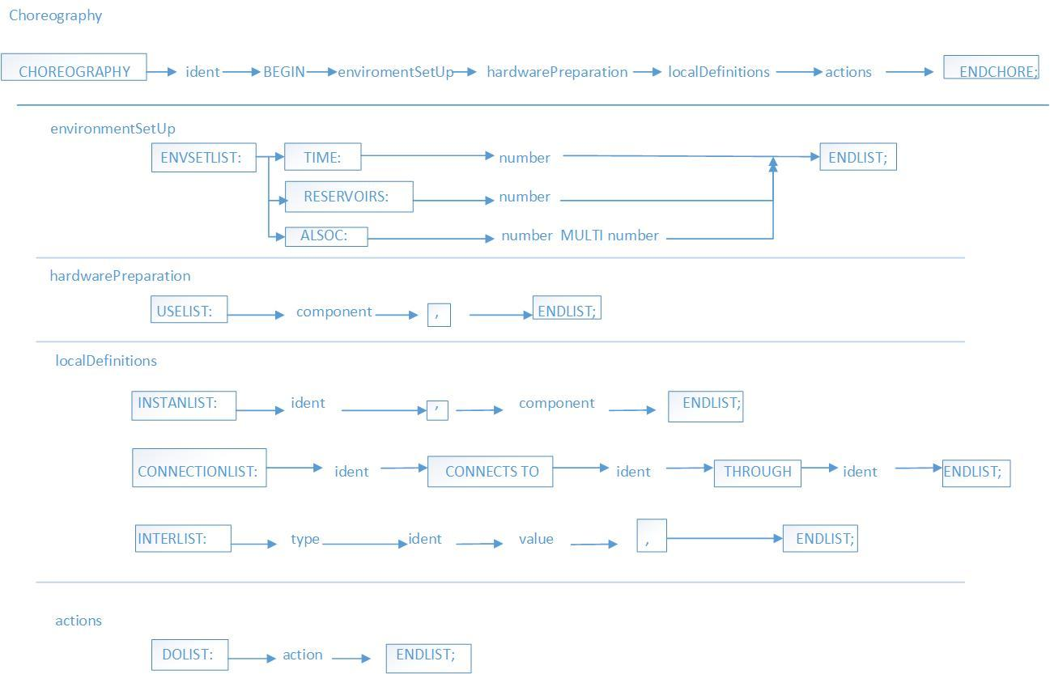
CHEAT-SHEET(cont.1)

Slide 5
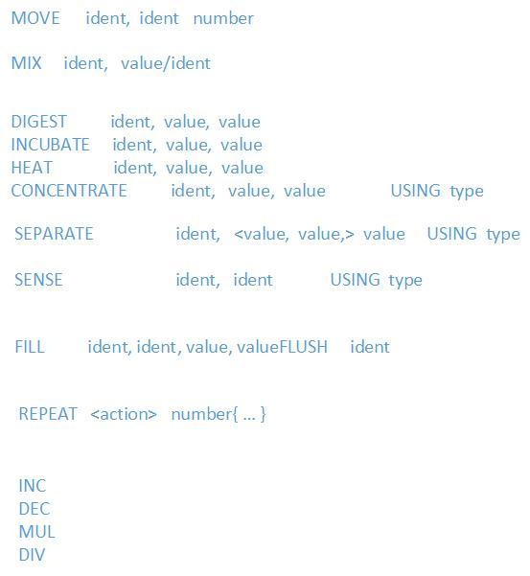
CHEAT-SHEET(cont.2)

Slide 6
EXAMPLE
DEFINE flu_diagnoses:
ENTITYLIST:
storage without control;
valve with control;
mixer with control;
electrophoresis with control;
PCR with control;
RDR with control;
Exhaust with control;
ENDLIST;
COMPONENT LIST:
valve: V1,V2,V3,V4,V5,V6,V7,A4,A6,B2,RDvalve;
PCR_chamber of PCR: RD_chamber of RDR;
Electrophoresis_section of electrophoresis;
B3 of exhaust;
Storage: L1,L2,L3,PCR_product,B1B4;
ENDLIST;

Slide 7
EXAMPLE(cont.1)
CONNECTION LIST:
L1 connects to V1 at 10 blocks;
V1 connects to V3 at 100 blocks;
L2 connects to V2 at 10 blocks;
V2 connects to V3 at 120 blocks;
V3 connects to V4 at 40 blocks;
V4 connects to PCR_chamber at 40 blocks;
PCR_chamber connects to V5 at 40 blocks;
V5 connects to A4 at 110 blocks;
A4 connects to PCR_product at 10 blocks;
PCR_product connects to A6 at 10 blocks;
A6 connects to RDvalve at 50 blocks;
L3 connects to V6 at 10 blocks;
V6 connects to RDvalve at 100 blocks;
RDvalve connects to RD_chamber at 10 blocks;
RD_chamber connects to V7 at 30 blocks;
V7 connects to B1 at 10 blocks;
B1 connects to B2 at 20 blocks;
B2 connects to electrophoresis_section at 10 blocks;
electrophoresis_section connects to B4 at 10 blocks;
B2 connects to B3 at 10 blocks;
ENDLIST;
ENDDEFINE;

Slide 8
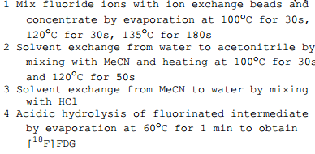
EXAMPLE(cont.2)
Imaging-Probe-Synthesis

Slide 9
EXAMPLE(cont.3)
CHOREOGRAPHY Imaging-Probe-Synthesis BEGIN
ENVSETLIST:
TIME:548
RESERVOIRS:4
ALSOC: 1.3 * 0.9
ENDLIST;
USELIST:
mixer,
heater,
INPUT port ip1,
INPUT port ip2,
INPUT port ip3,
INPUT port ip4,
ENDLIST;
INSTANLIST:
s1, ip1,
s2, ip2,
s3, ip3,
s4, ip4,
heater1, heater,
mixer1, mixer,
ENDLIST;

Slide 10
EXAMPLE(cont.4)
DOLIST:
MOVE mixer1, s1
MOVE mixer1, s2
MIX mixer1, 30
MOVE heater1, mixer1
CONCENTRATE heater1, 100, 30 USING EV
CONCENTRATE heater1, 120, 30 USING EV
CONCENTRATE heater1, 135, 180 USING EV
MOVE mixer1, s3
MOVE mixer1, heater1
MIX mixer1, 30
MOVE heater1, mixer1
INCUBATE heater1, 100, 30
INCUBATE heater1, 120, 50
MOVE mixer1, heater1
MOVE mixer1, s4
MIX mixer1, 60
MOVE heater1, mixer1
CONCENTRATE heater1, 60, 60 USING EV
ENDLIST;
ENDCHORE;

