Slide 1
TaxSphere
India
Admin & Employee
Workflow Guide
Internal compliance operations | Current desktop MVP

Slide 2
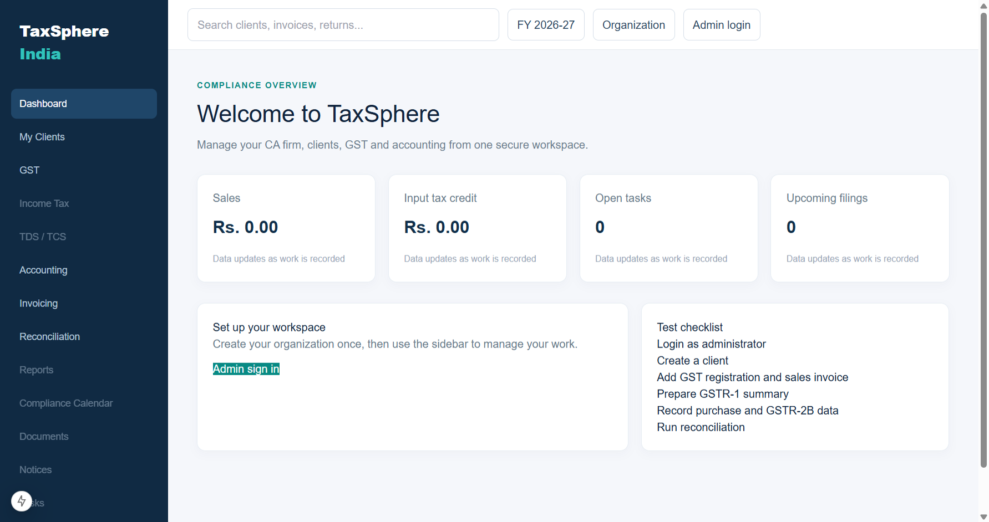
SCREEN WALKTHROUGH
Step 1: Dashboard
Login ke baad yahi main screen open hoti hai. Sidebar se working module select karein.
TaxSphere India | Internal admin and employee training

Slide 3
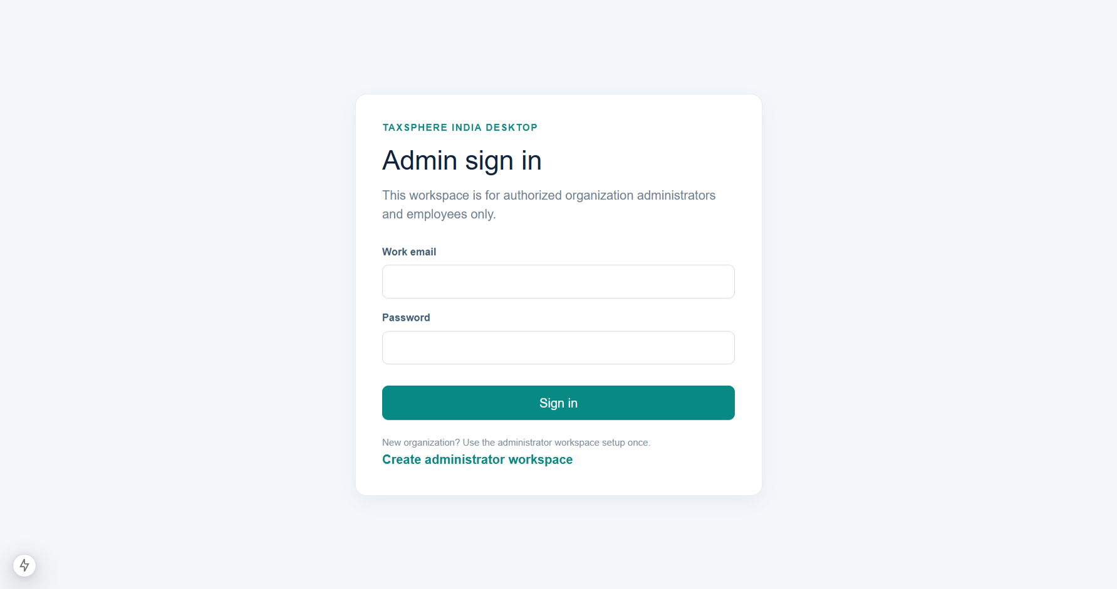
SCREEN WALKTHROUGH
Step 2: Admin Login
Existing admin or employee approved work email aur password enter karta hai.
TaxSphere India | Internal admin and employee training

Slide 4
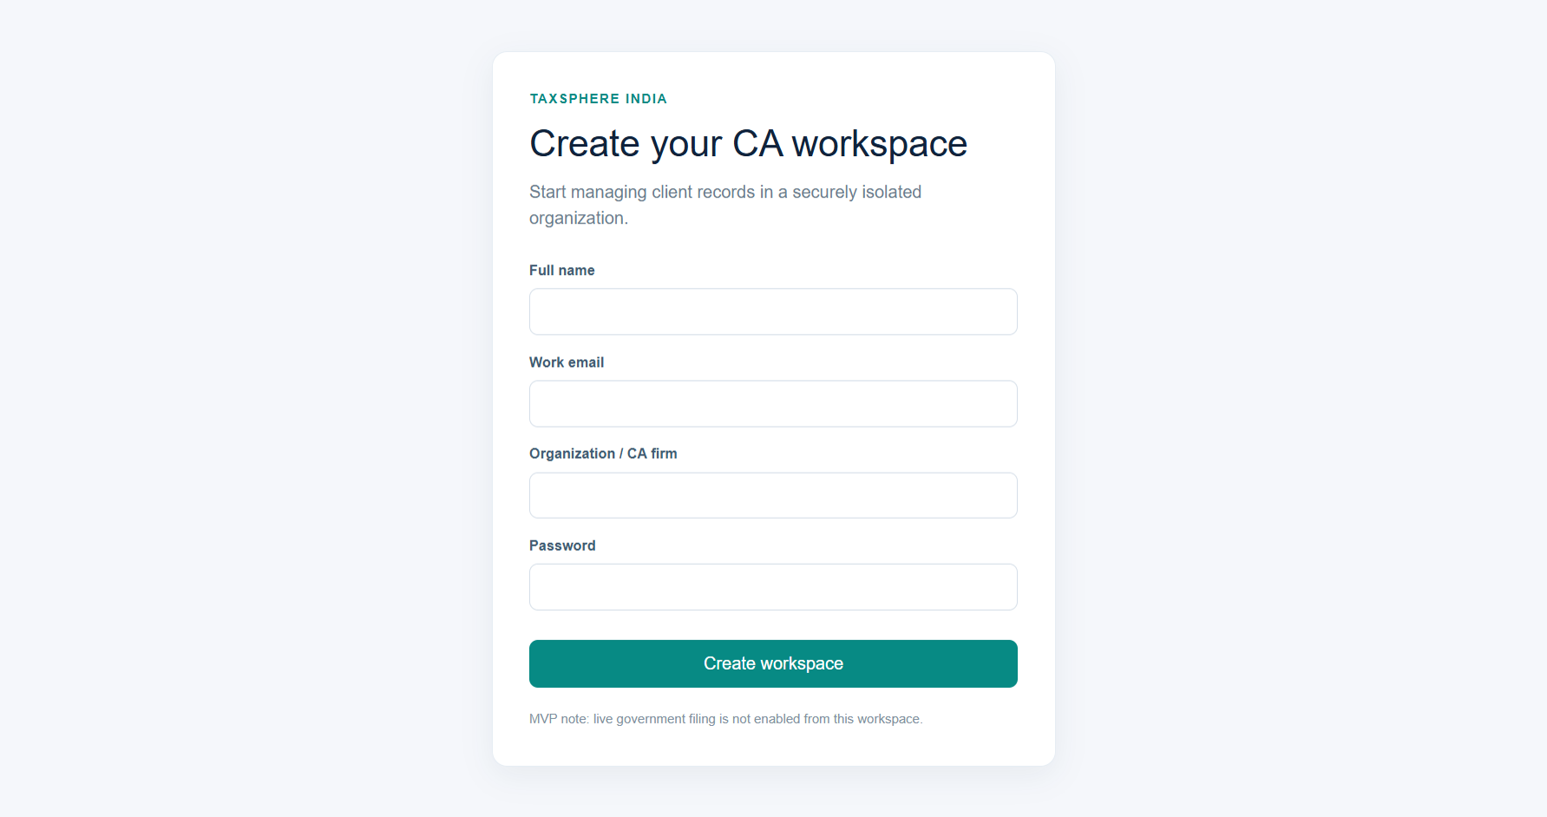
SCREEN WALKTHROUGH
Step 3: Create Workspace
First-time only: Admin ID, organization/CA firm aur password create karein.
TaxSphere India | Internal admin and employee training

Slide 5
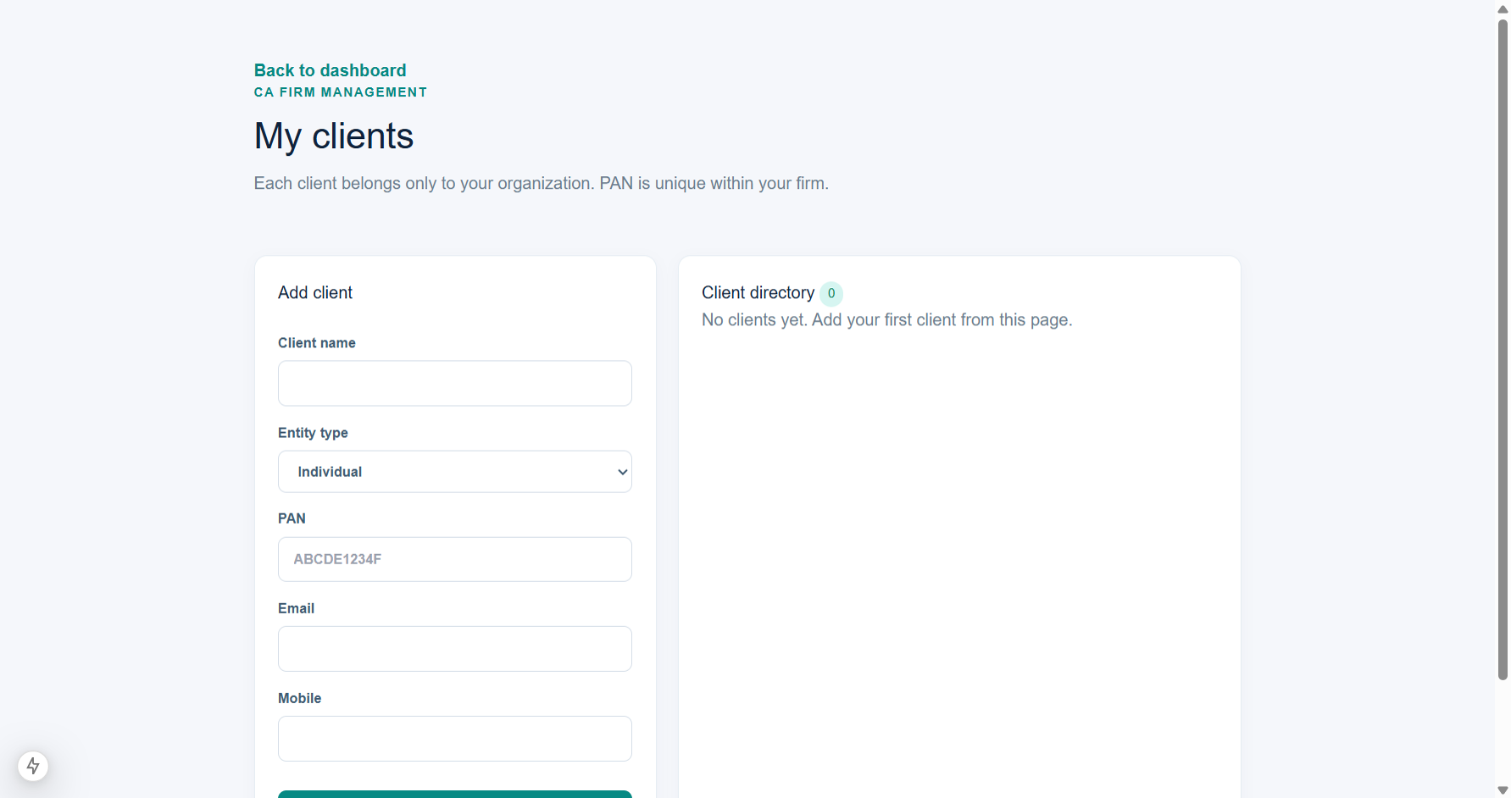
SCREEN WALKTHROUGH
Step 4: My Clients
Client ka legal name, entity type, PAN aur contact details save karein.
TaxSphere India | Internal admin and employee training

Slide 6
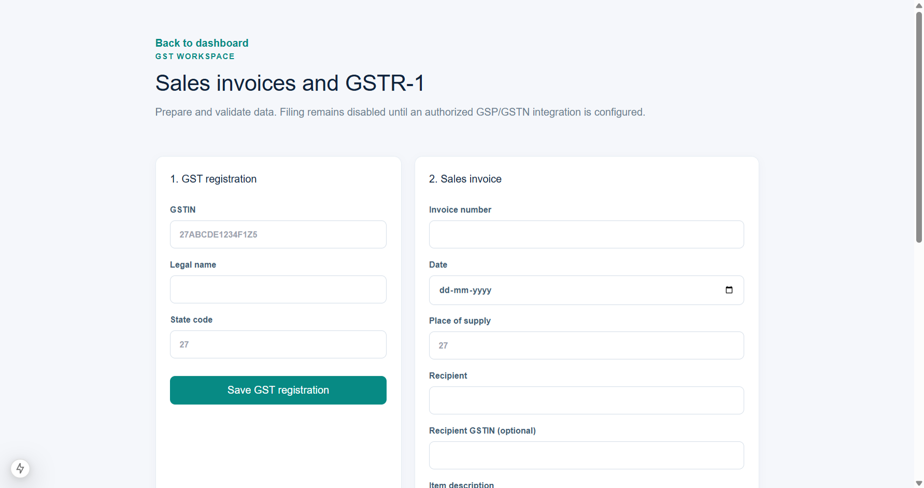
SCREEN WALKTHROUGH
Step 5: GST Workspace
GSTIN add karein, sales invoice validate karein aur prepared GSTR-1 summary dekhein.
TaxSphere India | Internal admin and employee training

Slide 7
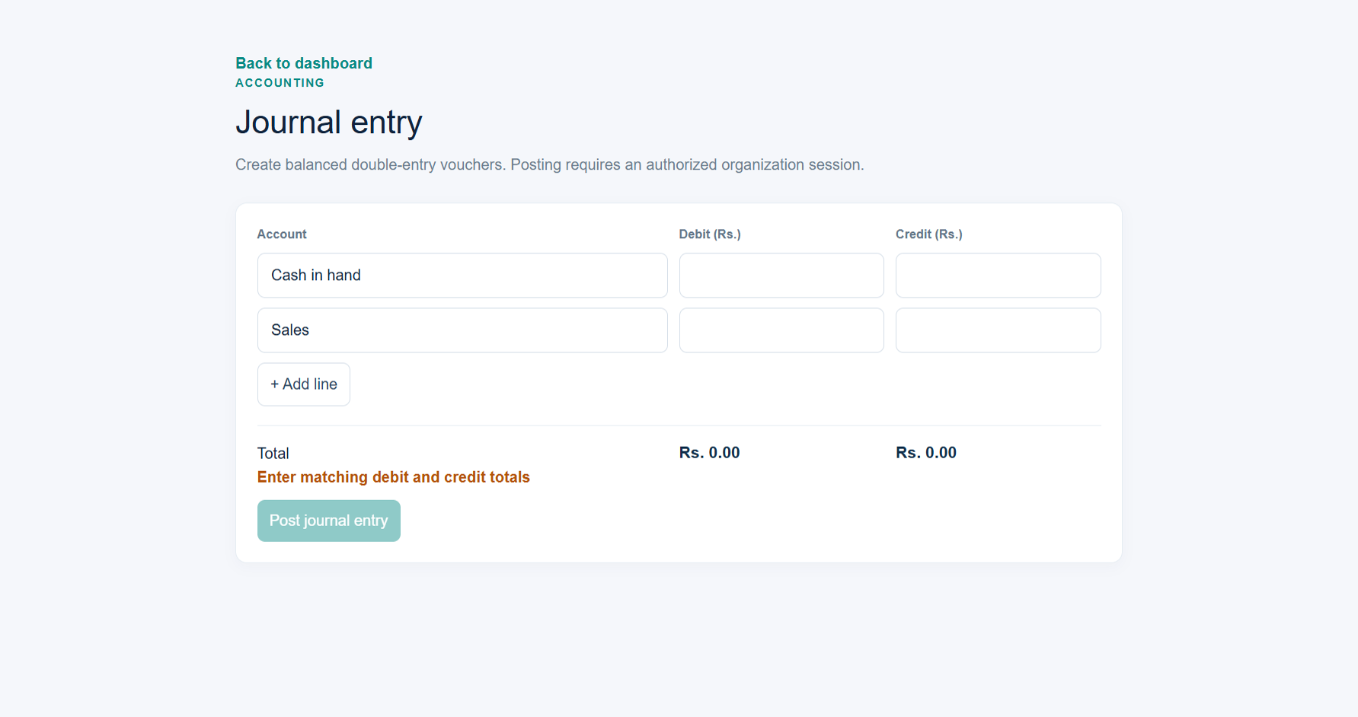
SCREEN WALKTHROUGH
Step 6: Accounting
Debit aur credit lines add karke balanced journal voucher prepare karein.
TaxSphere India | Internal admin and employee training

Slide 8
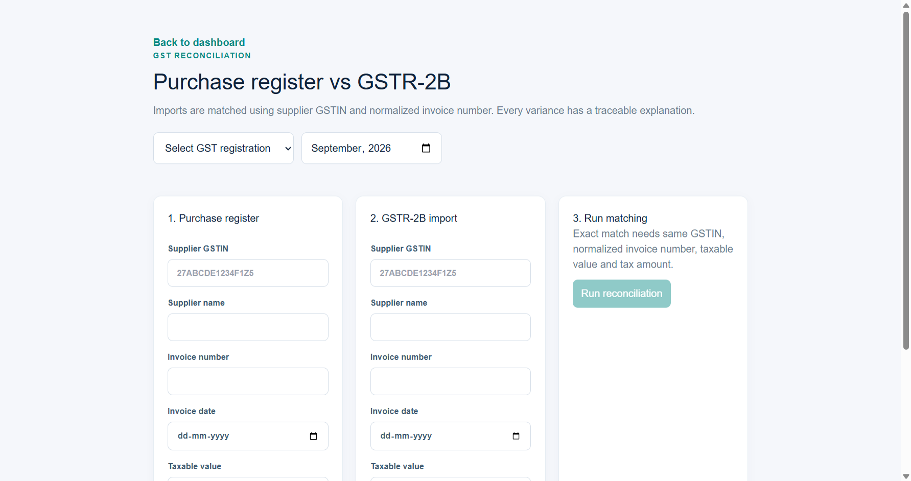
SCREEN WALKTHROUGH
Step 7: Reconciliation
Purchase register aur GSTR-2B data match karke result aur explanation review karein.
TaxSphere India | Internal admin and employee training

Slide 9
OVERVIEW
Application purpose
Internal desktop workspace for your organization’s GST, accounting and client compliance operations.
Only organization admins and authorized employees use the software.
Clients do not receive a login in this desktop edition.
Current live modules: Clients, GST invoices, GSTR-1 preparation, Accounting journals and GSTR-2B reconciliation.
Prepared return/report is different from legally filed return.
TaxSphere India | Internal admin and employee training

Slide 10
ADMIN SETUP
First-time admin account creation
Click Create administrator workspace once.
Enter full name, firm/organization name, work email and strong password.
This creates your Admin ID and an isolated organization workspace.
Next time, use Admin sign in with the same email and password.
If email already exists, sign in rather than creating a duplicate workspace.
TaxSphere India | Internal admin and employee training

Slide 11
LOGIN
Daily admin and employee login
Open the TaxSphere desktop application.
Select Admin sign in.
Enter authorized work email and password.
After successful login, the dashboard opens automatically.
Use the left sidebar for My Clients, GST, Accounting and Reconciliation.
Never share login credentials with an unauthorized person.
TaxSphere India | Internal admin and employee training

Slide 12
MY CLIENTS
Client workflow
Open My Clients.
Add client name, entity type, PAN, email and mobile number.
Choose correct entity type: individual, proprietorship, partnership, LLP, company, trust or other.
PAN is unique inside the organization to prevent duplicate client profiles.
Verify source documents before saving client information.
Create/select a client before beginning a compliance job.
TaxSphere India | Internal admin and employee training

Slide 13
GST
GST invoices and GSTR-1
Add active GST registration: GSTIN, legal name and state code.
Enter sales invoices with place of supply, recipient, HSN/SAC, taxable value and GST rate.
System calculates CGST/SGST for intra-state supplies and IGST for inter-state supplies.
Prepare current-month GSTR-1 summary after validated invoices are entered.
GSTR-1 remains Prepared until an authorized GSTN/GSP filing integration confirms submission.
TaxSphere India | Internal admin and employee training

Slide 14
ACCOUNTING
Accounting journals
Open Accounting and create a journal voucher.
Enter debit and credit account lines plus narration/reference.
Posting is allowed only when debit total equals credit total.
Use balanced entries for receipts, payments, expenses and adjustments.
Review voucher evidence before posting any accounting entry.
TaxSphere India | Internal admin and employee training

Slide 15
RECONCILIATION
Purchase vs GSTR-2B reconciliation
Select GST registration and tax period.
Record purchase-register invoices from books.
Import or enter GSTR-2B invoice data.
Run reconciliation to compare GSTIN, normalized invoice number, taxable value and tax amount.
Review exact match, value mismatch, missing in books and missing in GSTR-2B explanations.
ITC eligibility requires professional review; matching does not by itself establish eligibility.
TaxSphere India | Internal admin and employee training

Slide 16
TESTING
Demo checklist
Login as administrator.
Create a sample client.
Add GST registration and sales invoice.
Prepare GSTR-1 summary.
Create one balanced accounting journal.
Add purchase and GSTR-2B entries, then run reconciliation.
Use this sequence when presenting the current MVP to management.
TaxSphere India | Internal admin and employee training

Slide 17
IMPORTANT
Not ready yet
ITR tax computation and ITR filing workflow.
TDS/TCS, PF, FSSAI, Udyam, IEC, trademark, ISO and loan workflows.
Document uploads, reminders, WhatsApp/SMS/email integrations.
Live GST/Income Tax submission, ARN capture, acknowledgement and e-verification.
Do not commit unavailable software workflows to clients until implementation and testing are complete.
TaxSphere India | Internal admin and employee training

Slide 18
SUMMARY
End-to-end standard process
Admin login
Create or select client
Open relevant module
Collect verified information
Enter and validate data
Internal review
Prepare return/report/reconciliation
Record filing only after verified portal acknowledgement
Keep approvals and supporting documents under your internal document policy.
TaxSphere India | Internal admin and employee training

