Slide 1
<>
Quiz Application Using File Handling in C++
Dhruav Mathur 27
Atulit Singh 17
Ashish Ohol 28
Janshrutt Narula 20

Slide 2

Introduction
Problem Statement: In educational settings, quizzes are a common method for assessing knowledge. However, managing quizzes, tracking user scores, and allowing users to register and log in can be cumbersome without a systematic approach.

Slide 3
OOP Concepts
Classes and Objects
Encapsulation
Inheritance
Static Members
Method Overloading
Data Abstraction

Slide 4
C++ Libraries Used
iostream
cstring
string
fstream
sstream
vector
algorithm

Slide 5
Tasks Performed
Students: Registration, Login, Taking a quiz, View scores, View student details, View leader board
Admin: Login, Add questions, View scores, View leader board, Remove questions

Slide 6
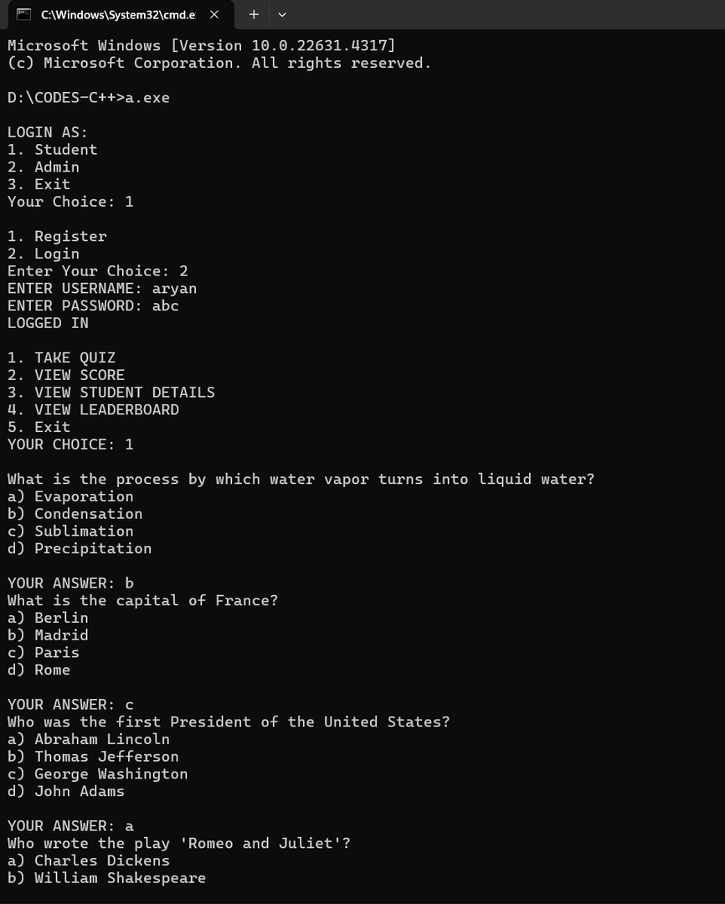
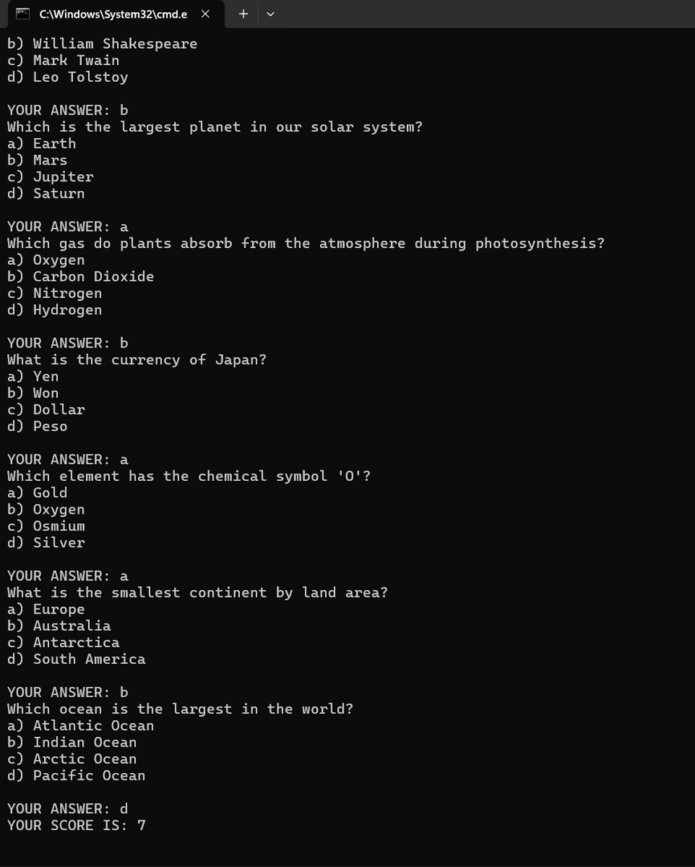

Slide 7
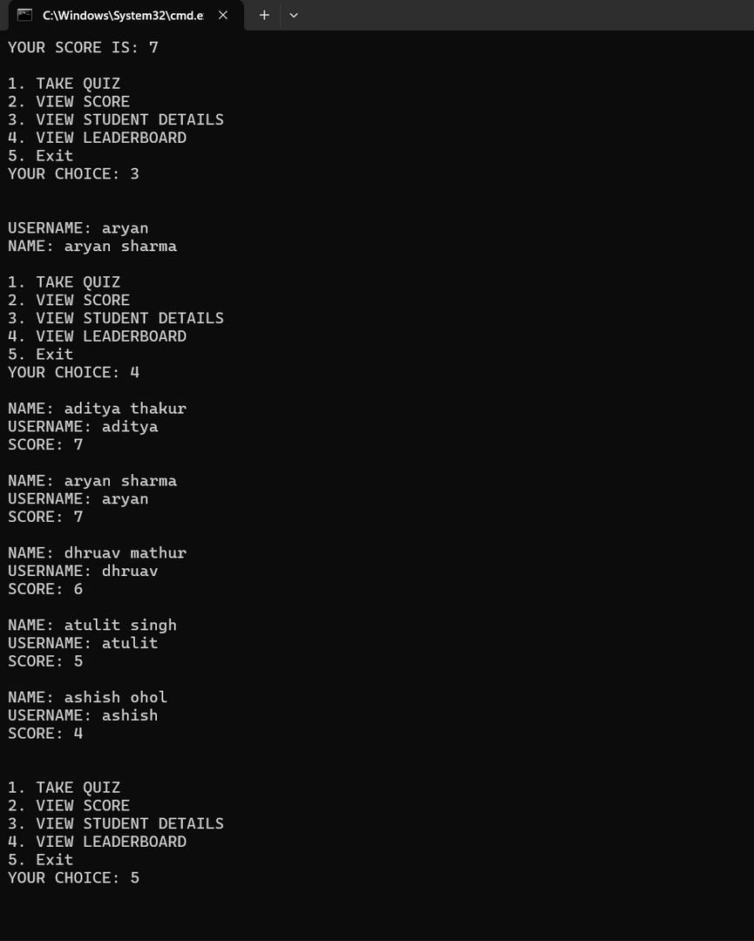
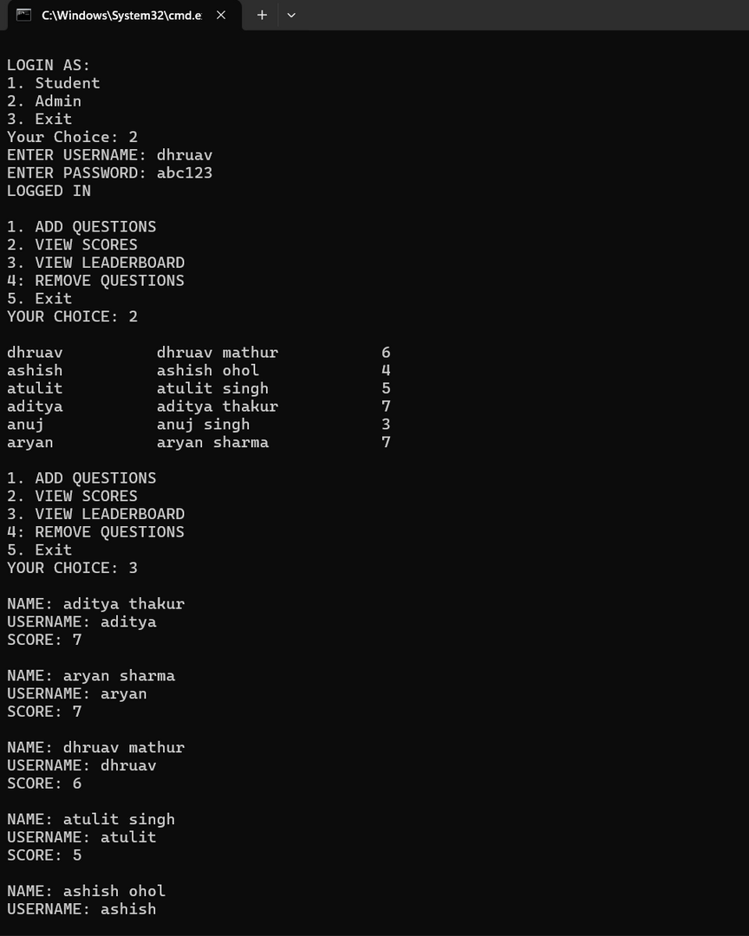

Slide 8
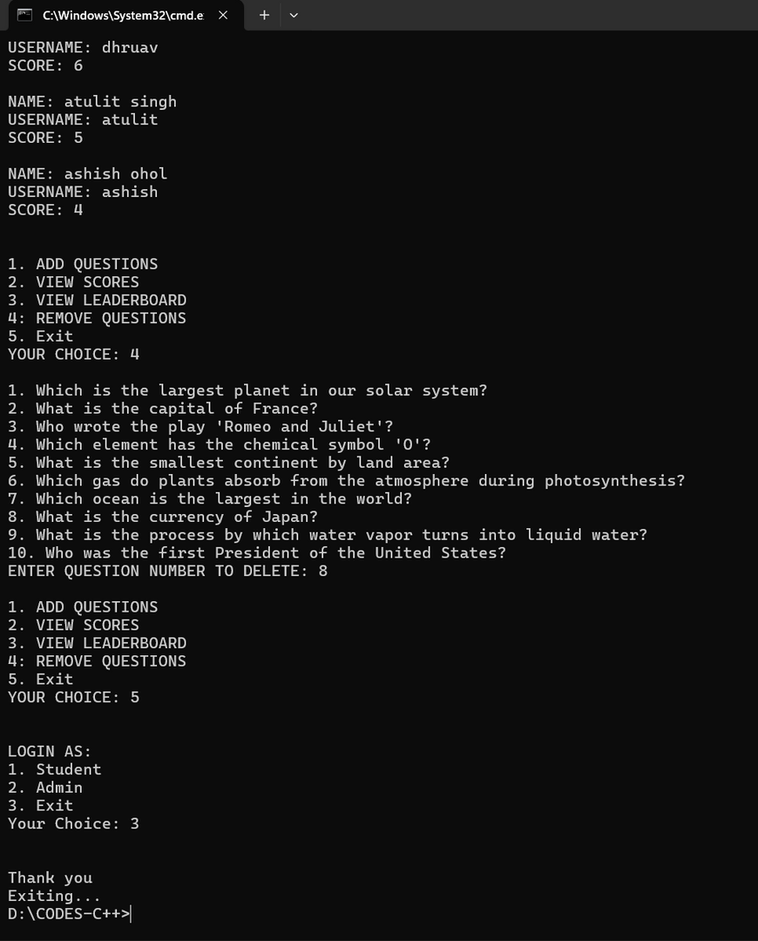

Slide 9
References
GEEKSFORGEEKS : https://www.geeksforgeeks.org/object-oriented-programming-in-cpp/
W3SCHOOLS: https://w3schools.com/cpp/cpp_oop.asp
PPTS OF OBJECT ORIENTED IN C++
Stack Overflow

Slide 10
Conclusion
By utilizing file handling for data persistence, the application provides a seamless experience for both users and administrators.
This project not only addresses the problem of managing quizzes but also serves as a practical example of applying OOP concepts in C++.

