Slide 1
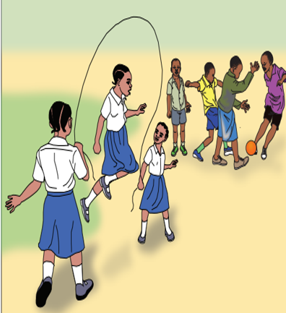
Challenge Brief
How can we improve middle-childhood and adolescent dietary choices and lifestyle behaviors?

Slide 2
Problem Context – Background
Status
Adolescents (10-19yrs) in Tanzania account for 19% of the total population (NBS, 2018)
Middle childhood (5 – 9) and adolescence (10 – 19) are affected by triple burden of malnutrition:
stunting is 25.0% (1 /4),
thinness - 11.2% (1 /10),
overweight 5.1% and 1.1% obese (1 /20),
Anemia - 33.7% (3 /10)
Also, 43.6% of girls and 40.7% boys are not physically active
Dietary intake and Diversity based on 2019 school malaria and Nutrition survey
A: Dietary Diversity
Pupils (aged between 5 and 19) consumed only 2 out of 5 food groups per week
B: Dietary Intake
Consumption of starches :76.0%
Consumption of vegetables: 32.2%
Consumption of fruits 16.5%
Consumption of sugar, oils and fats Urban areas: 32.9% rural areas: 16.6%
Globally, the increased availability and affordability of energy-dense, nutrient-poor processed foods; edible oils and sweetened beverages; away-from-home food intake; and reductions in physical activity contribute to a rise in overweight, obesity and diet related NCDs among children aged 5–19 years, impacting their current and future health, education and productivity

Slide 3
Problem Context: Key bottlenecks
Dietary choices and lifestyle behaviors (eating and physical activity) are influenced by a range of factors at different levels:
Individual/Intrapersonal factors
Poor personal preferences around food and healthy eating,
Incorrect perceived benefits on dietary choices
Limited understanding on the context determinants of malnutrition among school aged children and adolescents
- dietary patterns,
- food choices,
- physical activity,
- food environment including multiple deprivation facing adolescents living in fragile settings
Interpersonal factors
Socio-cultural norms, social network and support systems that surround children. For example;
Family’s food choices, parenting style and dietary preferences.
Peer relationships can affect decision-making and food consumption choices.
Organizational and environmental factors including physical surroundings and public spaces where school aged children and adolescent spend their time
For example - type and availability, accessibility and affordability of food in the home, at school in the neighborhood that can influence food choices.
Macro-level factors include policies and legislation that regulate food availability, accessibility, affordability, and promotional messaging.

Slide 4
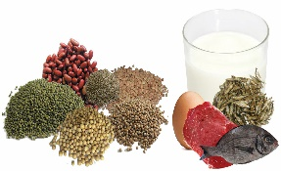
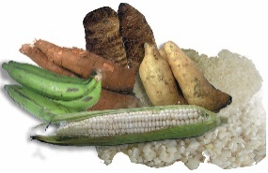
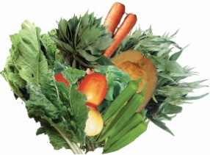
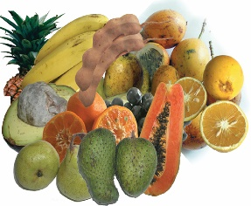
Design Challenge:
How might we improve middle-childhood and adolescent dietary choices and lifestyle behaviors?
How can packaging information on commercial food/beverages products be easily tracked and accessed to inform individual dietary choices and influence positive behaviors among the middle childhood and adolescent.
How can information on dietary choices and lifestyle behaviors (eating and physical activity) be packed and /or disseminated to motivate/ create more interaction and be more acceptable/ adaptable among the middle childhood and adolescents?
Maybe improve school’s food environment in a manner that is more informative/ /attentive to the age group?

Slide 5
References and Resources
Convention on the Rights of the Child, https://www.unicef.org/crc/
UNICEF reports on nutrition, https://data.unicef.org/topic/nutrition/child-nutrition/
Key partners and players:
WHO – plays a leading global policy setting, normative, and coordination role in public health.
International Non-Governmental Organizations (INGOs), including Nutrition International, Save the Children, Helen Keller International, World Vision Tanzania, IMA, Catholic Relief Serives.
Academia and research , including the Ifakara Health Insitutute, University of Sokoine, University of Dodoma, Tanzania Food and Nutrition Center.
Private sector, including the Information and Technology companies.
Local and national NGOs – play a key role in addressing country or district specific requirements

