Slide 1
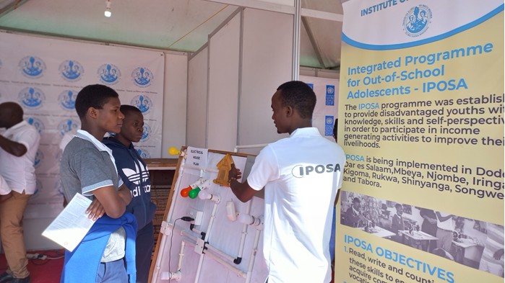
Providing multiple pathways to skills development for out of school adolescents in Tanzania
July 2022

Slide 2
Programme Context (Data &Evidence)
According to the Population and Housing Census data from 2012, around 1,500,000 children between the ages of 14 and 17 were not attending school. The results of the 2021 Education Sector Analysis indicate an increase in enrollment at the primary education level however 3.2 million children and adolescents remain outside the formal education system, of whom more than 2 million are of lower secondary school age and 1.2 million never attended school.
In order to provide adolescents with the skills necessary for self-employability, UNICEF established a program called Integrated Programme for Out of School Adolescents in collaboration with the Ministry of Education through the Institute of Adult Education. After completing their training in the centers, the adolescents develop skills and competences for civic engagement and self employability .

Slide 3
What does the programme offer to Adolescents?(Outcome and reach)
The Programme offers vocational skills, life skills, entrepreneurship skills and literacy skills to out of school adolescents who never attended school or dropped out of school.
Cumulatively there are over 20,000 out of school adolescents who have been enrolled into the programme in 8 regions of Tanzania Mainland since 2019
Graduates from the programme are starting their own business using the skills gained from the training and few others are being employed in different sectors.

Slide 4
Key Bottlenecks
Difficulty in collecting and obtaining data from the field including enrollments trends due to the flexible nature of the programme. i.e an adolescent can enroll anytime and leave anytime after acquiring necessary skills
After IPOSA graduates leave their respective centers, there is no way to keep track of them. Therefore, it is necessary to set up a system that will monitor their whereabouts, activities they are engaged in, number of youth employed in their workshops, and feedback which will accurately record the impact of the program on specific beneficiaries.

Slide 5
Design Challenge:
How can we effectively close the information gap and inform the implementing partners of the impact it had on specific beneficiaries by tracking the IPOSA graduates?
How can develop a software that link IPOSA coordinators at school, district, regional and country level to collect monthly enrollment data?

Slide 6
References and implementing partners
More information on the structure, curriculum and implementing partners will be shared.
Thank you

