Slide 1
Challenge Brief Template
Strengthen options for scaling up market-based sanitation in Tanzania
Nb: example included here is from a UNICEF global design challenge from several years ago, and was not derived for Tanzanian context.

Slide 2
Problem Context – Background (data, evidence)
What is the problem UNICEF is trying to address?
Poor hygiene & sanitation practices in low-income communities leading to increased hygiene and sanitation-related diseases
Limited options for strengthening market-based sanitation in Tanzania
Why is it a problem?
Open defecation rate for Tanzania remains at 11 percent (16 % rural and 1% Urban).
Almost 40 percent of the population still use unimproved sanitation facilities
Limited availability of sanitation and hygiene products or the lack thereof.
Weak supply chain for sanitation and hygiene products.
Demand creation for sanitation and hygiene
Supply chain disruptions
Who is impacted?
Last mile populations
Schools
Healthcare facilities

Slide 3
Problem Context: Key bottlenecks
What are some key bottlenecks that contribute to the existence of this problem?
Weak engagement of the private sector in the sanitation and hygiene products supply
Disruptions in supply chain for sanitation and hygiene products
Limited space for the private sector to thrive
High levels of poverty impacting uptake of sanitation facilities.
Local culture and societal norms impacting uptake of sanitation
High cost of some sanitation products
Poor uptake of the sanitation products

Slide 4
Design Challenge – How might we …
What is the objective UNICEF hopes to accomplish or the Change UNICEF hopes to see?
Adopt innovative options to increase demand creation and marketing of sanitation and hygiene products.
Increase access to improved sanitation and hygiene and contribute to ending open defecation in Tanzania by 2025.
What are some potential entry points?
Engaging with key stakeholders (Ministry of Health, PoRALG, LGAs (MINS), CSO partners, private sector, MOE)

Slide 5
References and Resources
Share links to documents, articles, research, reports, etc. that students can reference as part of the desk research on the topic.
National strategy for accelerating sanitation and hygiene for all (2020 – 2025)
Guidance to Market-based sanitation - https://www.unicef.org/media/88821/file/MBS-Guidance-2020.pdf
List partners, other organizations, or initiatives working in this space
LGAs in Iringa, Mbeya, Njombe and Songwe
Private sector

Slide 6
EXAMPLE

Slide 7
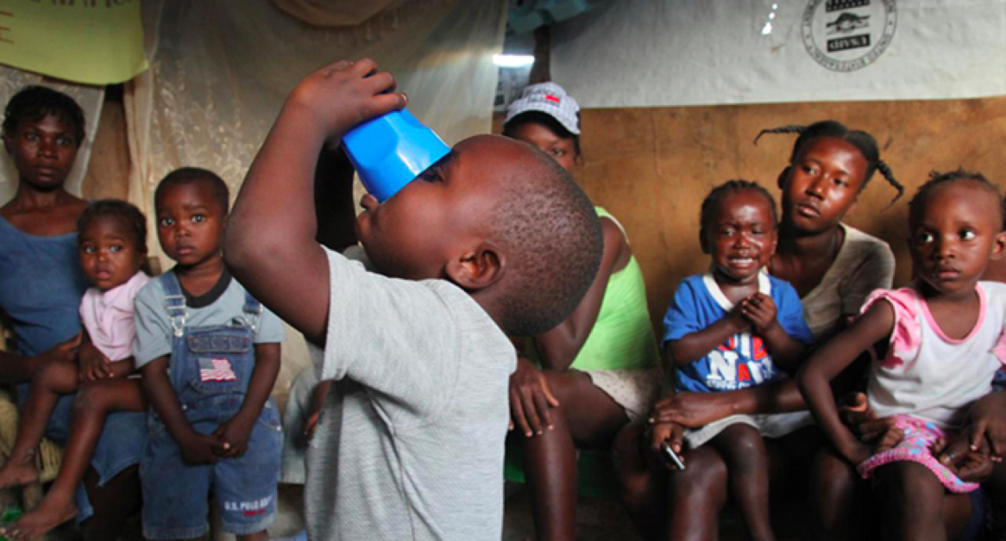
How can we improve caregivers’ treatment of diarrhea?

Slide 8
Problem Context
Y4C | Sample Challenge Brief
Diarrhea kills some 800,000 children under 5 each year. Deaths can be prevented by a simple and inexpensive public health solution – oral rehydration salts therapy (ORS) in combination with zinc formulated as dispersible tablets. A 10-14 day course has proven to provide protection against future bouts of diarrhea for up to 2-3 months. Despite the existence of such a successful course of treatment, ORS is oftentimes not properly implemented or used.
According to studies demonstrating the success of ORS and zinc tablets, over a standard course of treatment, zinc supplementation results in a 25% reduction in duration of acute diarrhea and a 40% reduction in treatment failure or death in persistent diarrhea. These studies also reveal that children receiving zinc simultaneously experience a decrease in the severity of their diarrhea episodes.

Slide 9
Key Bottlenecks
Y4C | Sample Challenge Brief
Confusion of treatment guidelines for the different age groups.
Incorrect use of ORS, including dissolving in dirty water.
Non-completion of the 10-14 day course of zinc.
Lack of parental awareness of the importance and benefits of ORS therapy.
Illiteracy, especially of mothers in rural areas, which makes it difficult to follow guidelines.
Lack of access to health centers where ORS is distributed due to:
Accessibility factors – there are few health centers and these are located far away from the villages.
Lack of information – parents are not aware of where health centers are located or what services they offer.
Cultural factors – movement of mothers, especially young mothers, may be controlled by husbands or mothers-in- law.
Poverty – families do not have money to pay for needed health services.

Slide 10
Design Challenge:
Y4C | Sample Challenge Brief
How can caregivers’ treatment of diarrhea improve?
> Can products/systems be repackaged to be clearer and easier to properly use, even for illiterate consumers? Maybe introduce simpler instructions or bundling of medicines.
> Maybe raise awareness of the importance and benefits of ORS?
> Improve overcome distribution challenges, especially in the most remote areas?

Slide 11
Reference and Resources
Convention on the Rights of the Child, https://www.unicef.org/crc/
UNICEF reports on Water, Sanitation, & Hygiene, https://www.unicef.org/wash/3942_resources.html
Key partners and players:
WHO – plays a leading global policy setting, normative, and coordination role in public health.
International Non-Governmental Organizations (INGOs), including Medecins Sans Frontieres, Oxfam, Save the Children, United States Agency for International Development (USAID), World Vision, and WaterAid.
Academia, including the London School of Hygiene and Tropical Medicine and the Center for Disease Control and Prevention (CDC).
Private sector, including the Bill and Melinda Gates Foundation and UN Foundation.
Local and national NGOs – play a key role in addressing country or district specific requirements

