Slide 1

How can we Improve appropriate breastfeeding practices among women in efforts to reduce Children stunting?

Slide 2
Problem Context
What is the problem you are trying to address?
The first 1000 days of life is a period of great potential and vulnerability. In particular, physical growth of children can be affected by the lack of access to basic and psychosocial needs to both maternal and newborns.
In Mwanza Region, TDHS 2015-16 reports shows
34.4% of children were stunted accompanied with
low number of children breastfed within one hour (36.3%)
breastfed exclusively (13.6%)
low number of children breastfed for two years (63.5%)
Literature shows maternal care, early initiation of breastfeeding, exclusive breastfeeding within six months and appropriate complementary feeding to newborns improves nutrition status, reduce risks child morbidity and mortality and enhance growth and development of children.

Slide 3
Under-fives Nutrition Status in Mwanza Region (TDHS2015-16
Nutrition indicator | Prevalence among < 5s in Mwanza | National average
Stunting | 38.6% | 34.4%
Wasting | 4.3% | 4.5%
Underweight | 14.1% | 13.7%
Anaemia | 62.6% | 57.7%
Exclusive breastfeeding (<6mo) | 13.6.% | 15.3%
Breastfeeding within 1 hr | 36.3% | 51.2%
Breastfeeding at 23months | 63.5% | 52.7%
Vitamin A rich diet | 71.1% | 75.5%
Iron rich diet | 35.2% | 36.1%
Micronutrient powder | 0% | 1.5%
Iron supplementation | 6.7% | 2%
Vitamin A supplementation | 47.1% | 41.2%
Deworming | 39.1% | 37.6%

Slide 4
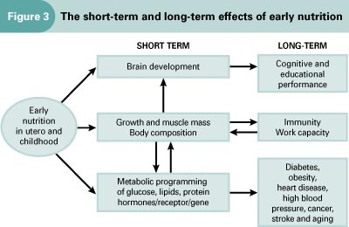


Slide 5
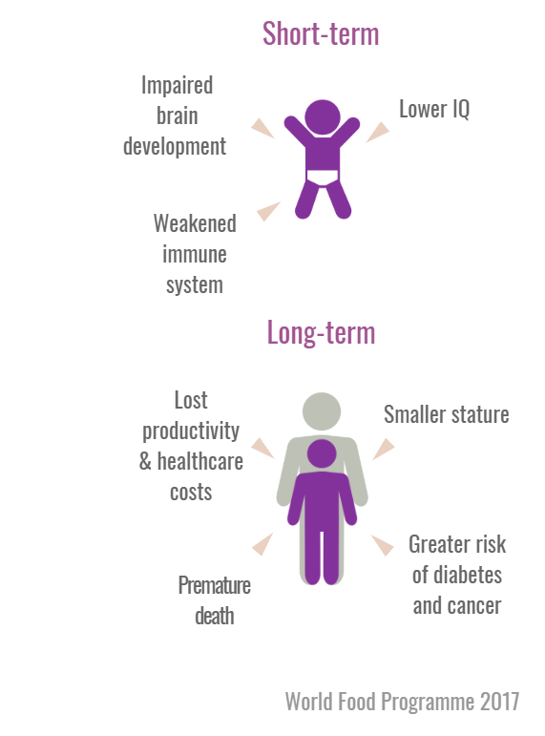
Negative Effects of Stunting

Slide 6
Key bottlenecks
Economic Factors
Lactating women are family bread winners. Most of time use for searching food, water and firewood.
Low budget allocated to Nutrition interventions at District and Regional level
Social Factors
Low support from family members (Inlaws, Partners and Community)
Nutrition writtings and publication based on scholarly level rather than community in general
Poor intergration of Nutrition to other sectors.
Provision of Nutrition education and councelling interventions focus on action based intervention rather knowledge based.
Physical Factors
Distance to seek for Health services
Poor infrastructure
Cultural factors
Colostrum misuse
Food distribution among family members

Slide 7
Design Challenge
What is the objective you hope to accomplish or change you hope to see?
Different approches to be employed to ensure breastfeeding practices are improved to reduce the prevalence of stunting and underweights among children in Mwanza Region.
What are some potential entry points?
TDHS 2015-16 information as evidence tool.
Using existing health management teams at Regional and District level, CHWs, influential community leaders, community awareness and use BCC materials in implementation/dissemination of breastfeeding messages.

Slide 8
References and Resources
https://dhsprogram.com/pubs/pdf/FR321/FR321.pdf
https://www.who.int/nutrition/publications/infantfeeding/bfhi_trainingcourse/en/
https://www.unicef.org/tanzania/media/2141/file/Tanzania%20National%20Nutrition%20Survey%202018.pdf
List partners, other organizations, or initiatives working in this space
Amref Health Africa
Nutrition International
IMA World Health
Boresha Afya-USAID Project

