Slide 1
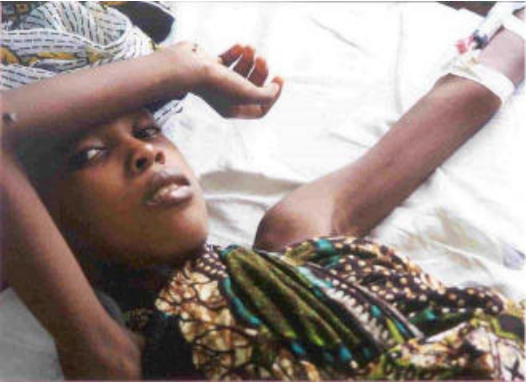
Type 1 Diabetes Children in Tanzania
Y4C Practical Training (PT) programme
Notes:
This is a category of Diabetes Mellitus
Type 1 diabetes is a condition in which your immune system destroys insulin-making cells in your pancreas. These are called beta cells. ( No insulin is produced at all)
Condition can be determined after 6 month of birth

Slide 2
Background
Type 1 Diabetes (T1D) is a vital problem in Tanzania. Substantial number of children with T1D can not access care resulting to avoidable disability and mortality.
At initial level, patients with T1D often present with Diabetes Ketoacidosis, a life threatening complication due to uncontrolled blood glucose levels in their bodies. Once diagnosed, patients need a lifelong therapy and behavioral modification.
Advanced care and follow up are available only at secondary and tertiary level for a smaller fraction of children, while primary healthcare facilities for a huge section are grossly lacking.
Notes:
Type 1 diabetes is a condition in which your immune system destroys insulin-making cells in your pancreas. These are called beta cells.
Diabetic ketoacidosis (DKA). If your body can't get enough glucose for fuel, it breaks down fat cells instead. This creates chemicals called ketones. Your liver releases the sugar it stores to help out. But your body can’t use it without insulin, so it builds up in your blood, along with the acidic ketones. This mix of extra glucose, dehydration, and acid buildup is known as ketoacidosis and can be life-threatening if not treated right away

Slide 3
Key bottlenecks
The inadequacy of optimal healthcare services is mainly due to the following constraints:
Inadequately trained healthcare personnel
Geographical barriers
Frequent non-availability of insulin

Slide 4
Design Challenge
Objective: improve type 1 diabetes healthcare services to children in Tanzania mainland and Zanzibar
Potential Entry Points:
Type 1 Diabetes
Type 1 Diabetes Healthcare services
Ministry of Health
Tanzania Diabetes association

Slide 5
References and Resources
https://drive.google.com/file/d/1y4YVgTqZdjJQu3Nf_-7BSR6pz0QtpQKg/view?usp=sharing
https://www.access2insulin.org/uploads/4/9/1/0/4910107/factsheet.pdf

