Slide 1
Challenge Brief Template
Improving Uptake of HPV vaccination services among Adolescent Girls
Y4C Practical Training (PT) programme

Slide 2
Background
There has been a decrease in HPV1 performance from 83% in 2020 to 78% in 2021
Minimal knowledge and awareness among adolescent regarding Cervical Cancer and HPV vaccine
HPV vaccination is targeting adolescent girls aged 14 years
Uptake of HPV vaccine is important for prevention of Cervical Cancer

Slide 3
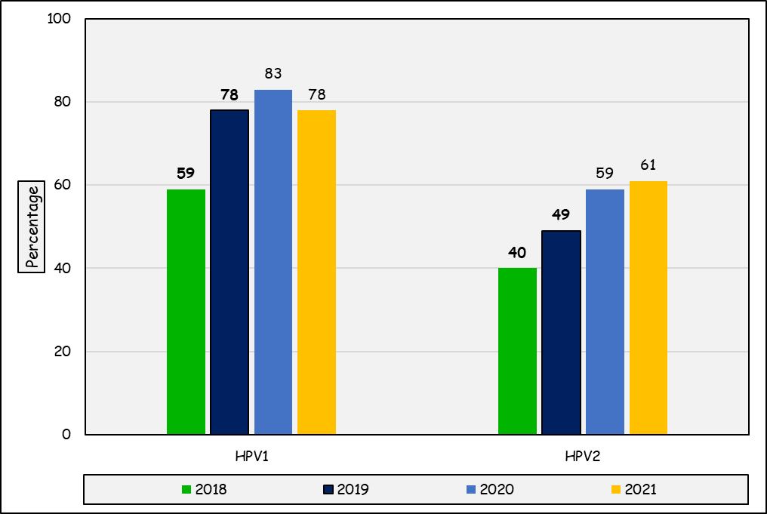
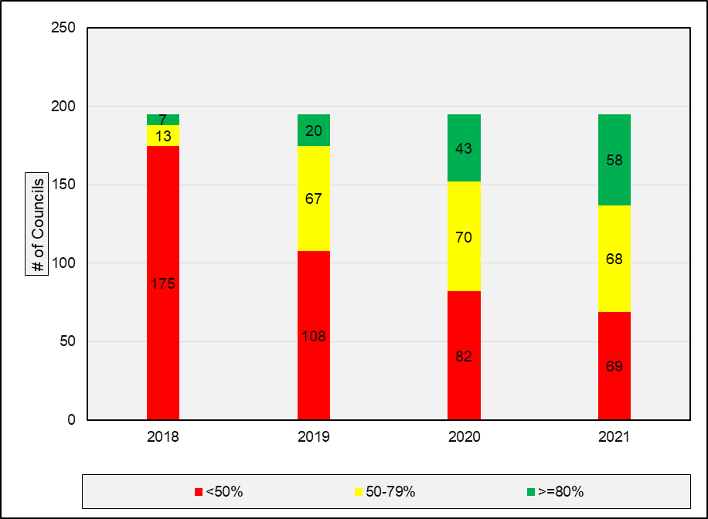
Background:
HPV Vaccine Coverage Trend
Distribution of Councils HPV2 Performances

Slide 4
Key bottlenecks
Inadequate Involvement of School Sector
Minimal awareness of HPV vaccination among parents/caregivers
Minimal knowledge about cervical cancer among adolescent
Inadequate strategies for reaching vulnerable, out of school adolescents
Poor belief and Misconception among community

Slide 5
Design Challenge
Goal: Increase uptake of HPV vaccination among girls aged 14 years to achieve the national target of at least 90%
Potential Entry Points:
Availability of Schools health Strategies
Availability of HPV vaccines at health facilities
Presence of trained HCWs and School health teachers

Slide 6
References and Resources
Human papillomavirus vaccines: WHO position paper, May 2017
D.S. LaMontagne, S. Barge, N.T. Le, E. Mugisha, M.E. Penny, S. Gandhi, et al Human papillomavirus vaccine delivery strategies that achieved high coverage in low- and middle-income countries. Bull World Health Organ 2011;89:821–830
A.J. Li, F. Kyesi, W. Mwengee, A. Mphuru, M.R. Giattas, B. Shayo, et al. Impact of the human papillomavirus (HPV) vaccine supply shortage on Tanzania’s national HPV vaccine introduction. Vaccine 2021
Human Papillomavirus vaccination demonstration programme. Post-introduction evaluation report. Kilimanjaro region, Tanzania2014.
Tanzania National Immunization Strategy 2021-2025
International Agency for Research on Cancer. Tanzania, United Republic of Fact Sheet. https://gco.iarc.fr/today/data/factsheets/populations/834-tanzania-united-republic-of-fact-sheets.pdf
Tanzania Joint Report form 2021

