Slide 1


Chatter-space - Real time chat application
KADI SARVA VISHWAVIDYALAYA
LDRP INSTITUTE OF TECHNOLOGY AND RESEARCH
Guided by: Name: Dungarani atveek [21BECE30059]
Prof. jalpa khammar Rakholiya Gauraj [21BECE30269]
Rathod Krunal [21BECE30272]
Savaliya krushang [21BECE30281]

Slide 2
Introduction
Chatter-space is a modern chat application built using the MERN stack technology (MongoDB, Express.js, React, Node.js). It provides a seamless communication platform with features similar to popular messaging apps like WhatsApp, but also includes unique functionalities to differentiate itself.

Slide 3
Objectives
Seamless Real-time Communication: To provide instant text messaging with real-time updates, ensuring users can communicate without delays.
Enhanced Multimedia Sharing: To enable users to upload and share photos, videos, and files effortlessly.
Efficient Group Management: To facilitate the creation and management of group conversations, making it easier for users to communicate in teams or social groups.
Robust User Authentication: To ensure secure login and registration processes, protecting user data and privacy.
Customizable Notifications: To offer personalized notifications for different types of messages, enhancing user engagement and experience.
Advanced Search Functionality: To allow users to quickly find messages, contacts, and groups, improving the overall usability of the application.
Expressive Communication: To support the use of emojis, allowing users to express emotions and add personality to their chats.

Slide 4
Key Features of Chatter-space
Real-time Messaging: Instant text messaging with real-time updates.
Multimedia Sharing: Upload and share photos, videos, and files.
Group Chats: Create and manage group conversations.
User Authentication: Secure login and registration system.
Custom Notifications: Personalized notifications for different types of messages.
Search Functionality: Quickly find messages, contacts, and groups.
Emoji Support: Use emojis to express emotions in chats.

Slide 5
Overview of the MERN Stack
MongoDB: NoSQL database designed for high availability, scalability, and flexibility , Stores chat data, user profiles, multimedia files, and other application data.
Express.js : Backend web application framework for Node.js , Handles routing, middleware, and server-side logic.
React : Frontend library for building user interfaces , Provides a dynamic and responsive user experience.
Node.js : JavaScript runtime environment for executing server-side code , Manages the server, handles real-time communication with WebSockets.

Slide 6
Why MERN Stack is Preferable Compared to Erlang, FreeBSD, Yaws, PHP, and XMPP
Rapid Development:
MERN Stack : Facilitates rapid development due to its unified use of JavaScript across the stack.
Erlang/FreeBSD/Yaws/PHP/XMPP : Development can be slower due to the need to work with multiple languages and technologies.

Slide 7
Why MERN Stack is Preferable Compared to Erlang, FreeBSD, Yaws, PHP, and XMPP
Modern Web Application Features:
MERN Stack : Provides modern web application features, leveraging React for a dynamic and responsive UI.
Erlang/FreeBSD/Yaws/PHP/XMPP : May lack some modern frontend development practices and tools.

Slide 8
Why MERN Stack is Preferable Compared to Erlang, FreeBSD, Yaws, PHP, and XMPP
Ease of Use:
MERN Stack : Offers a more straightforward development process with a cohesive ecosystem and extensive community support.
Erlang/FreeBSD/Yaws/PHP/XMPP : Can be more complex due to the diversity of languages and ecosystems involved.

Slide 9
Why MERN Stack is Preferable Compared to Erlang, FreeBSD, Yaws, PHP, and XMPP
Unified Language for Frontend and Backend:
MERN Stack : Uses JavaScript throughout, reducing context switching and simplifying full-stack development.
Erlang/FreeBSD/Yaws/PHP/XMPP : Involves multiple languages (Erlang, PHP), increasing the learning curve and complexity.

Slide 10
Why MERN Stack is Preferable Compared to Erlang, FreeBSD, Yaws, PHP, and XMPP
Suitable for Startups and Rapid Iteration:
MERN Stack : Ideal for startups and projects that need to iterate quickly and scale efficiently.
Erlang/FreeBSD/Yaws/PHP/XMPP : Better suited for projects requiring high concurrency and fault tolerance but may not be as flexible for rapid iteration.

Slide 11
Challenges faced and solutions
Real-time Synchronization:
Challenge: Ensuring real-time synchronization of messages across different devices.
Solution: Utilized WebSocket protocols for continuous two-way communication between the server and clients, achieving seamless synchronization.
Multimedia Handling:
Challenge: Managing large file uploads and ensuring smooth playback of multimedia files.
Solution: Implemented efficient file handling and storage solutions using MongoDB GridFS, allowing for the scalable management of large files.
User Authentication and Security:
Challenge: Ensuring robust security for user data and preventing unauthorized access.
Solution: Employed JWT for secure authentication and implemented encryption techniques to protect sensitive data.

Slide 12
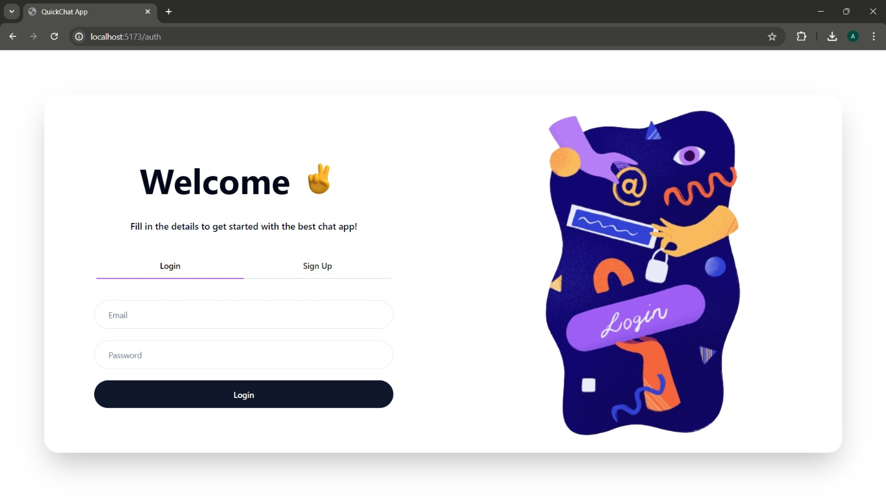
Implementation

Slide 13
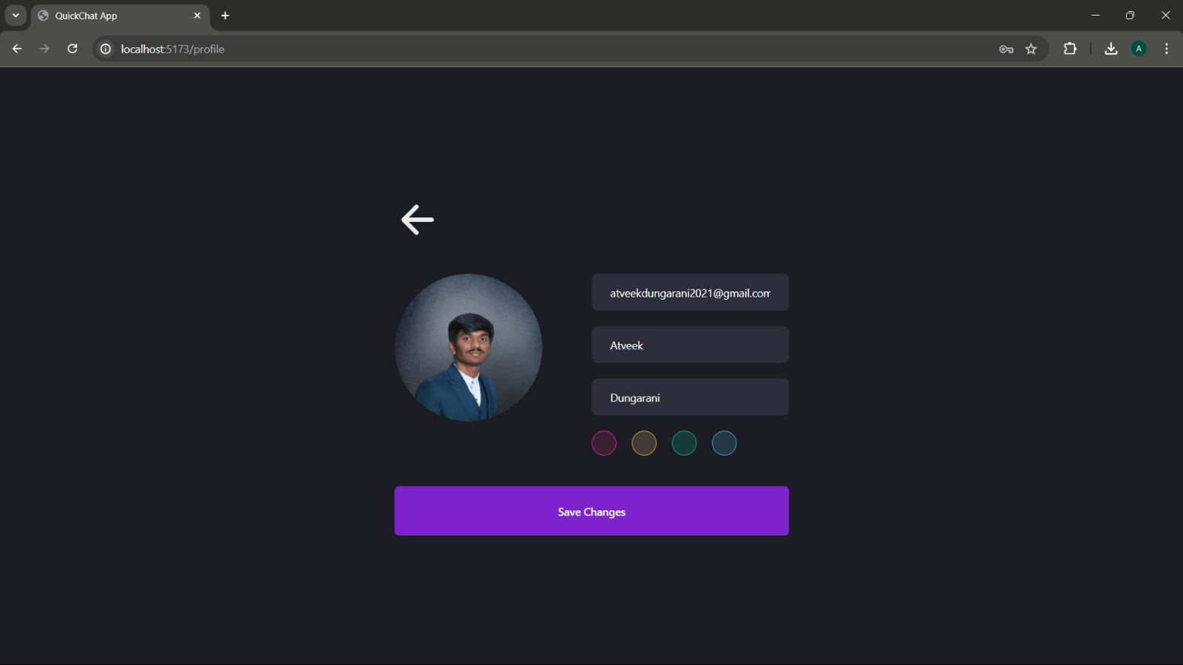

Slide 14
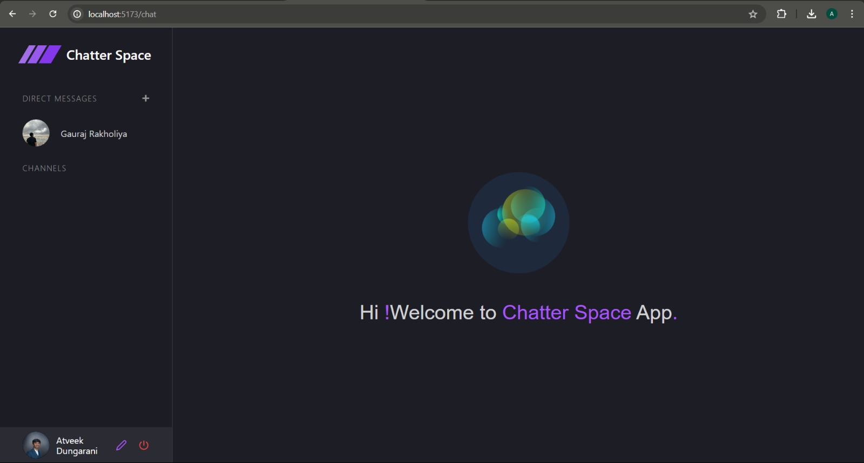

Slide 15
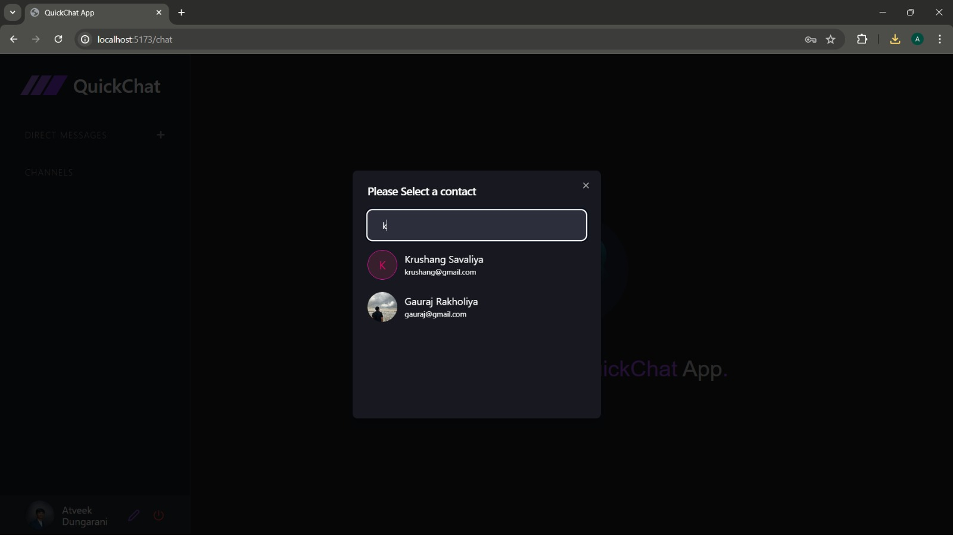

Slide 16
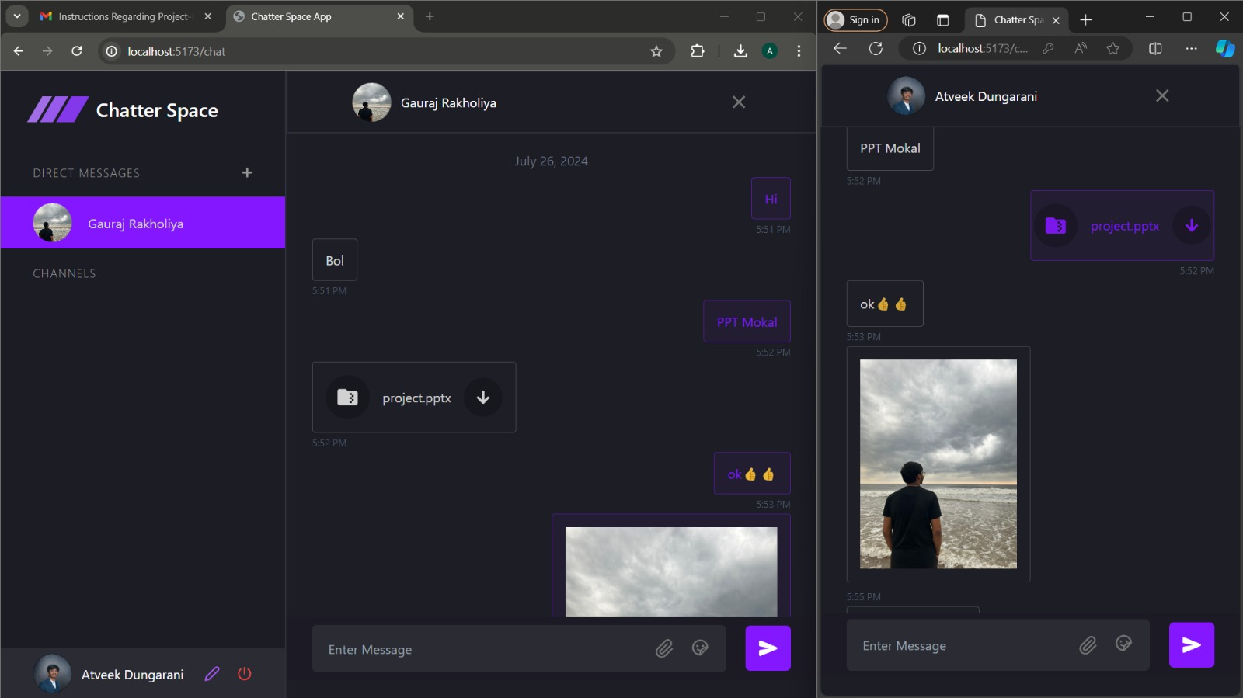

Slide 17
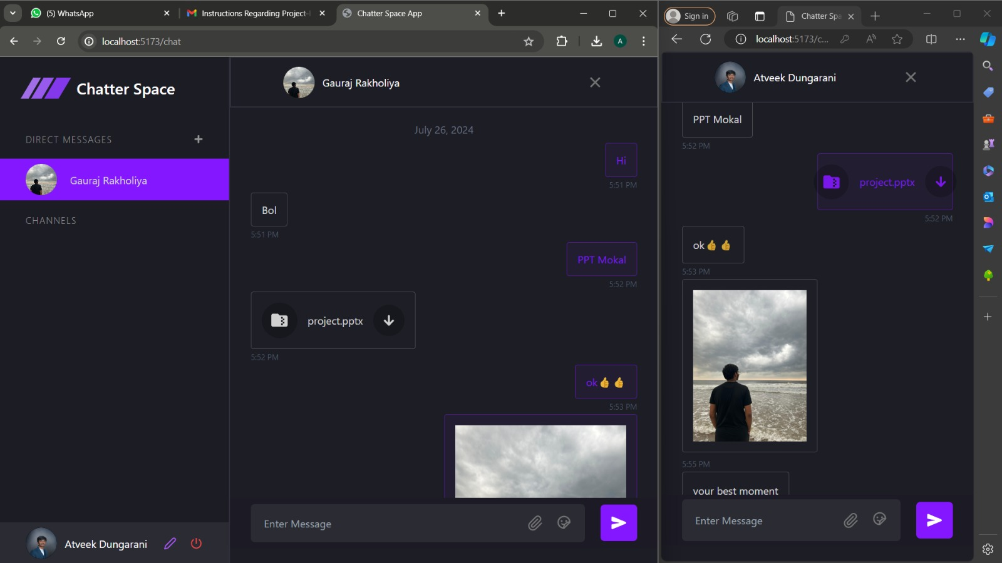

Slide 18
Conclusion
Summary: The MERN stack is preferable for projects requiring rapid development, modern features, and ease of use. The Erlang/FreeBSD/Yaws/PHP/XMPP stack excels in high concurrency and fault tolerance but involves more complexity.
Final Thought: Choosing between the two stacks depends on specific project requirements, team expertise, and development goals.

Slide 19
Future enhancements and potential features
Friend Request System:
Feature: Enable users to send friend requests to other users, with the recipients receiving notifications and the option to accept or decline the requests.
Benefit: Enhances the social networking aspect of the application by allowing users to connect and build their contact list. This feature also adds a layer of engagement and interactivity within the platform.

