Slide 1
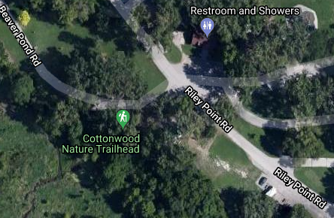
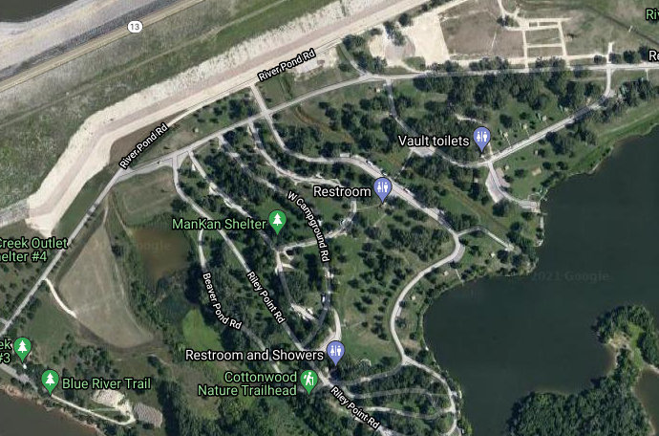
MAARS ARRL FIELD DAY 2021
EXECUTION
What:
The Manhattan Area Amateur Radio Society hosts ARRL Field Day 26-27JUN 2021, at Tuttle Creek State park, River Round Campground.
Field Day is ham radio's open house. Every June, more than 40,000 hams throughout North America set up temporary transmitting stations in public places to demonstrate ham radio's science, skill and service to our communities and our nation. It combines public service, emergency preparedness, community outreach, and technical skills all in a single event. Field Day has been an annual event since 1933, and remains the most popular event in ham radio.
Who:
All are welcome, open to the public
Equipment to bring
Any amateur radio equipment you want to bring
Camp chairs
Canopy for additional shade if desired
When:
Set up starts no earlier than Friday 25JUN 7PM (local)
Field Day officially starts Saturday 26 JUN 1PM (local), Ends Sunday 27 JUN 3:59 PM (local)
Where:
MAARS will conduct Field Day activities at the Bob Fleming Shelter located near the Cottonwood Nature Trailhead
GPS Coord: N39 14.976' W96 35.402'
https://goo.gl/maps/JtuhoWQL7QiH3NNWA
The link above can be used for Google Maps directions.
Information & Questions
Robert Oberle (KI5FFE)
580-699-0924
http://www.arrl.org/field-day
http://www.arrl.org/field-day-rules
http://www.arrl.org/shop/FieldDay/
http://www.ks0man.org/

