Slide 1
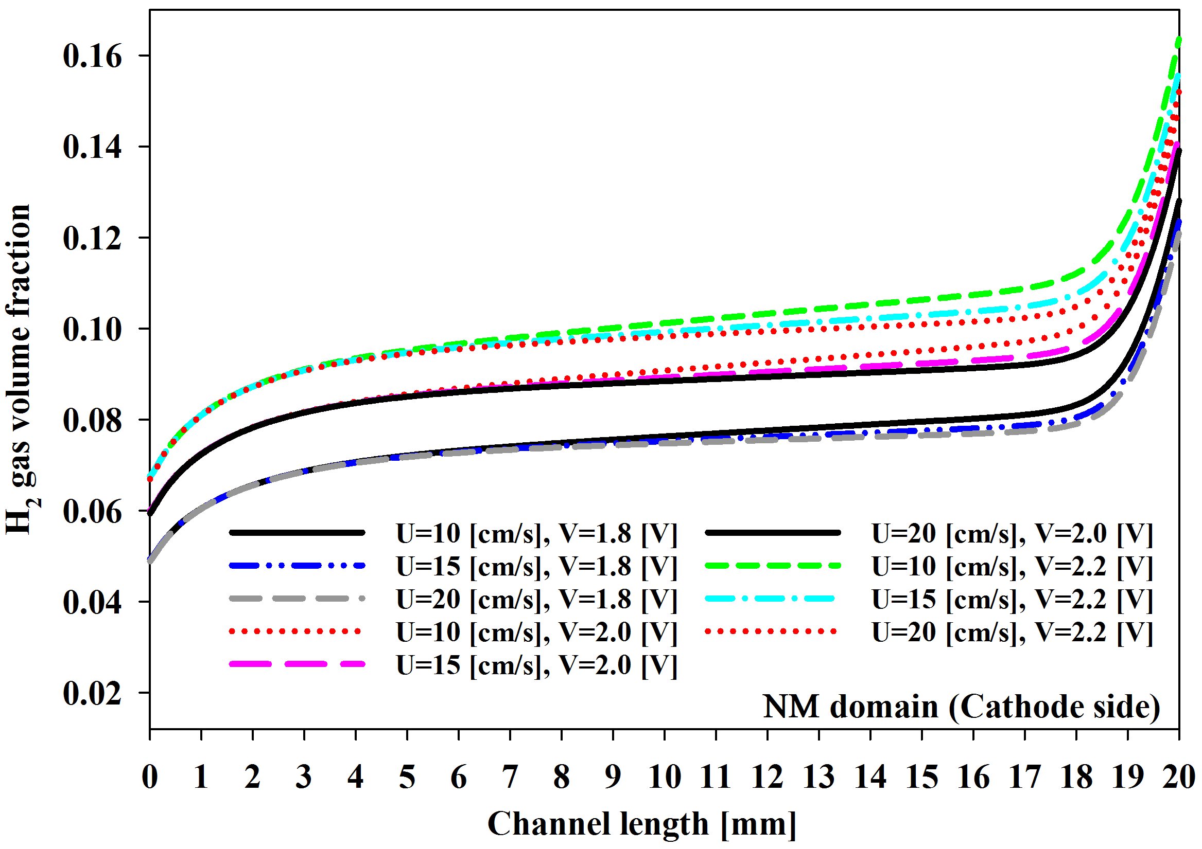
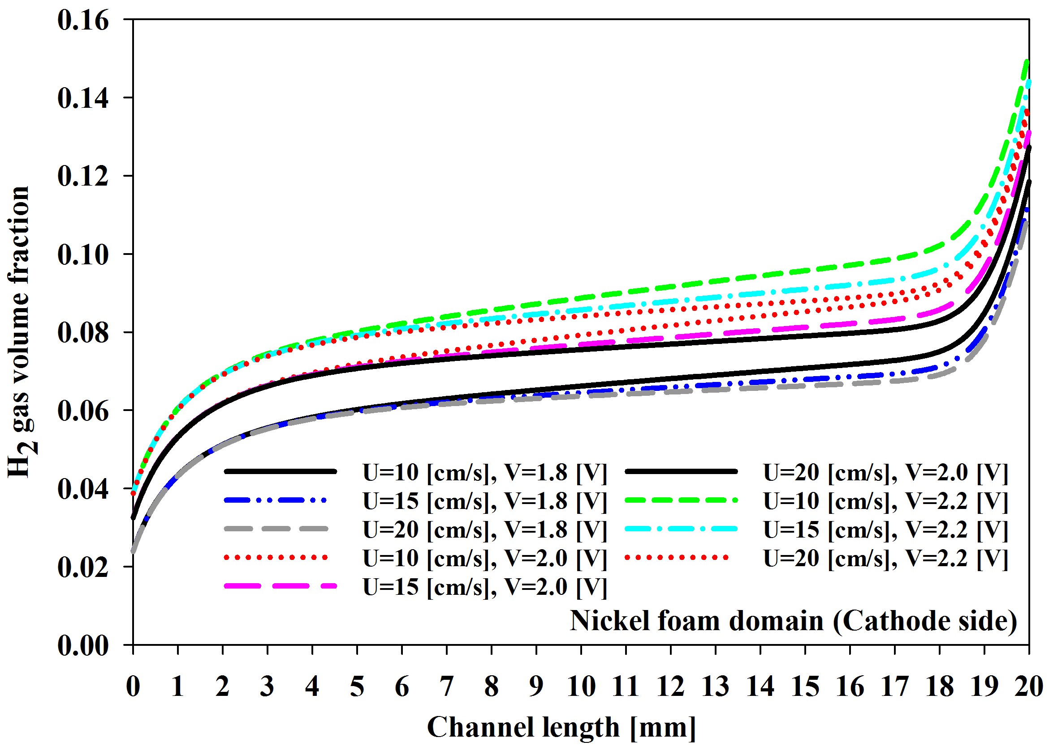
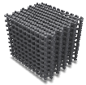

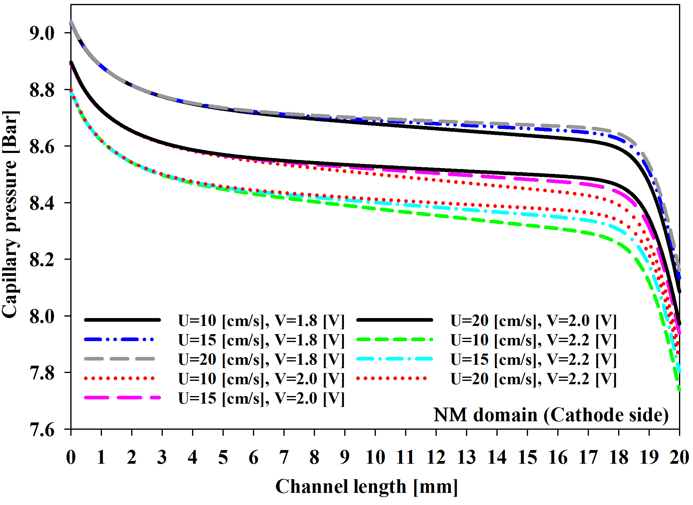
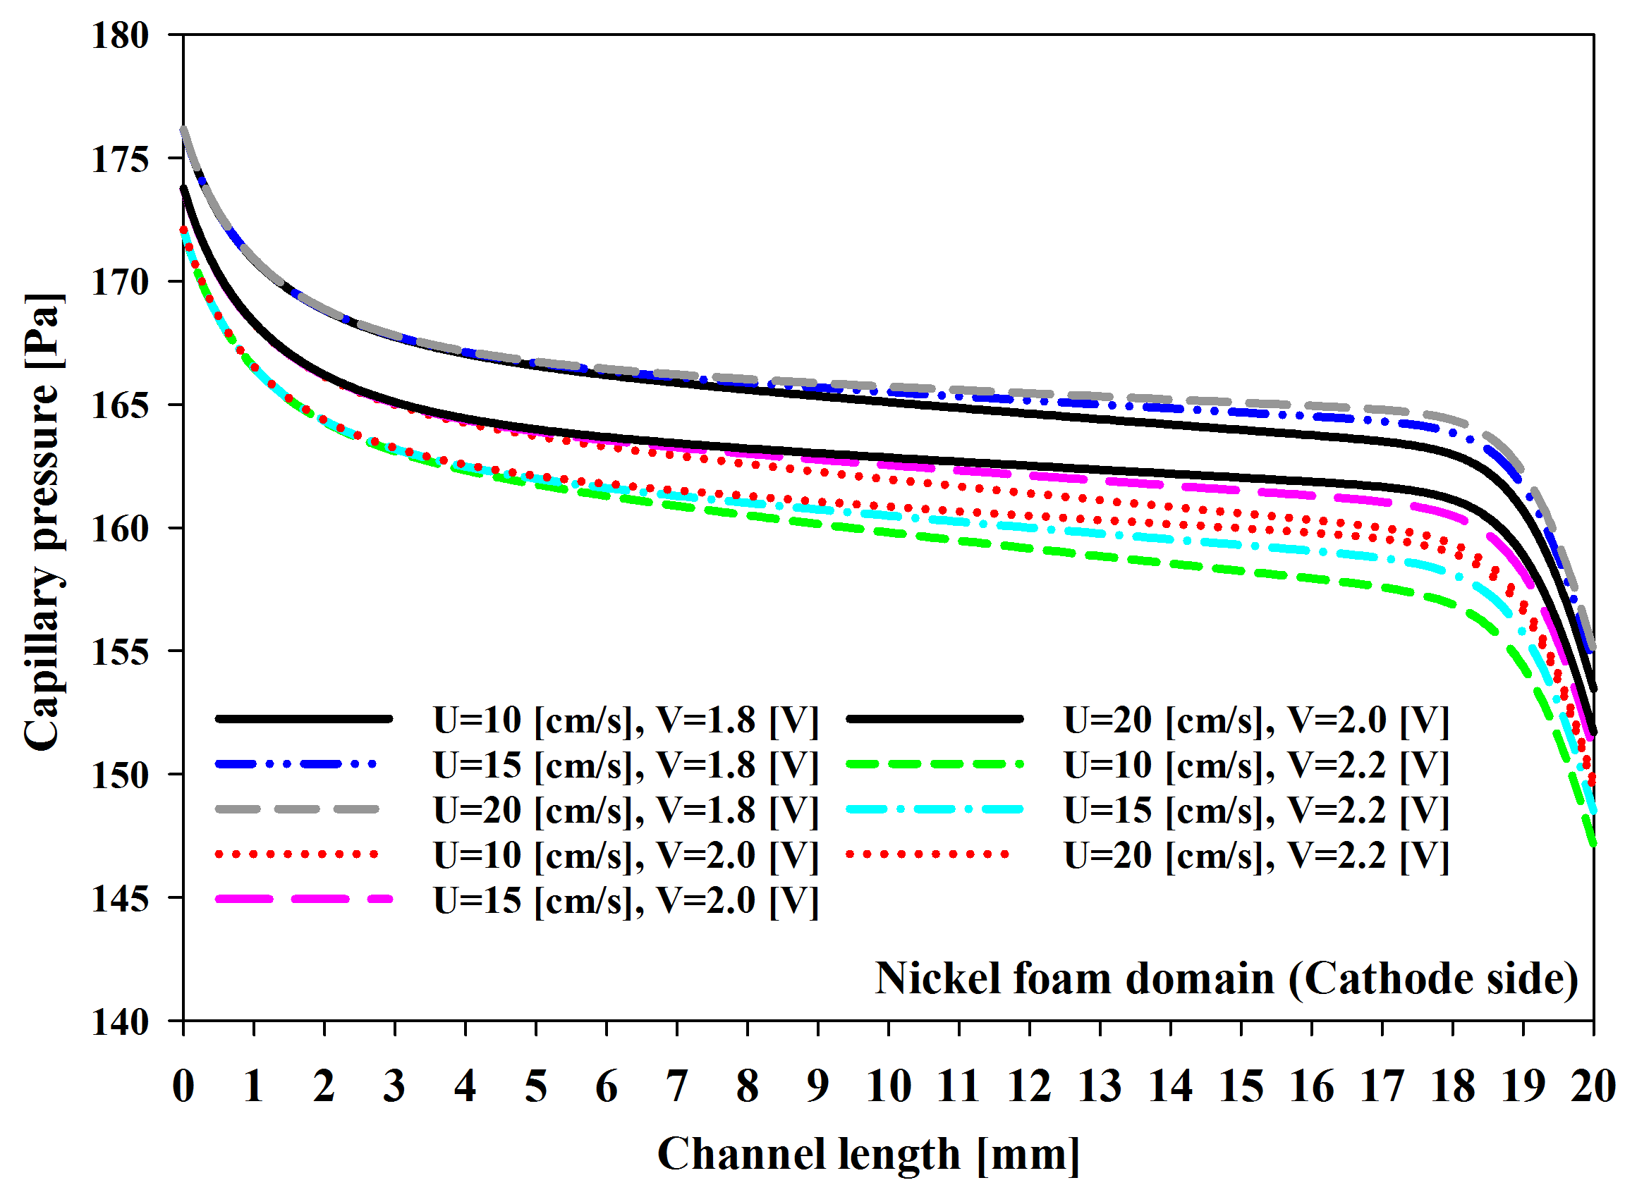
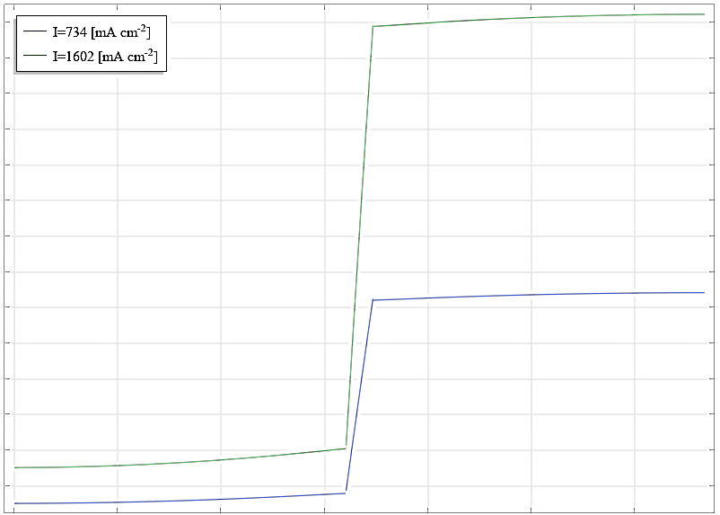
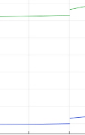
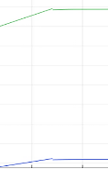

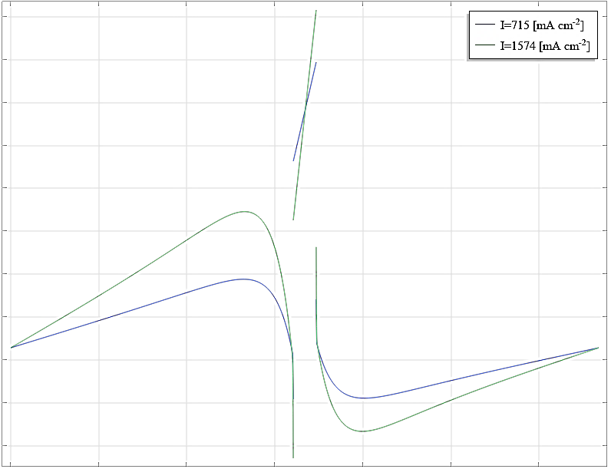

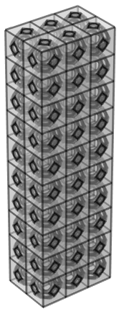
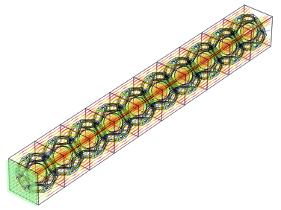
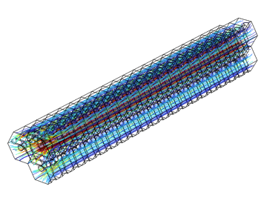
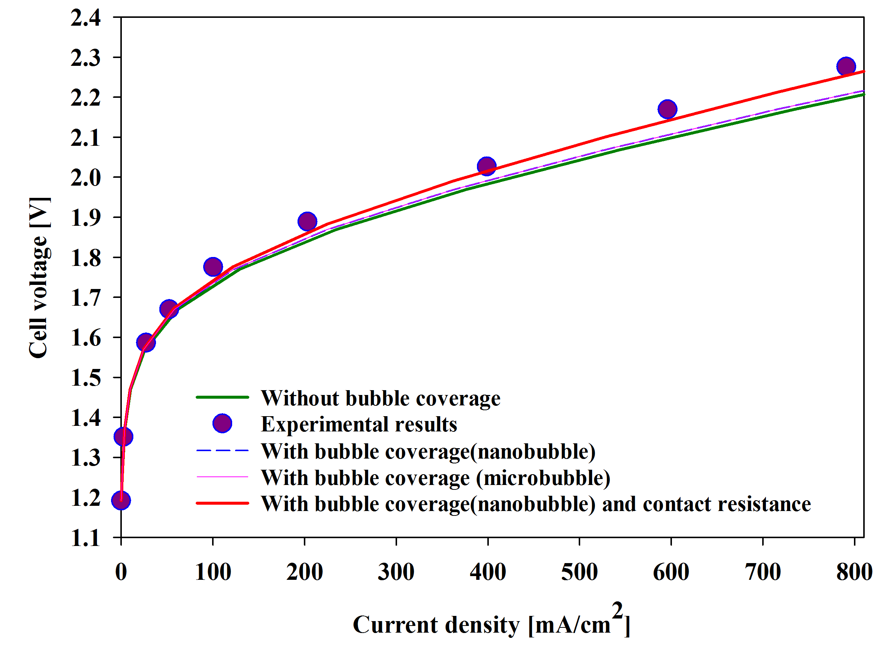
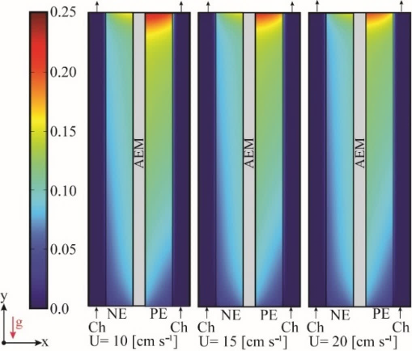
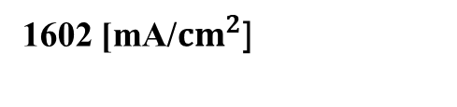
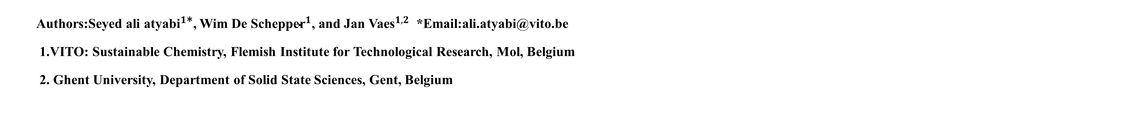

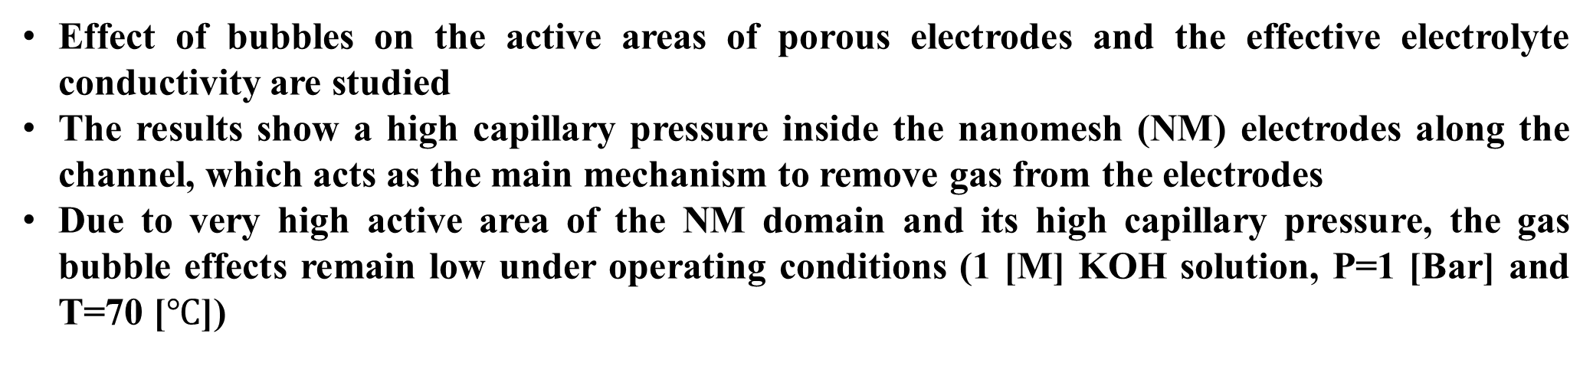
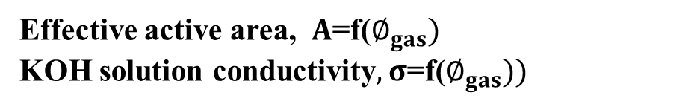
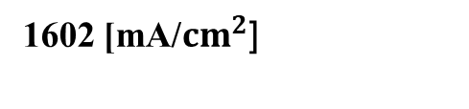

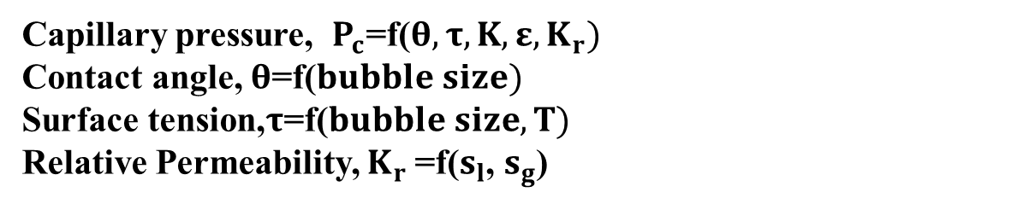
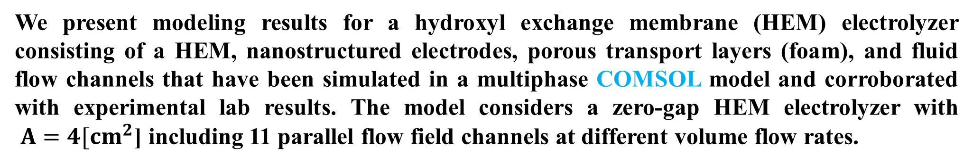
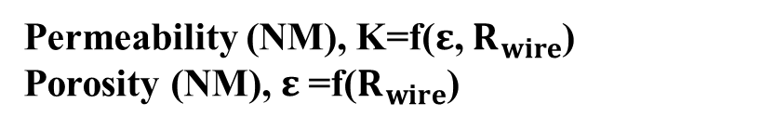
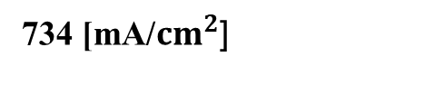
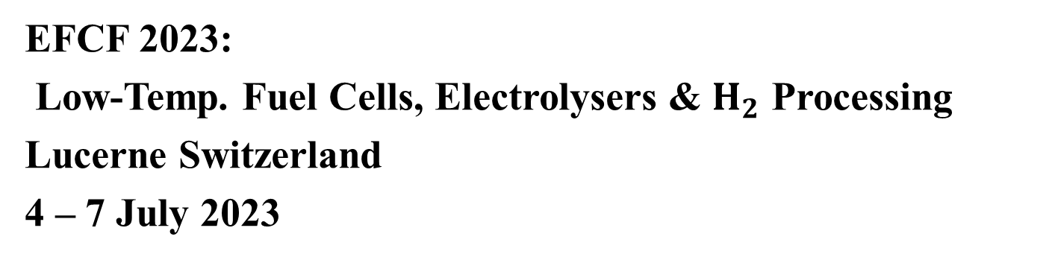
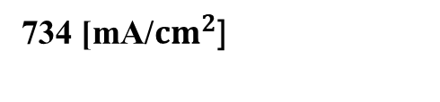

EFCF 2023:
Low-Temp. Fuel Cells, Electrolysers & $H_{2}$ Processing
Lucerne Switzerland
4 – 7 July 2023
A multiphase transport model for the evaluation of electrode and PTL bubble Coverage
in a Zero-Gap hydroxyl exchange Membrane Water Electrolyzer
Authors:Seyed ali atya${\text{bi}}^{1\text{∗}}$, Wim De Schepp${\text{er}}^{1}$, and Jan Va${\text{es}}^{1,2}$ *Email:ali.atyabi@vito.be
1.VITO: Sustainable Chemistry, Flemish Institute for Technological Research, Mol, Belgium
2. Ghent University, Department of Solid State Sciences, Gent, Belgium
Convection velocity in porous domains is low, so the buoyancy drive force in the opposite direction of gravity is favorable, the H₂ gas volume fraction is slightly increased along the channel. Increasing the flow rate at the channel's inlet improved gas removal from porous zones.
The mixture density of flow decreases from channel's inlet to outlet due to the increasing gas volume fraction because of natural convection velocity.
Abstract
We present modeling results for a hydroxyl exchange membrane (HEM) electrolyzer consisting of a HEM, nanostructured electrodes, porous transport layers (foam), and fluid flow channels that have been simulated in a multiphase COMSOL model and corroborated with experimental lab results. The model considers a zero-gap HEM electrolyzer with
$A=4{[cm}^{2}$] including 11 parallel flow field channels at different volume flow rates.
Because of the very large pore size diameter in Nickel foam compared to the NM electrodes (x7800) the capillary pressure in the NM electrodes is approximately 5000 higher than in the Nickel foam.
Whenever the relative permeability of a gas increases, it decreases gas volume fraction from channel's inlet to outlet, therefore the capillary pressure in the Nickel foam domain goes down. Whenever the rate of gas removal from porous zones rises, capillary pressure in the porous zone decreases slightly.
Although there is a high production rate of gas in the NM electrode, the gas volume fraction within the foam remains higher than that in the NM. This is because the capillary pressure in the foam domain is smaller compared to the NM. As a result, most of the gas accumulates within the foam domain.
Equations:
Butler-Volmer
Nernst-Planck
Nucleation theory
Darcy law
Leverett J-function
Assumptions:
steady state, multi-phase, isothermal, ambient pressure
Gas crossover is ignored
Bruggeman modification to estimate effective diffusion coefficient and electrical conductivity
Contact resistance between current collector and PTL included
Highlight
1602 [mA/${cm}^{2}$]
Effect of bubbles on the active areas of porous electrodes and the effective electrolyte conductivity are studied
The results show a high capillary pressure inside the nanomesh (NM) electrodes along the channel, which acts as the main mechanism to remove gas from the electrodes
Due to very high active area of the NM domain and its high capillary pressure, the gas bubble effects remain low under operating conditions (1 [M] KOH solution, P=1 [Bar] and T=70 [$℃$])
1100
734 [mA/${cm}^{2}$]
1000
900
Electrolyte potential [mV]
Approach
800
The I-V curve of a cell is extracted from the results of a 1D model without considering bubble effects, then the gas flux is calculated based on faraday’s law at each cell voltage.
In this 2D simulation, the gas fraction in the porous domains is extracted and subsequently used to compensate for bubble effects in the 1D model.
700
600
$I_{Avg}$=f($E_{cell})$
Effective active area, $A$=f($∅_{gas})$
KOH solution conductivity$, σ$=f($∅_{gas}))$
500
0
500
1000
1500
2000
2500
3000
3500
X [$μ$m]
Capillary pressure, $P_{c}$=f($θ,τ,K,ε,K_{r})$
Contact angle, $θ$=f($bubble size)$
Surface tension,$τ$=f($bubble size, T)$
Relative Permeability, $K_{r}$=f($s_{l}$, $s_{g}$)
1140
Electrolyte potential, 1[M] KOH, P=1 [Bar] and T =343.15 [K]
1D model
2D multiphase model
Final 1D model
considering bubble effects
1602 [mA/${cm}^{2}$]
1100
734 [mA/${cm}^{2}$]
Permeability (NM), K=f($ε$, $R_{wire}$)
Porosity (NM), $ε$=f($R_{wire}$)
1060
Specific active area, $A$=f($R_{wire}$)
${OH}^{−}$ [mol/$m^{3}$]
1020
980
940
0
500
1000
1500
2000
2500
3000
3500
X [$μ$m]
NE: Negative Electrode
PE: Positive Electrode
Ch: Channel
OH- concentration,1[M] KOH, P=1 [Bar] and T =343.15 [K]
Nickel foam
NM
Streamlines
Considering the overvoltage due to contact resistance between the current collector and Nickel foam, there is a good agreement between experimental data and numerical results.
Due to a very high active area of the NM electrodes, bubble coverage does not have a significant effect on cell voltage.
3D CFD simulation
Results
Gas volume fraction
The polarization curves for a 4 [$μm]$ NM electrode and Nickel foam at a 325 [ml/min] volume flow rate are compared with the results from Experiments.
Conclusion
Effect of bubble coverage on AWE performance is evaluated by multiphase model
Pore size of porous electrode has a direct effect on permeability and capillary pressure and consequently on gas removal from the porous electrode
Combination of high active area in NM domain and very high capillary pressure of NM domain bubble coverage has no significant effect on AWE cell performance
V1=10[cm/s]
V2=15[cm/s]
V3=20[cm/s]
References
The effect of velocity magnitude on H₂ and O₂ gas removal for a cell voltage of 2.2 [V]
[1] Zankowski SP, Vereecken PM. Electrochemical Determination of Porosity and Surface Area of Thin Films of Interconnected Nickel Nanowires. J Electrochem Soc 2019;166:D227–35.

