Slide 1
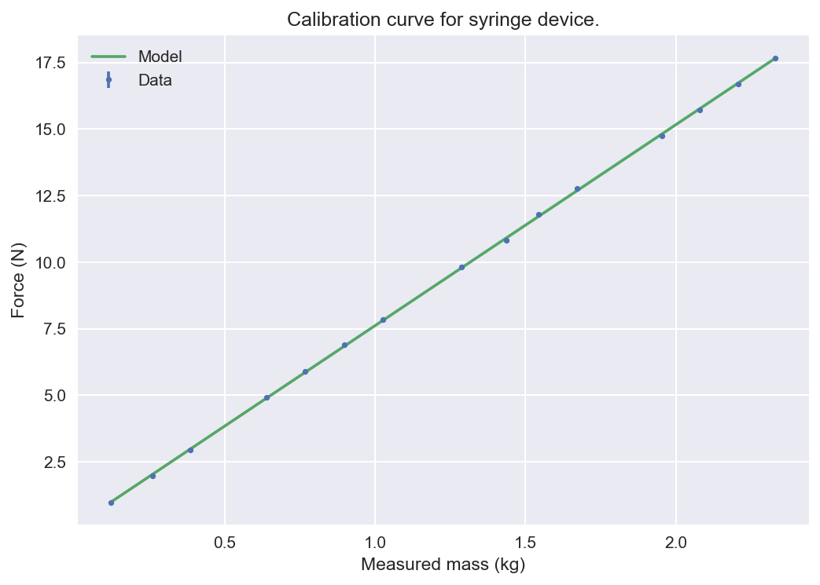
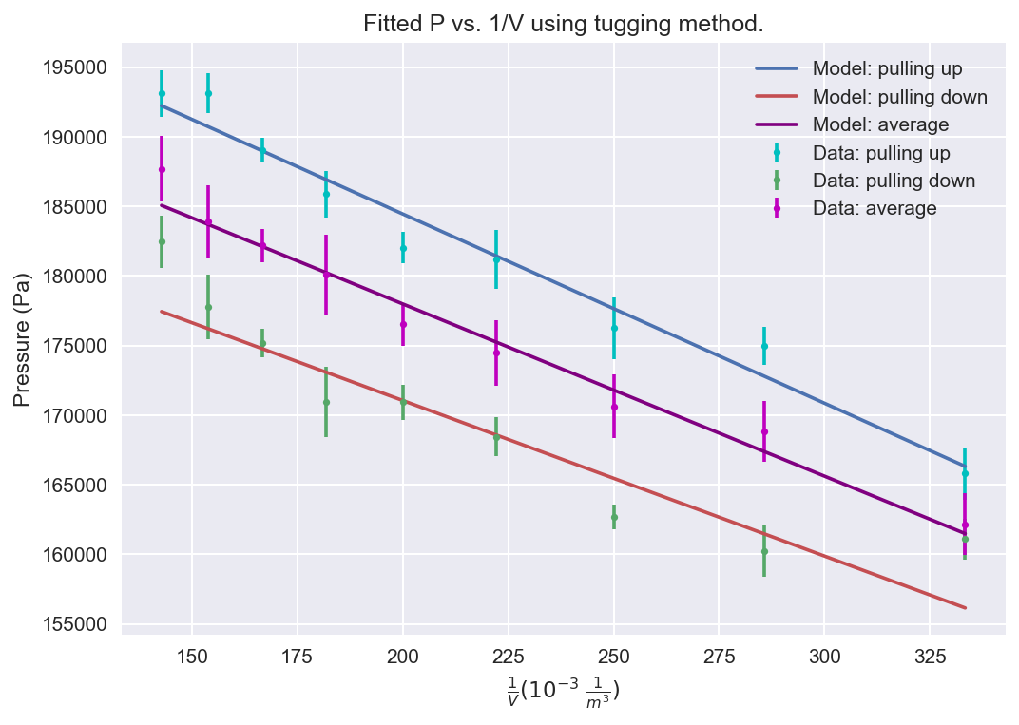
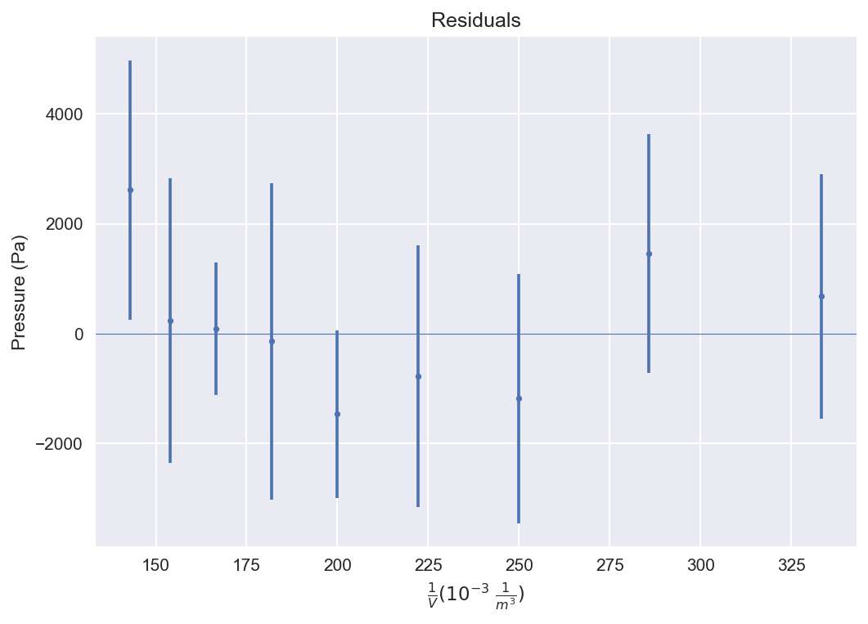
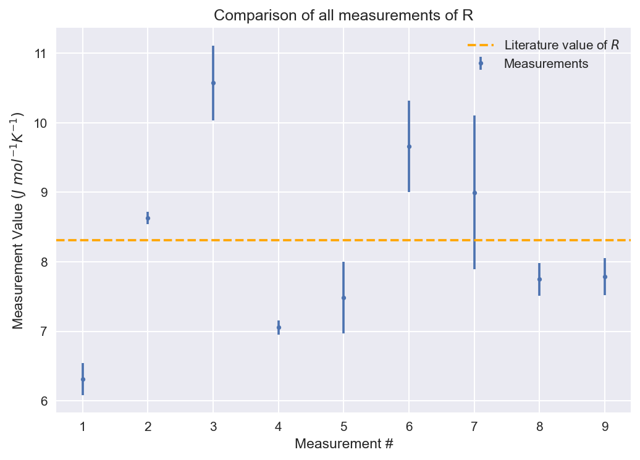
A)
B)
C)
D)
Figure 1): Outline of the final data and processing in the experiment. After weight-to-force calibration through the curve in A), the final mean pressure was plotted against inverse volume B) and fitted to a linear model (residuals shown in C)) to produce final values for the gas constant. D) shows all obtained values of R over the course of the experiment compared to the literature value.

