Slide 1
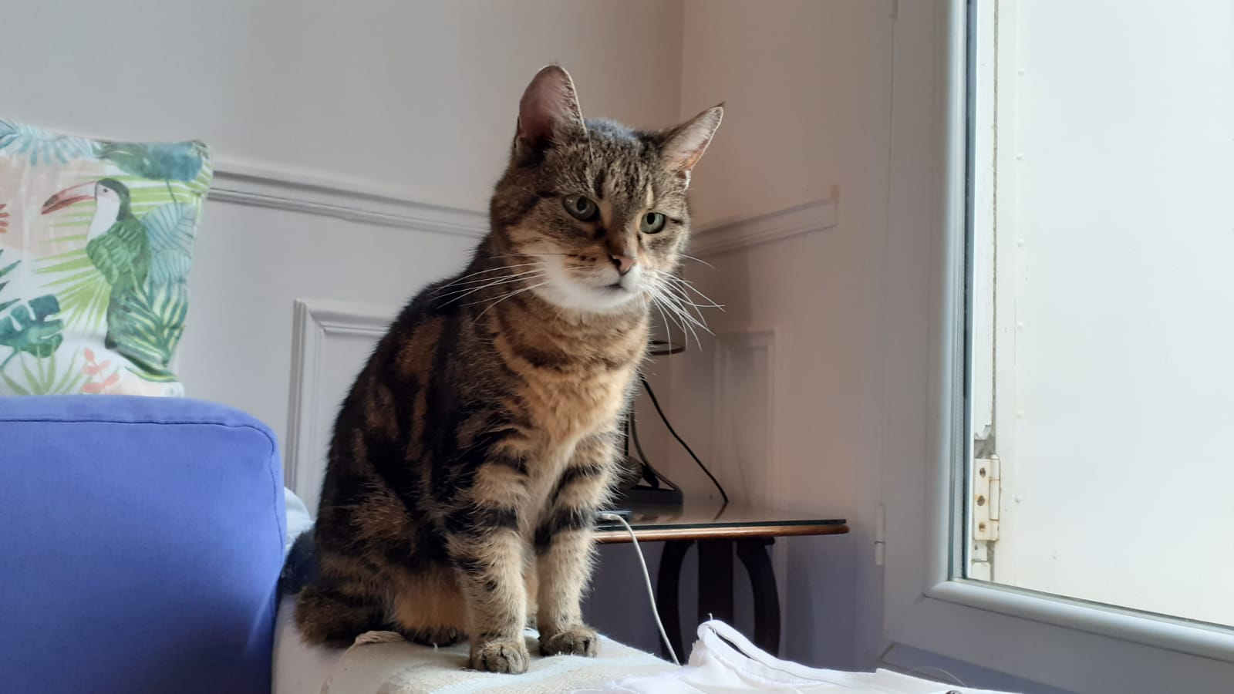
Cats acoustic data Project
Bony Audrey
Lagroy de Croutte de Saint Martin Anne-Victoire

Slide 2
Cats acoustic data Project
Bony Audrey
Lagroy de Croutte de Saint Martin Anne-Victoire

Slide 3
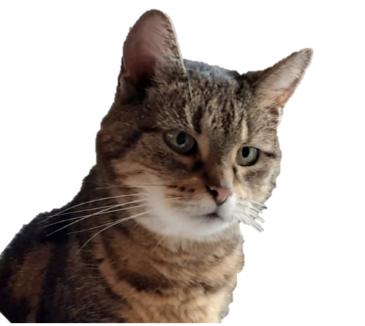
Cats acoustic data Project
Bony Audrey
Lagroy de Croutte de Saint Martin Anne-Victoire

Slide 4


Cats acoustic data Project
Bony Audrey
Lagroy de Croutte de Saint Martin Anne-Victoire
Supervisors : Amandine Shmutz (Mars), François Husson (Agrocampus Ouest)
Master’s Data Science for Biology
February 4th, 2021

Slide 5
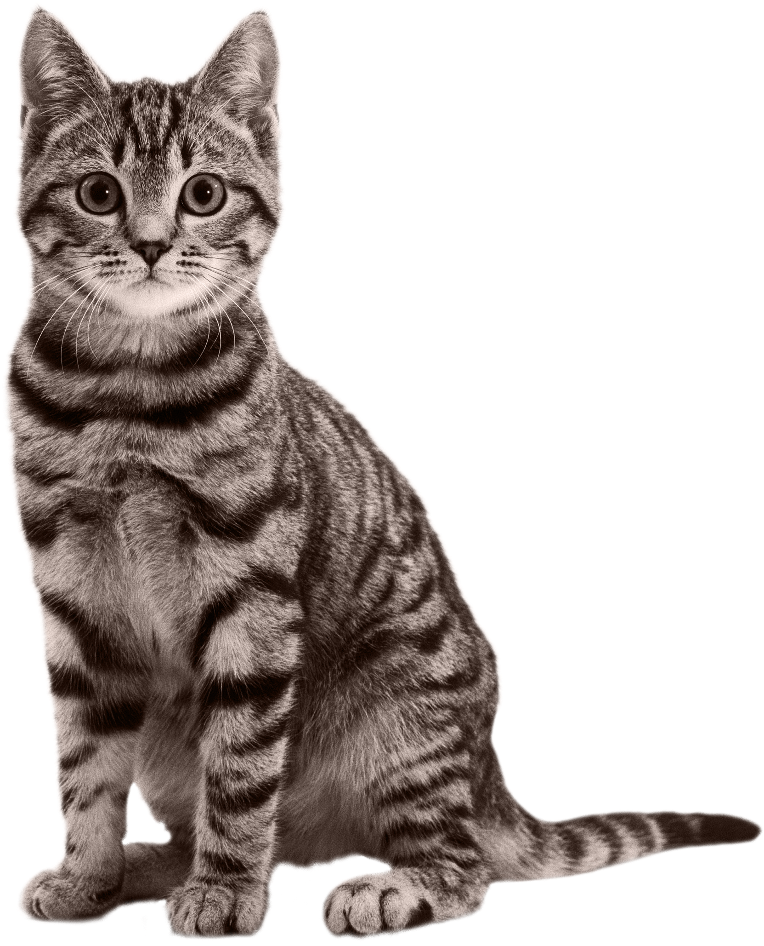
Cats acoustic data Project
Bony Audrey
Lagroy de Croutte de Saint Martin Anne-Victoire
February 4th, 2021
Supervisors : Amandine Shmutz (Mars)
François Husson (Agrocampus Ouest)

Slide 6
Cats acoustic data Project
Bony Audrey
Lagroy de Croutte de Saint Martin Anne-Victoire
February 4th, 2021
Supervisors : Amandine Shmutz (Mars)
François Husson (Agrocampus Ouest)

Slide 7

Cats acoustic data Project
Bony Audrey
Lagroy de Croutte de Saint Martin Anne-Victoire
February 4th, 2021
Supervisors : Amandine Shmutz (Mars)
François Husson (Agrocampus Ouest)

Slide 8
I- Data – Presentation

Slide 9
I- Data – Visualisation
Notes:
Présentation des graph amplitudes et spectro

Slide 10
I- Data – Listening recordings

Slide 11
I- Data manipulation – Filtering frequencies

Slide 12
I- Data manipulation – Filtering frequencies

Slide 13
II- Creation of a new data set a. Methodology

Slide 14
II- Creation of a new data set a. Methodology

