Slide 1


Explicit State Tracking with Semi-supervision for Neural Dialogue Generation
Xisen Jin, Wenqiang lei, Zhaochun ren, Hongshen Chen, Shangsong Liang, Yihong Zhao, Dawei Yin

Slide 2
Outline
Introduction & Motivation
Method
Architecture: CopyFlow network
Training: Posterior regularization
Experiments
Conclusion
Notes:
We first briefly discuss current approaches for neural dialogue generation. Then we introduce bottlenecks of current approaches and thereby elicit our motivation for explicit state tracking. We discuss the proposed methods in two aspects, the architecture and the training respectively. We then present our experiments and draw conlusions.

Slide 3
Dialogue systems
Dialogue systems are receiving increasing attention in multiple applications.
Task oriented dialogue systems
Used for hotel booking, navigation, restaurant reservation and etc.
Retrieve a specific entity from a domain-specific KB and provide cohesive response
Interact with KB
Non-task oriented dialogue systems
Forum question answering, chit chatting and etc.
Provide informative and cohesive response
All the domain knowledge is embedded in raw corpus
Trained on mass corpus(up to millions of dialogue turns)
Notes:
People might be unfamiliar with state tracking, but nowadays almost everyone has tried dialogue systems. Dialogue systems are receiving increasing attention in multiple applications.
In our research we divide current dialogue systems into two categories – Task oriented and non-task oriented dialogue systems. They have their own features. Task oriented dialogue systems are often used for AI assistants, and their goal is to retrieve a specific entity from a knowledge base and request or inform users with cohesive responses. To achieve these goals, they typically interact with knowledge bases. Non-task oriented dialogue systems are majorly used for forum question answering or chit chat robots. The goal is to provide informative and cohesive responses. They are typically trained with raw corpus like forum conversational logs, and thus all the domain specific knowledge is embedded in the corpus, and therefore they do not interact with knowledge bases. In addition, the corpus for training non-task oriented dialogue systems are enormous.

Slide 4
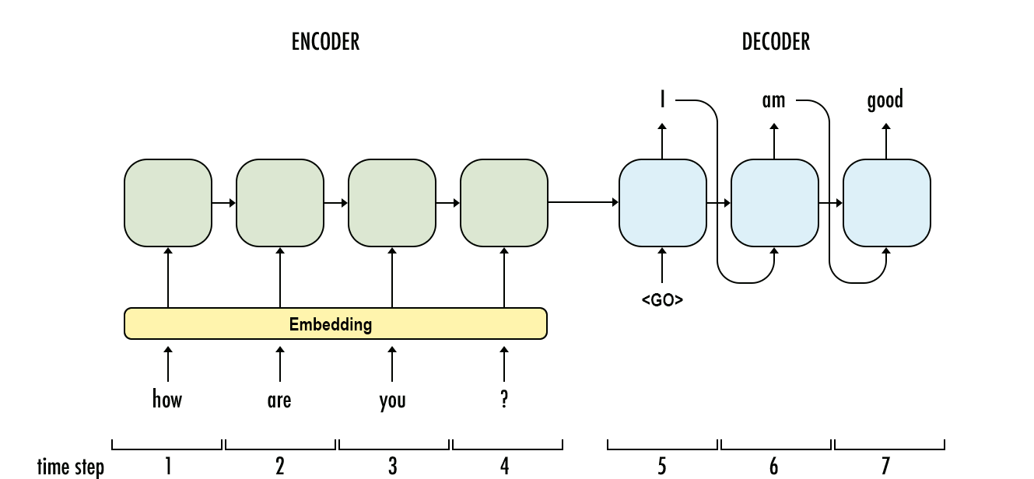
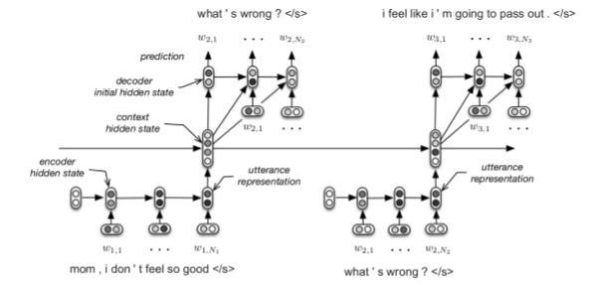
End-to-end training of dialogue systems
End-to-end dialogue models can be implemented with RNNs: Seq2seq(Shang et al. 2015)
Some variations of Seq2seq models
Hierarchical Encoder-Decoder(HRED)(Serban et al. 2015)
Sequicity Framework: End-to-end trainable modular dialogue system framework(Lei et al. 2018)
(a) Seq2Seq
(b) HRED
Notes:
(a)Image from internet
There are a lot of frameworks to implement dialogue systems. Among them, end-to-end training of dialogue systems is developing fast. They can be implemented with recurrent neural networks and sequence-to-sequence learning framework. The encoder encodes contexts, and the decoder decodes responses. Here are some variations of sequence-to-sequence models. Hierarchical encoder-decoder or HRED models the dialogue contexts in a hierarchy of words and turns. Therefore HRED can better handle long-term dependencies in dialogues. Sequicity framework is a task-oriented dialogue system framework that the whole pipeline of task-oriented dialogues are implemented with e2e trainable seq2seq models.

Slide 5
Dialogue state tracking
A dialogue state refers to representation of user’s intention up to current dialogue turn
In task-oriented dialogue systems, dialogue state tracking is necessary since it is utilized for KB search
Example training data for explicit dialogue states
User: Please find a moderately priced Italian restaurant
In non-task oriented dialogue systems, dialogue state tracking is helpful to generate context-aware and coherent responses
Hardly have annotated data
Usually implemented implicitly or with latent variables
Slot | Value
Price | Moderate
Food type | Italian
Notes:
We come back to the definition of dialogue state tracking. A dialogue state refers representation of user’s intention up to current dialogue turn. The table provides an example of dialogue state in a task-oriented dialogue. <explain>These dialogue states are used to perform a knowledge base query. Therefore, for task-oriented dialogue states, dialogue state tracking is necessary since it is utilized for KB search.
For non-task dialogue systems, dialogue state tracking is not mandatory but is helpful to generate context-aware and coherent responses an to handle long-term dependency. However, we hardly have any annotated data due to their enormous size of training data. Most of them are implemented implicitly or with latent variables. For example, the context level hidden states of Hierarchical Encoder Decoder dialogue model stores information of dialogue states up to current turn. However, such dialogue states represented as continuous vectors are not explicit for humans.

Slide 6
Motivation - SEDST
Current issue
Task oriented dialogue systems
Expensive state labeling
Non task oriented dialogue systems
Almost impossible state labeling
Implicit dialogue states are not capable for distinguishing similar concepts or entities(e.g. product names) in QA / transactional domain
Implicit dialogue states have poor interpretability
SEDST – semi-supervised explicit state tracking framework
Goal: Semi-supervised / Unsupervised explicit state tracking for task & non-task oriented dialogue systems
Notes:
Although dialogue state tracking is helpful and even mandatory, there are obstacles for its implementation. For task-oriented dialogue systems, annotated data of dialogue data is expensive and hard to obtain. For non-task oriented dialogue systems, state labeling is almost impossible, while implicit dialogue states are not capable for distinguishing similar concepts or entities in complicated domains, such as product names. Also implicit dialogue states have poor interpretability. Therefore we propose semi-supervised explicit state tracking framework. We propose semi-supervised or unsupervised explicit state tracking for both task oriented and non-task oriented dialogue systems.

Slide 7
Outline
Introduction & Motivation
Method
Architecture: CopyFlow network
Training: Posterior regularization
Experiments
Conclusion
Notes:
We first briefly discuss current approaches for neural dialogue generation. Then we introduce bottlenecks of current approaches and thereby elicit our motivation for explicit state tracking. We discuss the proposed methods in two aspects, the architecture and the training respectively. We then present our experiments and draw conlusions.

Slide 8
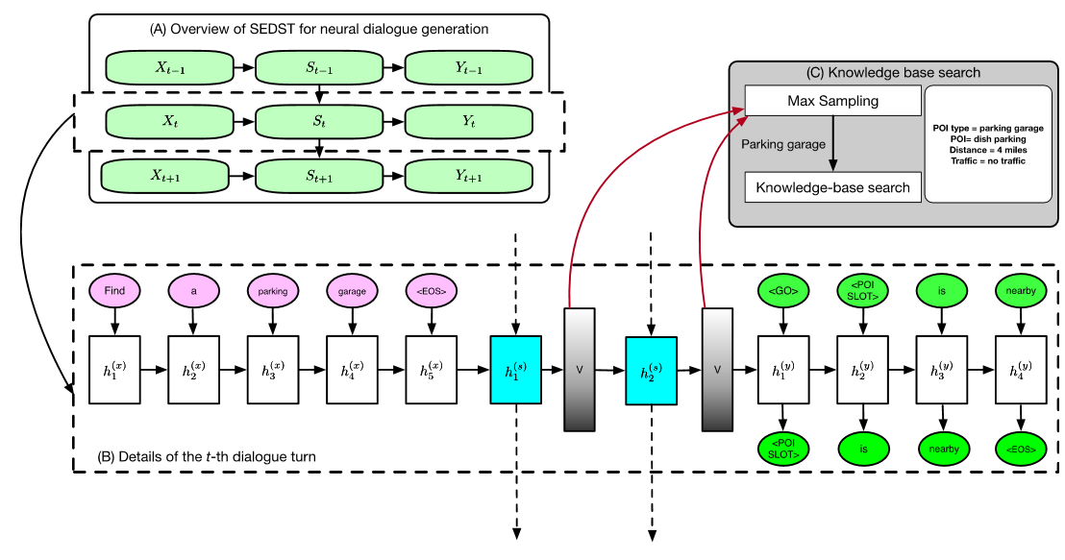
Backbone of SEDST
Copyflow network
Input encoder
State span decoder
Decode dialogue states sequentially (Lei et al. 2018)
E.g: <inf> Italian <sep> moderate </inf>
Response decoder
Backbone
I am wanting an expensive restaurant that offers African food. What is their number?
Context
(encode)
START Expensive African END
State span +
KB lookup
(decode)
Where are you located? I see two that might work but I’d like to offer the closest.
Response
(decode)
Procedure of encoding and decoding in a dialogue turn
Notes:
The backbone of our model employs a hierarchical structure. We propose copyflow network here. It consists of an input encoder, an intermediate state span decoder, and a response decoder. The state span decoder decodes dialogue states sequentially. For task-oriented dialogues, the state span is used to perform knowledge base queries.

Slide 9
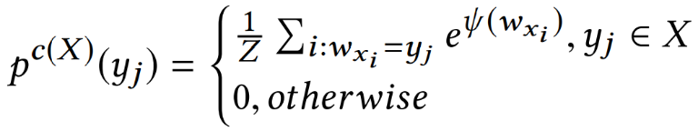
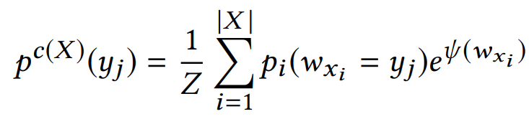



Model architecture – copyflow network
Attention GRU encoder decoder
More details in the paper
A “copyflow” from s to t:
Definition: Incorporating copying mechanism from s to t.
The probability of decoding a word is the sum of generation and copying probability
Generation probability
Copying probability
“Hard” copy (Gu et al. 2016)
“Soft” copy (proposed)
$$p_{j}^{g}= \frac{1}{Z}e^{w_{3}h_{j}^{(y)}}$$
$w_{x_{i}}=y_{j}$ : enable copying if the word exists in s
$ψ\left(w_{x_{i}}\right)$ : score of copying the i-th positional word
$p_{u}(w_{x_{i}}=y_{j})$: the probability that the i-th word in source sequence is yj
Notes:
We elaborate our discussion on copyflow network. We employ attention Gated Recurrent Unit encoder-decoder here, and more details are included in the paper. We focus on copyflows. A copy flow from s to t indicates that we incorporate copying mechanism from s to t. The copying mechanism is not hard to understand – the probability of generating a word is augmented with an additional probability of copying a word from the source sequence.
There are two category of computing copying probability. The first one is the originally proposed hard copying mechanism that copy from a deterministic sequence. Wxi equals to yj implies that the copying probability is non-zero if the word exists in the source sequence, and the score of copying the word is calculated with a multilayer perceptron with the output of encoders and decoders. More details can be found on the paper. On the other hand, we propose a soft / or implicit copying mechanism that allows copying from a sequence of nondeterministic probability distribution. The word with a higher probability has more chance to be copied. This soft copying mechanism is utilized for copying from the state span that mentioned above, which is also generated by the model and therefore is not deterministic.

Slide 10
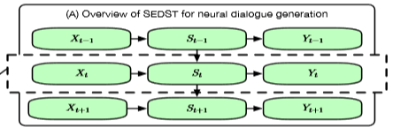
Model architecture – copyflow network
Inspired from the pattern that repeating of keywords could indicate dialogue states
Co-occurrence may span over dialogue turns – keywords should be “copied” over dialogue turns
From {previous responses, current inputs} to current state spans & From current state spans to current responses
Enables the model to “cache” keywords in state spans
Also possible to generate new words in state spans to further copy
From previous state spans to current state spans
The model learns to store information at state spans in the form of explicit word sequences
Role | Utterance
User | I am wanting an expensive restaurant that offers African food. What is their number?
Agent | Where are you located? I see two that might work but I’d like to offer the closest.
User | I do not care about the area of town.
Agent | Bedouin is an expensive African restaurant in the city centre.
Notes:
The inspiration and the principle behind the copyflow network is that the patterns of repeating of keywords could indicate dialogue states. The co-occurrence may span over multiple dialogue turns. To generate such words correctly, the model should learn to store them in the dialogue states, which is the only access to dialogue history for the model. <explain example> This pattern is also pervasive in larger non-task oriented dialogues.
To achieve the goal that the state span generates appropriate dialogue states and that the response generate state-aware responses, the copyflows need to be organized in a proper way. There are two major kinds of copy flow and both have an intuitive explanation.
There is a copyflow from the concatenation of the encoder input to the state span, and from state span to response. This two-step copying enables the model to cache keywords in state spans. We also observe that the model can generate new words in state spans which can be further copied to the response. Both of the actions can be learned in unsupervised scenarios.
There is another copy flow from previous state spans to current state spans. It enables the model to handle long-term dependency and allow the model to learn from keyword coocurrence over multiple dialogue turns.
Up to now, I have introduced a model architecture that make it easier for the model to learn from annotated dialogue states and make it possible to generate dialogue states as explicit word sequence without supervision. However, to achieve this better, we need further training techniques.

Slide 11
Training – Posterior regularization
The training can be unstable without it
Probabilistic interpretation of above-mentioned model
State span:
Response generation:
Additionally train a (helper) posterior network
Inputs for this model
Notes:
We propose posterior regularization for training. Before introducing this, let’s focus on what the model introduced previously actually calculates. The connection of the modules are actually organized as a directed probabilistic graph. <explain, xx conditioned by>We build another helper network or posterior network, that additionally task the response of the response at current turn as an input. Therefore this posterior network is not a casual system and can not be used during response generation. However, the output of this network can help the original prior network.

Slide 12
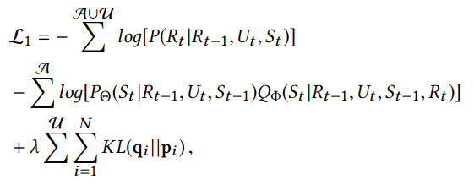
Training – Posterior regularization
Learning objective in semi-supervised scenarios for task-oriented datasets
Interpretation:
Given limited data, the posterior network learns better than the prior network, since it is exposed to more inputs
The output of the prior network is forced to be close to that of the posterior network – “weak supervision”
Response generation loss
Prior & Posterior state span generation loss
Regularization loss
Notes:
For semi-supervised learning scenarios for task-oriented datasets, there is a KL loss regularizing the output of the prior state span to the posterior state span. Given limited data, the posterior network learns better than the prior network because it is exposed to more inputs because it exposed to more inputs. The output of the prior network is forced to be close to that of the posterior network, thereby introducing weak supervision.

Slide 13
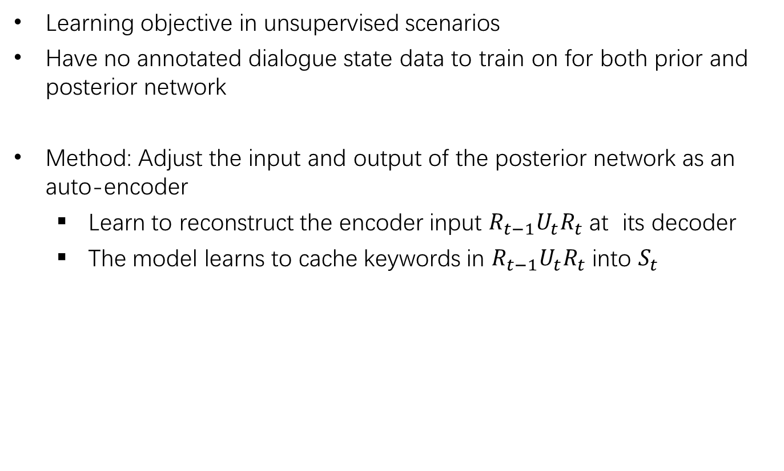
Training – Posterior regularization
Learning objective in unsupervised scenarios
Have no annotated dialogue state data to train on for both prior and posterior network
Method: Adjust the input and output of the posterior network as an auto-encoder
Learn to reconstruct the encoder input $R_{t−1}U_{t}R_{t}$ at its decoder
The model learns to cache keywords in $R_{t−1}U_{t}R_{t}$ into $S_{t}$
Notes:
In unsupervised scenarios, we completely have no annotated dialogue state data for training for both prior and posterior network. But still we can make posterior network a helper for the prior network. We adjust the input and output of the posterior network as an auto-encoder. The posterior network now learns to reconstruct the encoder’s input, which consists of previous response, current input, and response in current turn. With such a structure of autoencoder, the model learns to cache keywords into the state span.

Slide 14
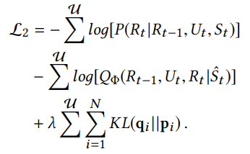

Training – Posterior regularization
Learning objective in unsupervised scenarios
Interpretation:
The posterior network learns compacted representation of $R_{t−1}U_{t}R_{t}$ with a learning objective of autoencoder
Although the prior network can explore a generation strategy of the state span, it is regularized towards the posterior network.
Response generation loss
Reconstruction loss
Regularization loss
Notes:
The loss in unsupervised scenarios consists of loss of response generation, reconstruction, and the regularization loss. Here the posterior network learns compacted representation of its input at its state span. Although the prior network can explore a generation strategy of the state span, it is regularized towards the posterior network. The autoencoder and its state is quite easy to learn, and it provides supervision signals for the prior network. Therefore, the output of the state span gets much cleaner now.

Slide 15
Outline
Introduction & Motivation
Method
Architecture: CopyFlow network
Training: Posterior regularization
Experiments
Conclusion
Notes:
We first briefly discuss current approaches for neural dialogue generation. Then we introduce bottlenecks of current approaches and thereby elicit our motivation for explicit state tracking. We discuss the proposed methods in two aspects, the architecture and the training respectively. We then present our experiments and draw conlusions.

Slide 16
Experiments
Task-oriented Dataset
Cambridge Restaurant Reservation dataset(676 dialogues)
Stanford In-Car Assistant dataset(3029 dialogues)
Non-task oriented Dataset
Ubuntu Dialogue corpus(487337 dialogues)
JD.com Customer Service corpus (425005 dialogues)
Research Questions
What is the overall performance of our model SEDST
How much does unlabeled data help dialogue state tracking on task-oriented dialogues?
Is our explicit state tracker helpful for non-task oriented response generation?
Does posterior regularization helps?
Can SEDST generate interpretable state spans?
Notes:
We experiment our model on two task-oriented dataset and two non-task oriented dataset. Cambridge restaurant reservation and Stanford in car assistant datasets are for task-oriented dialogue systems, and they include annotated dialogue states. Ubuntu Dialogue corpus and JD.com customer service corpus are for non-task oriented dialogues and do not have annotations for dialogue states.
We work on following research questions.

Slide 17
Results – task oriented
Comparisons: SEDST, SEDST\PR(without posterior-regularization), SEDST\UNLABELED(only trained on labeled data)
Metric 1: Joint Goal Accuracy(whether all the constraints are correct in a turn )
Notes:
For task-oriented dialogue systems, we majorly compare among SEDST, SEDST without posterior regularization and SEDST that trained only on labeled data. Comparisons with other baselines is included in the paper. The first metric we adopt is joint goal accuracy, that whether all the constraints for knowledge base search generated in the state span are correct in a turn. The left chart is for Cambridge restaurant reservation dataset, and the right chart is for Stanford in-car assistant dataset. We observe that SEDST outperforms SEDST without posterior regularization, and SDEST that only trained on label data.

Slide 18
Results – task oriented
Metric 2: Final Entity Match Rate(whether the state span in the final turn is correct)
SEDST outperforms SEDST\UNLABELED: SEDST could utilize unlabeled data for learning
SEDST outperforms SEDST\PR: Posterior regularization is effective
Notes:
We employ final entity match rate, which calculate the proportion of the dialogue where the state span in the final turn is correct. We observe a similar tendency. Therefore we can draw some conclusion. From the fact that SEDST outperforms that trained without unlabeled data, we know our model can utilize unlabeled data for learning. From the fact that SEDST outperforms that without posterior regularization, we know that posterior regularization is effective.

Slide 19
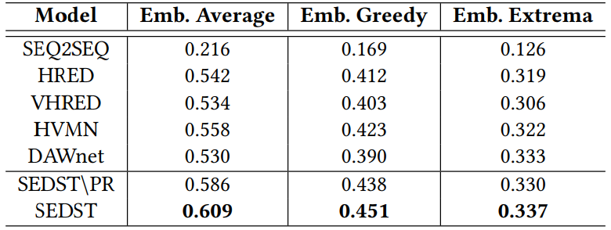
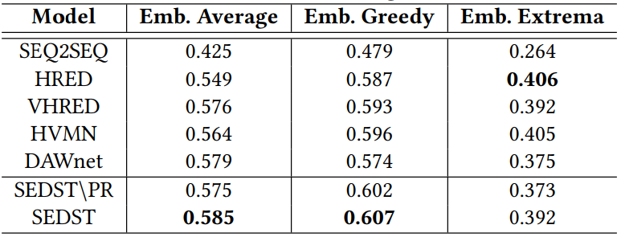
Results – Non task oriented
Metric for response generation: Embedding Based Metrics
Embedding Average
Embedding Greedy
Embedding Extrema
Specifically, our model outperforms VHRED and HVMN, which employs continuous latent variables for state tracking
(a) Table: Embedding Metrics on Ubuntu Dialogue Corpus
(b) Table: Embedding Metrics on JD.com Dialogue Corpus
Notes:
Evaluation of response quality in non-task oriented dialogue systems is not trivial because the commonly used metrics like BLEU or ROUGE score correlates badly with human evaluation. Here we employ embedding based metrics, which evaluates the similarity of the generated and ground truth responses in embedding space. From the table we find that our model outperforms most of the baseline. Quite notably, our model outperforms VHRED and HVMN, which employs continuous latent variables for state tracking

Slide 20
Examples
Contexts | Generated | Ground Truth
I just realised nothing can access my mysql database anymore , it says cannot connect , why would this be ? I did set it to be remote | State: remote would anymore mysql access Response: you can use the mysql client to connect to the server | State: - Response: is it running ?
is it running ? | State: running I says mysql access Response: yes , I am running it now | State: - Response: How do I check ? I was able to type mysql commands
How do I check ? I was able to type mysql commands | State: commands mysql I running How Response: you can use sudo | State: - Response: thats not mean your server was running check with ps or top or others tool
thats not mean your server was running check with ps or top or others tool | State: mysql top tool server check Response: thanks | State: - Response: How do I check if it ’s running ? Ah , k
How do I check if it ’s running ? Ah , k | State:mysql check ps server thats Response: ps aux | grep mysql | State: - Response:ps aux | grep mysqld

Slide 21
Outline
Introduction & Motivation
Method
Architecture: CopyFlow network
Training: Posterior regularization
Experiments
Conclusion

Slide 22
Conclusion
We have addressed the task of explicit dialogue state tracking for both task-oriented and non-task-oriented dialogue generation
For task-oriented dialogue systems, our model utilize unannotated data for learning.
For non-task-oriented dialogue systems, our model generate explicit dialogue states and improves response generation
We verify the effectiveness of our model with intensive comparison and ablation study
Future work: Transfer our model to other tasks (reading comprehension, summarization) / apply reinforcement learning to improve the state spans and response generation
Notes:
In this paper we have focused on both task-oriented and non-task oriented dialogue systems.
For task-oriented dialogue systems, our model utilize unannotated data for learning.
For non-task-oriented dialogue systems, our model generate explicit dialogue states and improves response generation

Slide 23
Thanks!
Thanks to SIGIR Student Travel Grant for travel reimbursement
Code available on:
https://github.com/AuCson/SEDST
Presenter Xisen Jin’s homepage:
https://aucson.github.io
Notes:
In this paper we have focused on both task-oriented and non-task oriented dialogue systems.
For task-oriented dialogue systems, our model utilize unannotated data for learning.
For non-task-oriented dialogue systems, our model generate explicit dialogue states and improves response generation

Slide 24
Details for KB search
Extra slides
We follow the setting of Sequicity (Lei et al. 2018)
The state spans are decoded without keyword and the queries are performed to all fields in a KB
Entity type information can be obtained with a separate classifier or pre-defined table
The retrieved results are utilized to fill in the placeholders in generated responses
What is the phone number of a moderately priced Italian restaurant?
KB-retrieval(key=moderate, italian)
The phone number for RESTAURANT_A is PHONE_NUMBER_A
The phone number for <NAME_SLOT> is <PHONE_SLOT>

Slide 25
Evaluation of state spans (non-task-oriented case)
Extra slides
We compare with DAWNet(Wang et al. 2018), which first extract “predictive keywords” with unsupervised methods then train on them with supervised methods
We calculate the proportion of the keywords that actually appear in the ground truth response
Model | Ubuntu Technical | Jd.com Customer Service
DAWnet | 5.5% | 32.6%
SEDST | 14.7% | 40.6%

