Slide 1
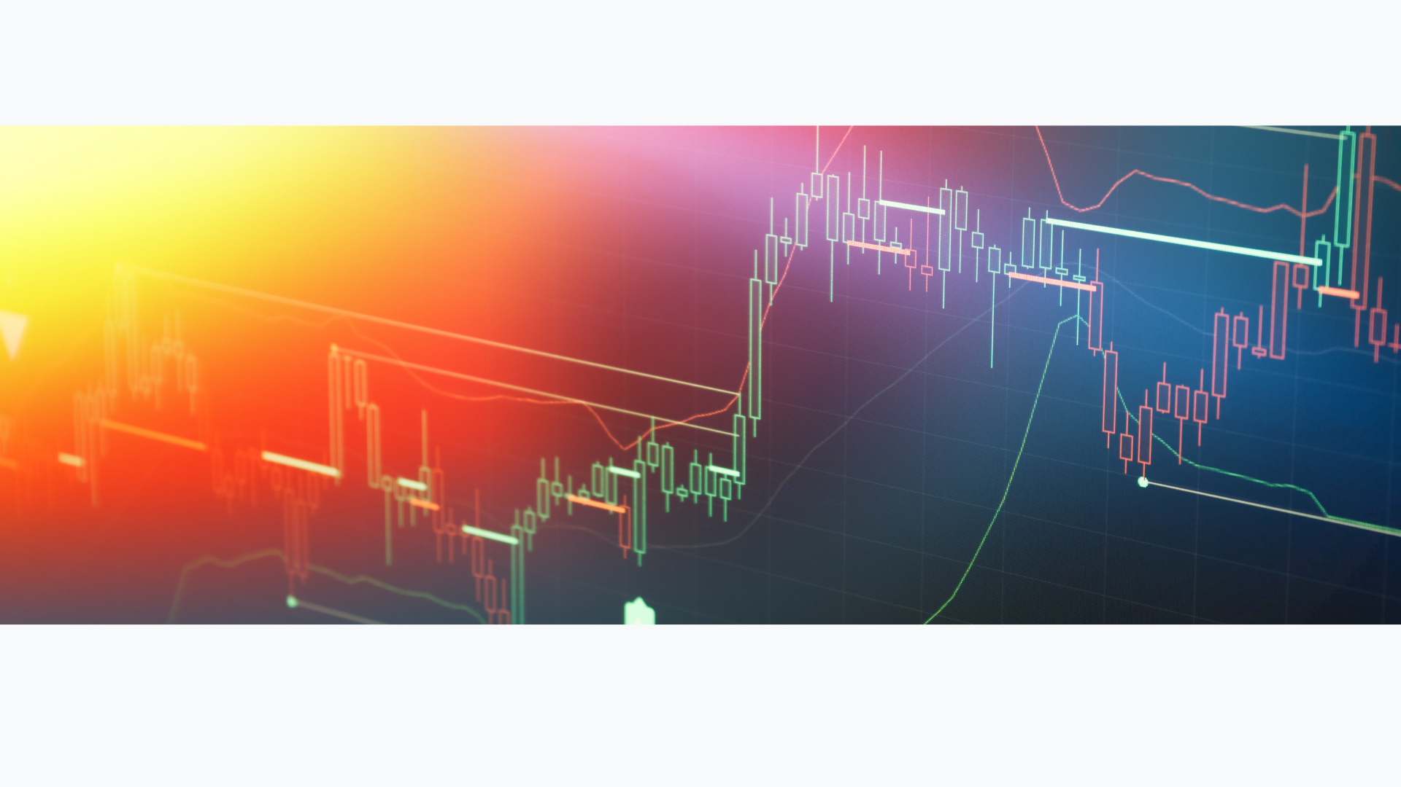


2026 - 2030
HORIZONS

Slide 2

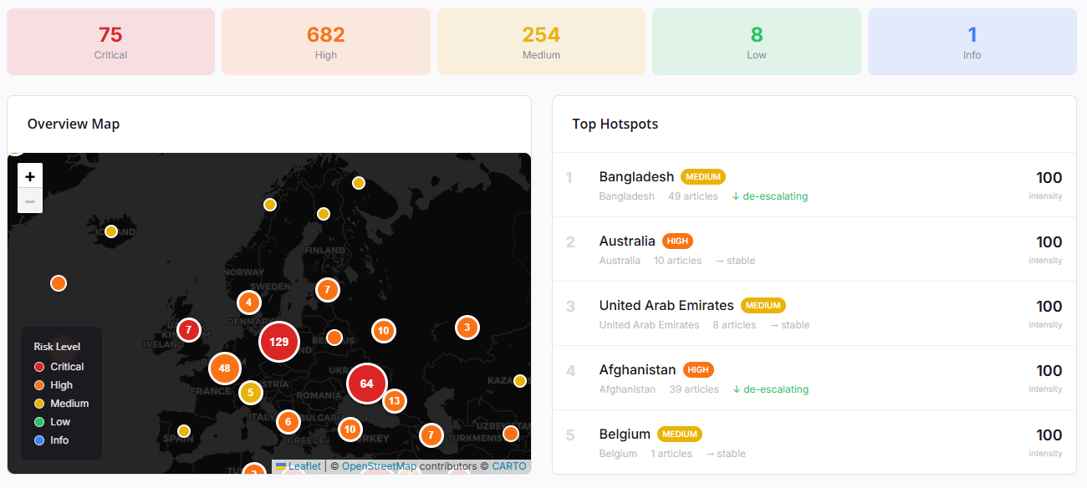
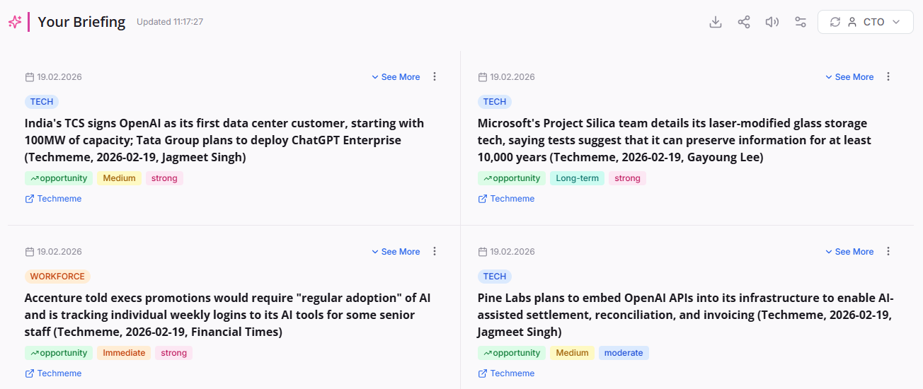
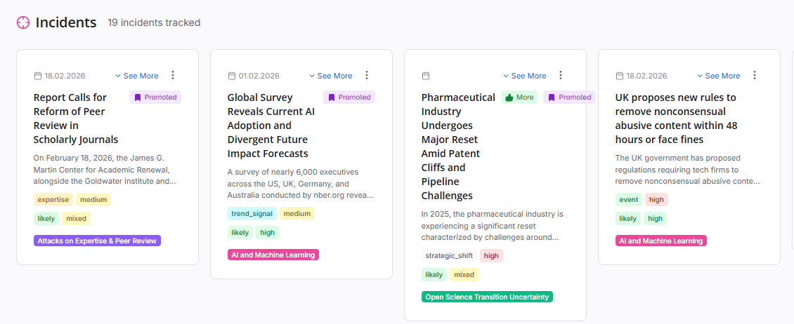
| We watch the news for you
AunooAI is an open strategic intelligence platform that continuously collects, classifies, and synthesises open-source information to produce structured foresight analyses.
The system combines automated multi-source collection with hybrid machine-learning and large-language-model enrichment, enabling analysts to move from raw information to actionable strategic insight.

Slide 3


The Analyst & Data Science Team
Oliver Rochford
Dr. Lamine M. Aouad
Lead Analyst · Strategic Advisor
Lead Data Scientist · Researcher & Academic
ADVISORY
CREDENTIALS
n8n · Arcanna AI · Picus Security · Spektrum Security · Tesseract Analytics
PhD, Computer Science — University of Lille 1
Distributed Computing & Numerical Analysis
PAST ROLES
Research Director: Gartner, Securonix, Tenable · Cybersecurity Leadership: HP, Verizon
PAST ROLES
Visiting Fellow, Marie Curie Institute Paris
Principal Researcher, Tenable
Principal Research Engineer, Symantec
Researcher, University College Dublin
SELECT PUBLICATIONS
Magic Quadrant SIEM — Gartner, 2014–2017
Innovation Tech Insight for SOAR — Gartner, 2017 (defined the SOAR category)
Quantifying the Attacker's First-Mover Advantage — cited WSJ, Forbes, Bloomberg
The Case for a Bug Bounty Program of Last Resort — cited in OECD Report
How Lucrative are Vulnerabilities? — Tenable Research, covered by Computer Weekly, IT Pro
Hacken für Dummies / Hacken Voor Dummies — MITP/Wiley, 2001 & 2003
SELECT PUBLICATIONS
Quantifying the Attacker's First-Mover Advantage — cited WSJ, Forbes
Towards Improving Privacy of Synthetic DataSets, 2021
Distributed Apriori-like Frequent Itemsets Mining, 2019
266 Google Scholar citations
406 Google Scholar citations

Slide 4

Why Human-AI Teaming Matters
Grounded AI foresight guided by expert judgement — what separates reliable intelligence from hallucinated noise
The Problem with AI Alone
The Aunoo Human-AI Retainer
Why unassisted AI intelligence fails in practice
Grounded AI · Expert oversight · Continuous improvement
NO FORESIGHT FRAMEWORK
GROUNDED AI
Generic LLMs summarise the past. Without embedded foresight structures — Three-Horizon frameworks, driver taxonomies — every prediction is word-pattern extrapolation.
LLMs guided by ontology-tagged, curated data eliminate hallucinations. AI works from trusted signal — not raw internet noise — producing defensible, auditable outputs.
NO CONTEXT MODEL
FRACTIONAL ANALYST ON DEMAND
Without a domain ontology, AI confuses noise for novelty and produces cargo cult foresight — the illusion of insight with no grounding.
Expert analysts curate intelligence, validate insights, and challenge assumptions — your forward observer always on call. Included with Enterprise retainer.
NO FEEDBACK LOOP
SELF-LEARNING TOPIC MODELS
Without continuous analyst validation, models drift, lose precision, and amplify bias. Intelligence quality degrades silently over time.
Analysts tune relevance scoring and refine scenario drivers so the system learns continuously. 98.3% of articles processed free via local SLMs.
AI without expert oversight hallucinates. Silence is not insight — it is dangerous.
AI + Foresight Tools + Human Intelligence = Faster, Reliable, Defensible Insights

Slide 5
How We Build the Intelligence
From raw information to enriched, analyst-ready signal
01
02
03
COLLECT
ENRICH
CONTEXTUALISE
Continuous, automated gathering from 7 curated source types — mainstream news, pre-print and peer-reviewed research, and expert social commentary — across every relevant language and geography.
Every article is scored on 8 analytical dimensions: relevance, sentiment, time-to-impact, driver type, forward signal, source credibility, factuality, and thematic category.
All outputs are filtered through your organisational profile, your priorities, risk appetite, competitive landscape, and sector, so analysis speaks directly to Wiley's strategic position.
Deduplicated · Scheduled · Configurable per topic
AI classifier + LLM adjudication · Confidence-scored
Framed for scientific publishing · Org-profile aware

Slide 6
How We Produce the Analysis
Five analytical lenses — each answering a distinct strategic question
1
2
3
4
5
CONSENSUS
STRATEGIC
SIGNALS
TIMELINE
HORIZONS
What do most credible sources agree on?
What are the most important long-term implications?
What is changing right now?
How is this situation evolving over time?
What futures are becoming possible?
What You Receive
Trend Synthesis
Early Warning
Emerging Topics
Cited Evidence
Convergent signals from high-credibility sources, framed for strategic planning
Weak signals and outlier developments before they enter mainstream consensus
Automatically detected new themes with velocity and novelty scoring
Every claim traceable to source articles with credibility and bias ratings

Slide 7
How Analysis Is Calibrated to Wiley
Three systems ensure every output is domain-specific, evidence-based, and relevant to a scientific publisher
Organisational Profile
Topic Ontologies
Analysis Prompts
Who is this analysis for?
What vocabulary does this domain use?
How are they combined?
Industry & org type
Key concerns & strategic priorities
Risk tolerance & innovation appetite
Decision-making style
Competitive landscape
Regulatory environment
Domain-specific categories
Future signal types
Sentiment framing
Time-to-impact horizons
Driver types
Versioned, lens-specific templates
Ontology values injected as constraints
Org profile injected as framing
Article corpus with metadata
Consistency controls (0.0–0.7)
Frames recommendations in terms of actions Wiley can actually take
Each topic has its own classification structure — not a generic tag system
Same evidence base, different profiles → fundamentally different outputs
= Analysis that is domain-specific · organisation-relevant · evidence-based · actionable for Wiley

Slide 8
What We Monitor
17 topics · ~42,900 articles analysed
AI and Machine Learning
19k
Patent Cliffs
367
Geopolitical Hotspots
18k
Scientific Publishers — General Monitoring
334
Trump Administration Tracker
1.6k
US Civil War & Societal Conflict Tracker
318
University Grants & Science Infrastructure
691
Brand Monitoring: Elsevier
218
Attacks on Expertise & Peer Review
652
Brand Monitoring: Wiley
194
U.S. Federal R&D Pullback
480
Open Science Transition Uncertainty
170
Brand Monitoring: SAGE Publishing
469
Compensatory R&D Investment Abroad
206
Publishing & Integrity Orgs Watch List
407
M&A Updates
28
Brand Monitoring: Pearson Education
399

