Slide 1
Class Diagram
Name: Abubaker
Roll Number: 21I-1379
Section: H

Slide 2
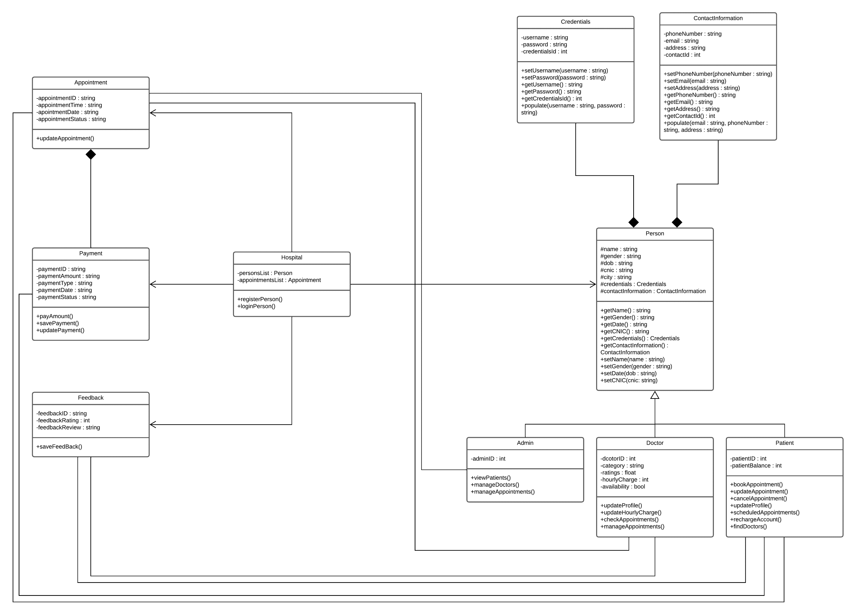

Slide 3
Explanation:
This is the oladoc class diagram, which depicts the relationships between the doctor, patient, admin, contact number, feedback, payment options, appointments, person, and credentials.
Activities at the hospital
Activities by Doctor
Patient Activity
Person’s Activity
Contact Information
Feed Back
Payment methods
Appointments
Admin
Credentials

Slide 4
oladoc's activity class diagram features
ADMIN:
Search & view Patient data
Admin can manage all the doctors
It can also manage appointments by the patients
DOCTOR:
Relation with person
Update his/her profile
Check Appointments
Manages Appointments
All the objects are linked with each other such as patients , doctor and admin’s object.
It gives full detail of hospital , admin , patient , doctor and how they can link with each other

Slide 5
Person:
All the data of person Like number email , cninc, address, password
Hospital:
This class contain all the data of person like person list, appointment, registration of person and login
Patient:
Book his appointment, update , cancel schedule
Recharge his account and find doctor
Oladoc classes and their attributes:
Hospital Entity:
Attributes: Appointment Lists, Persons List , HospitalName, HospitaliD
Patient Entity:
Attributes: patientID, patientBalance
Credential Entity:
Attributes: username , password, credentialsID
Contact Information Entity:
Attributes: phoneNumber, email, address, contactID
Person Entity:
Attributes: name, gender, dob, cnic, credentials, contact_information

Slide 6
Doctors Entity:
Attributes: doctorID, category, ratings, hourly_charge, availability
Admin Entity:
Attributes: admin_ID
Appointment Entity:
Attributes: ID , time , date, Status
Payment:
Attributes: payment_ID, payment_Amount, payment_type, payment_date, payment_status.
Feedback:
Attributes: feedback_ID, rating, review
Relationship Between the Entities
First of all person has a contact information and credentials so over here composition is done for the “HAS A” relation between
The person and his information
Second Person maybe doctor so over here polymorphism concept is implement
Third person is in hospital so inheritance concept implied over here .
Appointment , Feed back and payment also link with hospital. There object will be create in the hospital entity
Feed Back entity has a relation with patient it can sabe the feedback of person
Same as admin has a relation with patient, doctor and appointment Like admin view patients, manages doctors and appointments

