Slide 1
Augmented Reality Final Project
MR Virtual Drums
Group2

Slide 2
Introduction
Virtual Reality (VR) and Augmented Reality (AR) are transforming digital music experiences by offering immersive and interactive performance environments.
This project is an AR/MR drumming game. Gamers can place the virtual drum set in the real world and interact with it by holding virtual drumsticks with their hands. It provides a more fun and imaginative experience that goes beyond the real world.

Slide 3
Topic of Interest
This project focuses on VR Drums games, examining how virtual drumming enhances user experience, musical creativity, and physical engagement. The study will explore interaction mechanics, latency issues, realism in sound and haptics, and potential applications in music learning and entertainment.

Slide 4
Virtual and Augmented Reality in Music Performance
Simulating real-world drumming experiences with virtual drum kits.
Motion tracking for drumstick and hand interactions.
Latency challenges and solutions for real-time performance.
The role of haptic feedback and visual effects in enhancing realism.

Slide 5
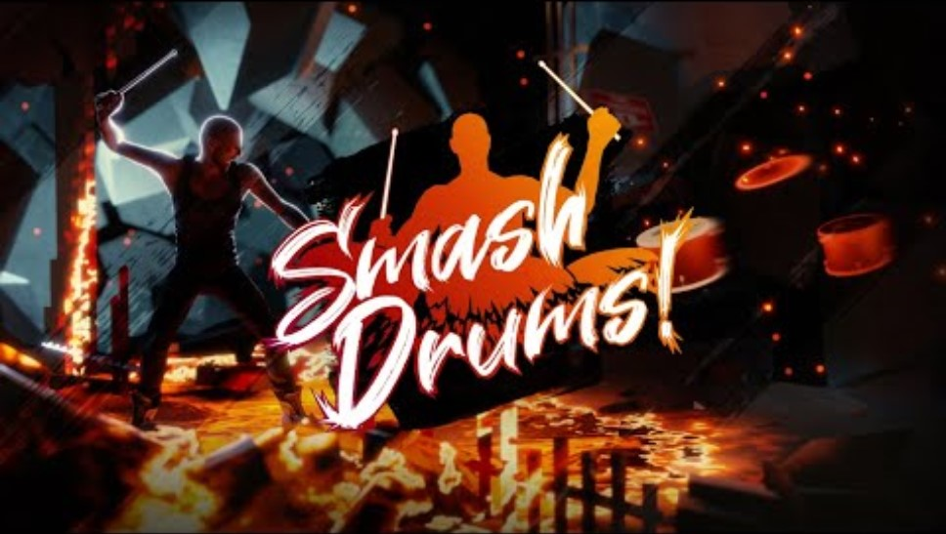
Existing Similar Works: Smash Drums

Slide 6
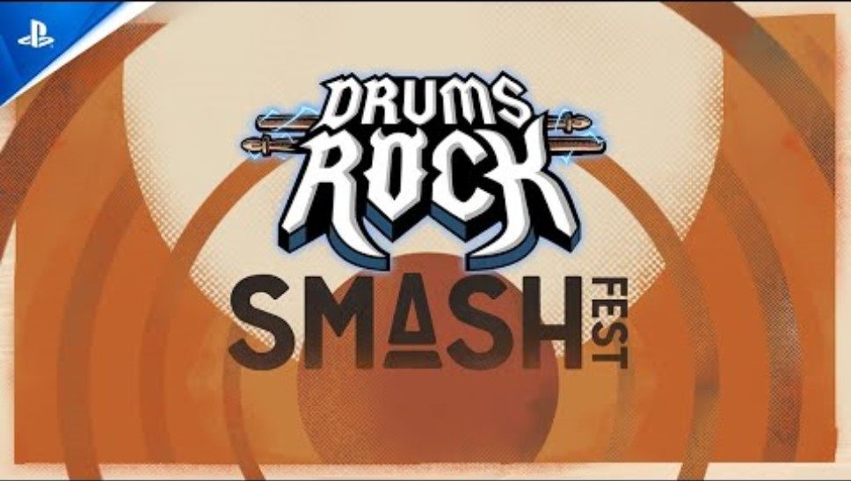
Existing Similar Works: Drums Rock

Slide 7
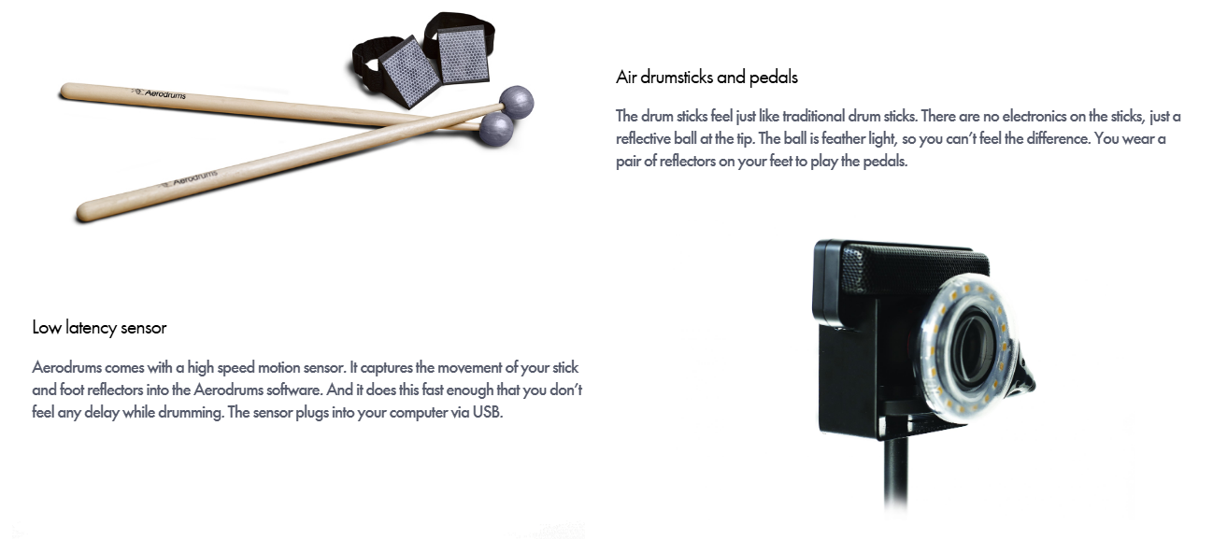
AeroDrums - Optical Tracking

Slide 8
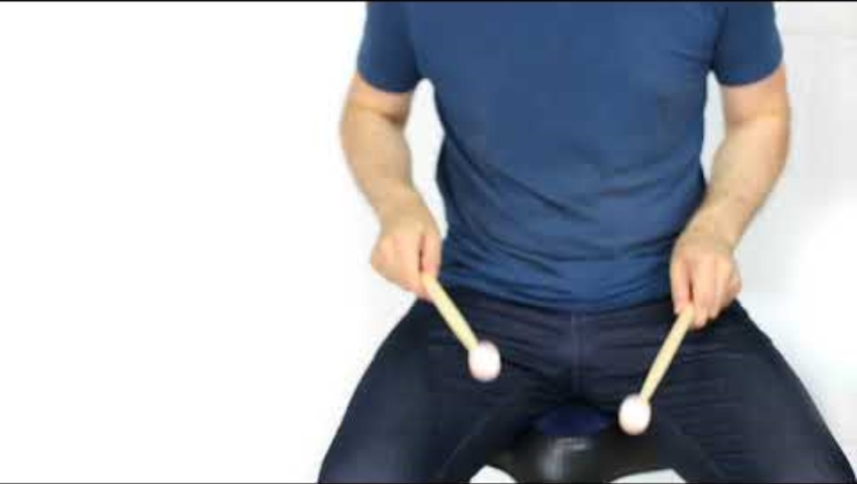
AeroDrums - Optical Tracking

Slide 9
Collision detection and hit feedback: Accurate collision detection between drumsticks and drums, precise audio and visual feedback when hitting the drum surface.
Audio and Visual Synchronization: Audios and animations should be tightly synchronized with user actions.
Controller Interaction and Drumstick Mapping: Map Quest 2 controller actions to virtual drumsticks to ensure intuitive and accurate hitting sensation.
Latency Control and Performance Optimization: Maintain stable frame rates and low latency to ensure that there will be no lag or crash during long-term operation.
Technical Challenges

Slide 10
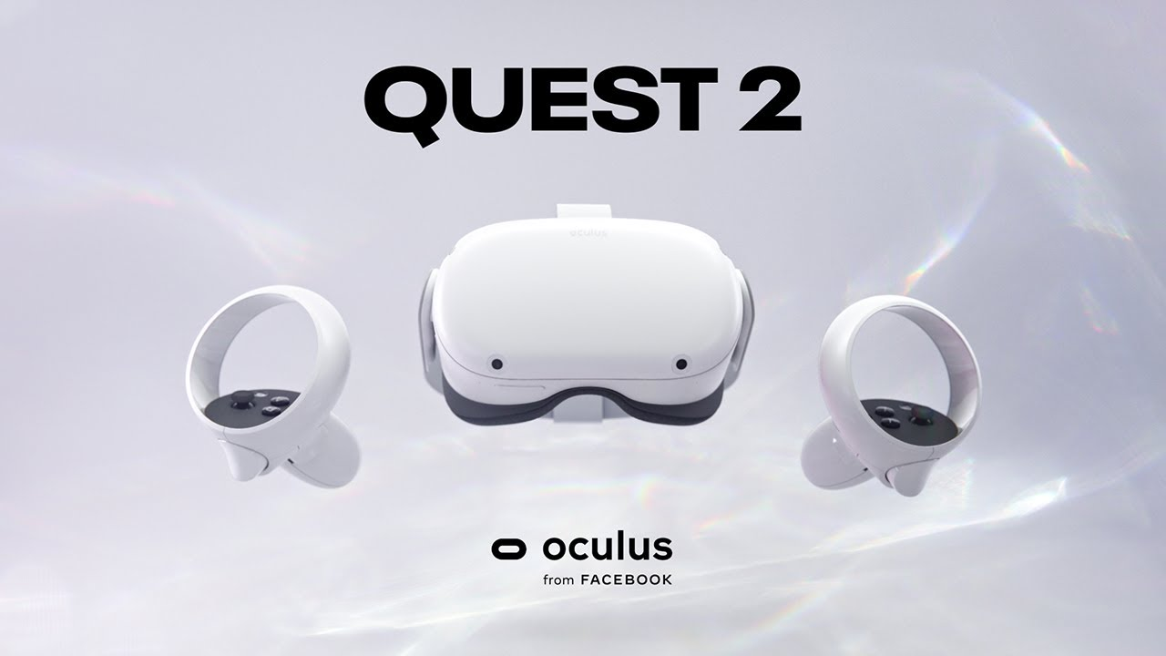
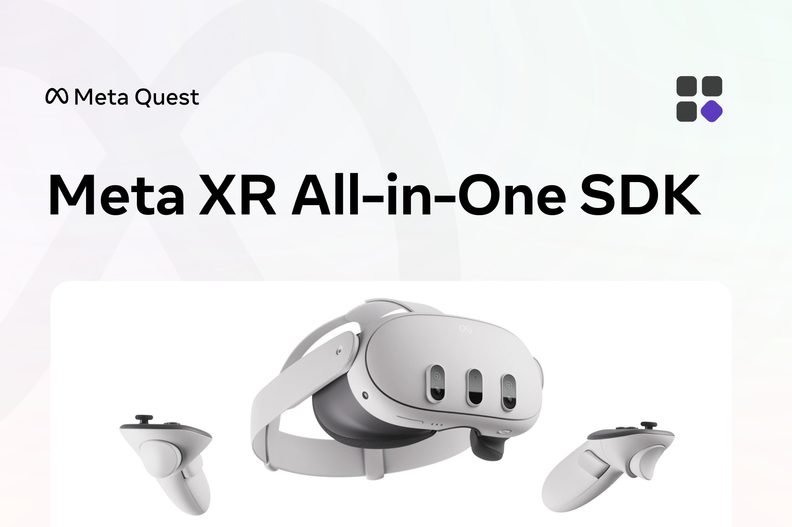

Implementation
We use the Unity physics engine to simulate drumstick motion, collision detection, and hit feedback, Quest 2 to implement grasping and releasing virtual drumsticks, and the Quest 2 passthrough API to put virtual drums in the real world.
Libraries:
• Meta XR SDK: passthrough, VR interaction
• Unity XR Toolkit: AR/VR interaction framework
• Unity Physics Engine: physical simulation and collision
Resources:
• Hardware: Oculus Quest 2
• Software: Unity, Meta XR SDK
• Asset: 3D models of virtual drumsticks and drums, drum audios

Slide 11
Evaluation
Visual and Audio Fidelity: High-quality graphics and realistic sound effects are essential for enhancing immersion. To evaluate this, we may use User Experience (UX) Testing that engages potential users in playtesting sessions and gets valuable feedback.
Real-Time Responsiveness: The system detects user inputs, like tapping virtual drums or cymbals, with minimal latency to ensure a seamless experience. The objective is to measure the delay between physical gestures and the corresponding visual response in the AR/MR environment.

Slide 12

Latest Progress
Users can grab, scale and position the drumset in the scene
Passthrough mode
When drums are hit
Play corresponding sound effects
Trigger haptic feedback on controllers
Drums bounce down and up

Slide 13
Future Plan
Add more drums and sounds
Add particle effects when drums are hit
Add music scores that users can play to

Slide 14
Thanks

