Slide 1



BIOMETRIC STUDENT ATTENDANCE
Task 3: REQUIREMENTS ANALYSIS
Presented by: GROUP 5

Slide 2
OUTLINE
1
2
3
4
Introduction
End users
Functional requirements
Non-Functional requirements
5
6
7
8
Data-flow diagram
Requirements prioritization
Constraints and acceptance criteria
Conclusion

Slide 3



1- INTRODUCTION
This requirement analysis document presents an in-depth exploration of the development of biometric student attendance mobile application. By harnessing the power of biometrics, we aim to revolutionize the traditional methods of attendance taking and introduce a more accurate, secure, and efficient approach for student’s attendance making.

Slide 4





2- END USERS
1
Lecturers/instructors: manage attendance
2
Administrators (HOD or designed person): managing the entire system
3
Students: marking attendance

Slide 5


3- FUNCTIONAL REQUIREMENTS
User Management
Student & Lecturer registration and account
Course registration
Attendance marking and data
Access by instructor
Student attendance view and marking
Biometric authentication
Fingerprint recognition and fast enough
Feedback in case of failure or success
Attendance Recording (multiple session a day &catch up classes)
Database managements
Real time reporting (notification & download of attendance)

Slide 6
4- NON-FUNCTIONAL REQUIREMENTS
Maintainability
well-documented, modular, best practices
Security
Authentication, data encryption, and authorization
Reliability
Data availability, integrity, and error handling
Performance
Response time, offline functionalities, battery consumption
Scalability
Handle large number of student
Usability
UI, guideline implementation, multilanguage support

Slide 7

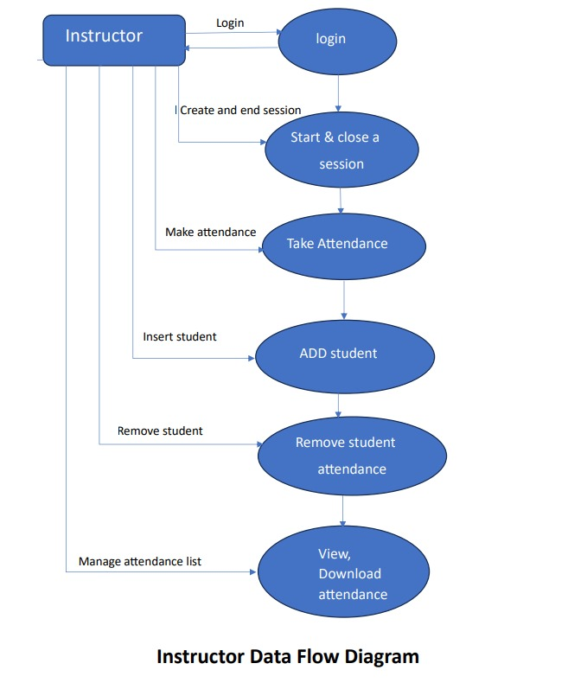
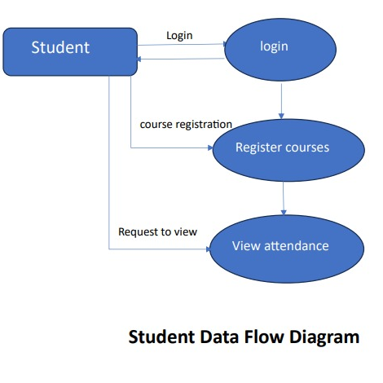
5-Data-flow diagram

Slide 8
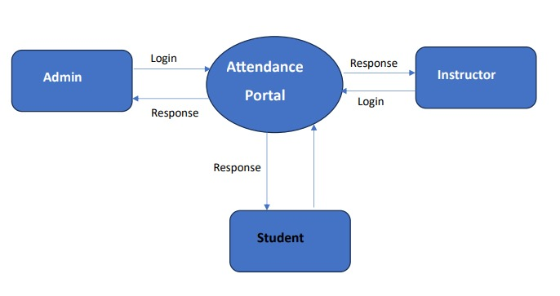
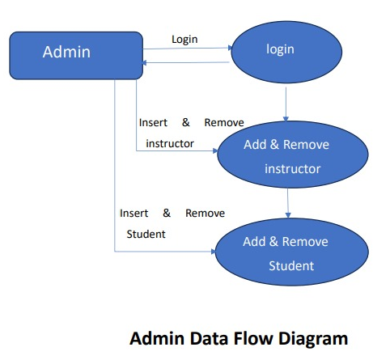
5-Data-flow diagram

Slide 9

6. Requirements prioritization
- User management
- Attendance making (fingerprint)
- Attendance data
- Biometric authentication
Functional
Performance, scalability, usability, reliability, security, portability
Non-Functional
User friendly interface
Ease navigation
Database integration
User Specific

Slide 10
7- Constraints and acceptance criteria
Constraints & assumption
Acceptance criteria
Accuracy
Speed
Scalability
Security
Integration
User-friendly
Compliance
Hardware compatibility
Integration

Slide 11
8- CONCLUSION
The development of a biometric student attendance mobile application that utilizes fingerprint recognition addresses the limitations of traditional attendance tracking methods.

Slide 12


Thank you
Presented by: GROUP 5

