Slide 1
CEF 440: INTERNET AND MOBILE PROGRAMMING

Slide 2
Group5
NAMES | MATRICULES
KENNE DATEWO SUZY MAIVA | FE21A214
SIAHA TOUKO AUBIN | FE21A304
DJEUNOU DJEUNOU MARIEKE JETTIE | FE21A168
TSAPZE ZAMBOU ROSELINE CYNTHIA | FE21A328
MATHO SONKWA HESTIE MAYELLE | FE21A438

Slide 3


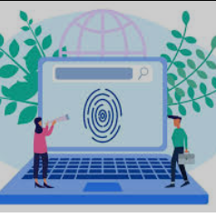
Requirements Gathering of Surdents Attendance mobile app
WWW.WEBSITE.COM
WWW.WEBSITE.COM
Planets
Although behind red, Mars is actually a very cold place.
Mercury is the second planet from the Sun
Design and Implementation
SWIPE UP!

Slide 4
Outline
01
Introduction
Project description and business need
Conclusion
02
03
Project objectives
04
Identify the stakeholders
05
Functional requirements
06
Non-functional req.
07
Constraints and considerations
08

Slide 5
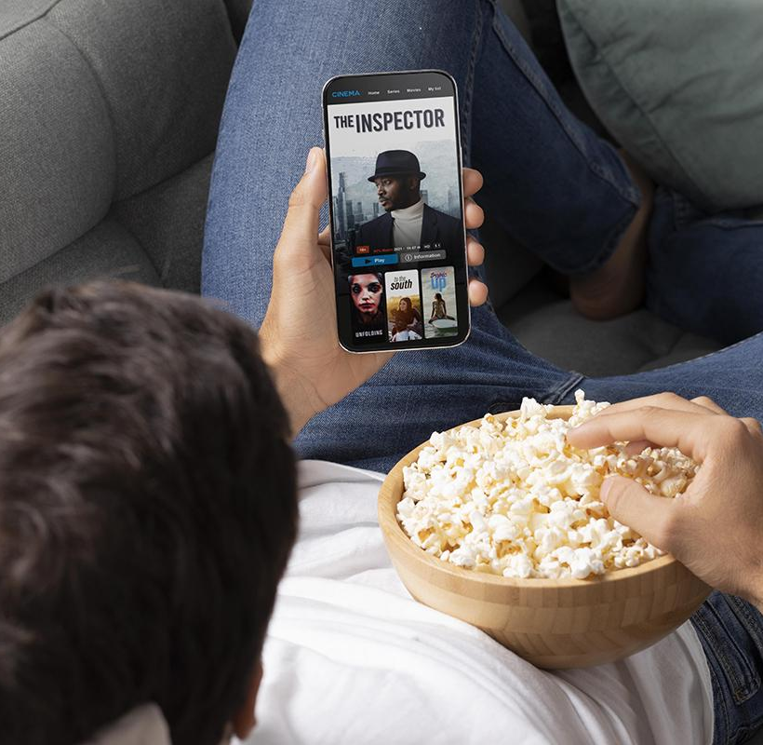
01
INTRODUCTION

Slide 6
The need for Requirements Gathering
Requirements Gathering is a crucial step for the mobile app development, the biometric student’s attendance application, which is a part of the SRS document which describe what the app will do and how it will be expected to perform where we have to DEFINE the purpose, DESCRIBE what we are building, DETAIL the requirements and DELIVER it for approval

Slide 7
02
Project description and understanding business need
Product perspective
Product features
Operating environment
Design and implementation constraints
Users need and documentation
Assumption and dependencies

Slide 8











Collect user’s requirements
You can use various methods to collect and analyze data about the users
Tools
- surveys
- Interviews
- focus groups (6-10)
- personas
- user stories
- user journeys
- prototype

Slide 9
Product Perspective
Product perspective
Operating environment
Design & impl constraints
Users need & documentation
Assumption and dependencies
Product features
The app will interact with the existing student attendance management system, which will include database and backend infrastructures.
will provide a convenient and secure way for students to mark their attendance using biometric authentication.
This project aims to use biometric technology, specifically fingerprint recognition, to create a secure and reliable system for recording student attendance.
will provide an intuitive interface for students and instructors

Slide 10
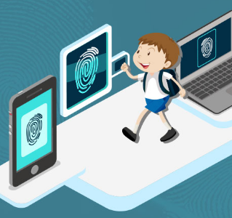
Project Features
Product perspective
Operating environment
Design & impl constraints
Users need & documentation
Assumption and dependencies
Product features
- Biometric Authentication (fingerprint)
- Attendance Marking (scanning)
- Real-time Data Synchronization
- Notifications
- Reporting and Analytics
- User Management

Slide 11

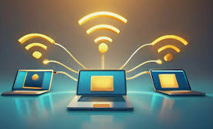

Operating environment
Product perspective
Operating environment
Design & impl constraints
Users need & documentation
Assumption and dependencies
Product features
Mobile Platforms: Android and iOS
Network Connectivity: synchronization

Slide 12
Design and implementation constrainst
Product perspective
Operating environment
Design & impl constraints
Users need & documentation
Assumption and dependencies
Product features
- Security considerations: The app must adhere to security best practices to ensure the privacy and integrity of biometric data and attendance records.
- Compatibility: should be compatible with a range of mobile devices and operating system versions to accommodate a diverse user base.

Slide 13
User needs and documetation
Product perspective
Operating environment
Design & impl constraints
Users need & documentation
Assumption and dependencies
Product features
- Each user will need to register into the system
- Students will be able to register their fingerprint and associate it to their account
- Instructors will be able to create different sections/courses for them to track student’s attendance, get notifications.
- The admin will be able to manage lecturers in the system.

Slide 14
Assumption and dependencies
Product perspective
Operating environment
Design & impl constraints
Users need & documentation
Assumption and dependencies
Product features
- Existing Infrastructure: The mobile application assumes the availability of a backend infrastructure, including a database and APIs, to store and retrieve attendance data.
- Biometric Technology Integration: depends on the successful integration of biometric authentication technology within the mobile platform.

Slide 15
03
Project objectives

Slide 16
Primary goals of biometric attendance
- Automate the process of recording student attendance using biometric authentication.
- Improve accuracy and reliability by dropping manual entry errors and proxy attendance.
- Provide real-time attendance data for effective monitoring and reporting.
- Enhance security by using biometric identifiers to verify student identity.

Slide 17
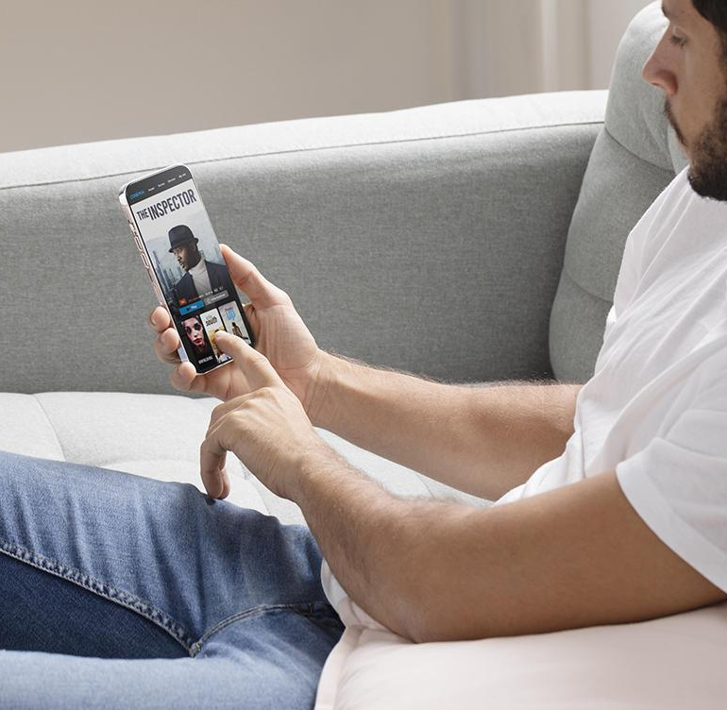
Advantages And Disadvantages of the app
Adv.
- Save of time compared to traditional method
- Error-prone
- Real-time attendance tracking
- Data synchronization
- security
DisAdv.
- Need of internet connection

Slide 18
04
Identify the stakeholders
Actors of the system

Slide 19

Stakeholders
Who will be affected by the app ? Business owner? Users? Or other decision makers?
The key stakeholders involved in the biometric student’s attendance app project include:
1) Lecturers/instructors:
2) Students: The end-users
3) Administrator: e.g.: HOD

Slide 20
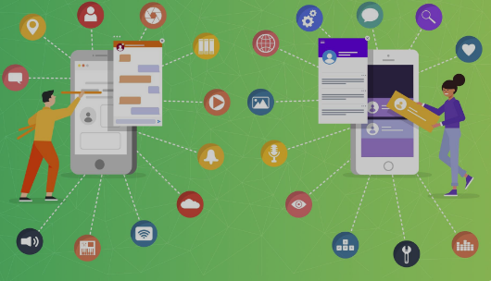
05
Functional requirements

Slide 21
Functional requirements
These requirements describe what the system should do and how it should respond to various inputs or stimuli.
User management:
Student registration
Lecturers' registration
The system should support the registration and management of student’s profiles
Each profile should include information such as student’s matricula, name, and biometric data
Allow for adding, updating, and deleting student’s profiles
Attendance marking: Display details like date, time, course title & code
Attendance data
Student attendance viewing: date, time, course name, attendance status (present, absent, late)
Admin attendance access: export attendance, download it

Slide 22
Functional requirements
These requirements describe what the system should do and how it should respond to various inputs or stimuli.
Biometric authentication:
The system shall support fingerprint biometric authentication method
Should be fast response (less than 5 second for each student)
Provide feedback to students, in case of failure or not.
Attendance recording:
Record timestamp of a student when he mark the attendance
Attendance record should be stored securely and be easily retrievable for reporting purposes.
The system should handle multiple attendance session in a day

Slide 23
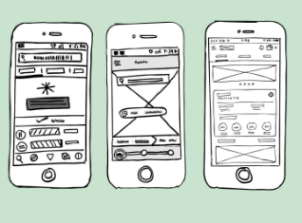
06
Non-Functional requirements

Slide 24
Non-Functional requirements
Define the qualities, constraints, and characteristics that describe how a software system should behave or perform, rather than specifying its specific functionality
Performance:
- Response time (<5 seconds)
- offline functionalities
- Battery consumption
Usability
- UI
- Accessibility
- Localization
- Intuitive and minimal training
- Provide clear information

Slide 25
Non-Functional requirements
Define the qualities, constraints, and characteristics that describe how a software system should behave or perform, rather than specifying its specific functionality
Reliability
- Availability (when needed)
- Data integrity
- Error handling
Security
- Authentication
- Data security
- Authorization

Slide 26
Non-Functional requirements
Define the qualities, constraints, and characteristics that describe how a software system should behave or perform, rather than specifying its specific functionality
Portability
- OS (Android & iOS
Scalability
- Large data handling
- Scale up and scale out
- Delay of recording avoided

Slide 27
07
Constraints and considerations

Slide 28

Compliance and consideration
- Compliance: adhering to predefined standards, regulations, guidelines, or specifications that are relevant to the software system being developed
- Hardware compatibility: devices
- Integration: with exiting university systems

Slide 29
08
CONCLUSION
Recap of the work

Slide 30
CONCLUSION
In summary, as far as mobile app development is concerned, the requirement gathering should be taken into consideration. These requirements will serve as a foundation for the design and implementation of the system, ensuring a correct, efficient, and secure method of tracking student attendance.

Slide 31
—Anonymous
Transforming Requirements into Mobile delights, for the success of your app !

Slide 32
Thank You !

