Slide 1
Aubrey Monk
18026172

Slide 2
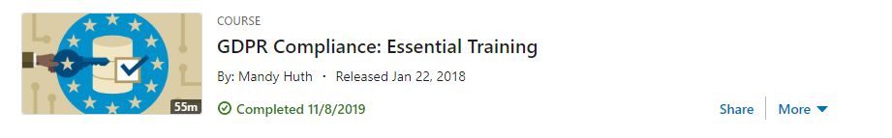
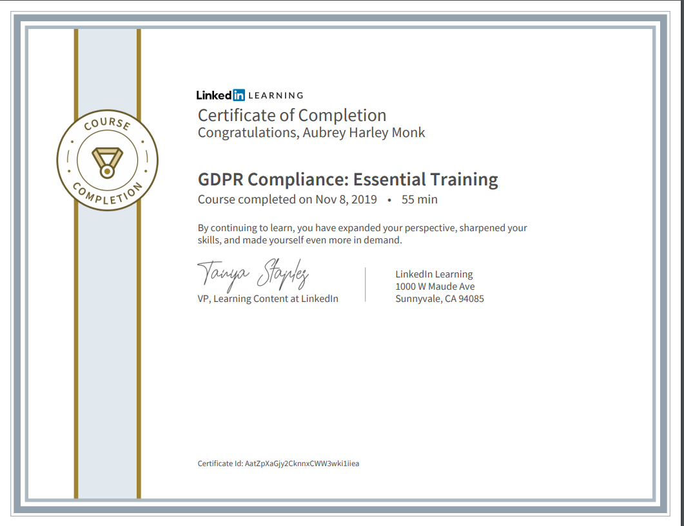
LinkedInLearning.com: GDPR Compliance Training - November 8th, 2019
I have never done a LinkedIn Learning course before, so I was curious as to how it was done, also I did not know much about GDPR, so I felt it was important for me to find out. During the course I was shown different videos on GDPR and asked to complete a test after each section, during this I felt very confident that I was grasping the topic well and I was also shocked to learn how important GDPR will be for my future career. After completing the course, I felt glad that I had chosen this activity as I learnt lots of important information. I think the reason this activity went especially well is because I took extra notes, this meant that I was able to retain the information I had learnt much more easily. This course was very useful as I will certainly need to know about GDPR for my career, it is very crucial in the Software Engineering industry because if I don’t work under GDPR standards I could jeopardize my career or get the organization I'm working for in trouble or fined. The only thing I feel like I could have done differently was do extra research on the parts I did not understand as well. My next steps are to attend Matthew Crossley’s lecture on GDPR which will occur on January 13th, 2020, I believe this will help me further solidify the knowledge I have gained doing this course.

Slide 3
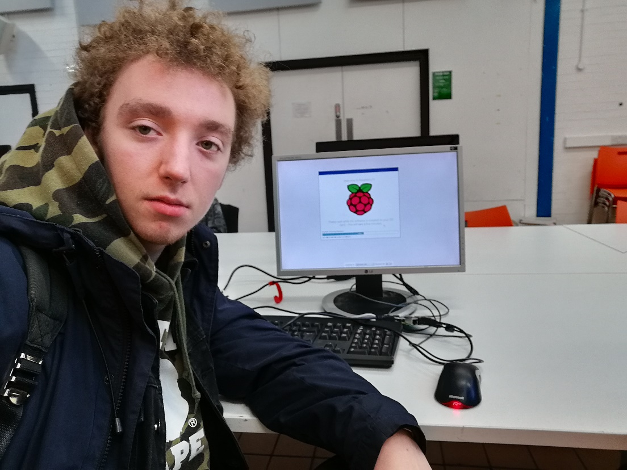
Raspberry Pi Jam at The Shed - December 14th, 2019
During the Pi Jam I attended a workshop on Python and then began to work on one of my university projects on a Raspberry Pi. Before going to this event, I did not know what to expect as I have never attended anything like this before, I felt quite nervous and anxious as I knew I would be meeting and talking to new people. During the start of the event I felt especially anxious, however, as time went on I finally settled in and was able to speak to others about what they were working on and about my university project. One positive aspect of this experience was that I gained new knowledge on Python such as syntax, how the language works and what it is used for, I feel this was beneficial to me as I have been eager to give python a go and I’m sure I will need to use the language in my future career. However, being nervous meant I was not able to get the most out of it as I found it difficult to chat and ask questions, this meant I couldn’t get all the knowledge I would have hoped for whilst learning Python. I think the main cause of my anxiety was that I was in an unfamiliar situation with new faces. I would like to attend another Pi Jam again and to be better prepared I researched good books on overcoming Social Anxiety and have ordered one of the books I found off Amazon.
https://www.amazon.co.uk/Beyond-Shyness-Conquer-Social-Anxieties/dp/0671741373/ref=tmm_hrd_swatch_0?_encoding=UTF8&qid=&sr=

Slide 4
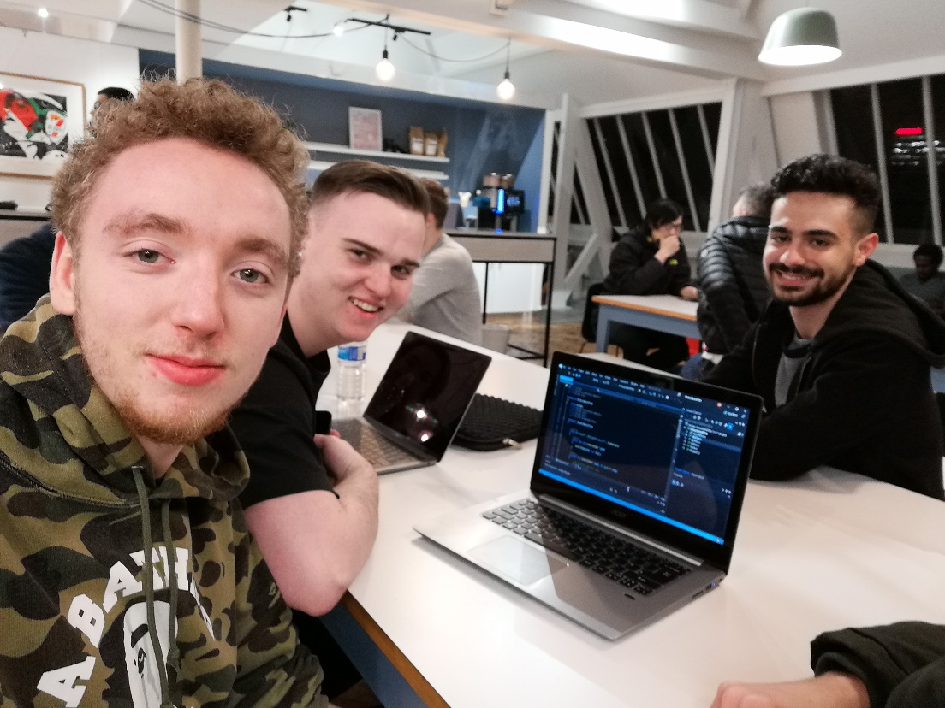
Code Up at Sevendale House - January 13th, 2020
Code Up is an event where lots of different people get together and help each other with their coding, there are also mentors that can give you guidance. Before this event I felt a lot less anxious than I did before the Pi Jam, during the event I barely felt anxious at all and I was very interested in talking to many different people that were there. Afterwards I was very happy I came and would like to attend another event like this one. The best thing about going to Code Up was having very insightful conversations with people working in the Software Engineering industry, I discussed things such as what it is like working in that sort of environment and the positives and negatives of the job. I also got help on some of my code I was writing for university, this was especially helpful as I was just beginning to learn a new language for my project. I think the reason I was a lot less anxious in during this in comparison to the Pi Jam was because it wasn’t a completely new experience to me, also I went with a few friends from my course, so I had familiar faces with me and this made me feel more at ease. In conclusion it was very successful, and I feel there was little I could have done differently this time, I would really like to go back to the next Code Up, I plan to do so on their next event on February 10th, 2020.

Slide 5
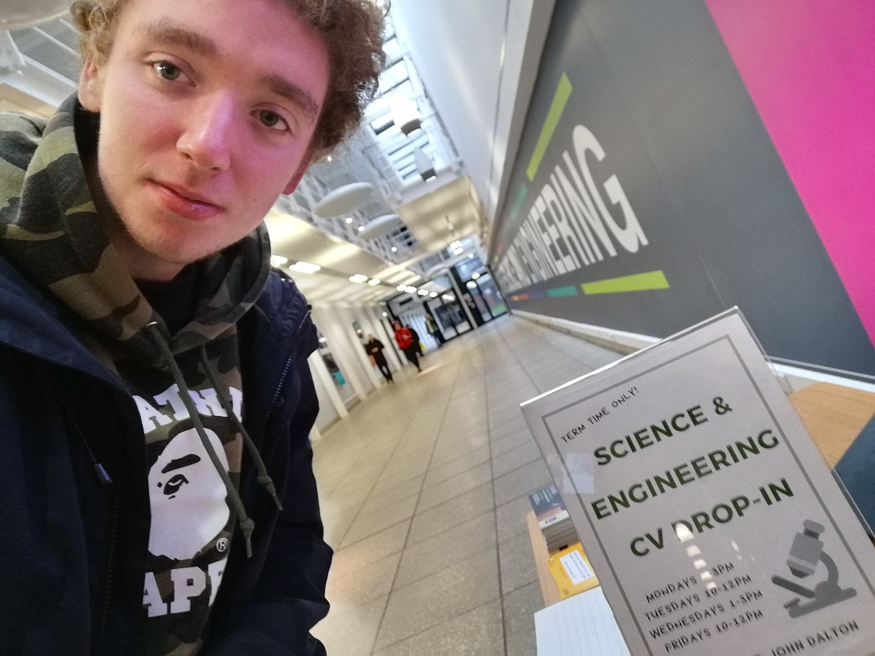
CV Drop In at the John Dalton ‘Street’ - 13th December 2019
Before going to the Drop-In, I had a professional CV but felt a little unprepared because it was not fully complete. During the drop-in I spoke to someone who gave me lots of helpful advice on how I could improve things such as layout and grammar, this made me feel quite confident on how I could remedy my CV. The only problem that arose was that I was unsure on the exact role I wanted my CV to be for, this meant that I was not able to receive advice on the specific skills and information that I could add to my CV to improve it for a certain job role. After the drop in I went through and made the suggested changes, but I felt a little unsettled that I could not fully finish my CV. Overall it was a positive experience and I gained lots of new knowledge CV writing such: as CV layout; how to talk about myself; and the things employers are looking for on a CV. However, I think I should have come better prepared as I would have been able to get advice on how to cater my CV towards a specific role. My next steps will be to do some more research into the Software Engineering and Computer Science industry and find a few specific job roles and skill sets, with this information in mind I will re-attend the drop-in.

