Slide 1




Predicting Rich’s transportation rates of unknown markets
Boya Zhang
SUNY Buffalo State College
Mathematics Department 2020/5/15

Slide 2


Outline
1. Introduction
2. Method or Approach
3. Data Analysis & Results
4. Conclusions

Slide 3
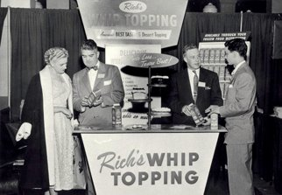




Introduction
Background
1959: the nation’s first non-dairy creamer hits supermarkets

Slide 4
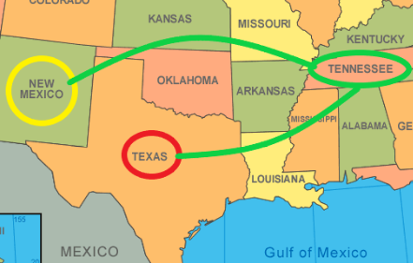
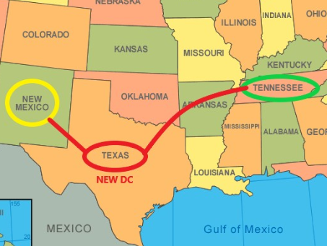
Project Aims
New Business Needs
New DC added in TX instead of old DC in TN
DC: Distribution Center

Slide 5
Method or Approach
General steps for project
1.defining project
3.collecting data
5.interpreting results
2.setting clear measurement priorities
4.analyzing data

Slide 6
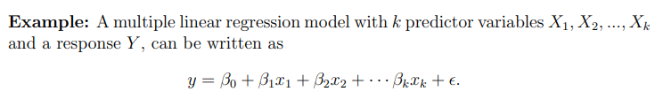
Method or Approach
1.Theoretical method
2.Technology method
Python
sklearn library
Jupyter Notebook

Slide 7
Data Analysis
Understanding existing data
Factors | DataTypes | Explanation
BaseRate | float64 | BaseRate was supplied to Rich by a shipping company, so Rich wanted to know expenses incurred
Carrier_Key | object | Unique code identifying an authorized carrier
Cases | int64 | Total cases’ volume of the inventory on thecarrier move
Cube | int64 | Total cubic volume of the inventory on the carrier move
Detention | float64 | Detention fee
Fuel | float64 | Fuel fee
Handling | float64 | Handling fee
Layover | float64 | Layover fee
LoadMiles | int64 | Total miles traveled
Mode | object | TL, MTL, LTL, IM
OtherAccessorial | float64 | The charge of other Accessorial fee
ShipDate | datetime64 | Date of shipment
StopCharges | float64 | Charges for stops
Stops | int64 | Number of stops
TotalAccessorial | float64 | The total charge of other Accessorial fee
TotalCharges | float64 | Total charges
Weight | int64 | Total weight of the inventory on the carrier move.
origin | object | The initial city and state names
destination | object | The destination city and state names
Per Mile Charge | float64 | Per Mile Charge
Fuel_fee
Split into years
and months
Frequency

Slide 8
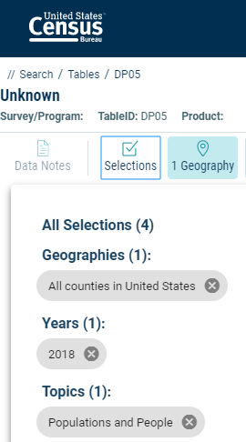
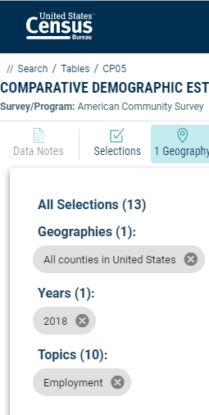
Data Analysis
Processing external data
Add population rate data to the dataset
The data unit: (thousand/city)
The data type: int64
Add employment rate data to the dataset

Slide 9
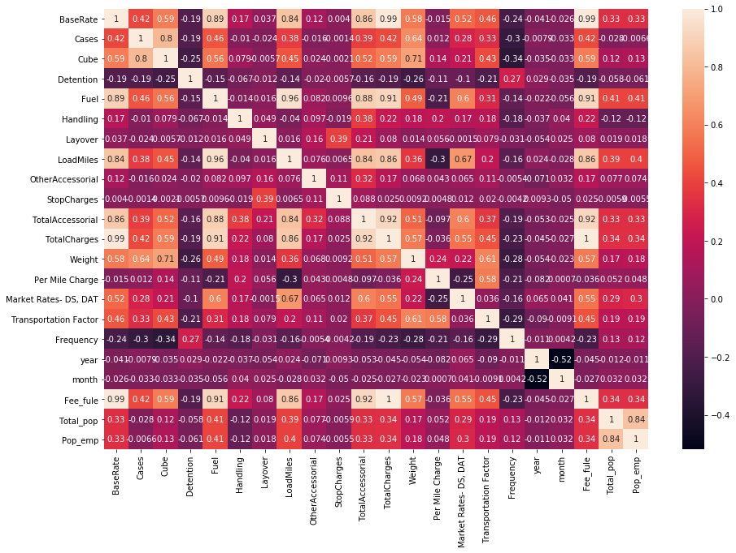
correlation matrix
TotalCharges=0.99BaseRate+Fuel+0.99Handling+Layover+0.99StopCharges+0.99OtherAccessorial+0.09fee_fule+0.088Detention+0.187

Slide 10
Data Analysis
Data processing flow

Slide 11
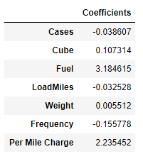
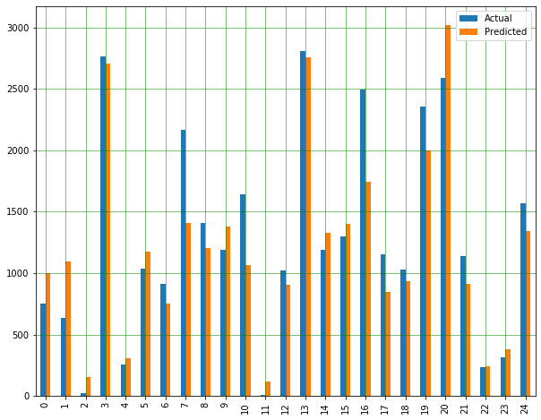

The influence of each internal factor in BaseRate (Take spring as an example)
result：
BaseRate=-0.04cases+0.1cube+3.18fuel-0.03LoadMiles+0.15frequency+2.23PerMileCharge+184.5

Slide 12








No external factors
Add external factors
Spring
Summer
Fall
Winter

Slide 13



Conclusions
Final Conclusions
Comparing the external factors with the internal factors (r squared, Mean Absolute Error, Mean Squared Error, Root Mean Squared Error) concluded that the formula.
Spring
Summer
Fall
Winter
Improvement :Collect external data from Canada for processing
Predictions are made using different machine learning models, such as Random forest

Slide 14
THANKS
Q & A
This research was partially supported by The Mathematical Association of America (MAA) and the National Science Foundation.
Thanks to Dr. Joaquin Carbonara, Dr. Xu Hongliang and Catherine March and her team at Rich’s (in particular Esha Thorat) for their guidance.

