Slide 1
Adventures of a Generalist Data Scientist
A look at Some of My Works at the Word Bank Group
Dunstan Matekenya, Data Scientist, World Bank Group

Slide 2
Share the diverse work that I have done
Provide some career guidance on DS
Provide guidance on potential DS research areas through Q/A
This is not a typical seminar as there is no focus on a research topic, instead, I will ….

Slide 3
Outline
Diverse DS Projects at the WBG
QA(DS Research areas & Career
DS career

Slide 4




My Data Science Career Illustrated
PhD research-Big Data
Freelance Data Scientist
Part-time ML Engineer-Startup
Data Scientist, WBG
Mobile phone data and development
Geospatial data (high resolution imagery)
Teaching DS
Random DS work
B.Ed (Mathematics)
Statistician, NSO, Malawi
Statistician with focus on GIS
2001-2006
2007-2008
2009-2013
2014-2016
2017-Present

Slide 5
I often consider myself a generalist Data Scientist because I solve problem of the day.

Slide 6
“DATA SCIENTISTS SPEND 80% OF THEIR TIME ON THE UNSEXY WORK: DATA ACQUISITION, DATA CLEANING, MUNGING, ETC”

Slide 7
Generalist Data Scientist Vs. Specialized Data Scientist
Generalist
Specialized
Job title: Data Scientist
Job description:
Data collection
Data analysis of any type
ML model building
Data visualization
DS project management
Job title: Data Scientist, ML Engineer, Research Data Scientist, Geospatial Data Scientist, Deep Learning Scientist, Visualization Specialist, Data Engineer, NLP Engineer, etc
Job description:
Focus on specific data (NL, images etc)
Focus on specific DS task (e.g., ML, visualization

Slide 8
Overview of my Diverse Projects at the Bank
Using mobile phone data in transport and health
Machine learning for missing data imputation
Large scale web scraping

Slide 9
Mobile Phone Data for Transport

Slide 10
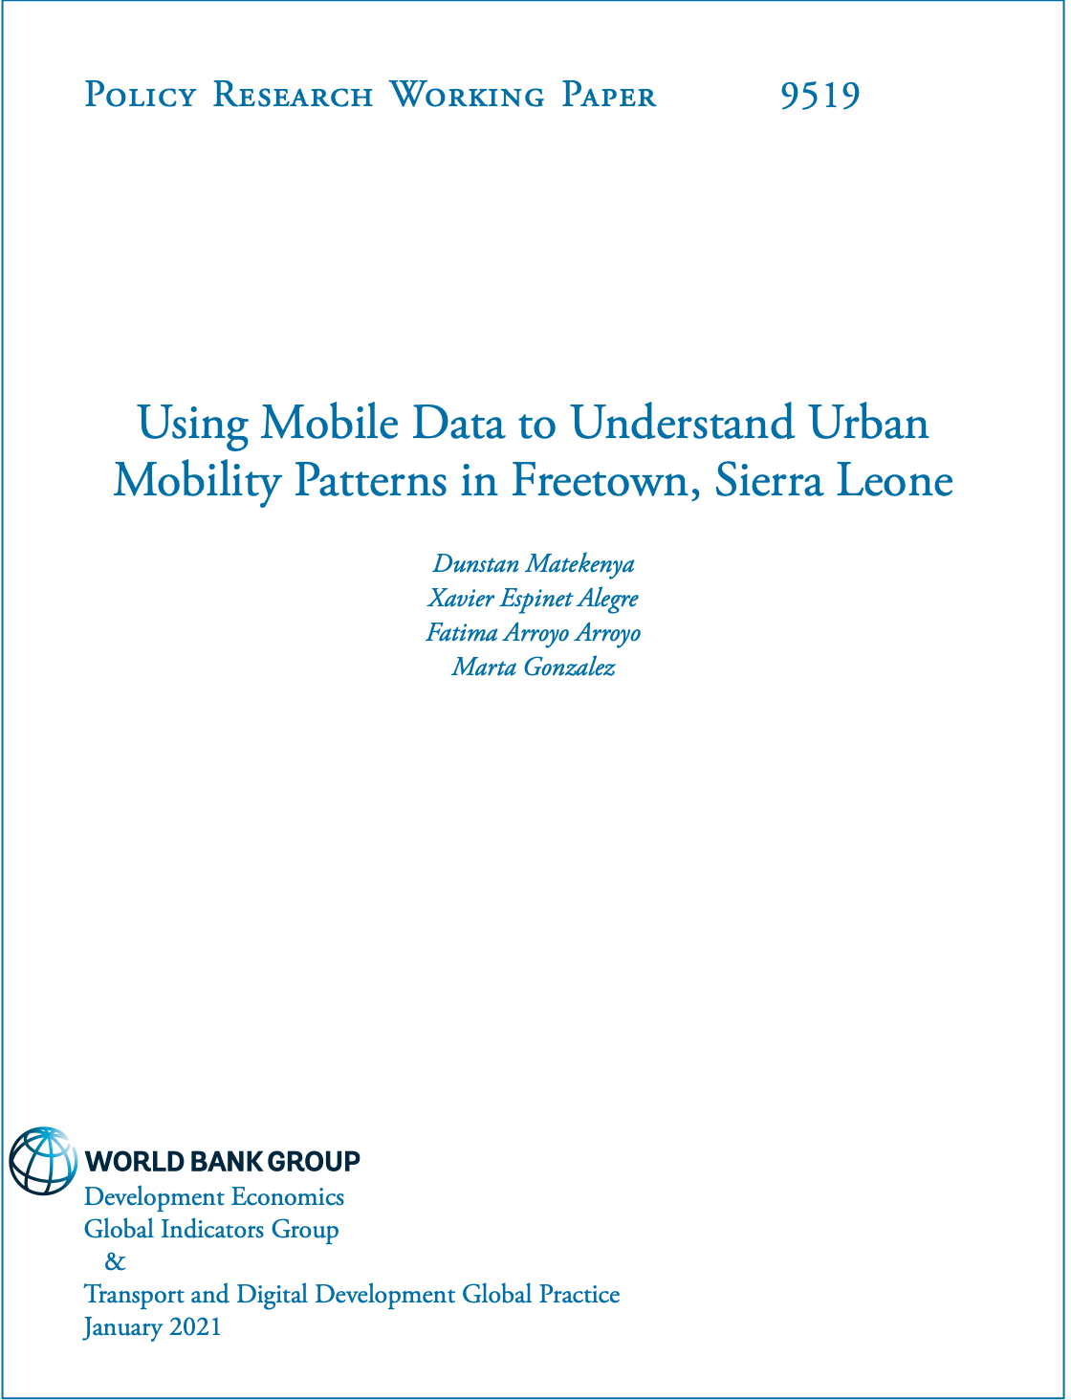
See this paper for technical details of this work

Slide 11
Mobile Phone Data Health

Slide 12
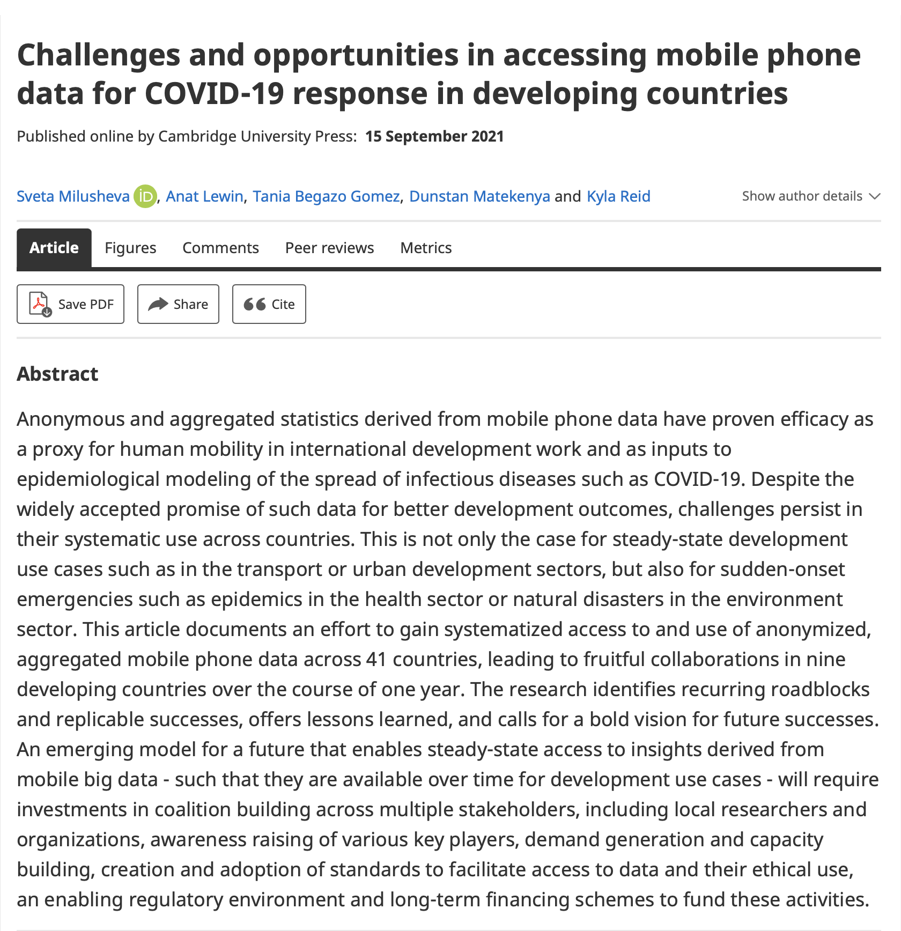
See this paper for technical details of this work

Slide 13
Machine Learning for Missing Data Imputation

Slide 14
Large Scale Web Scraping

Slide 15
QA
Data Science careers
Data Science Research topics
PLEASE ASK ALOT OF QUESTIONS TO LEARN ABOUT DS CAREER CHOICES AND DATA SCIENCE RESEARCH AREAS

Slide 16
Data Science Careers By Task
ML
Engineering, Infrastructure
Visualization
Teaching
Research (find new algorithms)

Slide 17
Data Science Careers By Industry/Discipline
Technology
Recommendation systems
Customer service
Product Science
Operations Research
Computer vision
Health
Others

Slide 18
THANKS FOR LISTENING

