Slide 1
Data Generation in Python
Web Scraping and APIs
Big Analytics with Python, AIMS 2022
Dunstan Matekenya, PhD

Slide 2
Expected Learning Outcomes
At the end of the session today, learners should:
01
BE FAMILIAR WITH ESSENTIAL PYTHON LIBRARIES FOR DATA SCIENCE
Learners should know which libraries to use for different data science tasks and use cases. For example, how to process spatial data or how to handle large scale data
02
UNDERSTAND KEY CONCEPTS IN WEB SCRAPING AND ACCESSING APIS
How you can generate, pull and assemble data using from websites and APIs using Python packages such as requests and BeatifulSoup.
03
APPRECIATE HOW TO PROCESS SATELLITE IMAGES IN PYTHON
Be able to handle spatial data in Python

Slide 3
Lecture Outline
1
Why Bother About Getting Data from Websites?
2
Introduction to APIs
API requests, Status codes, Qeuery parameters, Content type, JSON data
3
Web Scraping Primer
Why scrape websites, HTML, tools, key steps
4
Following Etiquette When Accessing Data Online

Slide 4
Why Gather Data From The Web
A LOT of data is on the Web
Some Data is only on the Web (e.g., Social Network Data, E-Commerce websites)

Slide 5
A Brief Introduction
To APIs

Slide 6
What is an API?
Application Program Interfaces (APIs), are used to retrieve data from remote websites. Sites like Twitter and Facebook all offer certain data through their APIs. To use an API, you make a request to a remote web server, and retrieve the data you need.

Slide 7
API Requests
About API Requests
Type of API Requests
APIs work the same way as browsers but instead of your web browser asking for a webpage, your program asks for the data. Data is usually returned in JSON format
The process: make a request to a webserver, the server then replies with our data
Tools
Requests: a package for accessing websites
Special packages from the service provider or third party (e.g., for twitter, Facebook and other organizations) they are specific Python packages for accessing the APIs which you have to install
GET requests are the most common and widely used methods in APIs and websites.
The GET method is used to retrieve data from a server at the specified resource. For example, if you have an API with a /users endpoint. Making a GET request to that endpoint should return a list of all available users.

Slide 8
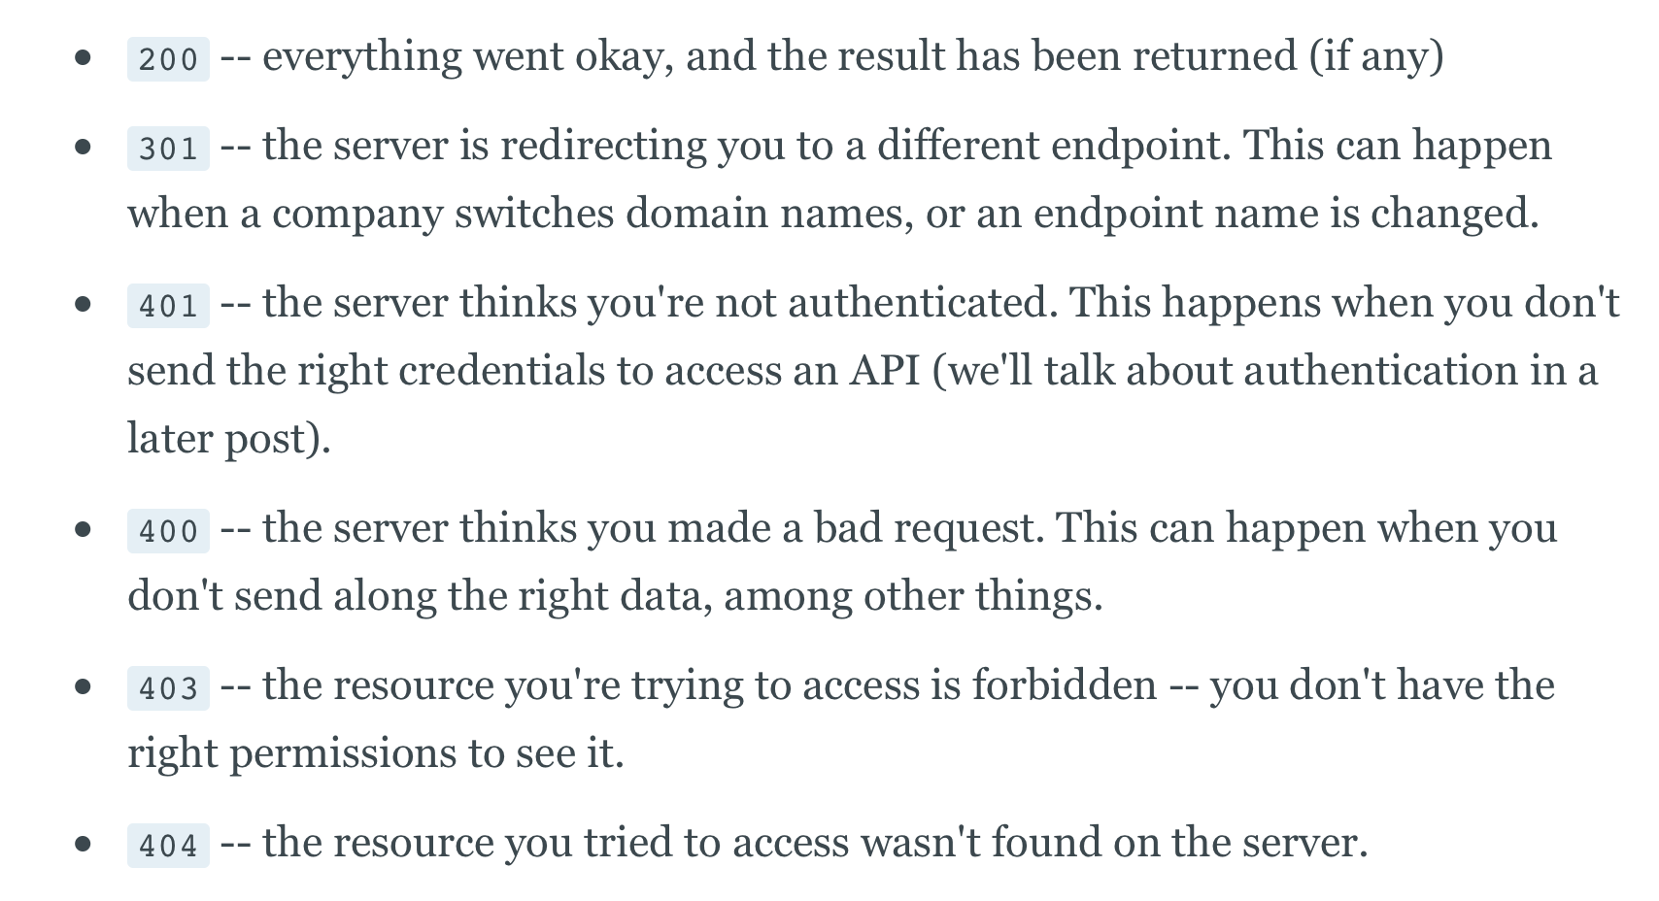
Status Codes
Status codes are returned with every request that is made to a web server. Status codes indicate information about what happened with a request. See https://restfulapi.net/http-status-codes/ for a complete list of status codes.
Common Status Codes
How to Ensure You Get 200 Code
Make sure you have credentials if required
Hit the right endpoint by checking the API documentation
Put correct query parameters
Follow the rules (requests limits etc)

Slide 9
Working With JSON Data
JSON is the primary format in which data is passed back and forth to APIs, and most API servers will send their responses in JSON format.
Recall the dictionary data type in Python: JSON is simply a nested dictionary
Python has the built-in json package to handle JSON data
The package allows different conversions, for instance, lists and dictionaries to JSON
The json package has two main methods:
dumps -- takes in a Python object, and converts it to a string.
loads -- takes a JSON string, and converts it to a Python object.

Slide 10
Getting Content From API Requests
Getting the JSON: use the .json() method on the response.
Metadata: the response also comes with metadata containing information on how the data was generated and how to decode it. In Python, we can access this with the headers property of a response object.

Slide 11
A Brief Introduction
Web Scraping

Slide 12
What We Will Cover
WEB CRAWLING is essentially what companies such as Google, Yahoo, MSN and others do, gathering any kinds of information. They will view an entire webpage and index it. Bots used by these search engines will go through every page and link on a website and literally pull out ANY information which is included.
WEB SCRAPING is generally more targeted at certain websites, looking for specific information, e.g. GTINs/EANs for e-commerce merchants or for price comparison, so that the methodology and software are different.
The two terms can be used interchangeably and of course web scraping involves some limited web crawling

Slide 13
Why Scrape?
USUALLY WHEN THERE IS NO API AVAILABLE, YOU HAVE NO OPTION BUT TO SCRAPE TO GET THE DATA
IN SOME CASES (E-COMMERCE ETC), SCRAPING IS PART OF THE GAME
WEB SCRAPING ISNT ALWAYS LEGAL/ALLOWED, SOME WEBSITES PROHIBIT

Slide 14
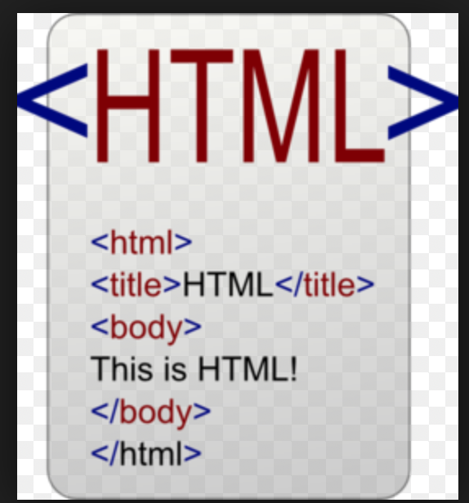
Main Languages for the Web
HTML, CSS and Javascript
HTML gives structure to content (text, images, etc.)
CSS gives appearance to content (font colors, image borders, etc.)
JAVASCRIPT makes content interactive (a clock that ticks in real time, sparkly things that follow your mouse cursor)

Slide 15
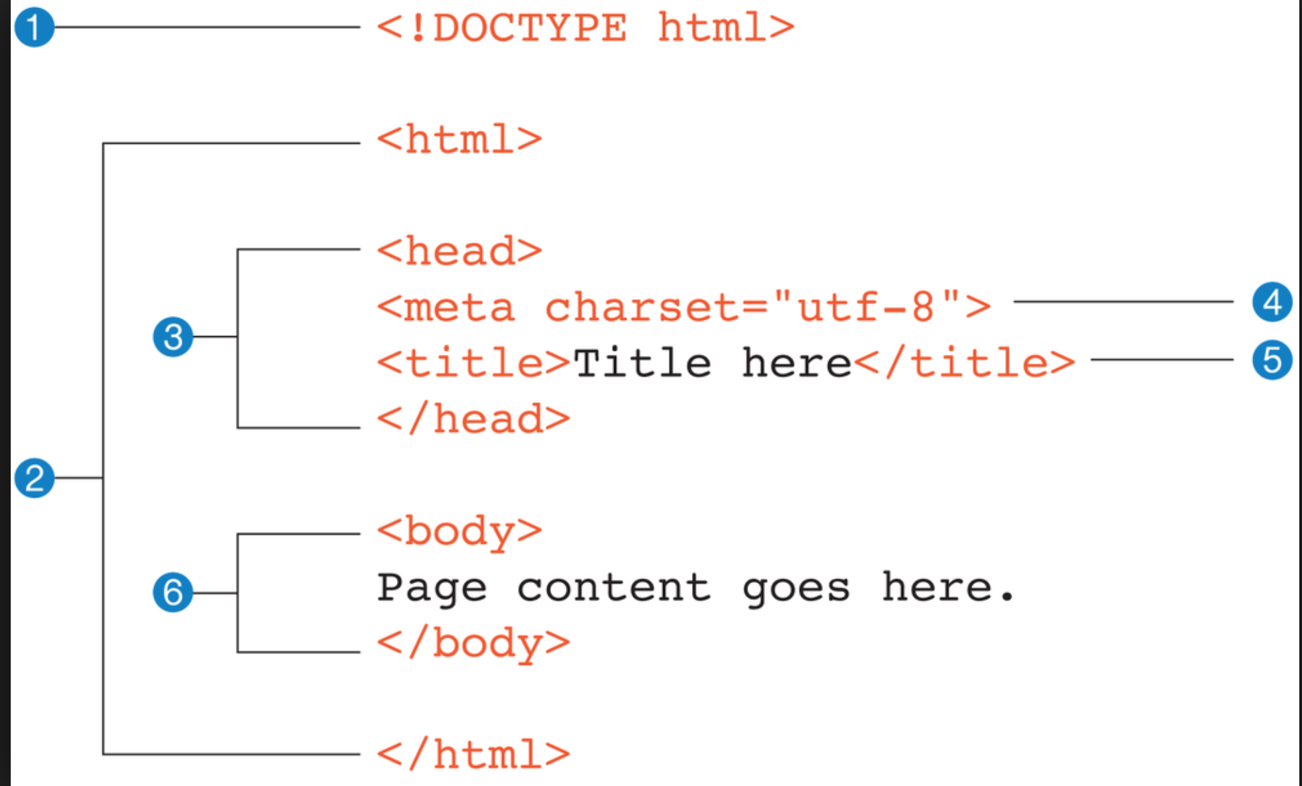
HTML Structure
ITS CRUCIAL TO UNDERSTAND THE HTML STRUCTURE OF THE WEB PAGE OF INTEREST TO SUCCESSFULLY SCRAPE IT
You can check HTML document structure by viewing the page source
For more detailed inspection, use developer tools provided by the browser
A sample HTML document structure

Slide 16
Python Tools for Web Scraping
Requests, Beautifulsoup, Scrapy
Depending on your level of programming and needs, the most common tools include:
Requests: A base library for sending requests to web servers including APIs
BeatifulSoup: Parsing HTML documents to extract useful data
Scrapy: A a more sophisticated framework for web scraping. See details here: https://docs.scrapy.org/en/latest/intro/overview.html

Slide 17
Main Steps in Web Scraping
A Summary of Main Steps
Understand the structure
of the HTML
Ensure you have the required
tools installed
Find the URL(s) you want
to Scrape
Write code, get and save the data
Based on what data you are looking for. If the site has an API, please use it
Using developer tools in your browser identify the structure of the pages you are trying to scrape
Requests, BeatifulSoup, Scrapy

Slide 18
Notes About Accessing Websites
Before scraping, check if there is an API available
When using API read the documentation carefully
Before scraping check legality of scraping the website of interest
Don’t send too many requests or you can get banned
When using API stick to the requests limits
Check out this blog which talks about some of the legal issues:
https://benbernardblog.com/web-scraping-and-crawling-are-perfectly-legal-right/

Slide 19
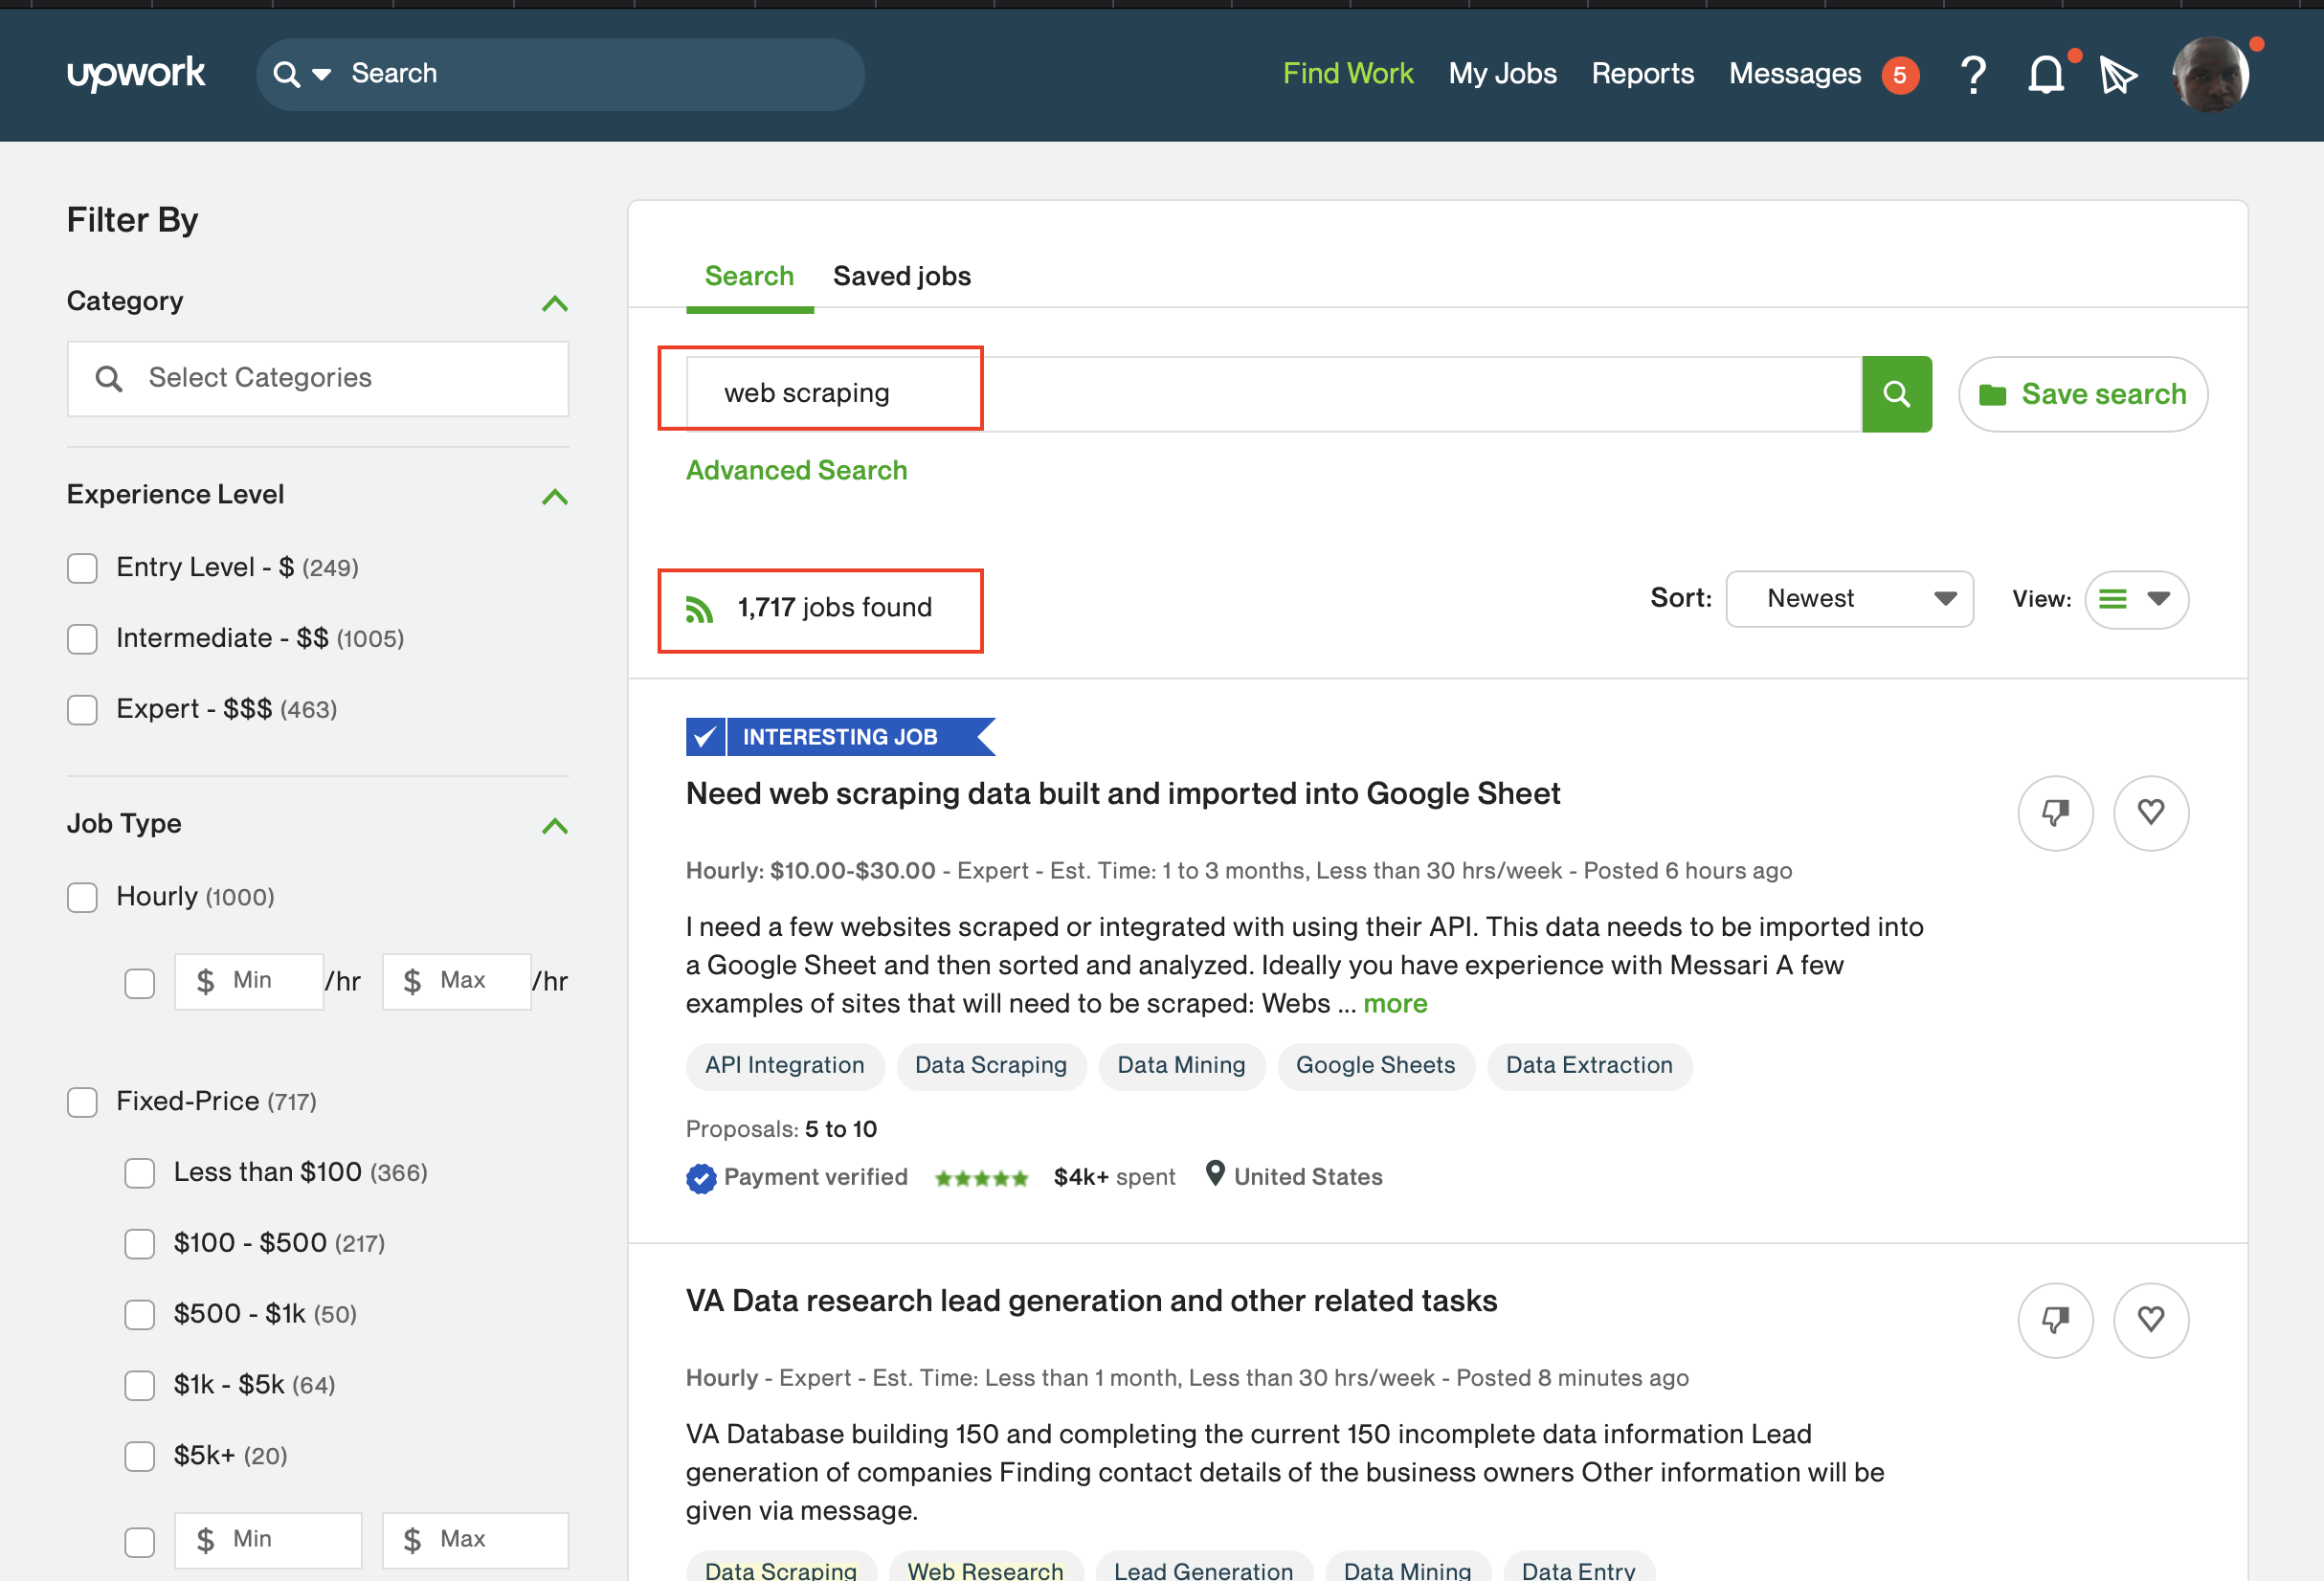
Web scraping is tedious and hard BUT there is money to be made on Freelancing sites

