Slide 1
Spark APIs with Focus on DataFrames
Big Data Analytics with Python, AIMS-Rwanda 2022
Dunstan Matekenya, PhD

Slide 2
Contents
Review Spark APIs
Spark Data Types
Working with RDDs
Structured APIs
Spark DataFrames
Getting and installing spark
Spark basic architecture
Sparks application concepts
Spark APIs and toolset
Hello Spark-First Spark program

Slide 3
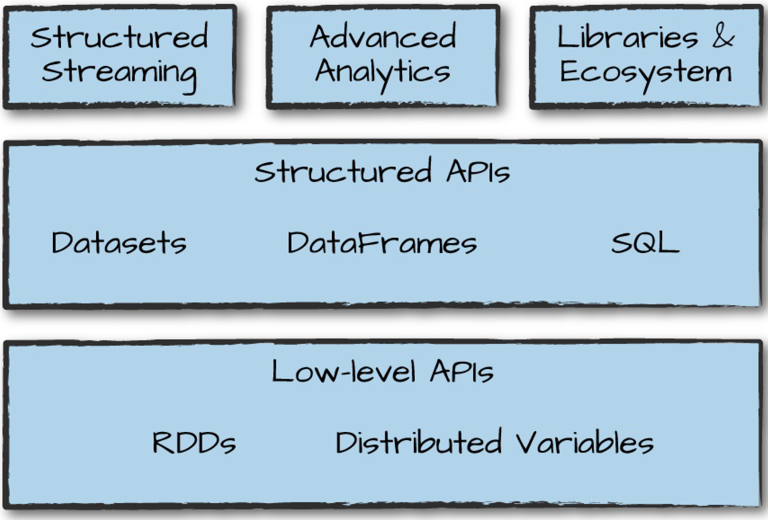
Spark APIs
Within each programming language, Spark has APIs which essentially is different ways to interact with Spark functionality depending on your use case.
Spark has two fundamental sets of APIs: the low-level “unstructured” APIs, and the higher-level structured APIs.
On top of these primitives (building blocks) Spark has a series of standard libraries for additional functionality.

Slide 4
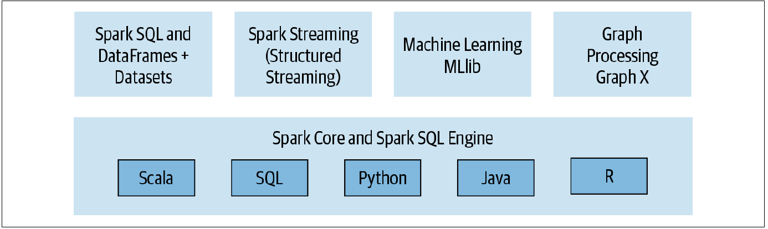
Apache Spark Ecosystem of APIs and Libraries
Apache Spark components and API stack

Slide 5
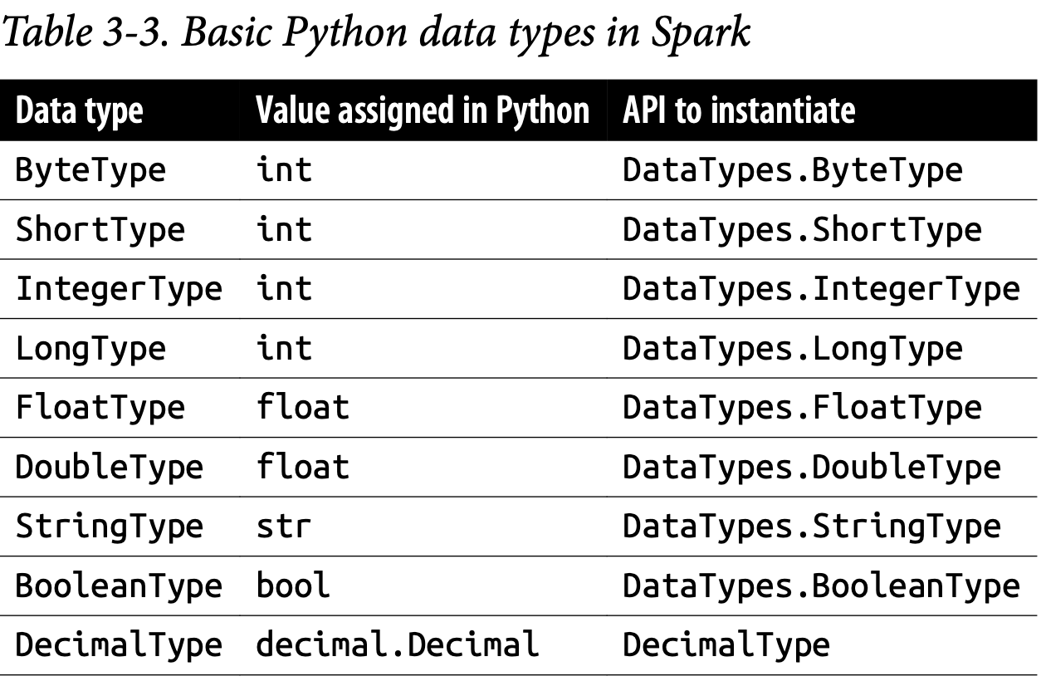
Spark Basic Data Types
It's important to understand data types when working in any language or platform
Spark supports basic internal data types. These data types can be declared in your Spark application or defined in your schema.
Spark basic data types

Slide 6
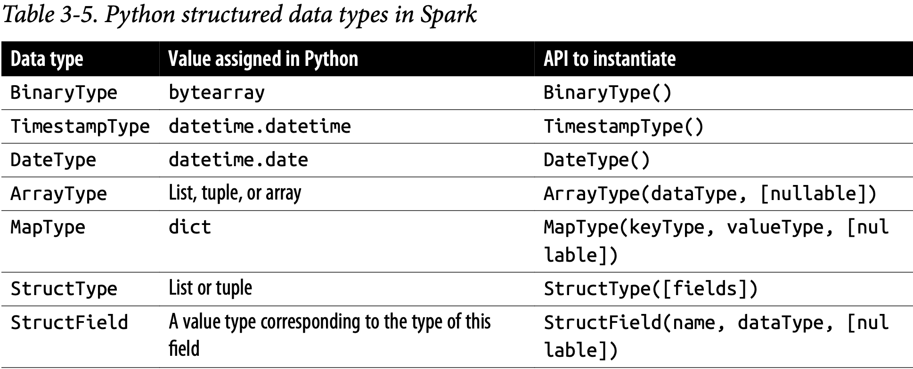
Spark Complex Data Types
In some cases, you have to work with more complex data structures, Spark the as well
Spark complex data types
For more details on all the data types that Spark supports in Python, see this documentation link

Slide 7
Working with Spark RDD’s
What are RDDs
Why RDD’s important?
Loading external datasets into RDD’s
RDD operations and actions
RDD persistence
Advanced topics

Slide 8
What are RDDs
RDD stand for Resilient Distributed Dataset. It is a read-only, partitioned collection of records. RDDs can only be created through deterministic operations on either (1) data in stable storage or (2) other RDDs.
The RDD is the most basic abstraction in Spark. There are three vital characteristics associated with an RDD:
Dependencies
Partitions (with some locality information)
Compute function: Partition => Iterator[T]
Initially, RDD was the only programming API available in Spark

Slide 9
Challenges with RDDs
The compute function (or computation) is opaque to Spark. That is, Spark does not know what you are doing in the compute function. Whether you are performing a join, filter, select, or aggregation, Spark only sees it as a lambda expression.
Another problem is that the Iterator[T] data type is also opaque for Python RDDs; Spark only knows that it’s a generic object in Python.
Because of the above, RDD doesn’t have the ability to present data in a tabular format as is preferred by data science work. Furthermore, in the RDD programming model, a developer is responsible for specifying all computations even common data analysis operations such as filtering, selecting, counting, aggregating, averaging, and grouping.

Slide 10
So, Why Still Learn About RDD’s
Because RDDs are the most basic abstraction, they also provide the most flexibility. When the functionality you need isn’t available or isn’t working well in the structured APIs like DataFrames, you will have no choice but to program using RDDs.
Furthermore, all the structured APIs are built using RDDs, as such it pays to know a little about RDDs

Slide 11
Spark’s Structured APIs
It's important to note as previously mentioned that initially, Spark only had RDDs which are hard to work with for data science tasks
The structured APIs solved that problem by providing high level language for interacting with data
There are obvious advantages for the structured APIs such as expressivity, simplicity, composability, and uniformity.
Spark provides three structured APIs: DataFrames, Datasets and SQL
However, all structured APIs are built on top of the Spark SQL engine

Slide 12
Short Exercise: Compare and Contrast RDDs Vs. the DataFrames API through a simple but common data science task: aggregate by some key and compute summary statistic -a group by operation.
Run the RDDs-vs-DataFrames Notebook and play with it.

Slide 13
For detailed knowledge on how to work with RDD’s, follow this Spark tutorial

Slide 14
Spark’s Structured APIs-More Advantages
Very simple to write the code
Familiar style for data analysts and scientists
The structure of Spark’s high-level APIs also introduces uniformity across its components and languages.
Since Spark can inspect or parse queries which come from high level APIs and understand our intention, it can optimize or arrange the operations for efficient execution. As opposed to RDDs where the responsibility of optimization is left to the developer

Slide 15
Introducing the Spark DataFrames API

Slide 16
What’s Important to Know About the DataFrames API
How to create DataFrames (e.g., from external data sources, using Python objects)
How to define schemas and why they are important in some cases
How to work with DataFrames columns and expressions (e.g., add new columns using expression and other columns)
How to work with the Row DataType which is what you each row of the DataFrames contain
How to perform common DataFrames operation (e.g., saving to disk, transforming DataFrames, aggregate functions, collection functions, statistical functions etc)
How to perform higher order functions on DataFrames (e.g., working with Spark’s complex data types such as arrays, defining your own functions and applying them on the DataFrame
Know how to switch between Spark DataFrames and other data structures. For instance, convert DatFrame to RDD, to Pandas DataFrame, to Python list etc

Slide 17
Common DataFrame Operations
Reading, writing to file
Projections and filters
Renaming, adding, and dropping columns
Aggregations
Higher order functions
User defined functions (udf)
Spark built-in functions
Functions for complex data types

Slide 18
Spark Built-in Functions
Aggregate functions
Collection functions
Datetime functions
Math functions
Miscellaneous functions
Non-aggregate functions
Sorting functions
String functions
UDF functions
Window functions

Slide 19
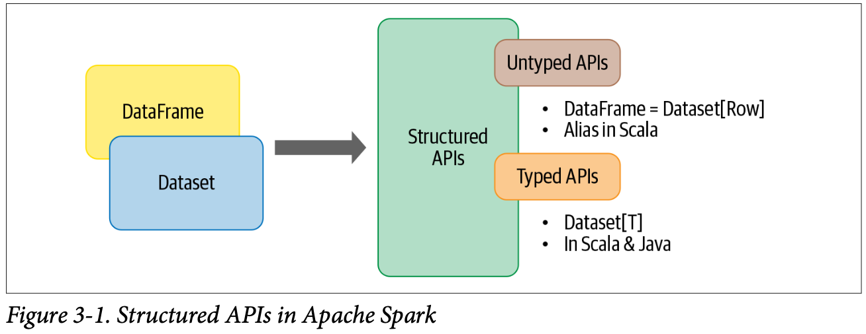
Other Structured APIs in Spark: Datasets
"In Spark’s supported languages, Datasets make sense only in Java and Scala, whereas in Python and R only DataFrames make sense.” Learning Spark

Slide 20
Spark Datasets API
A Dataset, by contrast, is a collection of strongly typed JVM objects in Scala or a class in Java.
The Datasets API only makes sense if you are working in Java or Scala
This has to do with the fact that Python and R are not compiled languages. You don’t have to declare data ty types in advance in Python and R. Data types are dynamically inferred or assigned during execution, not during compile time.

Slide 21
Other Structured APIs in Spark: Spark SQL
Spark SQL plays a crucial part in the Spark structured APIs because DataFrames and Datasets are built on to[ of the SQL engine. But it has more function:
Connects to the Apache Hive metastore and tables.
Offers an interactive Spark SQL shell for quick data exploration.
Provides a bridge to (and from) external tools via standard database JDBC/ ODBC connectors.
Generates optimized query plans and compact code for the JVM, for final execution.

Slide 22
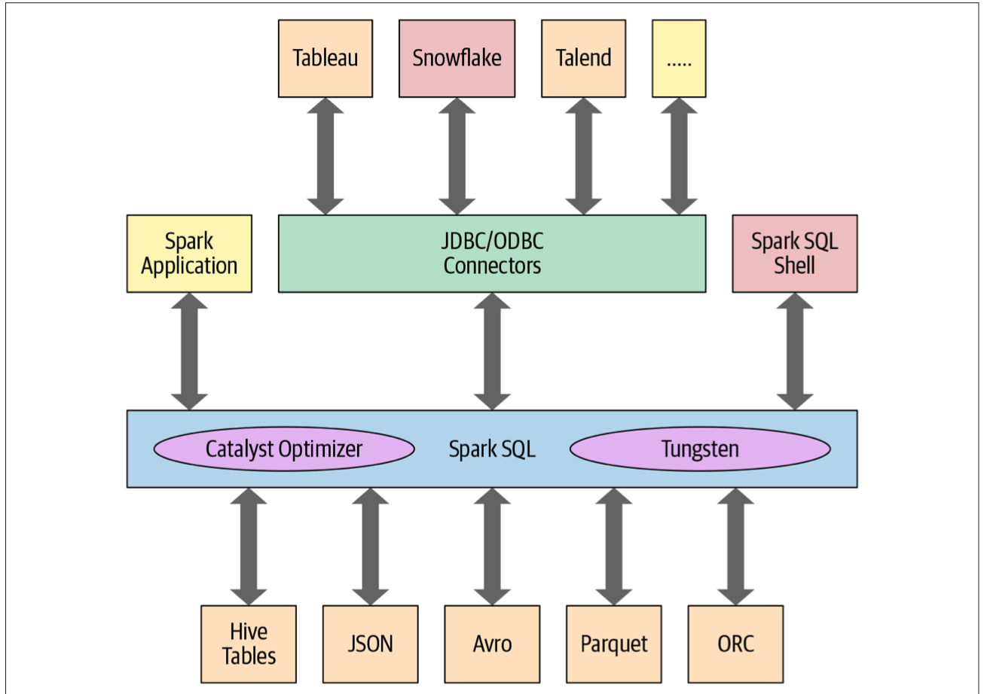
Spark SQL
The Spark SQL enables connection to different external data stores and data sources

Slide 23
Spark SQL
The core components of the Spark SQL engine are the Catalyst optimizer and Project Tungsten. They are responsible for supporting the high-level DataFrame and Dataset APIs and SQL queries.
When you run your DataFrame, Dataset or SQL operations, the Catalyst optimizer and Project Tungsten are the ones which executes computational plans

Slide 24
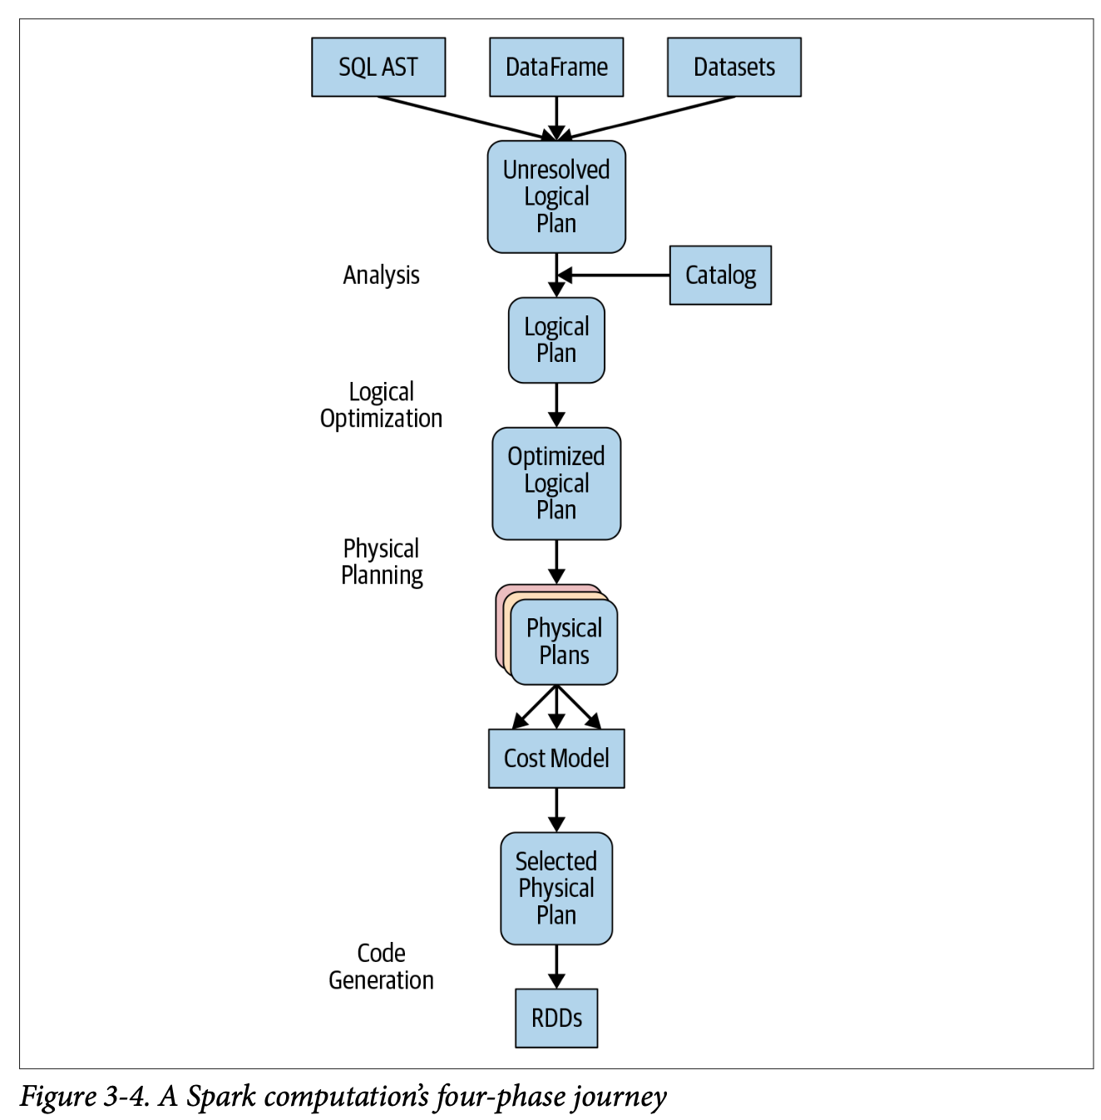
How Spark SQL works with DataFrames and Datasets in a Computation

Slide 25
Spark SQL Vs. DataFrames and Datasets
There is amazing interoperability between Spark SQL and the other high level APIs
You can read in data as a Spark DataFrame but later use SQL queries to interact with the data
You can easily switch between the SQL table view and DataFrames view

Slide 26
General Guidelines on How to Choose Spark APIs

Slide 27
[RDD, DataFrames, Datasets] vs. What You Want To Do
For Data Scientists, in general, DataFrames or Datasets are recommended as they are high level and already filled with alot of functions convenient for DS. For instance, filters, maps, aggregations, computing averages or sums, SQL queries, columnar access, or use of relational operators on semi-structured data
Depending on you language you choose between Datasets (Java, Scala) and DataFrames (R and Python)
If your processing dictates relational transformations similar to SQL-like queries, use DataFrames.
Whether you using Datasets or DataFrames, you should drop down to RDDs if you need more control and want to tell Spark exactly how to make a computation.

Slide 28
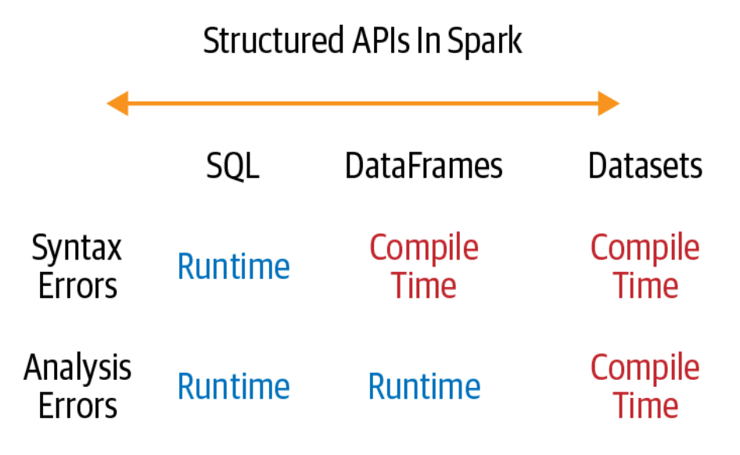
[RDD, DataFrames, Datasets] vs. How You Want To Catch Errors
If catching errors is important for your application, the illustration on the left shows how to pick the appropriate API
When errors are detected using the Structured APIs

Slide 29
What Else to Learn in Spark
Be comfortable with using high order functions (defining your own functions, working with complex data types (e.g., arrays)
Optimizing and tuning Spark applications.
Data partitions are very important to understand
Persisting data (e.g., using cache())
Setting and checking configurations when running your application (driver memory, executor memory, number of executors, etc)
Effective use of Spark UI to understand Spark configurations and resource usage
Other Spark libraries based on your needs
How to run Spark in other environments (particularly on the cloud)
There are scripts to create a Spark cluster on AWS or Google cloud
Learn about Kurbenetes and Spark
Explore Databricks- A company by people who created Spark

Slide 30
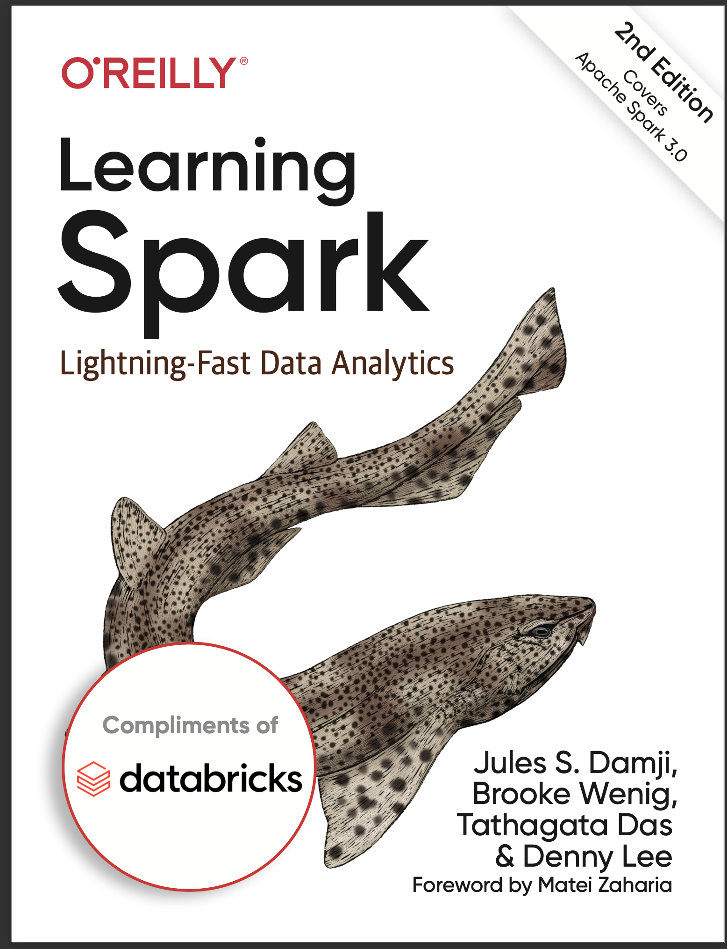
Further Resources
Spark Documentation of course
Learning Spark- Most of my screenshots and content has been shamelessly copied from this book

